Slide 1
Customer Lifetime Value
Notes:
Brief intro e.g., welcome to module 2. In this module we’re going to discuss…

Slide 2
Introduction
Customers are the key asset of any business. One could say that without customers there is no business.
In this module we will
Delve into customer loyalty
The phases of a customer relationship lifecycle
Computation and application of customer lifetime value

Slide 3


Slide 4
What is loyalty?

Slide 5
What is Customer Lifetime Value?

Slide 6
Customer Lifetime Value (CLV)
It computes the dollar value of an individual customer relationship
It is both backward looking and forward looking
Computing value of past customers
Using that information to project forward

Slide 7
What Is CLV Used For?
To determine how much to spend to acquire a customer.
To determine how aggressively to spend to retain a particular customer or group of customers
To value a company

Slide 8
How Would We Know the (Future) Value of a Customer?

Slide 9
Lifetime Value of a Customer (CLV)
Just like we use Net Present Value (NPV) to evaluate investments and companies, we use CLV to evaluate customer relationships
CLV is the expected NPV of the cash flows from a customer relationship
CLV is defined as the discounted sum of all future customer revenue streams minus product and servicing costs and remarketing costs.
Notes:
What is NPV?

Slide 10
The Base CLV model
Net Margin per Netflix Customer = M - R = $50
Retention rate = r = 80%
Number of customers who joined Netflix in June 2014 = 100
Month | Number of Customers | Total Net Profit | Total Net Profit | Present Value of Total Net Profit
June 2014 | 100 | [M – R] * 100 | 50 * 100 = 5,000
July 2014 | r * 100 = 80 | r * 100 * [M – R] | 50 * 80 = 4,000
August 2014 | r * (r * 100) = | r² * 100 * [M – R] | 50 * 64 = 3,200
September 2014 | r * (r * (r * 100))) = | r³ * 100 * [M – R]

Slide 11
The Base CLV Model
$M | Contribution per period from active customers. Contribution = Sales Price – Variable Costs
$R | Retention Spending per period per active customer.
r | retention rate (fraction of current customers retained each period)
d | discount rate per period
Present Value of net profit calculation is extended up to infinity…
CLV = [ $M – $R ] *[ (1 + d) / (1 + d - r) ]

Slide 12
The Base CLV Model
CLV = [ $M – $R ] × [ ( 1 + d ) / ( 1 + d – r ) ]
Short-Term Margin
Long-Term Multiplier

Slide 13
The Base CLV Model
CLV = [ $M – $R ] × [ ( 1 + d ) / ( 1 + d – r ) ]
Short-Term Margin
Long-Term Multiplier
If retention increases
How does the discount rate change?
How does long term multiplier change?
How does CLV change? (increases)

Slide 14
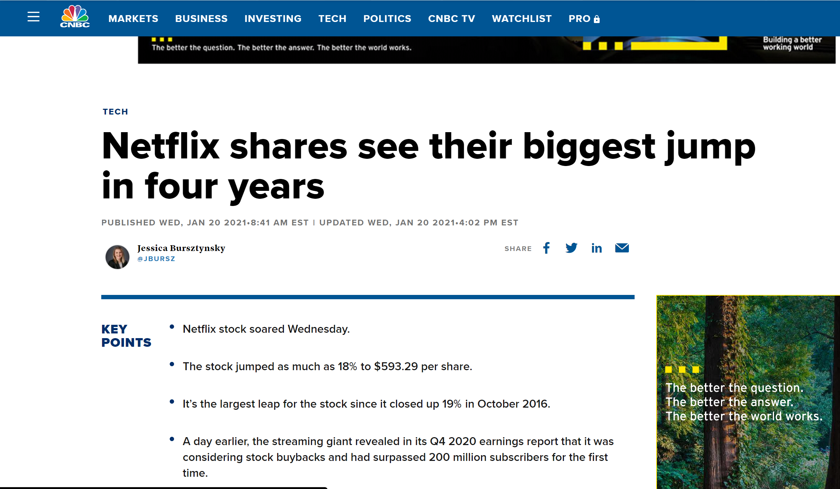

Slide 15
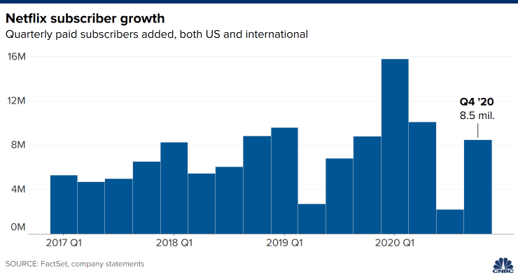
Q4 2020
200M global subscribers

Slide 16
Would you buy or sell Netflix today?
Stock Price = $483.6
Is a $214B market cap reasonable?

Slide 17
When we buy Netflix, what are we buying?

Slide 18
CLV Calculations- Netflix Inc.
CLV = [GP-R]*[(1+d)/(1+d-r)]
Consider Sep ’02
Number of Customers = 671
GP = Gross Profits per customer =(60.7-38.83) = $21.87
R = Total Variable Costs per customer = $ 5.91
d = Quarterly discount rate = 2.5%
r = retention rate =
[# of Sep ’02 total subscribers - # of Sep ’02 new subscribers] /
[# of June ’02 total subscribers] = 66%
Multiplier = (1+d)/(1+d-r) = 2.8
CLV = 44.64

Slide 19
CLV and Shareholder Value
Sep ‘02
CLV = 44.64
# of Customers = 671K
Share Price = 9.7
# of Shares Outstanding = 22,069
Market Cap =
CLV Based Valuation =

Slide 20
Brand Equity and Customer Lifetime Value
Marketing Actions
Customer Mindset Awareness Associations
Customer Behavior Acquisition Retention
Brand Equity
Customer Lifetime Value

Slide 21
Link Brand Equity and CLV
Brand Equity Differentiation Relevance Esteem Knowledge
Behavior Acquisition Retention Profit Contribution
Marketing Actions Advertising Innovation Promotions Market Presence Price
CLV
Source: Stahl, Florian, Mark Heitmann, Donald Lehmann, Scott Neslin, “The Impact of Brand Equity on Customer Acquisition, Retention, and Profit Margin,” Journal of Marketing, 76(4), 44-63.

Slide 22
Conclusion
Customer Lifetime Value can provide a forward-looking measure of the customer relationship.
It can connect marketing strategies to financial consequences.
Strategic marketing alternatives, (e.g., targeting, and promotion campaigns) can be evaluated based on whether they improve customer retention, and lifetime value

Slide 23
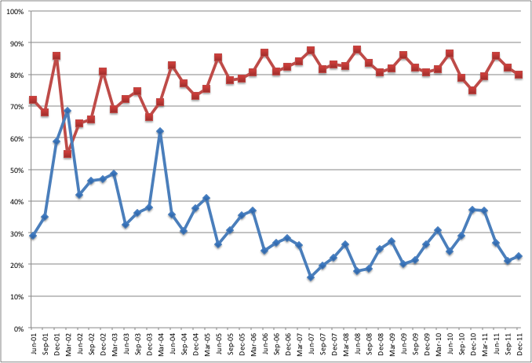
Retention Rate
Quickster
Acquisition Rate

Slide 24
CLV – Horses for Courses
Time horizon – Infinite or three to four years
Initial margin
Cohort and incubate
Contractual or non-contractual business model

Slide 25
CLV – Time Horizon
Percent of CLV Accruing in First Five Years
Discount Rate | Retention Rate
 | 40% | 50% | 60% | 70% | 80% | 90%
2% | 99 | 97 | 93 | 85 | 70 | 47
4% | 99 | 97 | 94 | 86 | 73 | 51
6% | 99 | 98 | 94 | 87 | 76 | 56
8% | 99 | 98 | 95 | 89 | 78 | 60
..
…
20% | 100 | 99 | 97 | 93 | 87 | 76
Source: Farris, Paul, Neil Bendle, Phillip Pfeifer, and David Reibstein (2010), Marketing Metrics, 2nd Edition, FT Press.

Slide 26
CLV-Initial Margin
Customer pays before using the service
e.g., apartment rentals, Netflix, Hulu
Customer pays after using the service
e.g., credit cards
CLV = [$M–$R]*[(1+d)/(1+d-r)]
CLV = [$M–$R]*[r/(1+d-r)]
Notes:
Explain $M and $R in formulas when talking about this slide.

Slide 27
CLV - Cohort and Incubate
Typical customer retention curve
Retention
Rate
Time
Retention Rate Depends on Time since customer acquisition

Slide 28
CLV - Cohort and Incubate
Cohort = customers acquired at the same time period (month, quarter or year)
Since retention changes with time since acquisition, CLV calculations are better if they are done separately for each cohort

Slide 29
CLV- Contractual vs Non-Contractual
Xfinity and Netflix have a contract with customers
They know when a customer unsubscribes to the service
This helps is knowing lifetime duration and retention rate
What if a customer does not sign a contract to use a service?
e.g., grocery stores (Kroger), others?

