Slide 1
Logistic Regression

Slide 2
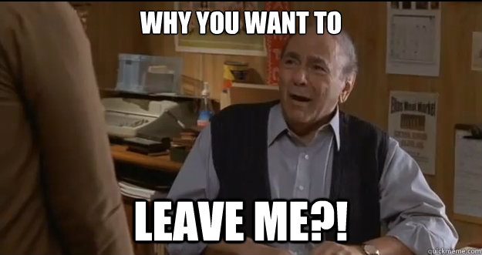

Slide 3
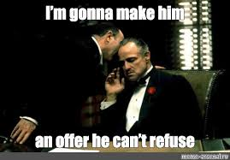

Slide 4
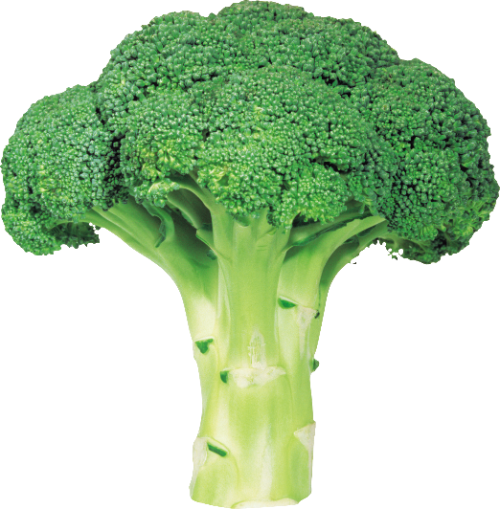
Class Rating

Slide 5
The Base CLV Model
CLV = [ $M – $R ] × [ ( 1 + d ) / ( 1 + d – r ) ]
Short-Term Margin
Long-Term Multiplier

Slide 6
Customer Retention: Logistic Regression
With categorical (1/0) dependent variables, linear regression can result in nonsensical estimated probabilities (e.g. probability of retention > 100%)
Linear regression assumes normal distribution
Choice/retention is an S-shaped curve
A model that allows us to do this is the so-called “logistic regression”

Slide 7
What are Utilities?
The total sense of expected preference for a product.
Infer that retained customers have unobserved utilities > 0
It is a weighted sum of the different attributes of a product and customer characteristics.
The weights are the coefficients estimated using logistic regression.

Slide 8
What are Utilities?
Consider an HP Monitor.
The utility of a HP monitor can be written as;
U = b0 + b1*price + b2 * 4K+ e1
b0, b1, b2 are the coefficients
Price and 4K are product characteristics
e1 is the error term is distribution logistic

Slide 9
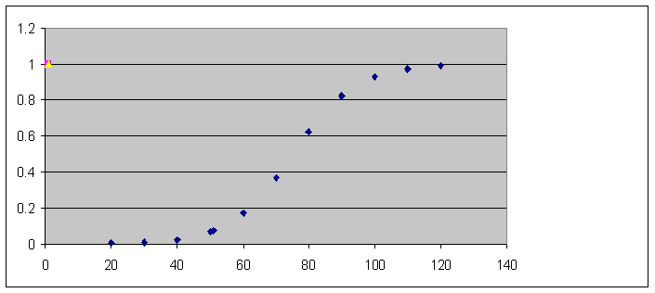
Logistic Regression – How do we go from Utilities to S- Shaped Choice Distribution?
= e^U
------
1+ e^U
Predictions are bound between [0,1]
Choice
Probability
Price Discount on
$499 HP Monitor
Notes:
The combination of exponentials gives us an S shaped curve. The software does all this internally. But lets see an example on doing logistic and interpreting coefficients. You will see the need to know the exponential transformation when we get to interpreting coefficients.

Slide 10
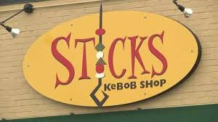
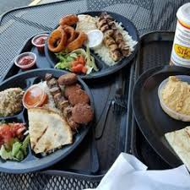
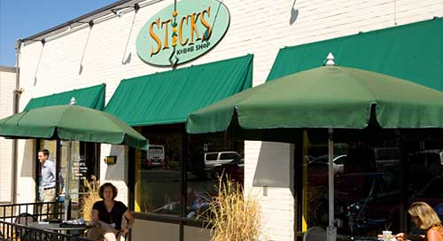
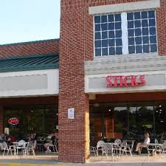
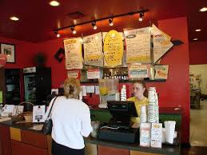
Example: What Differentiates Sticks Kebab Customers from Non Customers?
Notes:
Play video on sticks. So, sticks is a local store and they have some ideas about their customers. Lets see with data from a survey the store conducted with the customers and non customers if these hypotheses hold true.

Slide 11
Example: What Differentiates Sticks Kebab Customers from Non-Customers?
Please Indicate your best Answers to the following:
 | Strongly Agree (5) | Somewhat Agree (2) | Somewhat Disagree (3) | Strongly Disagree (2) | Don’t Know (1)
I tend to plan things carefully
I sometimes have trouble controlling my spending
I think it is important to purchase products that are made locally
I carefully consider the health benefits of what I eat

Slide 12
Example Output
Coefficients:
 | Estimate | Std. Error | Z Value | Pr (>|z|)
(Intercept) | -4.095 | 1.341 | -3.054 | 0.002
Plan.things | -0.168 | 0.191 | -0.877 | 0.380
Care.about.Health | 0.703 | 0.203 | 3.466 | 0.001
Purchase.Local | 0.582 | 0.215 | 2.712 | 0.007
Trouble.Spending | -0.211 | 0.140 | -1.501 | 0.133
Estimated Equation:
U = -4.095 +.70*(care.about.health)+.58*(purchase.local)
p(customer) = exp(U)/{1+exp(U)}

Slide 13
Example output
Null Deviance = 380.18
Variance in data without any model
Residual Deviance = 351.21
Variance in the errors, (y-hat)
R-Square =
1- (Residual Deviance/Null Deviance)
= 1-(351.21/380.18)
= 1- .923
= 7.7% (in sample accuracy or train data)

Slide 14
Predictive Accuracy
Train dataset
Estimate the coefficients
Test dataset
Predict outcomes using model estimated from train dataset
Mean Absolute Deviation (MAD)
=mean |predicted – observed| only in linear regression

Slide 15
Hit Rates – In Sample
 |  | Observed
 |  | Customer | Not a Customer
Predicted (probability >.5) | Customer | 40 | 4
 | Not a Customer | 57 | 19
Hit Rate (or confusion matrix) = (40+19)/(40+19+57+4)
= (59)/120 = 49%

Slide 16
HW2 Guidelines
Submit a PowerPoint deck
Describe the challenge
Report the insights gained from the data for each question and the predictive accuracy of the model
Provide recommendations to management for improving customer retention at Relay Foods
Report any concerns about the analyses
Model Details can be provided in an appendix
Class presentation is not graded. You can have one or all members of the group present.

Slide 17
Retention problems sneak up on you. You need to be actively monitoring retention cohorts even when retention is going up and to the right.
Dan Wolchonok
Former Director of Growth and Analytics @ Hubspot

Slide 18
Example Output
Coefficients:
 | Estimate | Std. Error | Z Value | Pr (>|z|)
(Intercept) | -4.095 | 1.341 | -3.054 | 0.002
Plan.things | -0.168 | 0.191 | -0.877 | 0.380
Care.about.Health | 0.703 | 0.203 | 3.466 | 0.001
Purchase.Local | 0.582 | 0.215 | 2.712 | 0.007
Trouble.Spending | -0.211 | 0.140 | -1.501 | 0.133
Compute:
U1 = -4.095 +.70*(4.18)+.58*(1) AND p(customer) = exp(U1)/{1+exp(U1)}
&
U2 = -4.095 +.70*(4.18)+.58*(2) AND p(customer) = exp(U2)/{1+exp(U2)}

Slide 19
Example: What are Sticks Kebab Customers?
Coefficient of Purchase Local (b_{plocal}) | 0.58
Exp(b_{plocal}) | 1.79
 | Purchase Local = 2 | Purchase Local =1
U = a+bx | -.009 | -.589
P(sale) = exp(u)/(1+exp(u)) | 0.49 | 0.36
difference | 0.13
Customers who responded 2 on purchase local are 13% more likely to be customers than customers who responded 1
U = -4.095+.70*avg(care about health)+.58*(2)

Slide 20

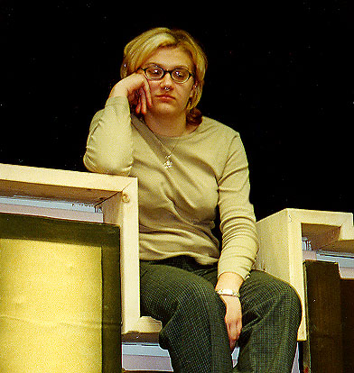


Reaction to econometric analysis?

Slide 21
Model Building
Determine properties of dependent variable
Linear, + ve values, Dummy Variable, text data
Select model that reflects dependent variable properties
Logistic regression for dummy variables

Slide 22
Model Building
Include the decision variable of interest among the independent variable set
Price, advertising, etc
Include common control variables
Quality, Distribution, Demographics, Tenure, Competition etc.

Slide 23
Model Building
Does including lagged dependent variable lead to UNIT ROOT?
If UNIT ROOT, use difference as the dependent variable

Slide 24
Marketing Mix Models - Summary
Are independent variables correlated?
Is the sign of a variable not making sense?
Is the significance and sign of the coefficient changing with other variables in the model?
Do we have an omitted variable bias?
If no omitted variable bias-
Check for correlation among independent variables
If they are correlated; try combining them (add/subtract/divide/multiply etc.)

Slide 25
Model Building
Does the model hint @ causality or is it a correlational model?
Are dependent and independent variables measured at the same time?
Are there sufficient controls or confounding variables included
Can a reverse causation reasonably exist
Do we need to recommend an experiment?

Slide 26
When to apply which Model?
Dependent Variable | Example | Model | Transformation
Linear, positive and negative values |  | Multiple Regression | None
Linear, only positive values | Sales | Multiple regression | Log
Dummy Variable, 1/0 | Customer Retention | Binomial Logit, Random Forests
Linear, 0 to 100% | Market Share, Click Through Rate | Multiple regression | Logistic
Dummy Variable, one out of many | Brand Choice | Multinomial Logistic
Rating Scale, 1-5 etc | Movie Rating | Ordinal Logit
Dummy Variable, Many out of many | Shopping Basket | Multivariate Logit

Slide 27
Correlation vs Causation
Does Skipping breakfast cause obesity?
http://www.webmd.com/diet/news/20080303/eating-breakfast-may-beat-teen-obesity
Alternative explanations:
Physical activity
Lack of sleep

Slide 28
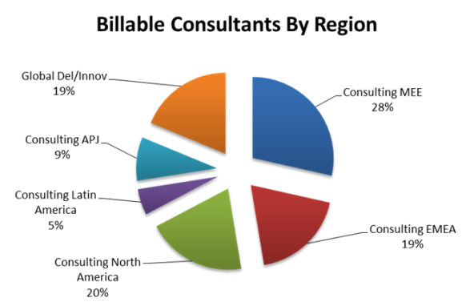
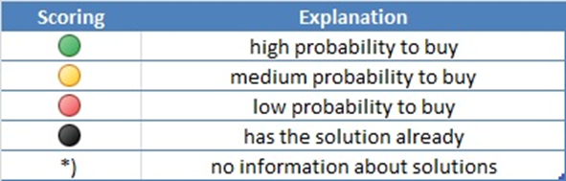
SAP Propensity Modeling : SAP Global Lead Platform/MEE Leads
Project in 2013 for SAP Global Lead Platform – MEE Region – to better focus consultants on solutions w/in accounts
Focus on “market categories” including applications, analytics, database & technology, cloud etc. plus core ERP and education & likelihood to buy
Piloted on 64 top accounts and rating each account by propensity and likelihood to buy specific SAP solutions
Applying propensity models to the sales funnel

