Slide 1
MCB 638
Live Session 10
Monday

Slide 2
Please stay safe!
Wash hands and don’t hoard the toilet paper!

Slide 3
Agenda for Live Session 10
Process Learnings
Preparation for Final
What’s left/Advice for students in next class
Time to complete on-line teaching evaluation

Slide 4
Process Learnings
Please take a few minutes to complete the on-line teaching evaluation. I would really appreciate it! We will review for improvement opportunities for this course. Survey closes on March 17.
Good job on labelling your work – Question #’s, formula titles, answers, etc.
Be sure to click on Upload once you Browse to any files you are attaching in 2SU, especially if you write a message/note.
If you are having trouble seeing your grades, contact Student Support
Be sure to submit your project PowerPoint on time. Let’s not lose any points for timeliness.
There will be Office Hours on Thursday, 9-10 pm EST

Slide 5
Final Preparation
20 Questions
Multiple choice
90 min max
More like Quiz 1 than Quiz 2
To be done in 2SU
Will be done together in our Live Session 11 on Mar 23
Password will be posted at the beginning of Live Session 11

Slide 6
DMAIC
Define
Measure
Description:
Clearly identify the business problem / performance gap (output measure), customer, scope, goals and resources.
Key Concepts:
y = f(x)
Types of data
Descriptive statistics and soft tools
Project:
Complete Problem Definition Worksheet
Tools:
Process map
SIPOC
Descriptive statistics
Thought process map
Affinity diagram
Sigma Quality Level (SQL)
Description:
Validate your measurement system and collect baseline data.
Key Concepts:
Mapping a process/value-stream, forms of waste, measurement error, reproducibility, repeatability
Project:
Identify potential inputs, develop operational definitions, develop data measurement/collection plan, validate measurement system, collect baseline data, calculate SQL.
Tools:
Operational definitions
Kappa
Process map (detailed)
Data measurement plan
Data stratification tree
Histogram
Trend/ line chart
Pareto chart
Fishbone (cause/effect) diagram
Week 1
Week 2

Slide 7
Analyze
Description:
Analyze, describe, and present the data to discover the root cause(s), identify/prioritize critical inputs (x’s), determine the inputs impact on the output.
Key Concepts:
Inferential statistics, common distributions, developing a hypothesis, determining the likelihood some event happens based on a sample (calculating probabilities), Using the normal distribution as the “go to” distribution.
Project:
Write a null and alternative hypothesis statement.
Tools:
Hypothesis testing
Chi-square test for independence
Key Concepts:
Collecting sample data, how confidence intervals and sample size are related.
Project:
Utilize the sample size formula.
Tools:
Confidence intervals.
Key Concepts:
Determining input’s (x) impact on the output (y).
Project:
Use regression to identify relationships between the output (y) and inputs (x’s).
Tools:
Correlation
Simple linear regression
Multiple regression
Scatterplot
Trend/ line chart
Pareto chart
Fishbone (cause/effect) diagram
Week 3 & 4
Week 5
Week 6 &7

Slide 8
Improve
Control
Description:
Develop potential solutions, select best solution, pilot solutions, measure results, document new process.
Key Concepts:
Discover y= f(x)
Project:
Implement a solution, run a pilot, evaluate the results, complete a hypothesis test.
Tools:
Affinity diagram
Fishbone cause/effect diagram
Pareto
Control charts
Hypothesis testing
Process map
Solution selection matrix
Description:
Implement process changes and controls. Verify expected performance was achieved, monitor performance to sustain new levels.
Key Concepts:
Xbar/R and ImR control charts, Different control charts applicable to different processes, time series forecasting methods predict future performance.
Project:
Utilize an appropriate control chart and /or time series forecasting method
Tools:
Control charts
Time series analysis
Operational definitions
Process map
Sigma Quality Level (SQL)
Week 8
Week 9

Slide 9
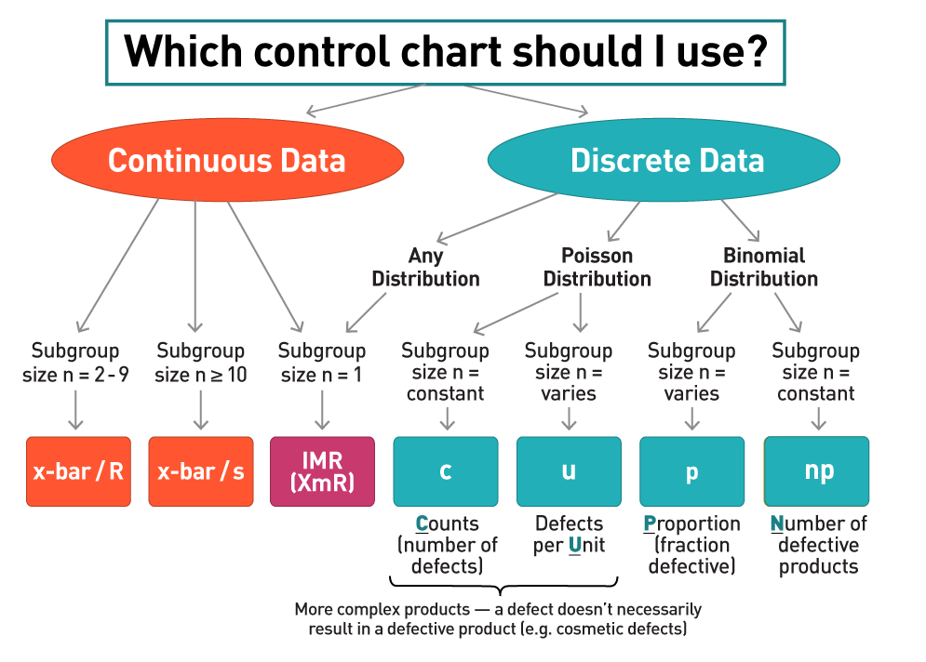
Which Control Chart should I use?

Slide 10
IMR chart – What can you conclude?

Slide 11
Regression Analysis
Why do we use this tool? What are we trying to prove?
What are residuals? Why do you want to check them?

Slide 12
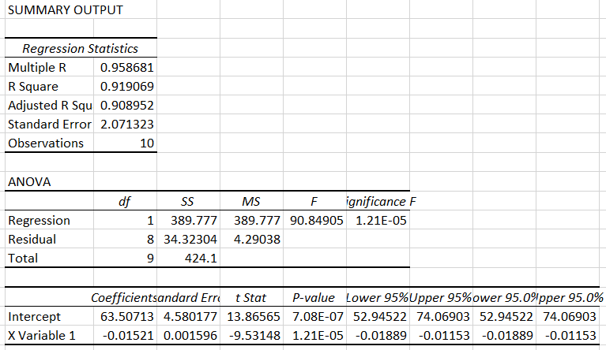
Regression Analysis - How to interpret Output
R=.9586
R ² = ?
Formula: Y = 63.5 - .015x
Slope = ?

Slide 13
Correlation Coefficient/Coefficient of Determination
For Simple Linear Regression:
What does R mean? - Correlation Quotient
What does R² mean?

Slide 14
Simple Linear Regression
We believe there is a relationship between amount of rain and grass height.
Here is the output of our Regression.
SUMMARY OUTPUT
Regression Statistics
Multiple R | 0.957962049
R Square | 0.917691287
Adjusted R Square | 0.901229545
Standard Error | 0.461484468
Observations | 7
ANOVA
 | df | SS | MS | F | Significance F
Regression | 1 | 11.87230328 | 11.8723 | 55.74691 | 0.000680309
Residual | 5 | 1.064839572 | 0.212968
Total | 6 | 12.93714286
 | Coefficients | Standard Error | t Stat | P-value | Lower 95% | Upper 95% | Lower 95.0% | Upper 95.0%
Intercept | 2.175630252 | 0.264189718 | 8.235106 | 0.00043 | 1.496508961 | 2.854751543 | 1.496508961 | 2.854751543
X Variable 1 | 0.67341482 | 0.090192883 | 7.466385 | 0.00068 | 0.441566634 | 0.905263006 | 0.441566634 | 0.905263006
What is our n? 7
What is the equation that could be used to predict grass height? 2.17+0.6734x
What % of the variability in grass height can be explained by amount of rain? R2 → 91.77%

Slide 15
Multiple Regression
SUMMARY OUTPUT
Regression Statistics
Multiple R | 0.93692
R Square | 0.877818
Adjusted R Square | 0.816728
Standard Error | 1.910708
Observations | 10
ANOVA
 | df | SS | MS | F | Significance F
Regression | 3 | 157.3761585 | 52.45872 | 14.36907531 | 0.003802411
Residual | 6 | 21.90484149 | 3.650807
Total | 9 | 179.281
 | Coefficients | Standard Error | t Stat | P-value | Lower 95% | Upper 95% | Lower 95.0% | Upper 95.0%
Intercept | -37.8257 | 13.97978519 | -2.70574 | 0.035305339 | -72.03299866 | -3.618394522 | -72.03299866 | -3.618394522
X Variable 1 | 4.49671 | 1.209174094 | 3.718827 | 0.009866037 | 1.537967283 | 7.455452126 | 1.537967283 | 7.455452126
X Variable 2 | 3.373888 | 1.229038819 | 2.745144 | 0.033506538 | 0.366538832 | 6.381238138 | 0.366538832 | 6.381238138
X Variable 3 | 0.305914 | 0.351507068 | 0.870293 | 0.417594045 | -0.554192603 | 1.166021015 | -0.554192603 | 1.166021015
What is the regression equation?
What variable(s) might be significant? X1 or X2
What is the correlation for this model? What does it mean? – Strong Relationship with Multiple R 93%

Slide 16
Hypothesis Testing
How do you set up a Hypothesis Test? Ho and Ha. .
What is alpha? How do we choose our alpha? 01 0r 0.05
What is the saying used to make a decision on your Hypothesis Test?
p is low Ho must go

Slide 17
Hypothesis Testing
Key points:
Ho (the null hypotheses) and Ha (the alternative hypothesis)
Ho - always includes =. Could be >=,<=
Ho – there is no difference
Ha – always put what you are looking to prove here – There is a difference
Do you have continuous or discrete data?
Do you have a one sample or two sample test?
If p is low, Ho must go
If p < alpha, reject the null

Slide 18
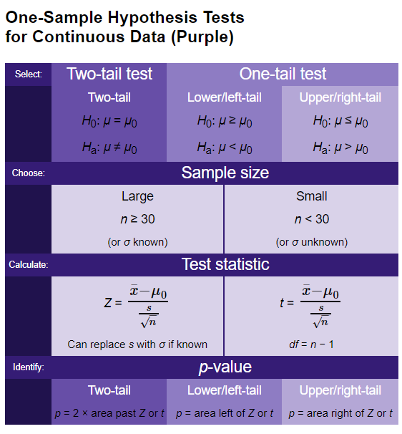
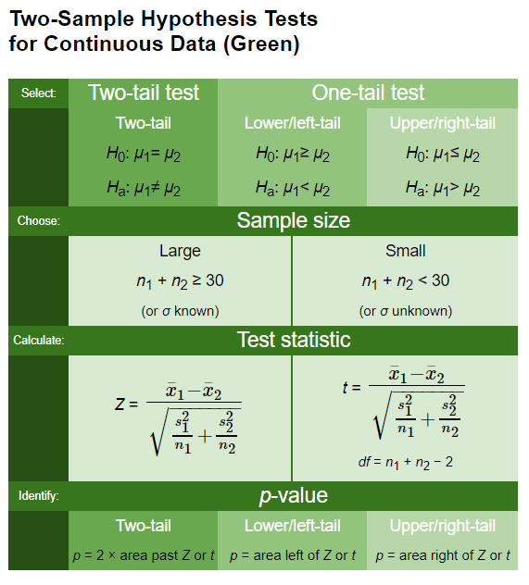
Hypothesis Tests for Continuous Data

Slide 19
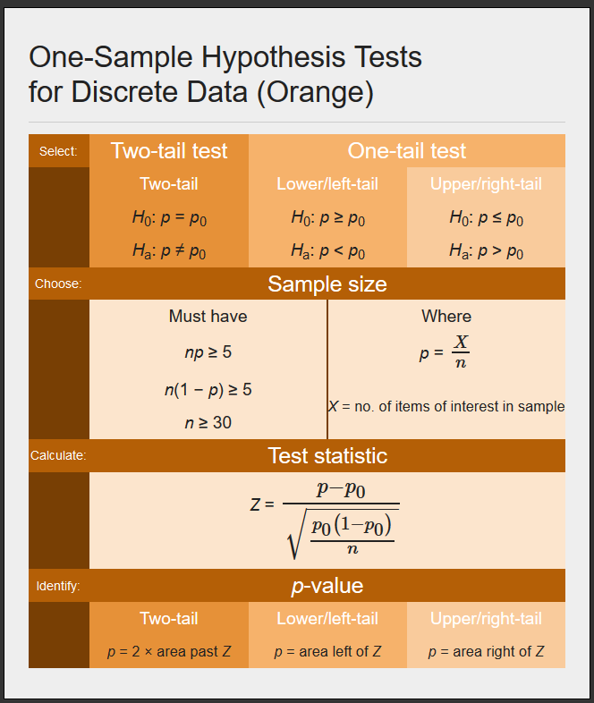
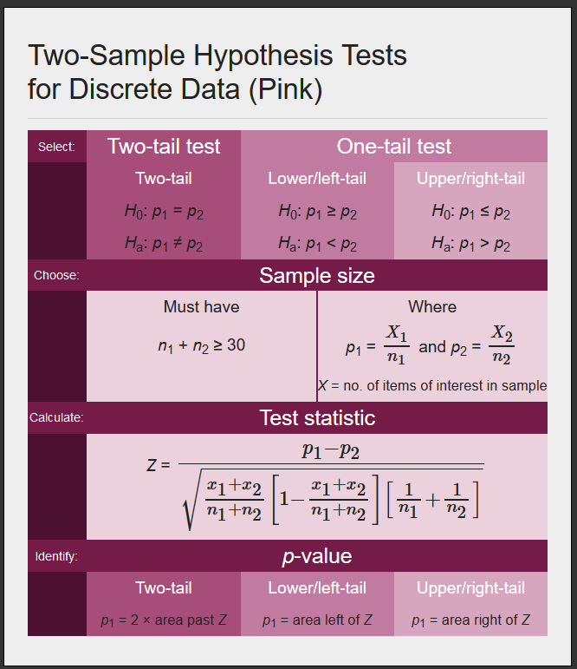
Hypothesis Tests for Discrete Data

Slide 20
Hypothesis Testing
Develop your hypothesis statements H₀ and H_{a}.
These are statements about a population, so they are written in terms of a population parameter.
The null hypothesis, H₀, is a statement of "no effect" or "no difference." It cannot be proven true but can be shown to be untrue with specific risks of error. These decisions are analogous to a courtroom finding a defendant not guilty or guilty.
The alternative hypothesis, H_{a}, represents the result when the null hypothesis is rejected. Because H_{a} expresses the hypothesis we hope to find evidence for, begin with H_{a} and set up H₀ as the nonoccurrence of the "preferred" outcome.
Select a level of significance α.
Select a sample size n.
Select an appropriate test (one sample, two sided, etc.) for your hypothesis.
Calculate the standardized test statistic from the sample data (t, Z, etc.).
Use the test statistic to compute the area in the tail(s), or p-value.
Compare the p-value with α.
Reject or fail to reject the null hypothesis.
State your decision.

Slide 21
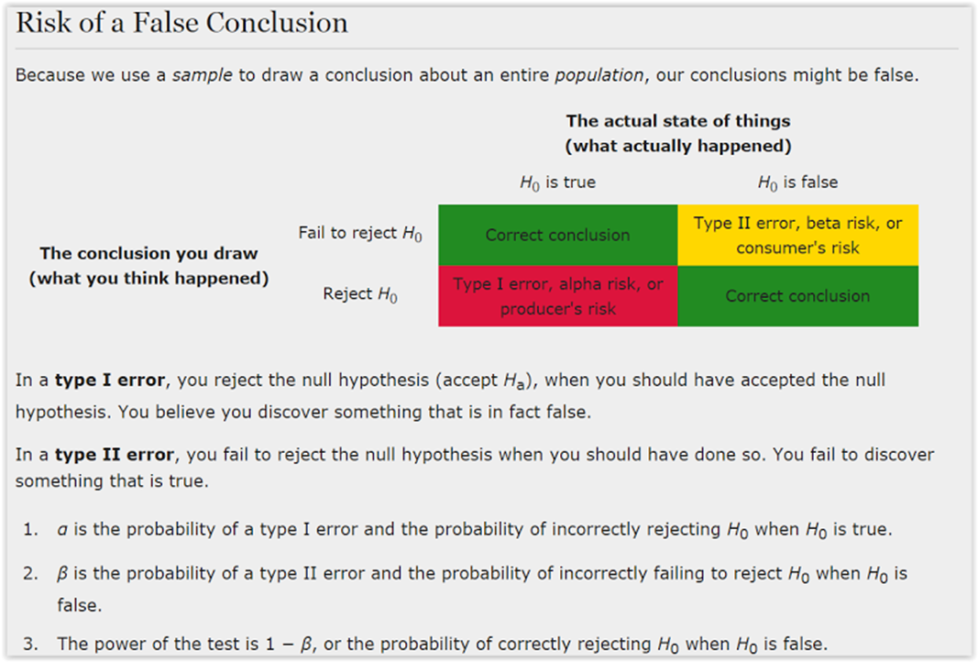
Error

Slide 22
Time Series Analysis
3 methods:
First Order Autoregressive Model (AR 1)
Moving Average Forecast Model
Exponential Smoothing Model
You might be asked to conduct one of these!
Watch which row you start the model in. Check your formula to be sure you are predicting future values based on history, not based on the current time period or the future.

Slide 23
Breakouts – Final Prep

Slide 24
What’s left:
Week 10
Process Improvement Project (with Storyboard) | Coursework → Assessments | 4 days after Live Session 10 = Mar 20
Week 11
Final Exam | Live Session #11 | During Live Session #11 = Mar 23

