Slide 1
MCB 638
Live Session 6
Monday

Slide 2
Agenda for Live Session 6
Process Learnings
Tips
Linear Regression and Correlation
Prep for Quiz 2
Wrap-up/What’s next/Feedback

Slide 3
Process Learnings
Is there a way to get the notes from the asynchronous material without the video?
Yes! Use the Print button above the screen.
View Keyframes will just show the unique slides.

Slide 4
Follow up from Live Session Week 5
Explain z vs z*
z* is another test statistic. It is an abbreviated version of z. It is a
quick and easy z.
It is found on the Table D at the bottom of the t distribution data
z* is used for Confidence Intervals and sample size.
The z* values are ‘close’ to the Z values for comparable confidence levels
as in the Standard Normal Table C

Slide 5
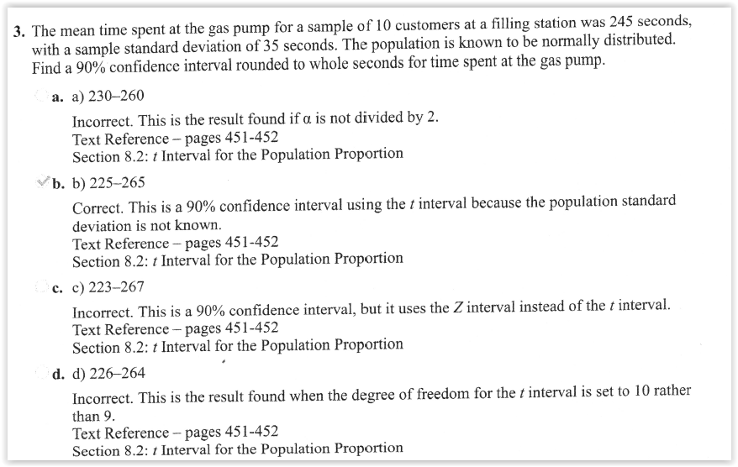
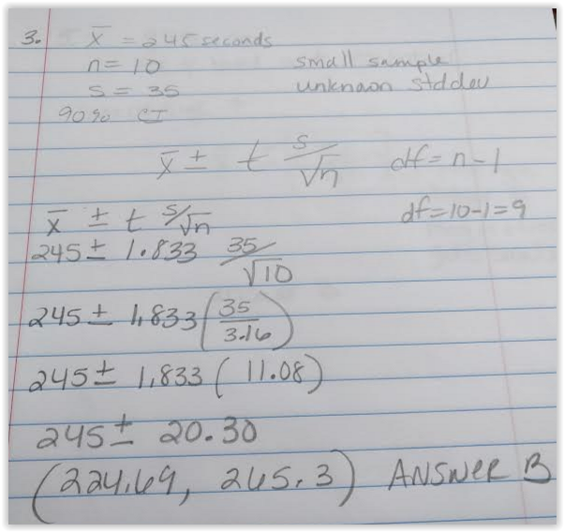
Chapter 8 Practice Quiz
Confidence Interval problem using t distribution

Slide 6
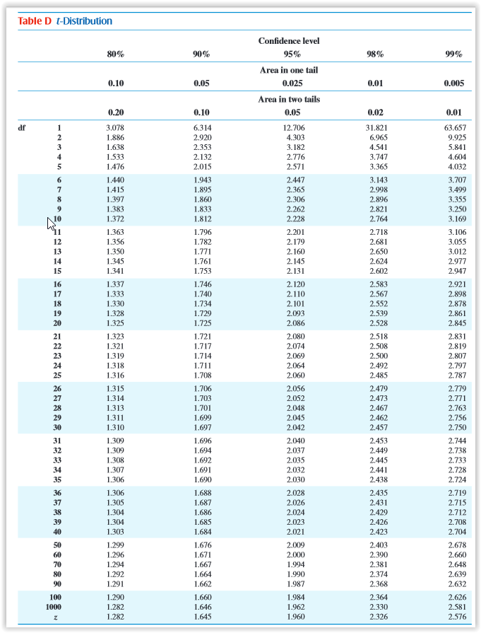
In Excel: use Confidence.t and then
add and subtract this number from
the mean to get the confidence
interval

Slide 7

Analyze
Description:
Analyze, describe, and present the data to discover the root cause(s), identify/prioritize critical inputs (x’s), determine the inputs impact on the output.
Key Concepts:
Inferential statistics, common distributions, developing a hypothesis, determining the likelihood some event happens based on a sample (calculating probabilities), Using the normal distribution as the “go to” distribution.
Project:
Write a null and alternative hypothesis statement.
Tools:
Hypothesis testing
Chi-square test for independence
Key Concepts:
Collecting sample data, how confidence intervals and sample size are related.
Project:
Utilize the sample size formula.
Tools:
Confidence intervals.
Key Concepts:
Determining input’s (x) impact on the output (y).
Project:
Use regression to identify relationships between the output (y) and inputs (x’s).
Tools:
Correlation
Simple linear regression
Multiple regression
Scatterplot
Trend/ line chart
Pareto chart
Fishbone (cause/effect) diagram
Week 3 & 4
Week 5
Week 6 &7

Slide 8
Simple Linear Regression
Looking for strength and direction of relationship of 2 variables
Plot the data – Scatter Plot
Data -> Data Analysis Toolpack -> Regression
Correlation coefficient = r
-1 < r < 1
Positive or negative relationships exist
For a good relationship, you want r >.7 or <- .7
Called ‘Multiple R’ in Excel (Will not see the direction in Multiple R in Excel). Need to look at the slope in the formula at the bottom of the results
Coefficient of Determination = r squared (literally r times r)
Tells us the % of variation in y that is explained by x
Called R Square in Excel

Slide 9
Simple Linear Regression Practice
Draw a chart of the data (scatterplot)
Add the line and equation
Run the regression
Analyze the results

Slide 10
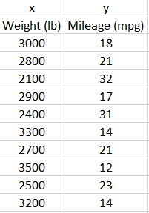
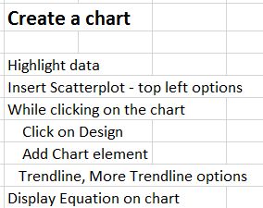
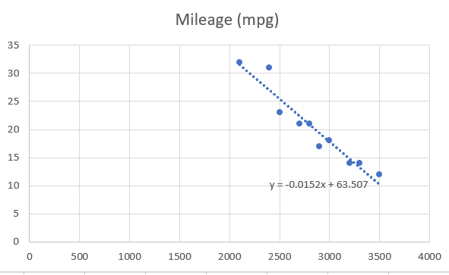
Simple Linear Regression Example
Draw a chart of the data:
MPG
Add the line and equation
Weight (lbs)

Slide 11
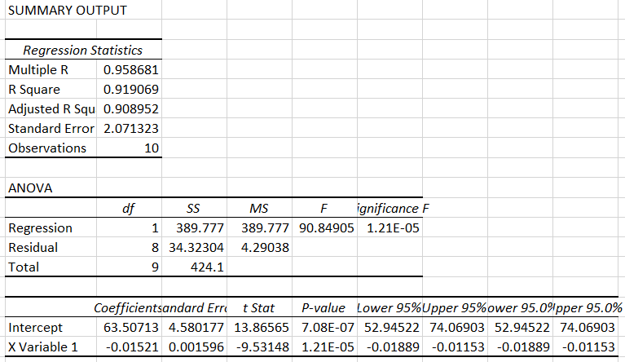

Simple Linear Regression Example continued:
Run the Regression
Data → Data Analysis → Regression
R=.9586
Y = 63.5 - .015x

Slide 12
Simple Linear Regression
Real world problems:
Trying to find the true x in order to drive improvement in y
Is distance of a service center from headquarters related to their average time to resolve a customer issue?
Determining if there is a relationship between advertising dollars and sales dollars

Slide 13
Correlation
If simply looking for whether two variables are correlated
Using Excel =CORREL(x data, y data)

Slide 14
Prep for Quiz 2
2 hours to complete. System will not drop you off at 2 hours, but your time will be visible to me once you finish. Suggest you keep track of your time.
6 questions
Covers Chapters 3, 6, 8, 9, 11.2
Multiple choice and fill in the blank
Due 2/20 by midnight Eastern time

Slide 15
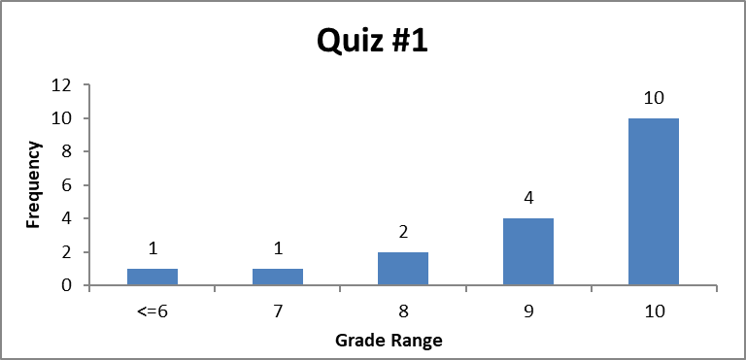
Measures of central tendency and spread/dispersion –
Quiz 1- Histogram
(Hypothetical data)
Mode: Score
Achieved
the Most)
n = 18 In Excel
Mean: 9.2 =average( )
Median (middle) = 10 =median( )
Mode (Most)= 10 =mode( )
Range: 10-6 = 4 =max( ) – min( )
Standard Dev = 1.2 =stdev.s( )
Variance = Standard Deviation squared = 1.2² = 1.44 =var.s( )

Slide 16
Sigma Quality Level
Key: Define what a defect is
Your team issues invoices. Per your customers, there are several main problems with the invoices: the date is missing, the amount listed does not match the amount owed, the address is incorrect, and fees are applied incorrectly. In the last 6 months your team issued 2522 invoices. During that time, you received 389 complaints for the above problems. What is the Sigma level for your process?
1. Defect opportunities per unit: D = 4
2. Units produced per timeframe: U = 2522
3. Total possible defects per timeframe: D × U = 10088
4. Total actual defects during that timeframe: A = 389
5. Defect per opportunity rate: A ÷ DU = DPO =.0386
6. Defects per million opportunities (DPMO): DPO × 1,000,000 = 38,600
7. SQL value (from SQL table): 3.3

Slide 17
Recommended approach for word problems
First determine what kind of a problem it is:
Normal Distribution
Binomial Distribution
Hypothesis Test
Chi Square
Confidence Interval
Sample Size
Decide which approach you will use (e.g. use Table or use Excel function)
Read each question carefully for hints (probability, normal distribution, etc.) and details
Determine if your data is Discrete or Continuous
Follow the instructed approach (Asynchronous material or PowerPoint from Live Session)

Slide 18
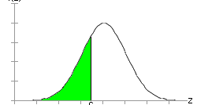
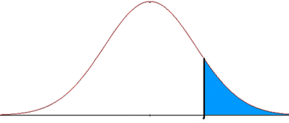
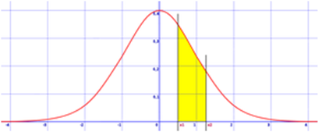
Normal Distribution
Continuous: Normal distribution
About probability
Use table or Excel
Normal: Z = x-mu
std dev
Then look up Z in Table C for Probability of what falls to left of x
Use the probability the Z table gives you
Subtract the probability the Z table gives you from 1
Find the probability for each point and subtract them

Slide 19
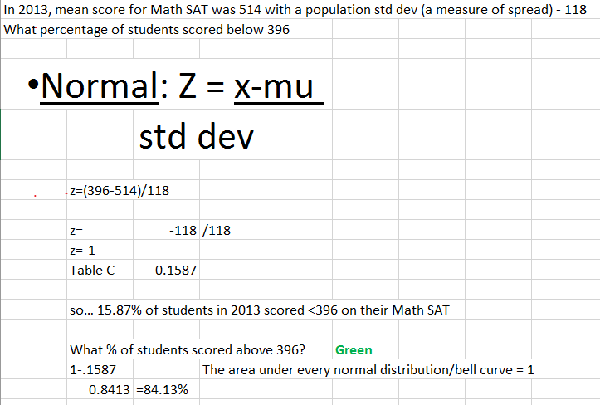
Normal distribution example

Slide 20
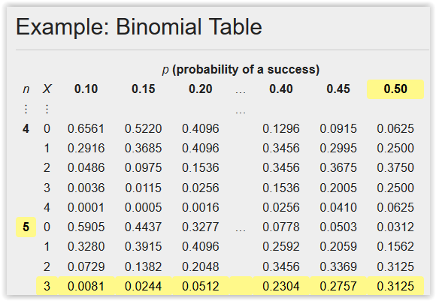
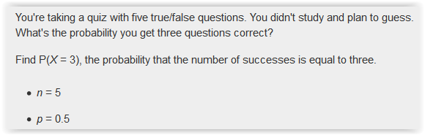
Binomial Distribution and example
Discrete: Binomial distribution (Y/N, Good/Bad)
About probability
Use table or Excel
Binomial - can calculate the Probability of success of getting x number of items good or yes or correct out of n by using Binomial Table.
Probability = 31.25%

Slide 21
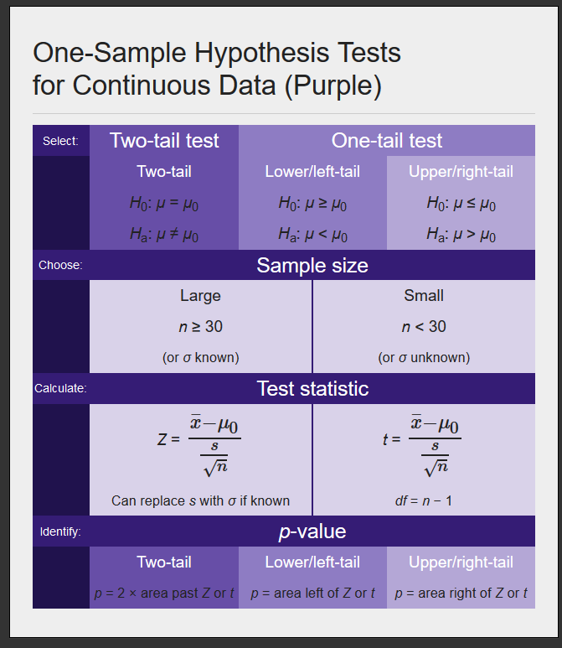
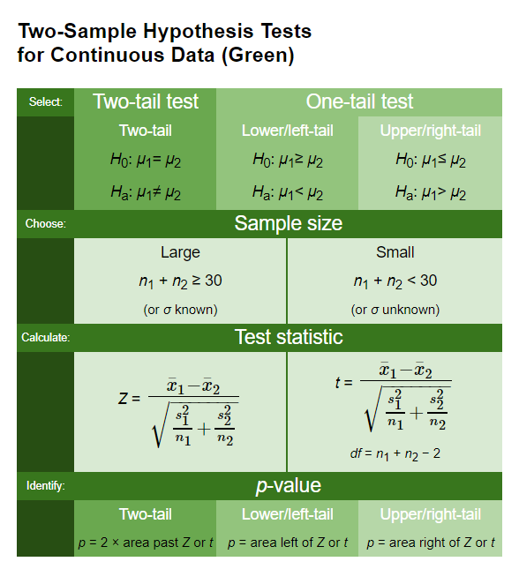
Hypothesis Tests for Continuous Data

Slide 22
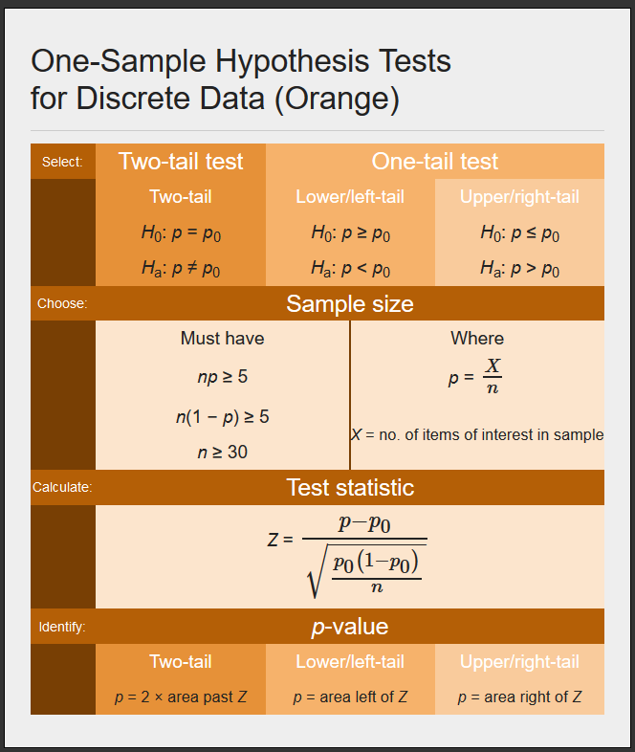
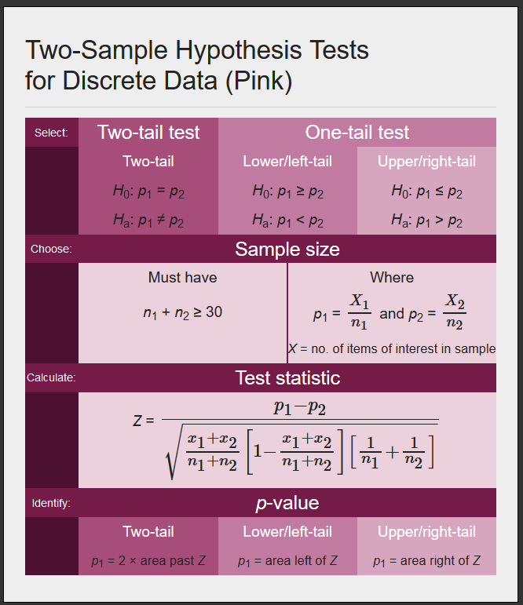
Hypothesis Tests for Discrete Data

Slide 23
Hypothesis Testing
Develop your hypothesis statements H₀ and H_{a}.
These are statements about a population, so they are written in terms of a population parameter.
The null hypothesis, H₀, is a statement of "no effect" or "no difference." It cannot be proven true but can be shown to be untrue with specific risks of error. These decisions are analogous to a courtroom finding a defendant not guilty or guilty.
The alternative hypothesis, H_{a}, represents the result when the null hypothesis is rejected. Because H_{a} expresses the hypothesis we hope to find evidence for, begin with H_{a} and set up H₀ as the nonoccurrence of the "preferred" outcome.
Select a level of significance α.
Confidence level is 1 − α.
Select a sample size n.
Decide if your data is discrete or continuous and select an appropriate test (one sample, two sided, etc.) for your hypothesis.
Calculate the standardized test statistic from the sample data (t, Z, etc.).
Use the test statistic to compute the area in the tail(s), or p-value.
Compare the p-value with α.
Reject or fail to reject the null hypothesis.
State your decision.

Slide 24
Chi Square
Remember – Chi Square is used with categorical discrete data
χ² test for independence: a hypothesis test used to determine if two variables are related or are statistically independent
Convention:
H₀: Categorical Variable 1 and Categorical Variable 2 are independent (i.e., there is no relationship).
H_{a}: Categorical Variable 1 and Categorical Variable 2 are not independent (i.e., there is a relationship).
How it works:
Compares "observed" counts and "expected" counts or frequencies.
Calculate Chi Square. Look it up in table or use Excel to find p.
Compare p to alpha. If p is low, Ho must go.
Does not give kind (positive/negative) or intensity of relationship
All it tells us is if there is a relationship – not directional

Slide 25
Chi Square steps
Write your hypothesis statements
Ho: Gender and beverage preference are independent (no relationship)
Ha: Gender and beverage preference are not independent (relationship)
Create your Observed and Expected Tables
Use Excel → CHISQ.TEST p = 4.22109E-50 ~ 0
4. Reach your statistical conclusion:
Select Alpha. We'll pick .05
p is low so reject the null (Ho)
5. State your practical conclusion:
There is a relationship between gender and beverage preference

Slide 26
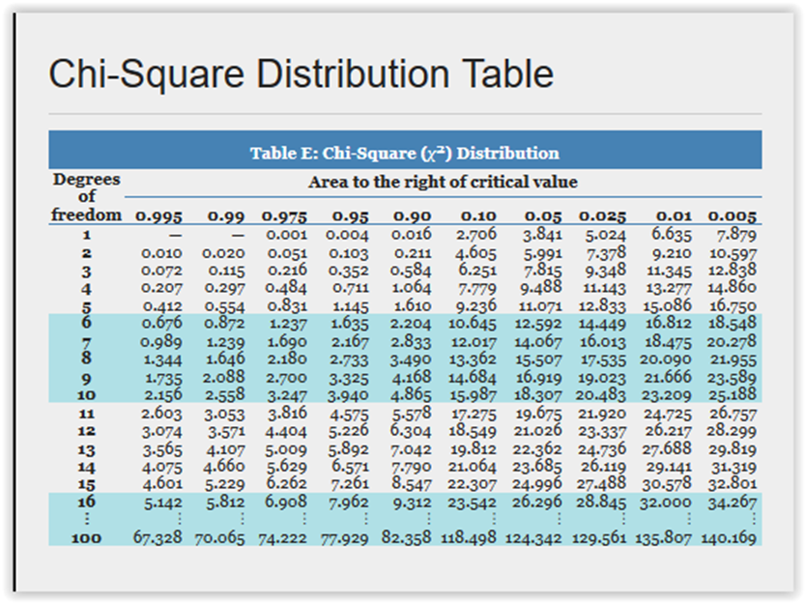
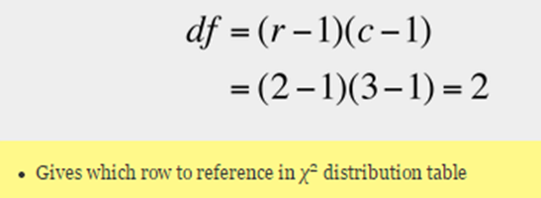
Chi Square steps
Or you can calculate Chi Square for all combinations of rows and columns, sum these numbers and use Table E to find the p value:
df in the left column:
Look for your X ² inside the table 227.38
The table only goes to 10.597
Find your p value in the header row across the top
~0
Chi Square values
in the table
Table E
Probabilities in the
header row

Slide 27


Sample Size – Continuous Data
Sample size for estimating the population mean:
n = (z* x std. dev)
------------------
E
Formula is more precise than using n = 30 for all continuous data problems

Slide 28
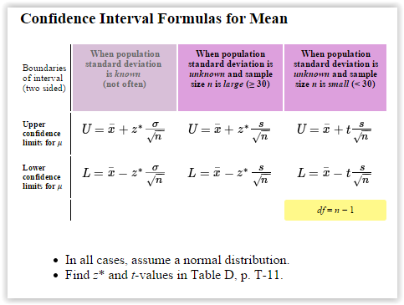
Confidence Interval – Continuous Data
Formula to use depends on population standard deviation and sample size:

Slide 29
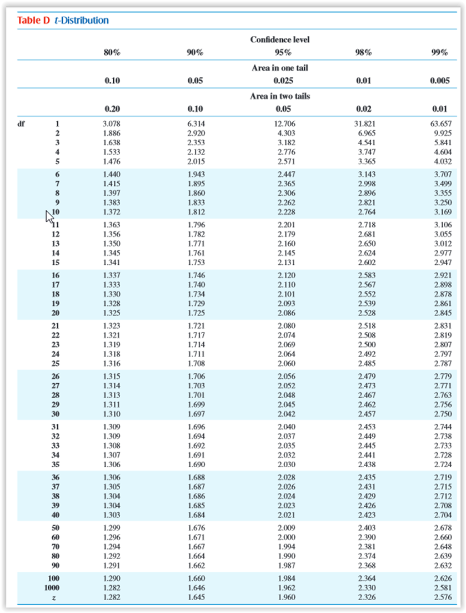
Finding z*
Confidence
level
z* →

Slide 30
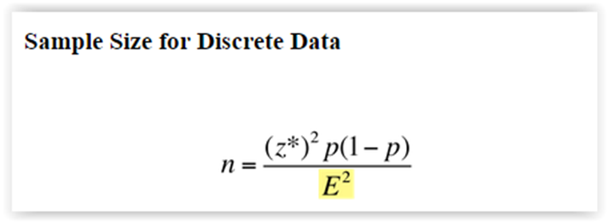
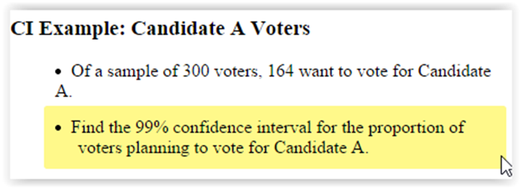
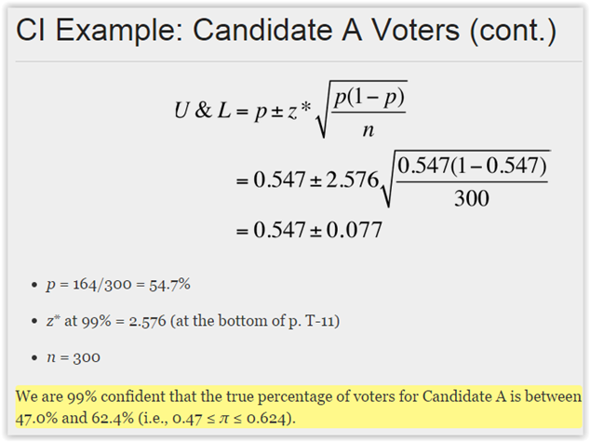
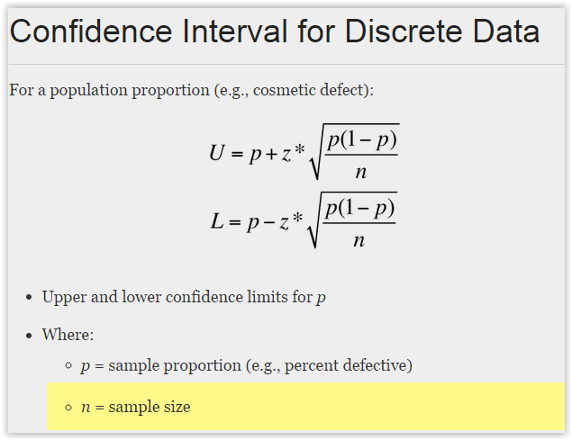
Sample Size and Confidence Interval for Discrete Data

Slide 31
Let’s practice!

Slide 32
What’s next:
Class Assignments | Submit / Post Location | Due Date
Week 6
Quiz #2 (covers Chapters 3,6,8,9,11.2) | Coursework → Assessments | 3 days after Live Session 6 = Feb 20
Week 7 (Reference : textbook Ch.4, Ch.13 – sect. 13.3 only)
Homework #4: (worth 5 points) Complete LearningCurve for Chapter 4. | LaunchPad | 3 days after Live Session 7 = Feb 27
Week 8 (Required Reading : Understanding Variation by Donald J. Wheeler)
Homework #5: (worth 3 points) Submit one Excel file containing this assignment: Complete Control Chart problems #1-10 on pgs 114 -116 from the Understanding Variation Book. | Coursework → Assessments | 3 days after Live Session 8 = Mar 5
Project – Analyze/Improve Phase
- Select your 5 tools
- Use these tools
- Start your PowerPoint

Slide 33
Questions?

