Slide 1
MCB 638
Live Session 7
Monday

Slide 2
Agenda for Live Session 7
Process Learnings
Quiz 2 Results
Multiple Linear Regression
Projects
Wrap-up/What’s next/Feedback

Slide 3
Process Learnings
Be sure you have obtained second book: “Understanding Variation” by Donald J Wheeler
Be sure to use the available time for quiz/tests (and not longer)
If you get a ‘sesskey’ error, you need to clear your browsing data

Slide 4
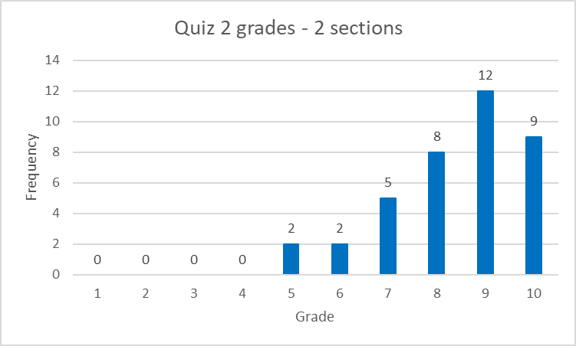
Quiz 2 Results – 2 sections
Histogram
Average: 8.5
Median: 9
Mode: 9
Range: 5 (10-5)

Slide 5
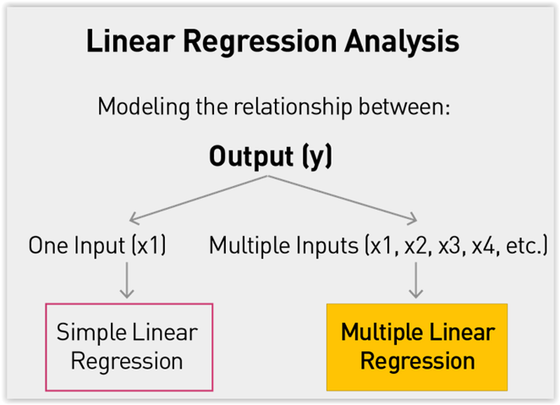
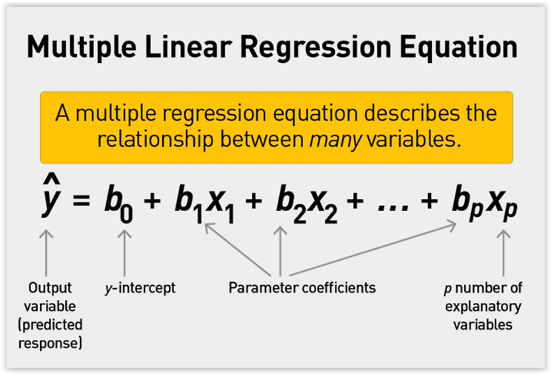
Multiple Linear Regression

Slide 6
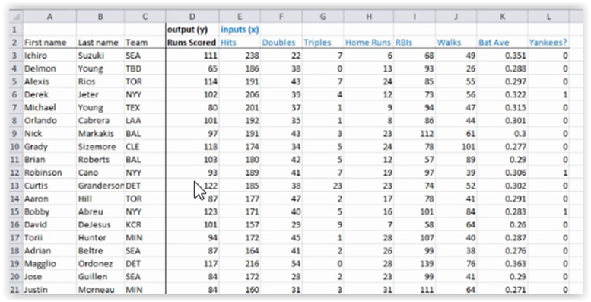
Setting up your data in Excel
Note column for y and columns for x variables

Slide 7
Setting up your data in Excel Using Categorical Data – e.g. month, day, brand
K = N − 1 For months: 12 − 1 = 11 input variables
Y | J | F | M | A | M | J | J | A | S | O | N
10 | 1 | 0 | 0 | 0 | 0 | 0 | 0 | 0 | 0 | 0 | 0
22 | 0 | 1 | 0 | 0 | 0 | 0 | 0 | 0 | 0 | 0 | 0
13 | 0 | 0 | 1 | 0 | 0 | 0 | 0 | 0 | 0 | 0 | 0
20 | 0 | 0 | 0 | 1 | 0 | 0 | 0 | 0 | 0 | 0 | 0
14 | 0 | 0 | 0 | 0 | 1 | 0 | 0 | 0 | 0 | 0 | 0
12 | 0 | 0 | 0 | 0 | 0 | 1 | 0 | 0 | 0 | 0 | 0
25 | 0 | 0 | 0 | 0 | 0 | 0 | 1 | 0 | 0 | 0 | 0
21 | 0 | 0 | 0 | 0 | 0 | 0 | 0 | 1 | 0 | 0 | 0
17 | 0 | 0 | 0 | 0 | 0 | 0 | 0 | 0 | 1 | 0 | 0
15 | 0 | 0 | 0 | 0 | 0 | 0 | 0 | 0 | 0 | 1 | 0
18 | 0 | 0 | 0 | 0 | 0 | 0 | 0 | 0 | 0 | 0 | 1
16 | 0 | 0 | 0 | 0 | 0 | 0 | 0 | 0 | 0 | 0 | 0
Notice – no December
All 0’s means it is December

Slide 8
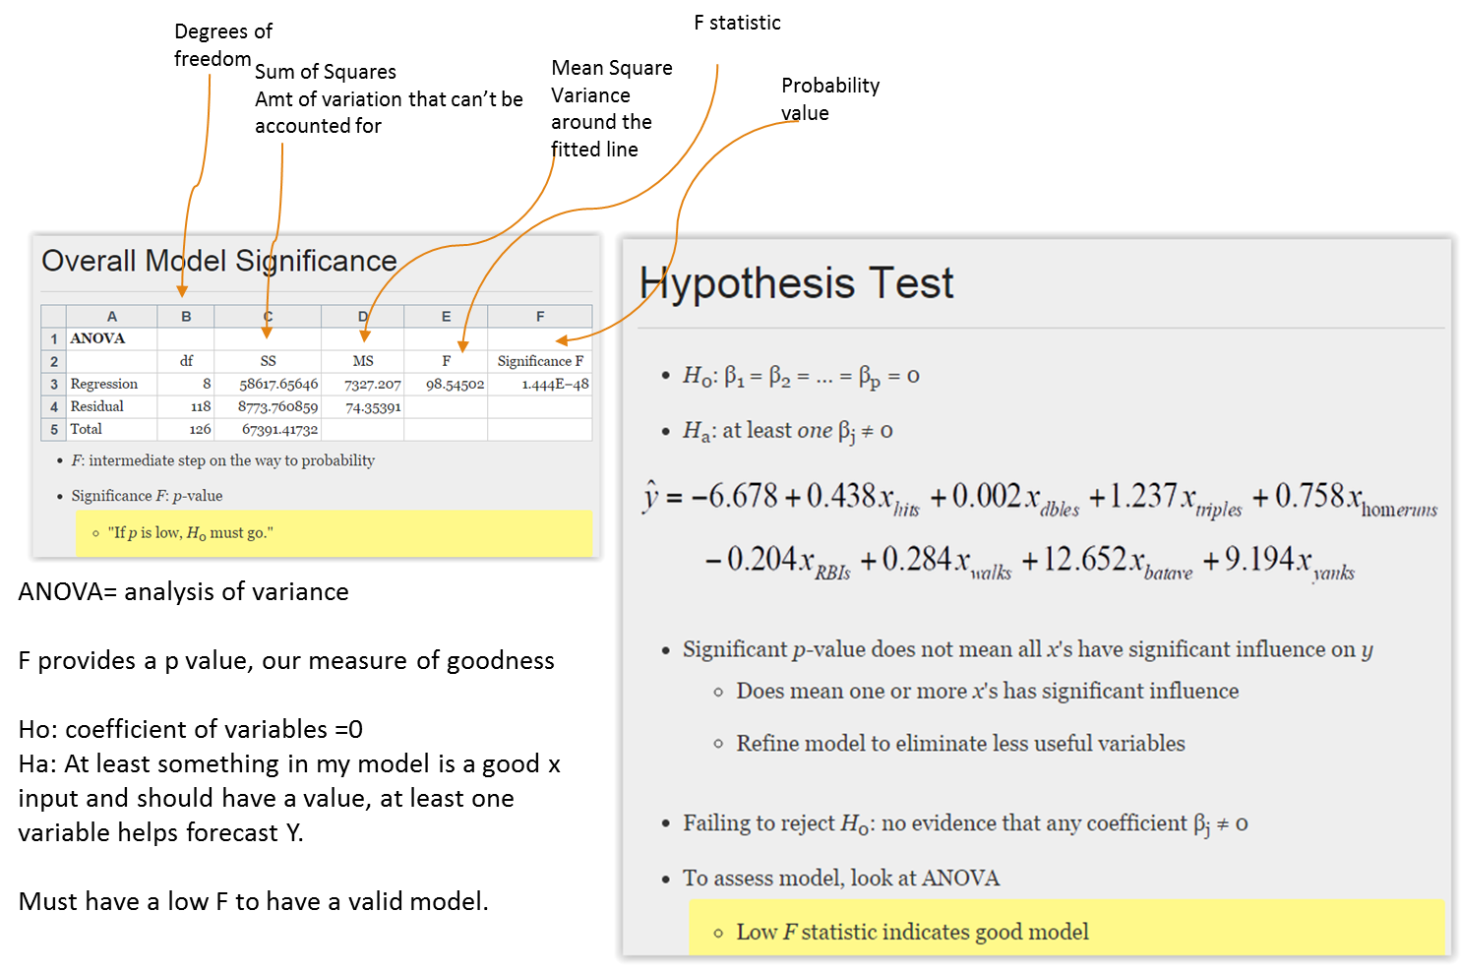
F test
Significance

Slide 9
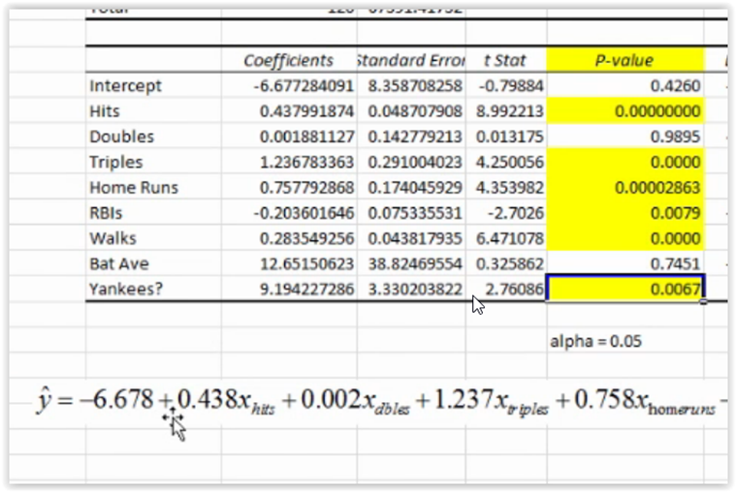
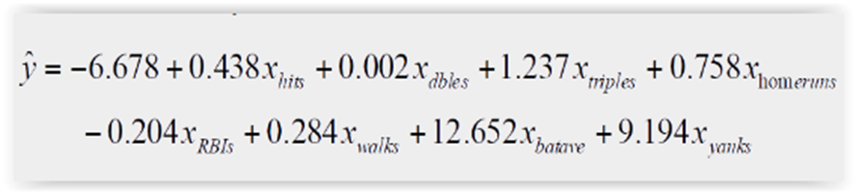
Multiple Linear Regression
p value helps you identify which input variable(s) are important/useful in describing Y.
We want p’s lower than our alpha, assume .05, so if p is low Ho must go – our implied Ho is, X doesn’t describe Y and Ha is, X does describe Y – so if we have a low p-value we reject Ho and say X does describe Y.
Then re-run your regression without the X’s that don’t help describe Y to develop a better model.
Ignore Intercept p-value
Keep x variable if p <.05
Next step - eliminate 2 x’s with high p values and re-run regression

Slide 10
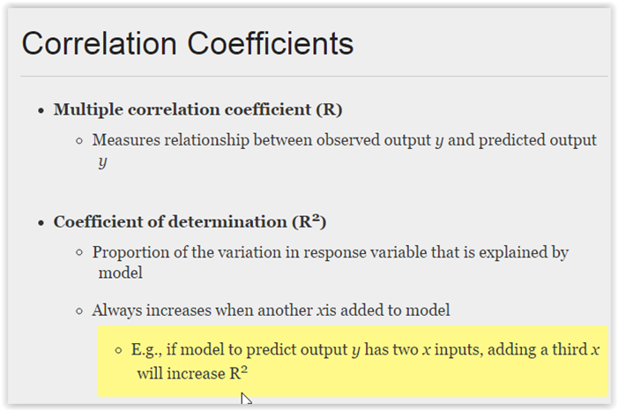
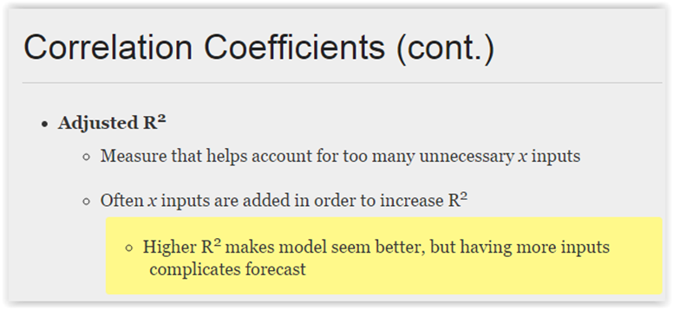
Multiple Linear Regression - Correlation Coefficients

Slide 11
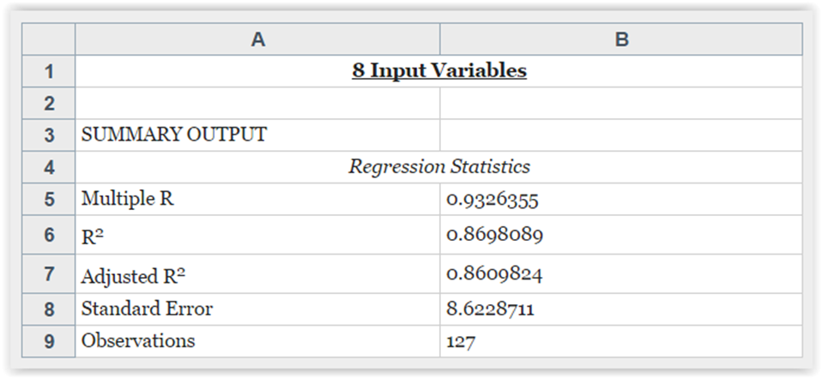
R, R² and Adjusted R²
For Multiple Regression:
Multiple R = measure of the relationship of the observed output of Y and the predicted Y
R Squared = proportion of the variation in Y that is explained by the model, always increases when you add more x’s
Adjusted R Squared = accounts for excess x’s, a better measure of the variability explained by the model

Slide 12
If get #NUM!
https://support.office.com/en-ie/article/how-to-correct-a-num-error-f5193bfc-4400-43f4-88c4-8e1dcca0428b
And check for all 0’s in any columns where that variable is giving the error.

Slide 13
Let’s work through an example

Slide 14
Projects – Storyboard Rubric:
Content Requirements | Possible Points
Project
A) An executive summary is provided in the storyboard format including: Is the storyboard presented in 1 PowerPoint slide? Follows DMAIC? Are tools/graphs/charts used and clearly visible? Do they support findings and conclusions? Are arrows, call-out boxes, etc. used to summarize, highlight questions and key learnings? Are expected results clear? And next steps noted? | 5

Slide 15
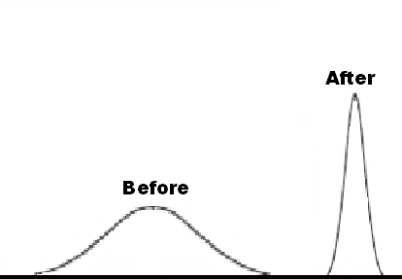



Process Improvement Project – Cycle Time Reduction
Process owner: Dan
Key Dates --->
Team Launch
8/23
Define
9/08
Measure
10/16
Analyze
10/24
Improve
10/31
Control
On-Going
DEFINE
MEASURE
ANALYZE
IMPROVE
It takes 43 days to process a grant application. Only 8% of applications are being processed within 30 days of receipt. The time to process the application has lead to unhappy applicants and staff who are finding more and more of their daily work time being devoted to “grant administration.” The funding levels available to applicants and the number of applications are expected to increase in the near future, which has the potential to compound the problem.
Defects/delays are inherent in the current process. Current SQL is 1.9
The Number of applications received is increasing.
New Application Procedure =
Less Mistakes & Quicker Cycle Time
The time to complete a process cycle is also increasing.
Problem: Incomplete and inaccurate applications were identified as the primary factor leading to defects in the process cycle.
Solution: New Application process incorporating drop down menus
CONTROL
The defect rate reduced from 93% to 32%
Before
After
↑ Number of Applications + ↑ Cycle Process Time __Tough Times Ahead
Monthly monitor and review procedure is in place. Out of control signal = action plan.
PROJECT TEAM: Dan • Mary • Karen • Linda • Peter
BUSINESS CASE: $54,000 in annual processing costs

Slide 16
Discussion on projects
What questions do you have?
What is most challenging for your project?
What successes or key learnings have you had?
What tips do you have for others?

Slide 17
What’s next:
Class Assignments | Submit / Post Location | Due Date
Week 7 (Reference :: textbook Ch.4, Ch.13 – sect. 13.3 only)
Homework #4: (worth 5 points) Complete LearningCurve for Chapter 4. | LaunchPad | 3 days after Live Session 7 = Nov 21
Week 8 (Required Reading :: Understanding Variation by Donald J. Wheeler)
Homework #5: (worth 3 points) Submit one Excel file containing this assignment: Complete Control Chart problems #1-10 on pgs 114 -116 from the Understanding Variation Book. | Coursework → Assessments | 3 days after Live Session 8 = Nov 28
Project –Select and use tools
-Improve Phase
-Create PowerPoint including
initial ideas on Storyboard

Slide 18
Questions?

