Slide 1
MCB 638
Live Session 9
Monday

Slide 2
Agenda for Live Session 9
Process Learnings
Tips
Review of Control Chart HW
Time Series Analysis
Review of Possible Tools for Project
Wrap-up/What’s left/Feedback

Slide 3
Process Learnings
Please respond to the University survey about this class. Your feedback is important to me and for future students. We have made changes and improvements based on student feedback. Thank you!
Always click on Upload to be sure the file you Browsed to is posted in Assessments in 2SU.
Refer to documents posted under Files from our class main page. The project Rubric, sample Storyboards as well as other reference documents are posted.

Slide 4
Tip: Watch out!
Never average averages!!!
(or percentages)

Slide 5
Here’s Why
The reason for this is.. that each sub-group may not be the same size. And averaging the averages then gives a biased number. Let's take an extreme example:
Group 1
1500 orders 100 completed on time 6.6% accuracy
Group 2
200 orders 100 completed on time 50% accuracy
If we average the averages, we get (50 + 6.6)/2 = 28.3% accuracy
If we take the pure numbers, we get 200/1700 = 11.7% accuracy
This is more representative of reality as a HUGE amount of the
data is in Group 1. When we average the averages, we give equal
weighting to the 50% as to the 6.6%.
OK to average only when the
same sub-group size in each average

Slide 6
Control Chart HW
7. “Plot the limits from Figure 6.8 on Figure 6.10”
Taken literally – use the control limits from the 1988 data on the chart for your 1989 data.
Premise: We don’t calculate control limits from the data, and then re-calculate them after a few more data points. It is a very conscious process to determine when to change control limits.
9. “When is this favorable shift detected”
Until a process goes out of control, we just have noise and common cause variation. If we used the control limits from the 1988 data in #7 above, we see when the data went out of control.
Note: Up is not always favorable. We need to check the type of data we are plotting. A decrease in a deficit is favorable

Slide 7
Intro to Time Series
Time series analysis comprises methods for analyzing time series data in order to extract meaningful statistics and other characteristics of the data.
Data is collected at regular intervals over a given time period.
Time series forecasting is the use of a model to predict future values based on previously observed values. (a bit like looking in the rear view mirror to predict the future)
Time = input variable, Time Series =output variable
Y = f(?)

Slide 8
Intro to Time Series
Potential Components of Variation:
Trend
Long-term rise and fall
Calendar cycles
Seasonality
Business cycles
Affected by American politics
Autoregressive behavior - An autoregressive process operates under the premise that past values have an effect on current values.
5. Random variation

Slide 9
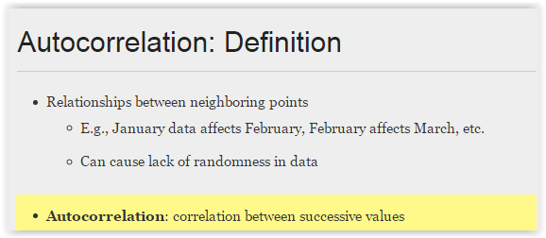
Autocorrelation
Regression on Time Series Data
Modeling trend and seasonal components may not generate random residuals
Residual plots help assess the fit of a regression line
DEFINITION of 'Autocorrelation'
A mathematical representation of the degree of similarity between a given time series and a lagged version of itself over successive time intervals. It is the same as calculating the correlation between two different time series, except that the same time series is used twice - once in its original form and once lagged one http://www.investopedia.com/terms/a/autocorrelation.asp#ixzz3cU65w3O0

Slide 10
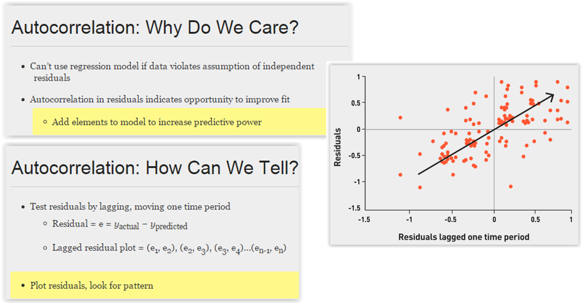
Autocorrelation

Slide 11
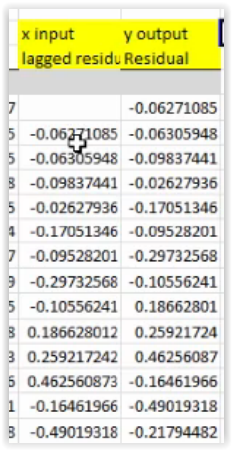
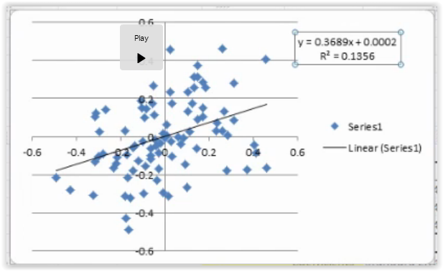
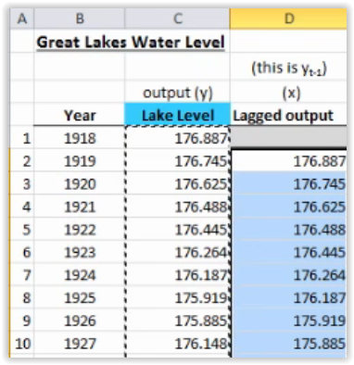
Is Autocorrelation Present?
Calculate residuals and lagged residuals.
Create a residual and lagged residual plot: Is there a pattern?
Y = residual, X=lagged residual
Generate X by using lagged Y

Slide 12
Time Series Analysis
3 methods:
First Order Autoregressive Model (AR 1)
Moving Average Forecast Model
Exponential Smoothing Model

Slide 13
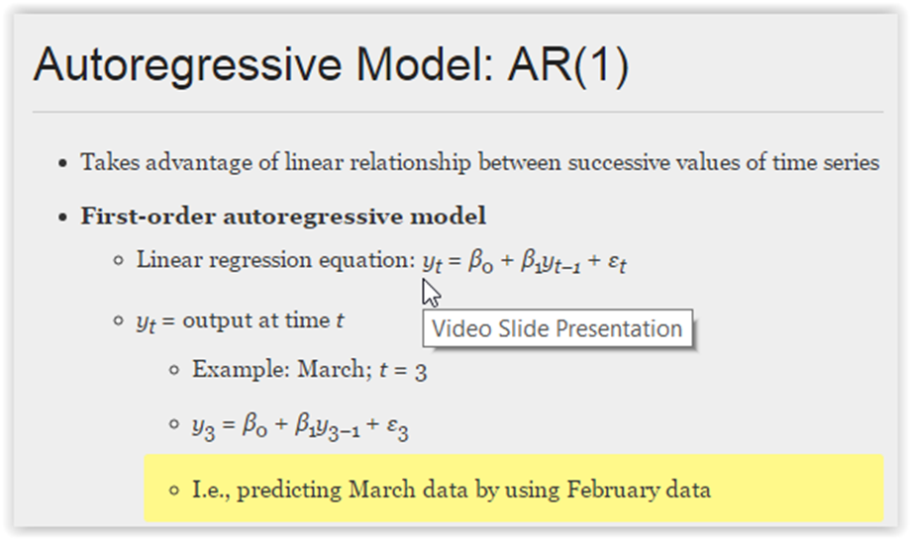
First Order Autoregressive Model (AR 1)

Slide 14
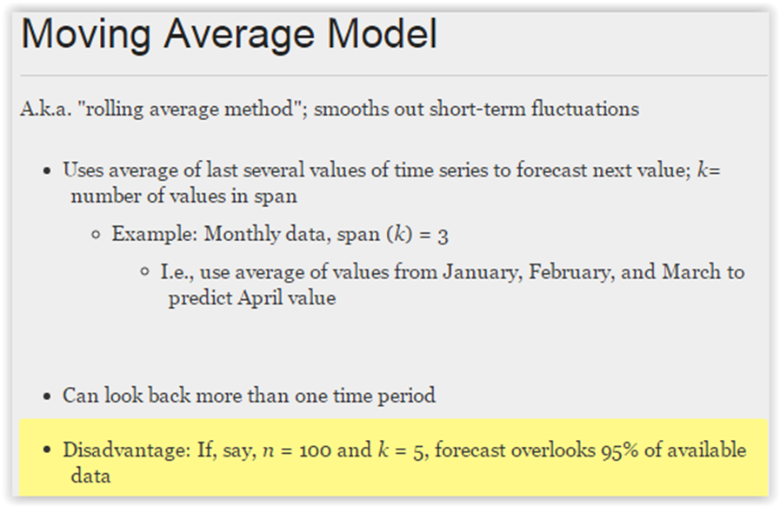
Moving Average Forecast Model
Smaller your K, the bumpier your forecast, and the closer to the actual data.

Slide 15
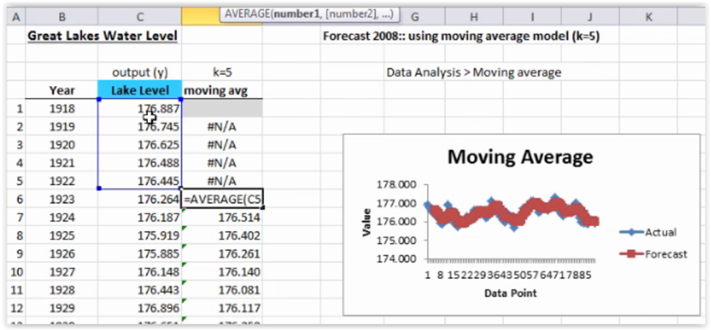
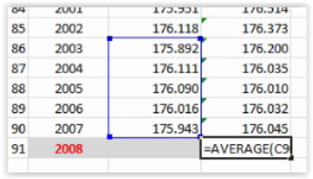

Moving Average Forecast Model
Once you click in a cell, the actual formula will show here in fx.
Click in here and a blue outline will surround the actual data being used.
Smaller your K, the bumpier your forecast
the closer to the actual data.

Slide 16
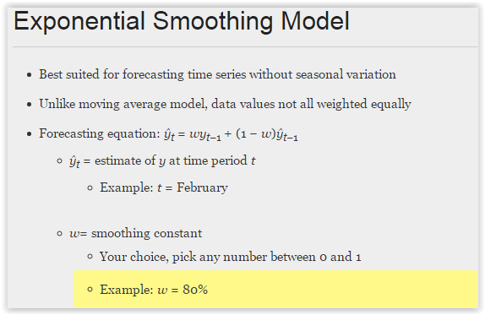
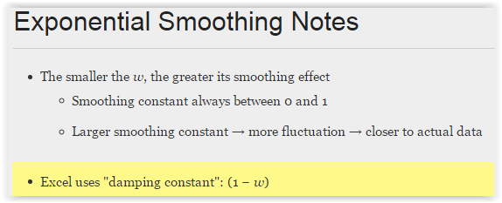
Exponential Smoothing Model

Slide 17
Excel tips
Be sure to place your cursor on the correct cell in the correct row for time series.
You want your formula to predict a current month’s value based on prior months (and you do not want to predict a current month’s value based on that same month’s data)
Let’s go check it out…

Slide 18
Time Series Analysis
Which model uses the average of several values of the time series to forecast?
Which model uses all the available time to forecast?
Which model takes advantage of linear relationships of successive values in the time series to forecast?
Why might we not be a huge fan of Time Series Analysis?
What might we look for instead?

Slide 19
Data Analysis Tools
Tool | What is it? | When do I use it? | Example | DMAIC
Affinity Diagram | A method to gather and organize brainstormed ideas (language data) into groupings based on the natural relationship between items. | When you need to organize and consolidate large amounts of qualitative data in order to support a concept or solution. | http://en.wikipedia.org/wiki/Affinity_diagram | Measure, Analyze, Improve, Control
Box and Whisker Plot | A graphical way to compare the medians and the variation between groups of data. It can also help to identify outliers. | When you need a quick visual look at one or more sets of data. They graphically show different types of populations without any assumptions of the statistical distribution. | Discovering Stats – pg.138-141 | Measure, Analyze, Improve
Cause and Effect / Fishbone / Ishikawa Diagram | A structured problem solving technique that graphically displays / organize all possible brainstormed causes relating to a problem (focusing on causes, not symptoms). | When you have a large number of factors that could influence your process and you need support for a resulting solution. | Slides posted in Course Materials | Analyze
Check Sheets | Used for counting and accumulating data in a logical format during observation. This is a straightforward and easy way to answer the question, how often are certain events happening? | When quantifying frequency / counting data on number of occurrences (eg. defects), information on variables (eg. weight, size, length, or defect location, etc.). | http://web2.concordia.ca/Quality/tools/6cksheet.pdf | Measure
Chi-Square – Test for Independence | This is a procedure used to determine if two classifications variables are related, testing the statistical independence of two random variables. It compares the number of observed counts against the expected number of counts to determine if there is a difference in output counts. | It is a good method to apply to before and after data to prove that a process improvement made an effective change. Use this method when you have nominal data in a table and you need to know if the output counts differ for two or more categories. | Discovering Stats – pg. 570-571 | Analyze, Improve

Slide 20
Confidence Intervals | A range of values in which we expect the population parameter to occur. A population parameter is likely to occur at a specified probability. It is constructed from sample data. | Confidence intervals determine if a process is centered where it is expected. They are used to identify a shift or change in the process (mean) and to identify a difference in two populations (eg. does Vendor 1 and Vendor 2 give us the same dimensioned part?) | Discovering Stats – pg. 369-421 | Measure, Analyze, Improve
Control Chart | Can serve as a statistical tool for problem identification as well as, ongoing monitoring of a process (graphically) over time. It can assist in distinguishing random variation (noise) from assignable variation (signal). | When you need to recognize and eliminate sources of variation in a process so that a process performs consistently and predictably. | Understanding Variation by D.J. Wheeler | Measure, Analyze, Improve, Control
Correlation Coefficient | Correlation coefficient R is a measure of the strength and direction of the linear relationship between 2 random variables. R falls on or between the numbers -1 and 1. Coefficient of determination R² is a measure representing the percent of variability in “y” that can be accounted for by the variable x. | Although correlation does not explicitly imply causation, establishing a correlation between two variables is necessary (but not sufficient) to establishing a causal relationship. | Discovering Stats – pg. 160-165 | Measure, Analyze, Improve
Design of Experiments (DOE) | A method for planning an experiment so that data can be analyzed by statistical methods. A designed experiment helps to obtain information on how input factors and combinations of those factors affect a process and its outputs. And it can place a given probability statement on the results. | When it is necessary to identify or monitor the way the results (or response) of a process changes when key variables of the process are altered. When you want to gain process knowledge on your quest to determining y=f(x). | http://thequalityportal.com/q_know02.htm | Measure, Analyze, Improve
Dot Plot | Quick graphical comparison of two or more data sets (processes) variability. | When you need a quick visual of the distribution (spread) of one or more sets of data. | http://processtrends.com/toc_statistical_charts.htm | Measure, Analyze, Improve

Slide 21
Histogram | A graphical method of displaying the distribution of data by bar graphing the number of units of a particular category (illustrates process centering, spread and shape). | Design of Experiments (DOE) | A method for planning an experiment so that data can be analyzed by statistical methods. A designed experiment helps to obtain information on how input factors and combinations of those factors affect a process and its outputs. And it can place a given probability statement on the results. | When it is necessary to identify or monitor the way the results (or response) of a process changes when key variables of the process are altered. When you want to gain process knowledge on your quest to determining y=f(x).
Hypothesis Testing | Hypothesis testing is a process (inferential method) that uses sample data from a population to confirm or refute some statement or claim about that population. | Dot Plot | Quick graphical comparison of two or more data sets (processes) variability. | When you need a quick visual of the distribution (spread) of one or more sets of data.
Linear Regression Analysis | This tool will help you to understand the relationship between the process output and any process input that could affect it. It is a way to model or predict the relationship between those variables. | When you suspect there is a relationship between an input and output variable. It is especially useful when the output variable is difficult or expensive to measure and the input variables are not. | Discovering Stats – pg.185-197, 634-638 | Analyze
Measurement System Analysis (MSA) | A process that includes identifying, quantifying and reducing measurement errors. Measurement systems (a decision making tool) play a large part in process improvement activities. | On every measurement system that a decision is based upon. | http://www.6sigma.us/MeasurementSystemsMSA/measurement-systems-analysis-MSA-p1.html Slides posted in Course Materials | Measure
Measures of Central Tendency (Measures of Location) | The behavior of the middle (or central portion) of the population of process data. 3 measures are: Mean = arithmetic average Median = middle value Mode = most frequent value | When you need a quantitative measure that summarizes an important characteristic of a population / process, the center of your data. | Discovering Stats – pg.90-103 | Define, Measure, Analyze, Improve, Control

Slide 22
Measures of Variation (Measures of Dispersion) | A measure of how the data is spread around the mean. 2 Measures are: Range = difference between the largest and the smallest data point Standard Deviation = measure takes into account each data point and its distance from the mean | On any set of data - all populations and processes have some degree of variability. | Discovering Stats – pg.104-118 | Define, Measure, Analyze, Improve, Control
Pareto Chart/Diagram | A descending bar and cumulatively increasing line chart used to separate the vital few from the trivial many. The vital few are the few factors accounting for the largest part (%) of a problem or condition. Pareto Principle: 20% of the sources cause 80% of the problem. | When you need to focus on the key problem(s) - when solved will have the greatest impact. | Discovering Stats – pg.41 | Define, Measure, Analyze, Improve
Process Map (or Process Flow chart) | A graphical tool for documenting a process. Each step or activity is mapped out as it occurs in the real-live process. | When improving or creating a process. | http://en.wikipedia.org/wiki/Business_process_mapping | Define, Measure Analyze, Improve, Control
Run Chart (Time Series Plot) | A graphical tool that can show and track trends or patterns over a specified time period. | When you need to do the simplest possible display of a trend over time. | Slides posted in Course Materials | Measure, Analyze, Improve

Slide 23
Scatter Plot/Diagram | A graphical tool to visualize the possible relationship between two variables and relative strength of that relationship. | When you need to display what happens to one variable when another variable changes (visualize a relationship between two variables). | Discovering Stats – pg.158-160 | Measure, Analyze, Improve
SIPOC (Supplier / Input / Process / Output / Customer) | A simple way to document (or map) a process in the “as is” (current) state by listing the suppliers, inputs, outputs and customers. The “process” should be identified by a high level flow chart. This sets the scope for the value-stream map. | This is a quick way to document your process (and start analyzing it) when parts of the process are not clear or consistent (such as, Who supplies inputs to the process? Who are the true customers of the process? Is there a customer for each output? What are the requirements of the customers?) | Slides posted in Course Materials http://www.isixsigma.com/library/content/c010429a.asp | Define, Measure
Stem and Leaf plot (Stemplot) | A graphical technique that shows the shape (distribution) of the data like a histogram but displays all of the individual values within an interval rather than just the frequency for each interval. | When evaluating the shape of the data with the ability to maintain visibility to the original raw data points. | Discovering Stats – pg.60-64 | Measure, Analyze, Improve
Thought Process Map (TPM) | A logical, visual representation or map of someone’s thought process flow (of questions, tools used to help answer the question, related actions and related decisions) that shows how a process or problem was/is attacked / addressed. | Use this for any situation. This is an “evergreen” document that can be used as a communication tool for where you are, where you’ve been and where you are going. | Slides posted in Course Materials | Define, Control

Slide 24
What’s next:
Class Assignments | Submit / Post Location | Due Date
Week 9
Homework #6: (worth 2 points) Submit one Excel file containing this assignment: . Complete Time Series problems - Excel data file posted in the Assessments folder | Coursework → Assessments | 3 days after Live Session 9 = Mar 12
Week 10
Process Improvement Project (with Storyboard) | Coursework → Assessments | 4 days after Live Session 10 = Mar 20
Week 11
Final Exam | Live Session #11 | During Live Session #11 = Mar 23
Project –Create PowerPoint
Prep for Final – next week

