Slide 1
EXtreme Data Driven Testing applied to TestNG
Kiran Eshwarappa
Selventhiran Elangovan
Notes:
Hello everyone, I am Kiran and along with me is Selva. Both of us work in vSphere QE team at vmware.
Today we are going to talk about Extreme DD testing.

Slide 2

Agenda
Brief on testing and its evolution
Limitations of existing Java test frameworks
EXtreme data-driven framework [Extreme-DD]
Working of Extreme-DD
Advantages
Future directions
Case study & Demo
Q & A
Notes:
We will give a brief history of evolution of software testing.
Then we will talk about limitations of existing java testing frameworks.
We will introduce you all the Extreme data driven framework and how it works.
Some of the advantages and future plans.
Followed by case study and Demo.
Then open for Q & A.

Slide 3
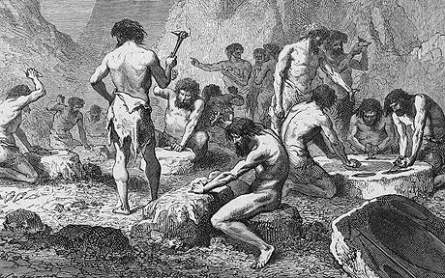
The evolution: Stone Age
Manual testing with no automation
Time consuming and less predictable
Cumbersome
Costly
Tools are not used efficiently
Notes:
Stone Age:
Early stage of software testing.
Testing was performed manually and was less predictable.
Cumbersome to do a regression cycle.
Testing was costly as no automation existed.
Testing tools even if existed were not used efficiently.

Slide 4
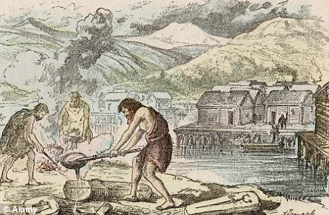
The evolution: Bronze Age
Test-data is hard-coded in to test-scripts
Many tests-scripts to maintain
Semi automatic, only some parts is automated
Test frameworks like Junit were born
Notes:
Bronze Age:
Only some part of the testing is automated
Scripts were written for each scenario and any change in testing needed modification in test-script.
Semi - Testing of few features are automated but they are triggered manually and result is read and understood manually.
Ex: The testing script(s) run for a long time.. and you make sure that it's finished and see a text/log file and compare values to see whether the test is PASS/FAIL!

Slide 5
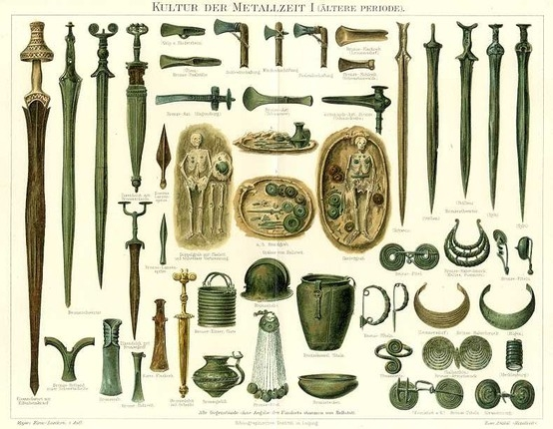
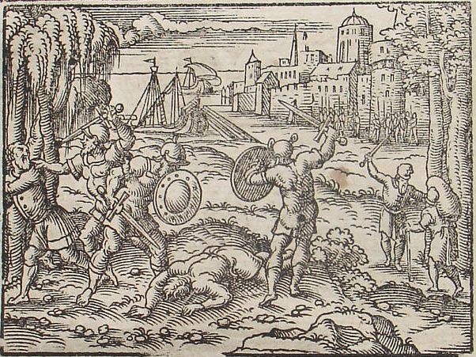
The evolution: Iron Age
Frameworks like TestNG are at testers disposal
Automated- some level of data driven testing
Don't have test-data generation capabilities
No standard data management and organization capabilities
Problems arising of product evolution
Notes:
TestNG is available for testers.
Automation is in place and some level of data driven testing is done. Like read the data from that properties and use it in this test.
Have to hand write all the 4 * 4 * 4 = 46 combinations!
The data given to the tests can be from different places like xml/db/csv etc and reading them in a standard way and organizing them is a challenge and no standards or best practices are available for the same. The test writer decides all these when under tight schedules.
When product evolves over time the problems with convention DD testing increases many fold. When new versions of products com out the old data need to be kept for testing older version but new data which is required for new features needs to be added which is not possible until one changes the test-script.
No standard way to manage the version compatibility of data.

Slide 6
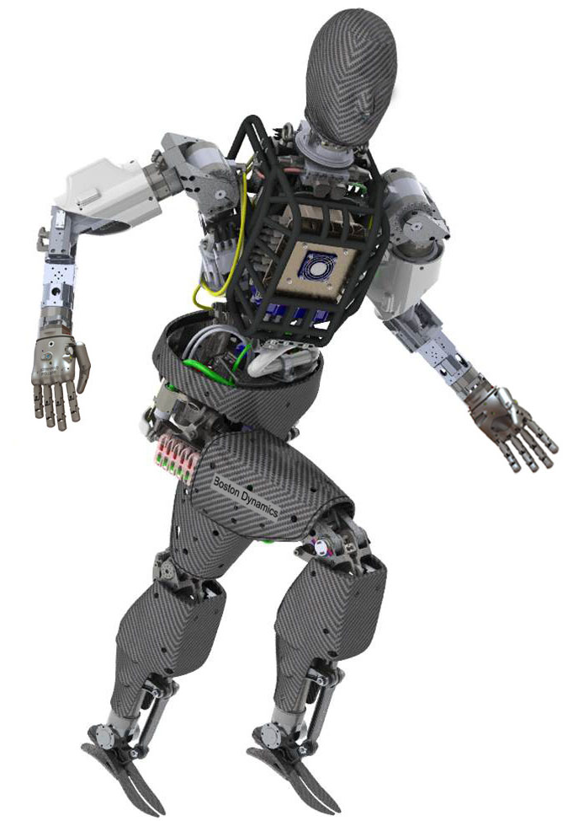
The evolution: Extreme-Age [Extreme Data Driven Framework]
Generic, pluggable Data Driven framework for Java
Standard mechanisms: data supplier, filter & generation
Dynamic test-data generation techniques.
Concentrate on test-data not on it's source
Standard and pluggable test-data injection mechanism.
Reuse of test-data across tests.
Have solutions for problems faced when products
and it's support matrix evolves over time.
Notes:
The Extreme-age. Now we have the Extreme Data Driven Framework to take of our wish list.
It’s a generic, pluggable Data Driven Framework for java testing.
Uses independent standard mechanisms for data supply, filtering and generation.
Have inbuilt dynamic test-data generation techniques.
Helps tests to concentrate on test-data not on how to get from its sources.
Standard and pluggable test-data injection mechanism.
Supports data re-use across tests.
Provides solutions for common problems faces when product evolves.
--Selective filtering of test-data. [Completely automated, once data is specified one can dynamically select what to run dynamically based on filtering mechanisms.]

Slide 7




Ex-DD Core Framework
Dynamic
Data Generator
Static
Class Name &
Context
Data Supplier
From
Harness
Data Sets
ALL
PAIR
WISE
OA
Id=001
os=win
version=5
Id=003
os=lin
version=4
Id=006
os=lin
version=5
Id=003
os=lin
version=4
Id=006
os=lin
version=5
Id=010
version=5
os=lin
Filter Chain
Test Instance Creator
Data-1
Data-2
Data-3
Data-4
Custom
Instance
Creator
Data Sets
Id=001
os=win
version=5
Id=003
os=lin
version=4
Id=010
version=5
os=lin
version=5
os=lin
Id=006
Test Harness
(TestNG…)

Slide 8


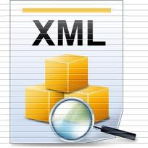
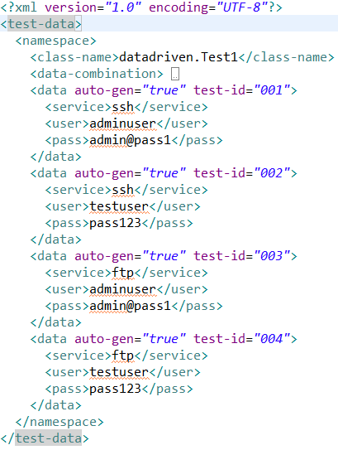
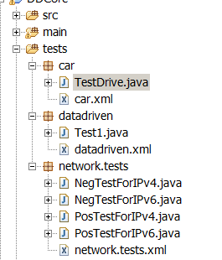
Ex-DD: Data Specification
Ex: “datadriven.Test1”
Data Supplier
Data Sets
Class Name &
Context
Data-1
Data-2
CP File Finder
Data-3
Data-4
Data-n

Slide 9
Ex-DD: Filtering
Filter Chain
TestId Filter
001-005, 010
Version Filter
Above-version = 5
Property Filter
os=linux
Filter-n
-------
Id=001
os=win
version=5
Id=003
os=lin
version=4
Id=006
os=lin
version=5
Id=010
os=lin
version=5
Id=010
os=win
version=5

Slide 10
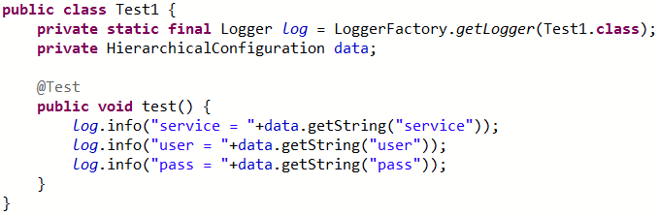
Ex-DD: Consumption
Data Sets
Test Instance Creator
Data-1
Data-2
Data-1
Data-3
Data-4
Data-2
Data-3
Custom
Instance
Creator
Data-5
Data-n
Data-4
Test Harness
(TestNG…)
Data-n

Slide 11
Ex-DD: test-data Generation
Exhaustive
Test | A | B | C
D1 | A1 | B1 | C1
D2 | A1 | B1 | C2
D3 | A1 | B2 | C1
D4 | A1 | B2 | C2
D5 | A1 | B3 | C1
D6 | A1 | B3 | C2
D7 | A2 | B1 | C1
D8 | A2 | B1 | C2
D9 | A2 | B2 | C1
D10 | A2 | B2 | C2
D11 | A2 | B3 | C1
D12 | A2 | B3 | C2
Data Generator
Property | Value-1 | Value-2 | Value-3
A | A1 | A2
B | B1 | B2 | B3
C | C1 | C2
ALL
PAIR
WISE
OA
Notes:
The values say A1, A2, .. Can be a single value, list of key/value pairs or hierarchical structure

Slide 12
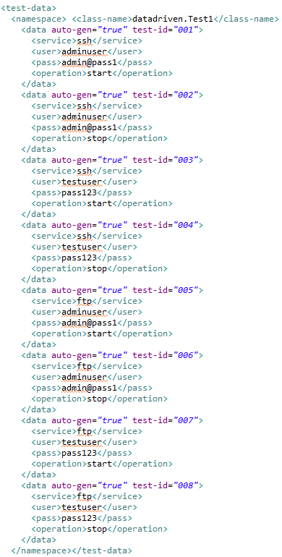
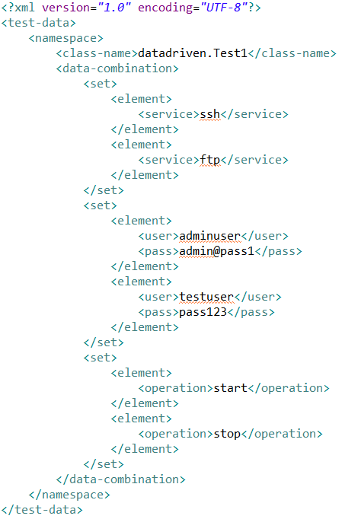
Ex-DD: test-data Generation
XML based data generation
2 x 2 x 2 = 8 combinations
2
Data Generator
ALL
PAIR
WISE
OA
2
2

Slide 13
Ex-DD: test-data Generation
Pair-wise
Property | Value-1 | Value-2 | Value-3
A | A1 | A2
B | B1 | B2 | B3
C | C1 | C2
Data Generator
Test | A | B | C
D1 | A1 | B1 | C1
D2 | A1 | B2 | C2
D3 | A1 | B3 | C1
D4 | A2 | B1 | C2
D5 | A2 | B2 | C1
D6 | A2 | B3 | C2
ALL
PAIR
WISE
OA

Slide 14
Ex-DD: Integration with any framework
Get the extreme-dd.jar and it's dependent jars.
Depending on the framework you use for testing plug the data injector in to the framework.
In case of TestNG we use @Factory to return test instances filled with data.
Start writing tests and data XML's in the same folder and see that everything works as expected.
Data get's injected to a member named ‘data’ in your test which is of type HierarchialConfiguration.

Slide 15
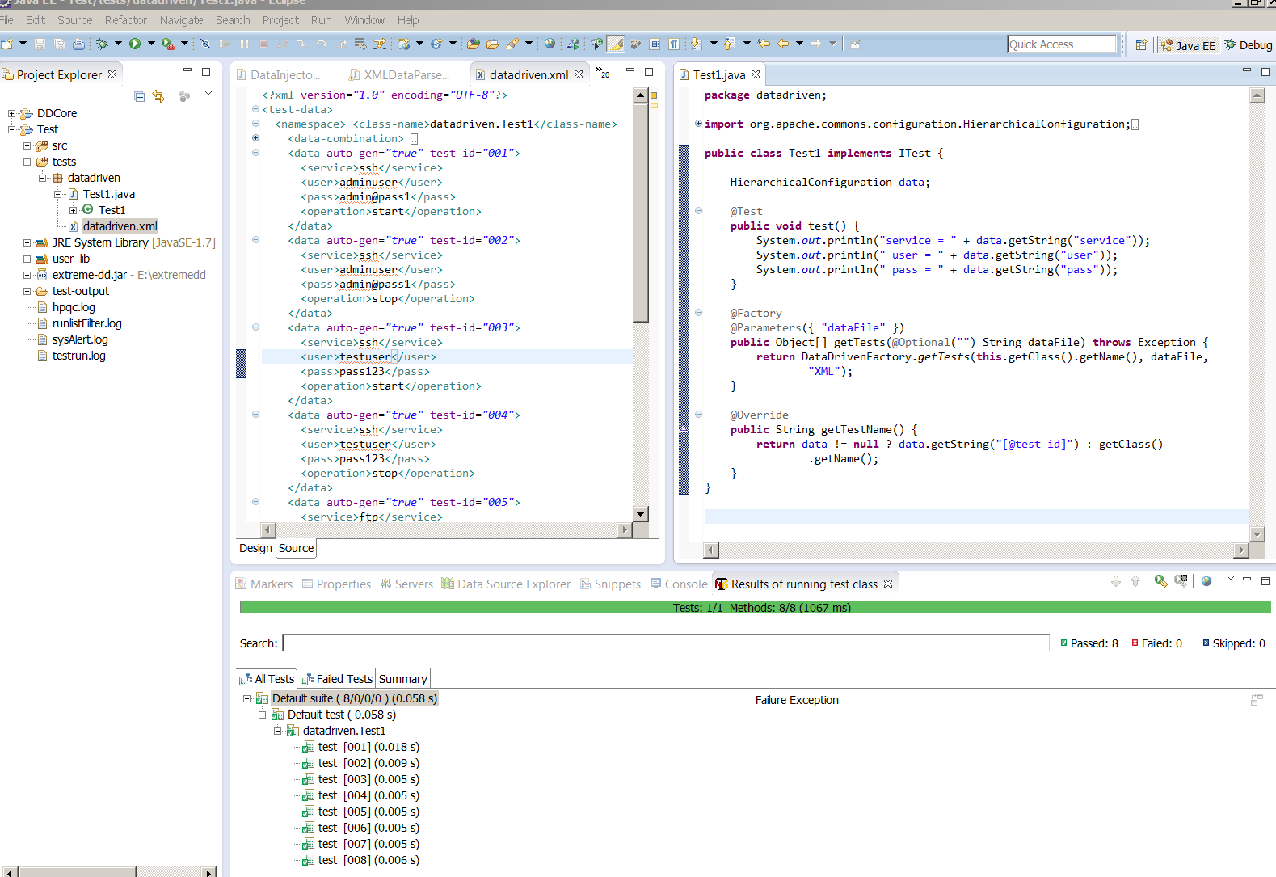
Ex-DD: TestNG

Slide 16
Ex-DD framework Advantages
Automatic data generation: Exhaustive & pairwise
Easy to adopt.
Integrate into any testing framework
Pluggable architecture
More coverage with less tests - pairwise/OA
Additions or deletions of test data is easy and tests can scale without any changes to scripts.
Careful test design with Ex-DD in mind will help to reduce the time and resources required.
Have definite solutions to tester/developer requirements like filtering, combining data, ease of specification
Notes:
Some of the advantages of Extreme data driven framework are
Data generation capability using Exhaustive or pairwise generator.
Easy to adopt as no special expertise is required.
Can be used in conjunction with any Java testing framework.
Can get more coverage with less test-data using pairwise testing.
When data is generated and a new property/value is added the number of combinations increases and this requires no change in tests.
Careful design with Extreme data driven testing in mind will help to reduce number of test scripts and increases efficiency.
Provides filtering capabilities to select specific data to be run. Ex: out of 100 tests I want to run only 10 tests which have failed.

Slide 17
Ex-DD: Advantages of using XML for test-data
No hardcoding of data file location in tests / any place.
We can utilize the flexibility of XML to source any data to tests.
Data is available along with tests so that test developer or anyone can easily see and understand the scenarios.
No single point of failure, no DB/NFS dependencies, Just plain XMLs.
We see the history of data over a period of time as test-data is under the same source code control as tests.

Slide 18
Ex-DD: Future Directions
Add more data generation capabilities like OA, sampling, etc.
Enable priority based data generation.
Data injection using Annotations to tests.
Enable linking of XML files for better sharing of data across packages.

Slide 19
Case Study
VM Migration in vSphere.
Matrix from v4.0 to v5.1
Migration of VM's in a virtualization environment is common and testing it with different scenarios is very crucial.
We have adopted extreme data driven approach to this and have saved considerable amount of time and could FC new feature's in less time.
Notes:
* We need to record demo.

Slide 20
Demo
3 tests with 3 combinations for migration tests?

Slide 21
Q & A

Slide 22
Thank you

