Slide 1

Weather Forecasting System
Predicting Daily Temperature Using Historical Climate Data
NAME: K.Sathish
REG NO: 323129510026
A machine learning–driven platform that transforms historical climate records into accurate, actionable daily temperature forecasts for agriculture, disaster management, and environmental research.

Slide 2
Why Accurate Weather Forecasting Matters
Agriculture
Transportation
Disaster Management
Optimizes planting, irrigation, and harvest scheduling to protect crop yields.
Enables route planning and logistics decisions to reduce weather-related disruptions.
Provides early warnings for extreme events, reducing casualties and economic losses.
Environmental Monitoring
Daily Planning
Tracks climate trends and ecosystem changes for long-term sustainability planning.
Supports individuals and businesses in scheduling outdoor activities and operations.

Slide 3

Limitations of Traditional Forecasting Methods
Where Conventional Approaches Fall Short
Spatial Resolution Gaps
Global models fail to capture hyper-local microclimate variations at neighborhood scale.
Data Volume Challenges
Manual analysis cannot process the terabytes of real-time sensor data generated daily.
Static Model Assumptions
Traditional numerical weather prediction (NWP) relies on fixed physical equations that struggle with rapidly changing conditions.
Delayed Updates
Forecast cycles are slow to incorporate new observations, reducing short-term accuracy.

Slide 4

ML-POWERED SOLUTION
Machine Learning–Driven Temperature Prediction
The system ingests multi-year historical climate records and applies supervised regression algorithms to forecast daily temperature with high precision.
Data Collection
Preprocessing
Model Training
Temperature Prediction
Key input features include historical temperature, humidity, rainfall, wind speed, atmospheric pressure, and seasonal indicators — enabling the model to learn complex, non-linear climate patterns over time.

Slide 5
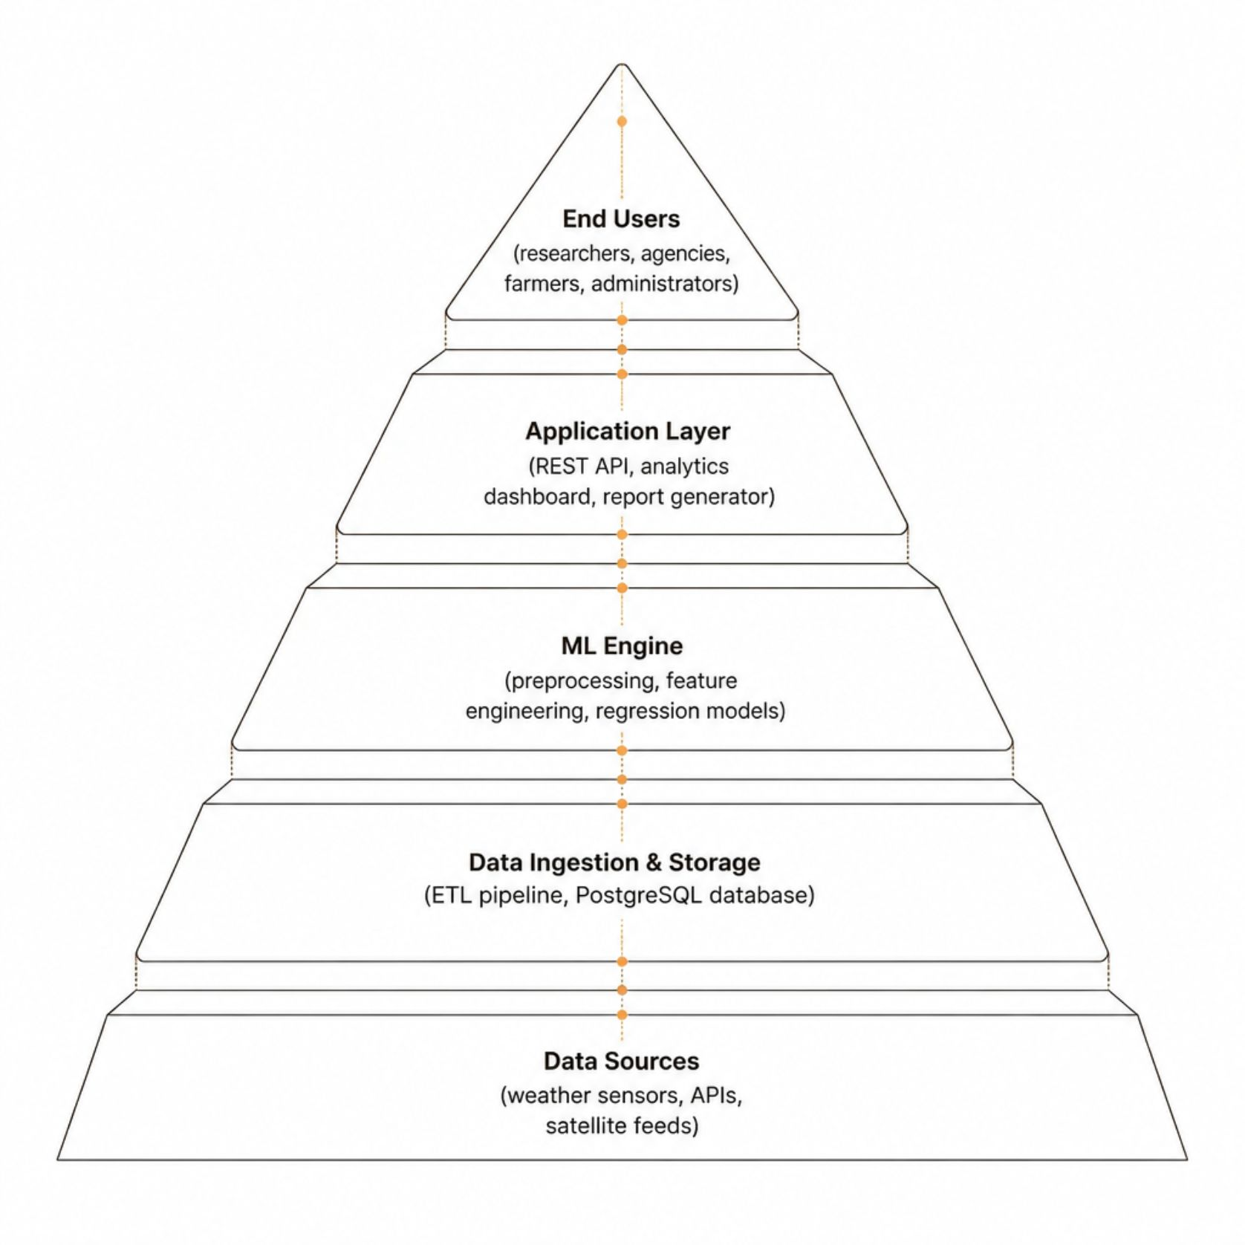

System Architecture & Workflow
End-to-End Data Flow
Raw climate data flows from heterogeneous sources through a standardized ETL pipeline, is stored in a relational database, processed by the ML engine, and delivered via a secure API to authenticated users through an interactive dashboard.
The architecture supports real-time batch updates and incremental model retraining to maintain forecast accuracy as new data arrives.

Slide 6

Data Pipeline, Preprocessing & Feature Engineering
Ingest Raw Data
Impute Missing
Detect Outliers
Normalize & Scale
Each stage transforms raw climate observations into a clean, model-ready dataset optimized for regression training.
Engineered Features
Dataset Overview
Temporal Features
Lag Features
Parameter
Source
Day-of-year, month, season indicators, and holiday flags.
T-1, T-7, and T-30 day temperature and humidity values.
Temperature (°C)
Weather Station
Humidity (%)
Sensor Network
Rainfall (mm)
Radar / Gauge
Rolling Statistics
Wind Speed (m/s)
Anemometer
7-day and 30-day moving averages for trend capture.
Pressure (hPa)
Barometer
Solar Radiation
Satellite

Slide 7
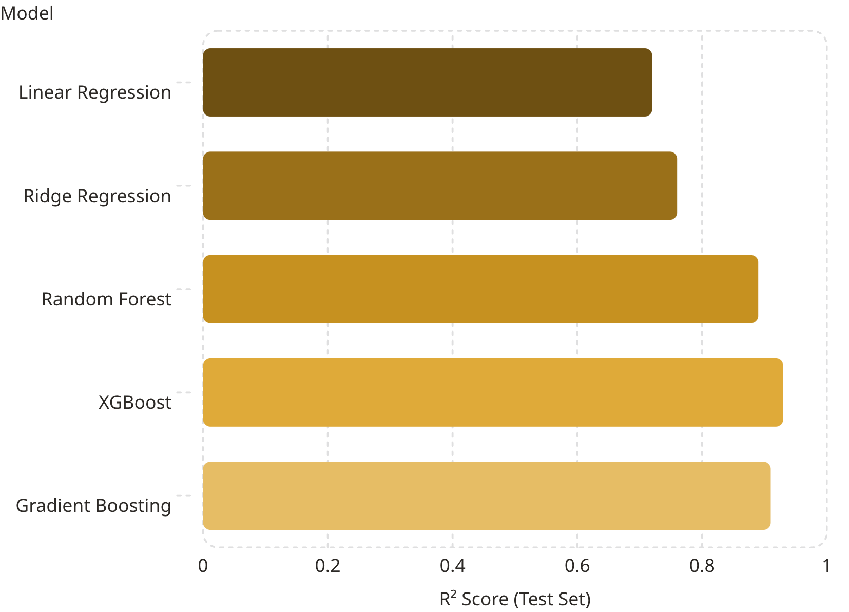
Regression Algorithms & Model Training
Algorithm Comparison
Ensemble methods consistently outperform linear models on temperature prediction tasks. XGBoost achieves the highest R² (0.93) by capturing non-linear interactions between climate variables.
Training Strategy
Hyperparameter Tuning
Feature Importance
80/20 train-test split with 5-fold cross-validation to prevent overfitting.
GridSearchCV optimizes tree depth, learning rate, and regularization parameters.
Historical temperature and humidity rank highest; seasonal encoding adds significant signal.

Slide 8
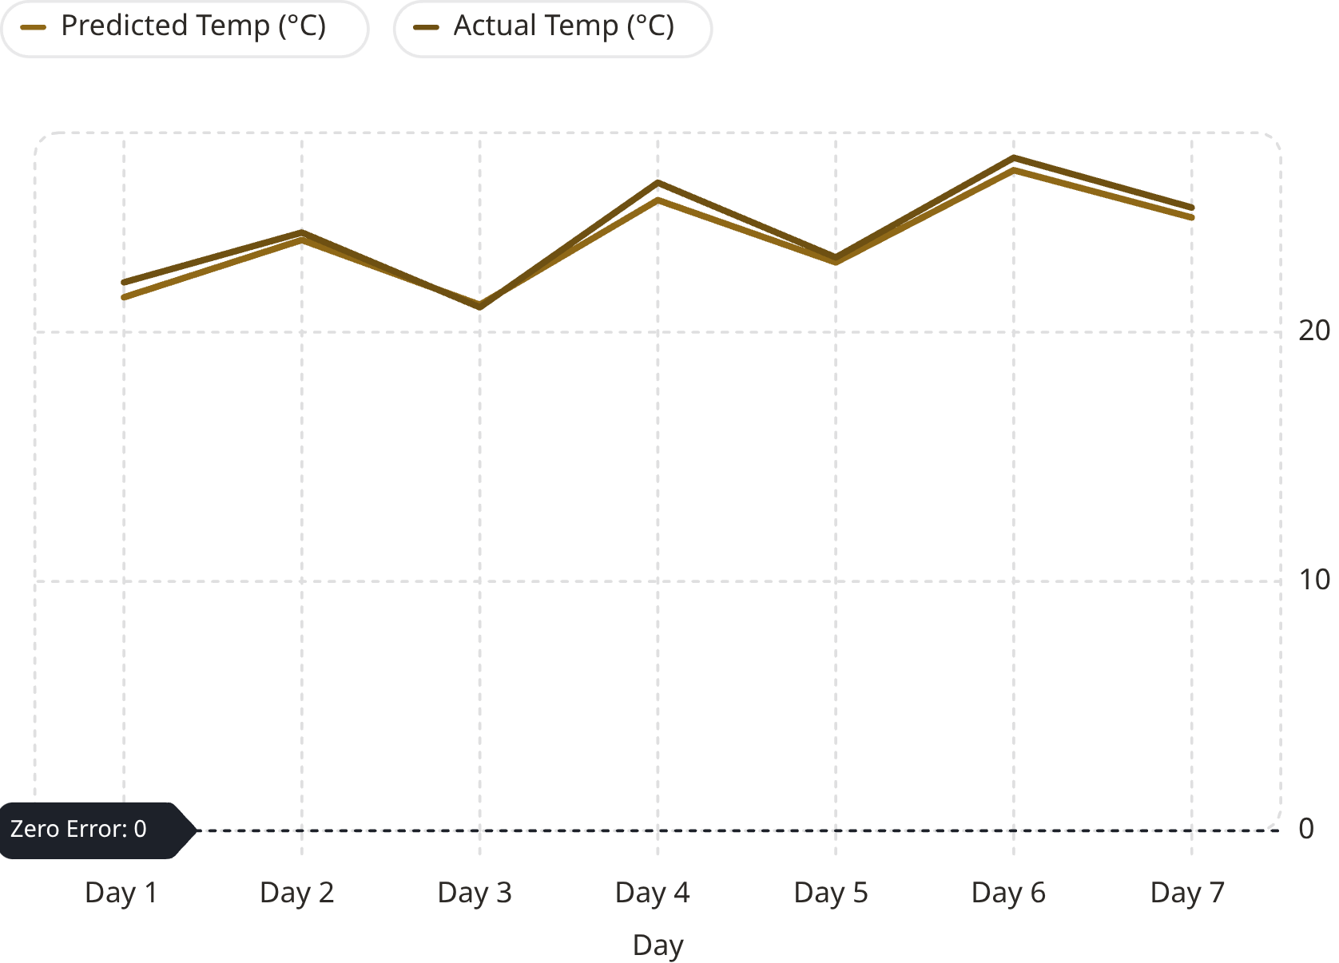
Evaluation Metrics & Prediction Results
0.93
1.2°C
R² Score
MAE
Variance explained by XGBoost on held-out test data.
Mean Absolute Error — average prediction deviation.
1.8°C
98%
RMSE
Uptime
Root Mean Squared Error penalizing larger outliers.
System availability for real-time forecast generation.
Predicted vs. Actual Temperature
The 7-day forecast closely tracks actual temperature readings, with minor deviations during rapid weather transitions. Error residuals are normally distributed, confirming model reliability.

Slide 9

User Roles & Functional Modules
Researchers
Access raw datasets, run custom analyses, export reports, and monitor model performance metrics.
Meteorological Agencies
Manage data ingestion pipelines, validate forecasts, and publish official weather bulletins.
End Users (Farmers, Public)
View daily temperature forecasts, seasonal trends, and receive automated alerts via dashboard or API.
Administrators
Manage user authentication, role-based access control, system configuration, and security audits.

Slide 10

Technologies, Outcomes & Future Roadmap
Implementation Stack
Expected Outcomes & Future Enhancements
Immediate: Deployable temperature forecast API with ≤1.5°C MAE accuracy.
Short-term: Integrate precipitation and wind speed prediction modules.
Medium-term: Incorporate deep learning (LSTM, Transformers) for multi-day forecasts.
Long-term: Expand to smart city platforms, IoT sensor networks, and climate change modeling.
Backend
Database
Python, Flask/FastAPI, Scikit-learn, XGBoost
PostgreSQL, Redis (caching)
Frontend
Infrastructure
React.js, D3.js, Chart.js
Docker, AWS/GCP, CI/CD pipelines
Real-world deployment targets include national meteorological services, agri-tech platforms, and disaster response agencies.

