Slide 1
Digital Portfolio
STUDENT NAME: Sathish.G
REGISTER NO AND NMID:2426j1561&asbruaz2426j1561
DEPARTMENT: B.SC.Information Technology
COLLEGE:KPR College Of Arts Science And Reasearch /Bharathiyar University

Slide 2
PROJECT TITLE
Photography&Videography Portfolio

Slide 3


AGENDA
Problem Statement
Project Overview
End Users
Tools and Technologies
Portfolio design and Layout
Features and Functionality
Results and Screenshots
Conclusion
Github Link
3/21/2024 Annual Review

Slide 4

PROBLEM STATEMENT
Photographers and videographers often struggle to effectively showcase their work in a professional and engaging manner.
Traditional resumes or static portfolios fail to highlight the visual creativity, storytelling skills, and technical expertise required in this field.
Without a well-structured digital portfolio, talented creators may find it difficult to:
Display high-quality photos and videos in an organized way.
Attract potential clients, collaborators, or employers.
Build a strong personal brand that reflects their artistic style.
Provide easy access to their contact details and services.
Therefore, there is a need for a dedicated photography & videography portfolio website that can present their creative work dynamically, enhance online visibility, and serve as a professional platform for career opportunities.

Slide 5

PROJECT OVERVIEW
The Photography & Videography Portfolio Website is designed to provide a professional online platform for creative artists to showcase their work. The website will feature a visually appealing gallery to display photos and videos, organized by categories such as events, portraits, products, or films.
It will include sections like About Me, Services, Projects, and Contact, allowing photographers and videographers to present their skills, achievements, and client offerings in a structured way. The project aims to highlight creativity while ensuring easy navigation, mobile responsiveness, and high-quality media display.
Ultimately, this portfolio will help creators build their personal brand, attract potential clients, and demonstrate expertise in photography and videography.

Slide 6

WHO ARE THE END USERS?
Potential Clients – Individuals or businesses looking to hire photographers/videographers for events, products, weddings, advertisements, etc.
Recruiters/Employers – Media companies, studios, and creative agencies searching for talented professionals.
Collaborators – Other artists, filmmakers, editors, or content creators interested in partnerships.
General Audience – People exploring photography and videography work for inspiration or appreciation.
Personal Network – Friends, family, and peers who want to view or recommend the creator’s work.

Slide 7
TOOLS AND TECHNIQUES
Programming Languages – HTML, CSS, JavaScript (for structure, styling, and interactivity).
Frameworks/Libraries – Bootstrap or Tailwind CSS (for responsive design), React.js (for dynamic UI).
Database (if needed) – MySQL / MongoDB (to store client info, contact forms, or project details).
Version Control – Git & GitHub (to manage and track code changes).
Development Environment – VS Code (for coding and testing).
Deployment Platforms – Netlify, GitHub Pages, or Vercel (to host the portfolio online).
Media Tools – Adobe Photoshop, Lightroom, Premiere Pro, After Effects (to edit and optimize photos/videos).

Slide 8
POTFOLIO DESIGN AND LAYOUT
Homepage (Showcase Banner) – A striking fullscreen image or video reel that instantly reflects the photographer/videographer’s style.
About Me Section – A short introduction with profile photo, creative background, and artistic vision.
Gallery/Portfolio Section – Categorized albums (e.g., Weddings, Portraits, Products, Films) with interactive lightbox or video playback.
Services Section – Clear list of services offered (event photography, product shoots, video editing, etc.).
Projects/Clients Section – Featured works with descriptions, behind-the-scenes, or client testimonials.
Contact Section – Contact form, social media links, and email for quick communication.
Responsive Layout – Mobile-friendly design with smooth navigation and fast-loading media.
8

Slide 9
FEATURES AND FUNCTIONALITY
High-Quality Gallery Display – Photos and videos showcased in a clean, responsive grid or slideshow.
Category-wise Portfolio – Work organized into sections (e.g., Weddings, Portraits, Commercials, Short Films).
Interactive Media Viewer – Lightbox for photos, video playback, zoom, and full-screen options.
About Section – Creative background, style, and professional journey.
Services Offered – Details of photography/videography packages and pricing (optional).
Client Testimonials – Feedback from past clients to build trust.
Contact & Booking Form – Easy way for clients to inquire or book services.
Social Media Integration – Links or embedded Instagram/YouTube feeds.
Responsive & Fast Loading – Optimized for mobile devices with compressed media for smooth performance.

Slide 10
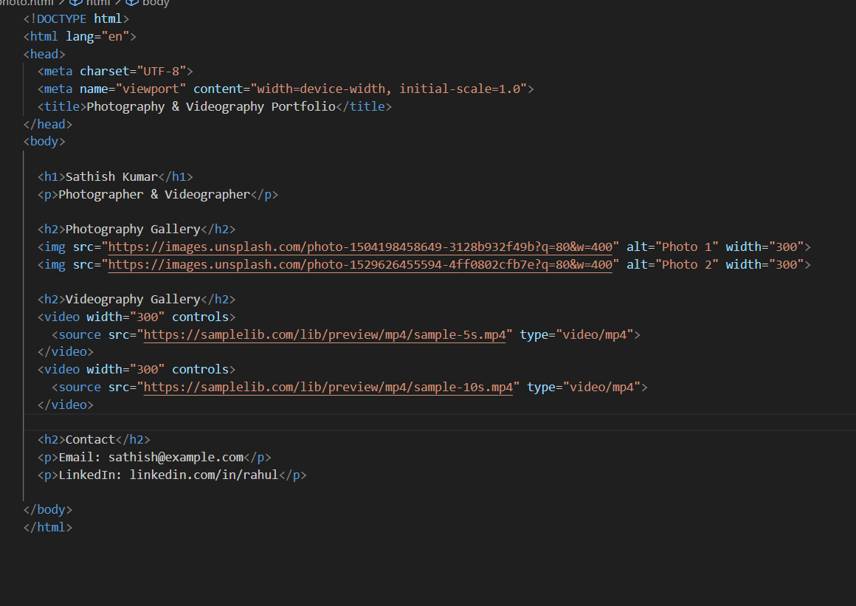
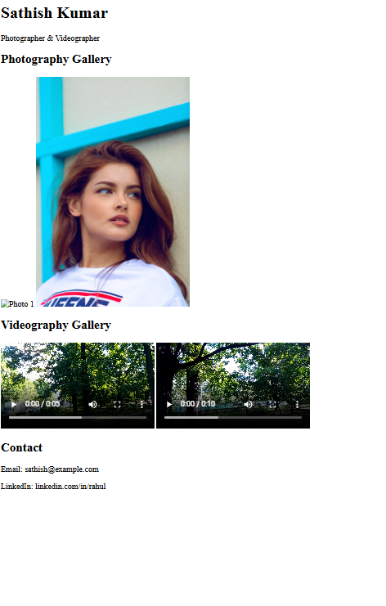
RESULTS AND SCREENSHOTS
3/21/2024 Annual Review
10

Slide 11
CONCLUSION
The Photography & Videography Portfolio Website provides a professional platform to showcase creative work effectively. It allows photographers and videographers to present high-quality images and videos, highlight their skills, and organize projects in a visually appealing way. By offering an accessible and interactive portfolio, it helps attract potential clients, collaborators, and employers, while strengthening personal branding and online presence.
11

