Slide 1
Discovering Non-Redundant K-means Clusterings in Optimal Subspaces
Dominik Mautz, Wei Ye, Claudia Plant, Christian Böhm
Rahul Alapati
Sathish Akula
Aditya Mahajan

Slide 2
Roadmap
Introduction
Problem Definition
Dataset Description
Algorithm Overview
Implementation Details
Experiments and Results
Future Work

Slide 3
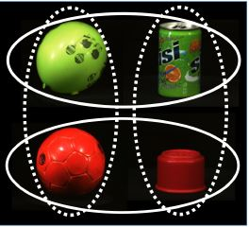
Introduction
Clustering is the task of grouping a set of objects having similar properties.
It is widely used in Machine learning, Data Mining, Pattern Recognition and Image Analysis.
A huge object collection in high-dimensional space can often be clustered in more than one way.

Slide 4
Challenges
Curse of dimensionality: Number of data points become increasingly sparse as dimensionality increases.
Distance between points become relatively uniform.
Given a large number of attributes some of the attributes will usually not be meaningful for a given cluster.
Given a large number of attributes, it is likely that some attributes are correlated. Hence, clusters might exist in arbitrarily oriented subspaces.

Slide 5
Non-Redundant K-means
NR-KMEANS discovers multiple, non-redundant k-means clusterings in orthogonal subspaces.
It is efficient.
Single input parameter: number of clusters.
Use of noise handling to outperform existing methods.

Slide 6
Datasets
Special Non redundant datasets consisting of more than one set of class labels:
Amsterdam Library of Object Images (ALOI) dataset – 288 data points and 611 dimensions.
Stickfigures dataset – 900 data points and 400 dimensions.
Fruits dataset – 105 data points and 6 dimensions.
Syn3Sub dataset – 2000 data points and 15 dimensions.
Datasets from UCI repository with single set of class labels:
Spam dataset – 4601 data points and 56 dimensions.
Shuttle dataset – 43500 data points and 9 dimensions.

Slide 7

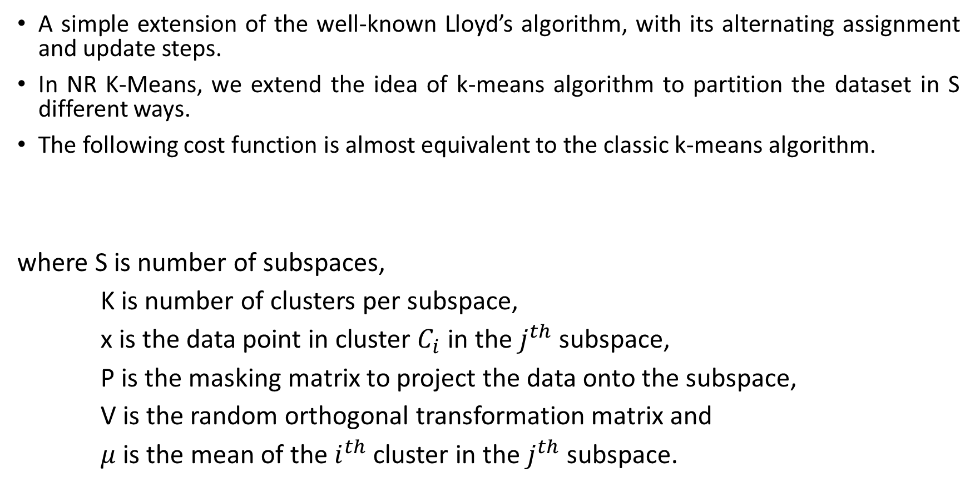
NR K-Means Algorithm
A simple extension of the well-known Lloyd’s algorithm, with its alternating assignment and update steps.
In NR K-Means, we extend the idea of k-means algorithm to partition the dataset in S different ways.
The following cost function is almost equivalent to the classic k-means algorithm.
where S is number of subspaces,
K is number of clusters per subspace,
x is the data point in cluster $C_{i}$ in the $j^{th}$ subspace,
P is the masking matrix to project the data onto the subspace,
V is the random orthogonal transformation matrix and
$μ$ is the mean of the $i^{th}$ cluster in the $j^{th}$ subspace.

Slide 8
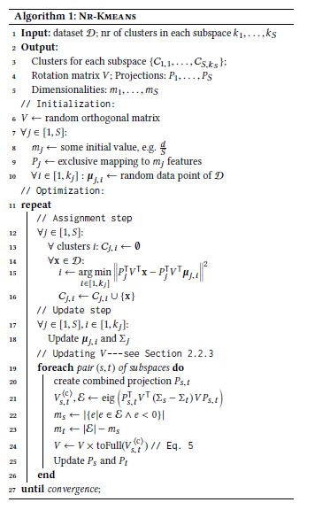

Slide 9
Challenges in Implementation
Information about the subspaces and clusters in the datasets is not explained in detail.
Optimization algorithm doesn’t discuss the nitty-gritties in detail.
Methods used for qualitative interpretation of clustering results are not discussed in the paper.

Slide 10
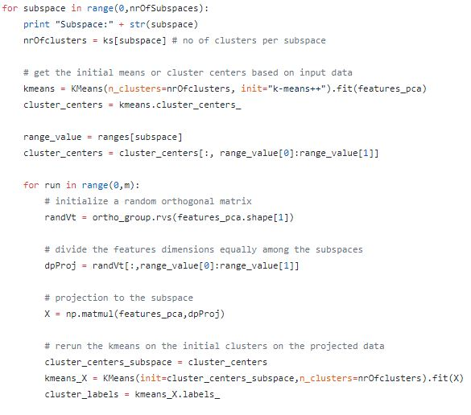
Code Snippets: Implemented in Python

Slide 11
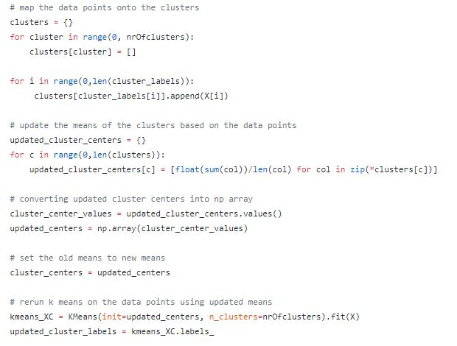

Slide 12
Evaluation Measures
Pair Counting F1-measure is used to account for multiple sets of class labels on the ground truth side, as well as for multiple sets of clusterings per subspace as a result of the algorithms.
The best achievable value is 1.
Average Variation of Information is used to measure the redundancy among the subspaces.
It measures the distance between two different clusterings, where higher values are better.

Slide 13
Experiments
We perform an effectiveness test and an efficiency test of our algorithm on the ALOI and Stickfigures datasets.
The ALOI dataset consists of 288 data points and 611 features. It has 2 subspaces with 2 clusters per subspace each.
The Stickfigures dataset consists of 900 data points and 400 features. It has 2 subspaces with 3 clusters per subspace each.
As a part of the effectiveness test, we report the Pair Computing F1- Measure and the average Variation of Information.
As a part of the efficiency test, we measure the running time of our algorithm in seconds on different datasets.

Slide 14
Experiments (cont.)
We have performed both the tests on full dimensional datasets as well as PCA applied datasets.
The Principal Component Analysis has been used to reduce the dimensionality of the ALOI dataset from 611 to 8 and Stickfigures dataset from 400 to 5, while keeping 90% of the total variance.
The performance of our NR-KMEANS algorithm on the ALOI and Stickfigures datasets both in full and reduced dimensionalities is compared with the original NR-KMEANS algorithm.

Slide 15
Results
Effectiveness Test
Reporting Pairwise Counting F1-Measure
Algorithm | ALOI | Stickfigures
NR-KMEANS | 0.93 | 0.97
Original NR-KMEANS | 0.77 | 1.00
Algorithm | ALOI (PCA = 8) | Stickfigures (PCA = 5)
NR-KMEANS | 0.64 | 0.68
Original NR-KMEANS | 1.00 | 1.00

Slide 16
Results
Effectiveness Test
Reporting Average Variation of Information
Algorithm | ALOI | Stickfigures
NR-KMEANS | 0.33 | 0.52
Original NR-KMEANS | 0.95 | 2.20
Algorithm | ALOI (PCA = 8) | Stickfigures (PCA = 5)
NR-KMEANS | 0.63 | 0.85
Original NR-KMEANS | 1.39 | 2.20

Slide 17
Results
Efficiency Test
Reporting Running Time (in seconds)
Algorithm | ALOI | Stickfigures
NR-KMEANS | 3480 | 1800
Algorithm | ALOI (PCA = 8) | Stickfigures (PCA = 5)
NR-KMEANS | 30 | 30

Slide 18
Observations
The original NR-KMEANS reports higher pairwise computing F1-measure and average variation of information on both the datasets in full and reduced dimensionalities.
This difference in performance between our NR-KMEANS and the original can be attributed to the fact that our NR-KMEANS doesn’t optimize random orthogonal transformation matrix V by combining the subspaces.
The original NR-KMEANS has better time complexity when compared to our implementation, because the original was implemented in SCALA, which is by default a Scalable Language.

Slide 19
Future Work
The main objective of the assignment step of the NR-KMEANS algorithm is to minimize the cost function. However, with each step as the cost function decreases, the NR-KMEANS tends to converge towards a local minima. This can be rectified to converge at a global minima.
Future efforts may be directed towards the incorporation of a fully-automated selection procedure for the number of subspaces and clusters within them.
We can also explore the possibility of the use of other clustering algorithms like hierarchical clustering, etc. or even a combination of effective clustering algorithms to cluster high dimensional data.

Slide 20


