Slide 1
Introduction To Testing

Slide 2
What is Software?
Software is a set of programs written by a programmer.
A program is a set of instructions written in a particular language.
An instruction is a means of communication between a user and a computer.

Slide 3
Types of Software
There are 2 types of software. System Software and Application Software.
System software manages a computer system and provides a service to the end user.
Ex: Operating System like Windows.
Application Software runs on top of a System software and allows the user to do some tasks.
Ex: WindowsMediaPlayer(plays movies). Calculator, Notepad, Excel etc.,.

Slide 4
What is Testing?
Testing is the process of executing a program with an intention of finding a defect.
Testing is a dynamic activity, a negative exercise with a positive intent.
It helps to find what is wrong with a particular program/software.
It helps to deliver a defect-free/quality product to the customer.

Slide 5
Software Usage
Software is all pervasive. It is in computers, mobiles, tablets, pacemakers, missiles, automobiles etc.,.
This ever pervading nature of the software is putting tremendous pressure on the developers to make the product error-free.
We cannot have a situation like : “ 2 missiles misfired and hit the wrong target out of the 10 launched”.
Or like, “there are 2 wrong landings of flights this month out of the 1000 landings”.

Slide 6
Software errors have disastrous consequences.
That’s why Testing should enable us to find defects as earlier as possible before the customers find them out.
Once the product is out in the market, it is out of the development team’s control.
The product is used/misused in many ways that are unimaginable.
Our(dev team) job is to make sure that in spite of all the abuse and misuse, software works correctly.

Slide 7
Purpose of Testing
The purpose/objective of testing is to
Identify defects.
Make sure the product satisfies the requirements of a customer.
Ensure the product is defect-free.
Improve the quality of the software.
Get repeated customers.

Slide 8
What is Defect?
A Defect is any variation from the product specification.
Any error in the software that effects the normal functioning of a software product.
Anything that is not user friendly.
Anything that doesn’t satisfy an end-user or a customer.

Slide 9
Why Do Defects Occur?
Defects occur due to many reasons :
Unclear requirements.(Requirements are captured in a requirements document by the Business Analyst).
Lack of propagation of the requirements among the development team.
Wrong testing practices.

Slide 10
4 Case Studies
Case 1 : Wrong/Unclear requirements :
BA(Business Analyst) captures the wrong/incorrect requirements.
The Designers/Software Architects prepare the design as per this wrong requirements.
The developers/programmers make the wrong code.
Testers test and qualify the product for release.
Wrong product reaches the customer.
Negative feedback from the customer, loss of Business.

Slide 11
Case 2: Correct Requirements:
The BA captures the requirements correctly.
The Design Team misinterprets them and prepare the wrong design.
The Developers make the wrong product.
Testers test and qualify the product.
Wrong product reaches the customer that doesn’t meet his/her requirements.
Negative feedback from the customer, loss of business for the vendor.

Slide 12
Case 3: Correct Requirements:
The BA captures the requirements correctly.
The Design Team interprets them correctly and prepare the correct design.
The Developers understand the design wrongly and make the wrong product.
Testers test and qualify the product.
Wrong product reaches the customer that doesn’t meet his/her requirements.
Negative feedback from the customer, loss of business for the vendor.

Slide 13
Case 4: Correct Requirements:
The BA captures the requirements correctly.
The Design Team interprets them correctly and prepare the correct design.
The Developers understand the design correctly and make the right product.
Testers miss the critical functionality and end up doing the wrong kind of testing.
Product reaches the customer with lot of defects.
Negative feedback from the customer, loss of business for the vendor.

Slide 14
Case 5: Correct Requirements:
The BA captures the requirements correctly.
The Design Team interprets them correctly and prepare the correct design.
The Developers understand the design correctly and make the right product.
Testers test and qualify the product.
Correct/Right product reaches the customer that meets his/her requirements.
Positive feedback from the customer, and thereby, repeated business.

Slide 15
Testing cannot make a bad product into a good product.
Testing can only show the presence of defects, not absence of them.
So, we can conclude that it is the responsibility of the entire Development team to produce the right product.
Quality is a shared responsibility.

Slide 16
Testing Vs Other Phases
Poor upstream activities implies heavy dependency on testing (High Rework Cost) | Ideal Right Balance, Promotes Teamwork, Delivers Quality
(Not Sustainable)Poor Quality of Software since poor upstream activities and poor testing | Risky . May lead to unexpected defects due to poor testing.

Slide 17
Who Should Test?
Anybody who is involved in the product development can test.
Software is man-made.
Anything that is man made is prone to errors.
Developers cannot test their own programs.
Only trained testers can do that.
So, for the sake of consistency and accountability, only professionally trained testers should test.

Slide 18
Test Process
Test and Identify the defects.
Report the defects.
Get the defects fixed.
Retest the fixes.
Close the defects.

Slide 19
Qualities of a Good Tester
Should be skilful.
Should come from a programming background(optional).
Should be diplomatic.
Should be good communicator.
Should have a test to fail attitude.

Slide 20
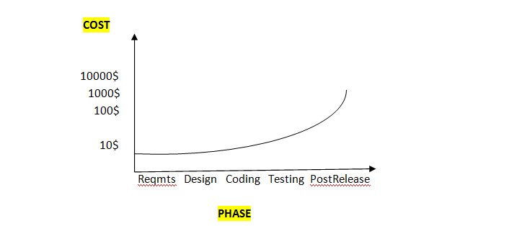
Cost of Quality

Slide 21
Cost of Quality
Cost of Quality is the amount of time , effort and money needed to fix a defect.
As we saw in the above picture, the earlier the defect is identified and fixed, the less is the cost of quality.
So to achieve this, let testing be an upfront/upstream activity rather than a downstream one.
Testers should be involved from the beginning of the lifecycle.

Slide 22
When To Start Testing?
When the product comes to testing.
Before the product is released.
When the customer reports a problem.

Slide 23
What are needed for Testing?
Resources like people, machines, software and time.
Programs that were developed professionally.
Automation tools if necessary.

Slide 24
When To Stop Testing?
When the product is defect-free.
When the customer is satisfied.
When the project reaches a deadline.
When there is a resource crunch.
When the product is full of bugs.

Slide 25
Fundamentals
The goal of testing is to find defects before the customer finds them out.
Exhaustive testing is not possible; program testing can only show the presence of defects, not absence of defects.
Testing applies thru all the phases of software life cycle and is not an end-of-cycle activity.
Understand the reason behind the test.
Test the tests first.

Slide 26
Tests develop immunity and have to be revised constantly.(Pesticide Paradox).
Defects occur in clusters and testing should focus on that clusters.
Testing encompasses defect prevention.
Testing is a fine balance between defect prevention and defect detection.
Intelligent and well planned automation is the key to realizing the benefits of testing.
Testing requires talented, committed people who believe in themselves and work in teams.

