Slide 1
SDLC
Software development life cycle in systems engineering, information systems and software engineering, is a process of creating or altering information systems, and the models and methodologies that people use to develop these systems.

Slide 2
3 P’s Of Software
People
Process Product/Project

Slide 3
Phases of Software Project
A software project is made up of a series of phases. Broadly, most projects comprise the following phases:
Requirements gathering and analysis.
Planning.
Design.
Development or coding.
Testing.
Deployment and Maintenance.

Slide 4
Process Model
A process model is a way to represent any given phase of software development.
Entry criteria, which specify when that phase can be started. Also included are the inputs for the phase.
Tasks or steps that need to be carried out in that phase, along with measurements that characterize the tasks.
Verification, which specifies methods of checking that the tasks have been carried out correctly.
Exit criteria, which stipulate the conditions under which one can consider the phase as done. Also included are the outputs for only the phase.

Slide 5
This model, known as the Entry, Task, Verification eXit or ETVX model, offers several advantages for effective verification and validation.

Slide 6
Clear entry criteria make sure that a given phase does not start prematurely.
The verification for each phase helps prevent defects, or at least, minimizes the time delay between defect injection and defect detection.
Documentation of the detailed tasks that comprise each phase reduces the ambiguity in interpretation of the instructions and thus minimizes the variations that can come from repeated executions of these tasks by different individuals.
Clear Exit Criteria provide a means of validation of the phase, after the phase is done but before handing over to the next phase.

Slide 7
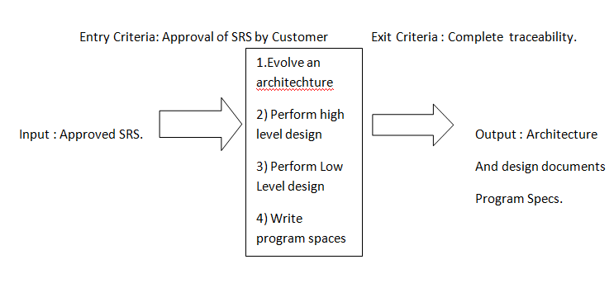
ETVX model

Slide 8
SDLC Work Flow

Slide 9
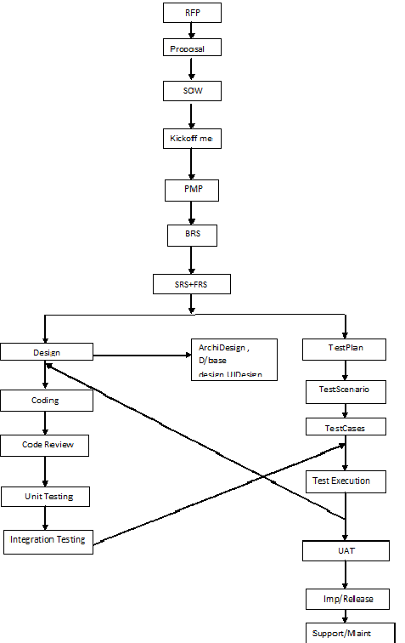

Slide 10
RFP : Request for Proposal.
Client will distribute the RFP to vendors(S/W companies)
Companies will respond to RFP with their proposals.
Proposal:
Proposal contains Technical Solutions, Cost, Delivery Schedule, Timeline, Deliverables etc..

Slide 11
SOW:
If Client likes the proposals from any vendor, then they will sign the Statement of Work(SOW) with the client.
Kick-Off Meeting:
Client will conduct the kick off meeting with the vendor and explains the expectations.
PMP:
Once the Proj Manager got identified then he/she will prepare the Project Management Plan.

Slide 12
BRS: Business Requirement Specification
After high level meeting with the customer they will release business requirements specification.
BRS is a high-level document containing project requirements from customer.

Slide 13
SRS
A Business Analyst will convert the BRS into the SRS.
Identify the standards, guidelines, checklist and templates required for the project.
Review SRS for
Consistency – functional points
Correctness – should be correct in all respects
Completeness – no requirement should be left.
Testability – eligible for testing or not.
Approved SRS is baseline.(SRS1.0)—make pdf.

Slide 14
Development
Based on the approved SRS software architect or Team Lead will design the model of the project(prototype).
Model contains:
Architectural Design
Database Design
UI Design
All UML diagrams

Slide 15
Use Case Diagrams
Class Diagrams
Object Diagrams
Sequence diagrams
Collaborative diagrams.
Review and approval of the design documents.
Also baseline the design.

Slide 16
QA & Testing
Test Manager will study the approved SRS and prepares the Test Plan for the project.
Review and approval of the Test Plan.
Based on the SRS and Design documents test engineers are going to identify the required Test Scenarios for the project.
Review and approval of the test scenarios

Slide 17
Test Engineers are going to prepare the Test Cases for all approved Scenarios.
Review and approval of Test Cases.

Slide 18
Development
Developers are going to convert the logic specified in design documents
Performs code review.
Once a particular unit of code is reviewed, performs unit testing.
Once unit testing is approved, developers will integrate the units and release the build for testing.

Slide 19
Testing
Perform integration testing
Once integration testing is done and approved, perform system testing.
Bugs will be reported to the dev team.

Slide 20
Bug fixing
The developers will analyze the bugs and then fix the bugs according to the priority of the bugs.
Once the bugs are fixed, they will report them back to the testing team.

Slide 21
Testing
Perform retesting and regression testing
Once the system testing is approved then the application will be released for UAT.
UAT will be performed.
Once UAT is approved, release the application for production/real time environment.
Provide support to the customer for any problems/issues for any future enhancements.

Slide 22
SDLC Models

Slide 23
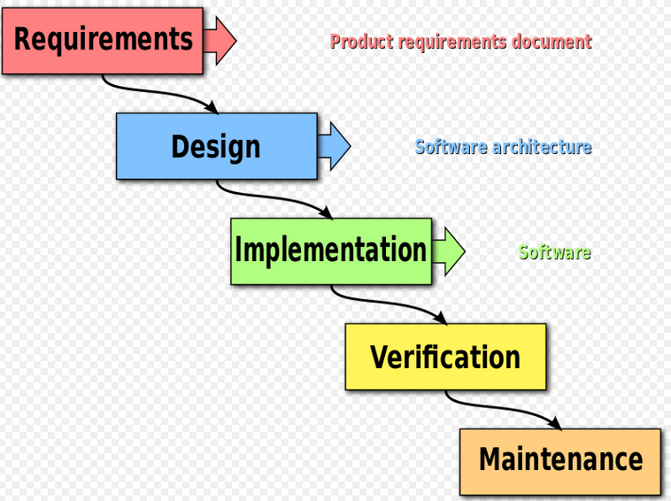
Waterfall Model

Slide 24
The waterfall model is a sequential design process.
Progress is seen as flowing steadily downwards (like a waterfall) through the phases of Conception, Initiation, Analysis, Design, Construction, Testing, Production/Implementation and Maintenance.

Slide 25
Thus the waterfall model maintains that one should move to a phase only when its preceding phase is completed and perfected.
Its approach is simple and very easy to follow.
Suited to software projects that are stable (especially those projects with unchanging requirements, such as with shrink wrap software) and where it is possible and likely that designers will be able to fully predict problem areas of the system and produce a correct design before implementation is started

Slide 26
Disadvantages of W/F model
Requirements are not always clear. They keep changing with time. Not suitable for projects that have changing requirements.
Testing only comes at the end of the lifecycle.
Something goes wrong in a particular phase we can go back to only one level higher.
Lot of idle time for resources.

Slide 27
RAD Model
RAD approaches to software development put less emphasis on planning tasks and more emphasis on development.
In contrast to the waterfall model, which emphasizes rigorous specification and planning, RAD approaches emphasize the necessity of adjusting requirements in reaction to knowledge gained as the project progresses.

Slide 28
This causes RAD to use prototypes in addition to or even sometimes in place of design specifications.
RAD approaches also emphasize a flexible process that can adapt as the project evolves rather than rigorously defining specifications and plans correctly from the start.

Slide 29
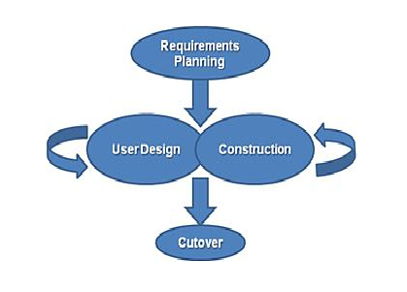

Slide 30
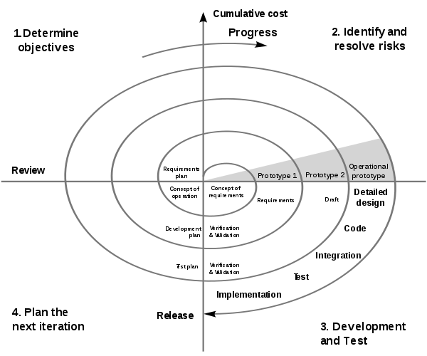
Spiral Model

Slide 31
The spiral model combines the idea of iterative development (prototyping) with the systematic, controlled aspects of the waterfall model.
It allows for incremental releases of the product, or incremental refinement through each time around the spiral.
The spiral model also explicitly includes risk management within software development.

Slide 32
The spiral model is based on continuous refinement of key products for requirements definition and analysis, system and software design, and implementation (the code).
At each iteration around the cycle, the products are extensions of an earlier product.
This model uses many of the same phases as the waterfall model, in essentially the same order, separated by planning, risk assessment, and the building of prototypes and simulations.

Slide 33
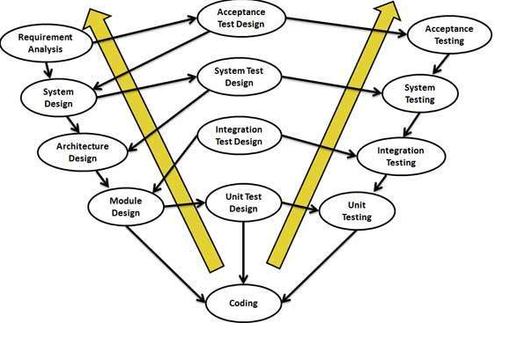
V - Model

Slide 34
The V model is based on the principle of “separation of planning phase from the execution phase”.
The left arm of the wing is Planning, while the right arm is Execution.
Testing process runs parallel to the Development.
Also testing starts from the beginning of the life cycle.
The V-Model demonstrates the relationships between each phase of the development life cycle and its associated phase of testing.

Slide 35
Advantages
Each phase has specific deliverables.
Higher chance of success over the waterfall model due to the development/testing early on due to the life cycle.
It has evolved over time and supports flexibility and agility throughout the development process.
In addition to being a highly disciplined approach, it promotes meticulous design, development, and documentation necessary to build stable software products.
Division of Labor.

Slide 36
Disadvantages
It is inflexible and encourages a rigid and linear view of software development and has no inherent ability to respond to change.
It provides only a slight variant on the waterfall model and is therefore subject to the same criticisms as that model.
It implicitly promotes writing test scripts in advance rather than exploratory testing; it encourages testers to look for what they expect to find, rather than discover what is truly there.

