Slide 1
AdaBoostRegressor

Slide 2
What is AdaBoostRegressor
An AdaBoost regressor is a meta-estimator that begins by fitting a regressor on the original dataset and then fits additional copies of the regressor on the same dataset but where the weights of instances are adjusted according to the error of the current prediction.
Purpose of AdaBoostRegressor
AdaBoost is a method that improves error of the target predictive model by iteratively giving weights on the training data points. AdaBoost assumes that the distributions of the source domain and the distributions of the target domain are identical.

Slide 3
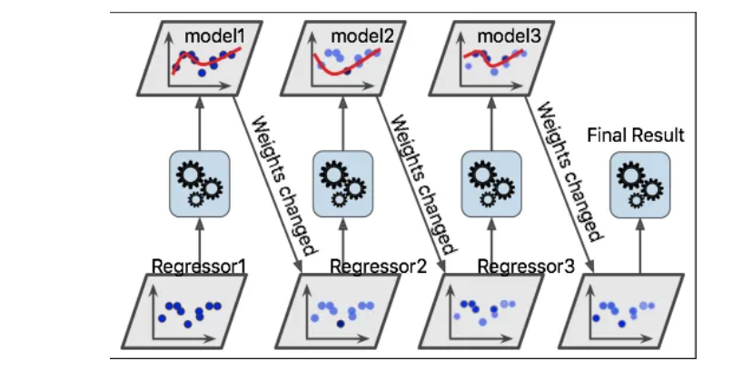
Diagram
It creates meta estimator means – huge data based on the dataset and it will create model one by one to minimize the errors and concluded the best model. Ex- dataset contains chest pain, based on the bmi,age,bodyweight- AdaBoostRegressor will find what would be correct cause of chest pain by making more models based on the original data.

Slide 4
Function to call
Ensemble --AdaBoostRegressor
Variable Parameter
Ensemble –AdaBoostRegressor
Estimator - The base estimator from which the boosted ensemble is built
n_estimators - The maximum number of estimators at which boosting is terminated. In case of perfect fit, the learning procedure is stopped early
learning_rate - Weight applied to each regressor at each boosting iteration. A higher learning rate increases the contribution of each regressor
Loss - The loss function to use when updating the weights after each boosting iteration.
random_state- Controls the random seed given at each estimator at each boosting iteration

