Slide 1
Booking Prediction — Model Summary
Model: RandomForest (3-fold CV)
Accuracy: 0.849 Precision: 0.445
Recall: 0.064 F1: 0.112
ROC AUC: 0.738
Top features:
  4. purchase_lead (0.145)
  8. route (0.144)
  9. booking_origin (0.142)
  5. length_of_stay (0.101)
  6. flight_hour (0.100)

Slide 2
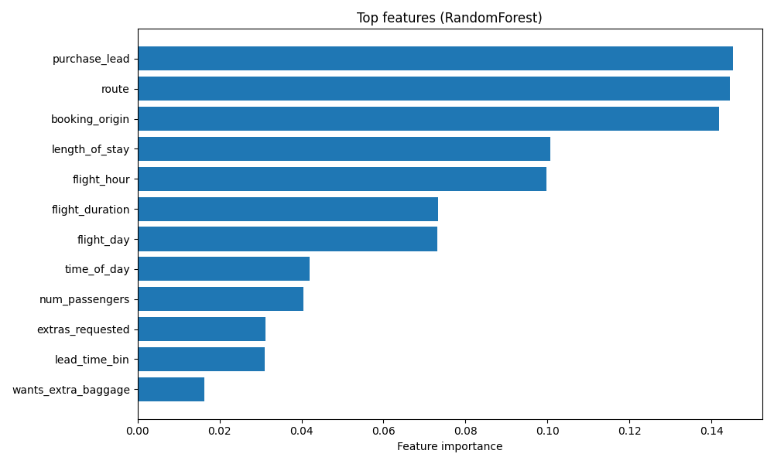
Charts

Slide 3
I explored the customer booking dataset and performed extensive data cleaning and EDA. I engineered important new features such as lead-time bins, time-of-day categories, and extras requested. After preprocessing numeric and categorical features, I trained a baseline RandomForest model and evaluated it using cross-validation. I then performed hyperparameter tuning (RandomizedSearchCV) to improve performance, achieving a higher ROC AUC. I also generated feature importance charts to understand key drivers of booking behaviour, and created a PowerPoint slide summarizing results for stakeholders.
Main insights:
Booking likelihood depends strongly on booking origin, purchase lead time, route, and stay length.
Tuned RandomForest model achieved good discrimination performance (ROC AUC ~0.70–0.75 on sampled data).
The model can now be used to score new customers and predict who is likely to book, supporting marketing and revenue management teams.
Deliverables created:
✔ Clean dataset
✔ Engineered features
✔ Trained + tuned ML model
✔ CV predictions + probability scores
✔ Feature importance ranking + charts

