Slide 1

Certification in Advanced Tech Service Engineering
Predictive– Case study
<Case Study - Predictive>
<Batch 2>
<Group 12- Slytherin>
<18-March-2023>

Slide 2
Plan
Team introduction
Predictive module overview
Introduction to case study
Case study solution design
Case study solution implementation
Learnings & enhancements

Slide 3




Team introduction – <Team Name>
Participant 1
Sathishkumar P H
Technology Services Engineer III
OMS
Sathishkumar.Ph@walmart.com
Participant 2
Swetha Gothandaraman
Technology Services Engineer III
DataOps – Bedrock/ USTech
Swetha.gothandaraman@walmart.com
Participant 3
Swetha Lakshman
Technology Services Engineer III
Replenishment
Swetha.Lakshman@walmart.com
Participant 4
Wazid Shaik
Technology Services Engineer III
Wazid.Shaik@walmart.com

Slide 4
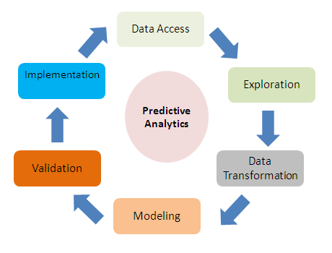
Predictive Overview
Predictive analytics uses advanced mathematical model to examine patterns in current and historical data in order to predict “What will happen in the future?”
Predictive analysis can be used in number of different applications such as Supply Chain, Financial Services, Human Resources etc. Example:
  Supply Chain: We can predict and manage inventory levels and pricing strategies.
  Supply chain predictive analytics use historical data and statistical models to forecast future supply chain performance, demand, and potential disruptions.

Slide 5
Introduction to case study
In this case study, we have utilized the given incident data from an IT Service Management to build a predictive model to find the estimate time taken to resolve an incident based on the below steps.
relationships between drent incident factor
Data Loading: Stage and load the CSV input file into snowflake DB using python
Data Preparation: Prepare the data by cleaning and formatting the given data using Python
Data Exploration: Identify patterns and relationship between different incident factors, using data visualization tool Power BI
Feature Engineering: Identify the relevant data for test and train the data in order to predict the resolution time
Model Development: Training the data using ML algorithms to get the accuracy to find out which algorithm is best.
Model Validation: Validate the predictive model to identify patterns and relationships between different incident factors

Slide 6
Case study benefits
Being part of a support model and working on incidents daily, it's essential for us to resolve the incident in a timely manner in order to deliver seamless experience to our customer.
This case study will help us to design a predictive model to recognize the incidents that are probably going to exceed the resolution time.
By anticipating the estimated resolution time for an incident, it will assist us to better manage their incident workload and improve MTTR and SLA’s.
This will help us to maintain our yearly evaluation metrics, since SLA is one of the key parameters for our year end goals.
This prediction helps leadership team to effectively allocate and manage their resources better.
This case study implementation in SNOW platform will give an insight to the end user, approximately when this incident can be resolved which helps end user to plan their workload accordingly.

Slide 7
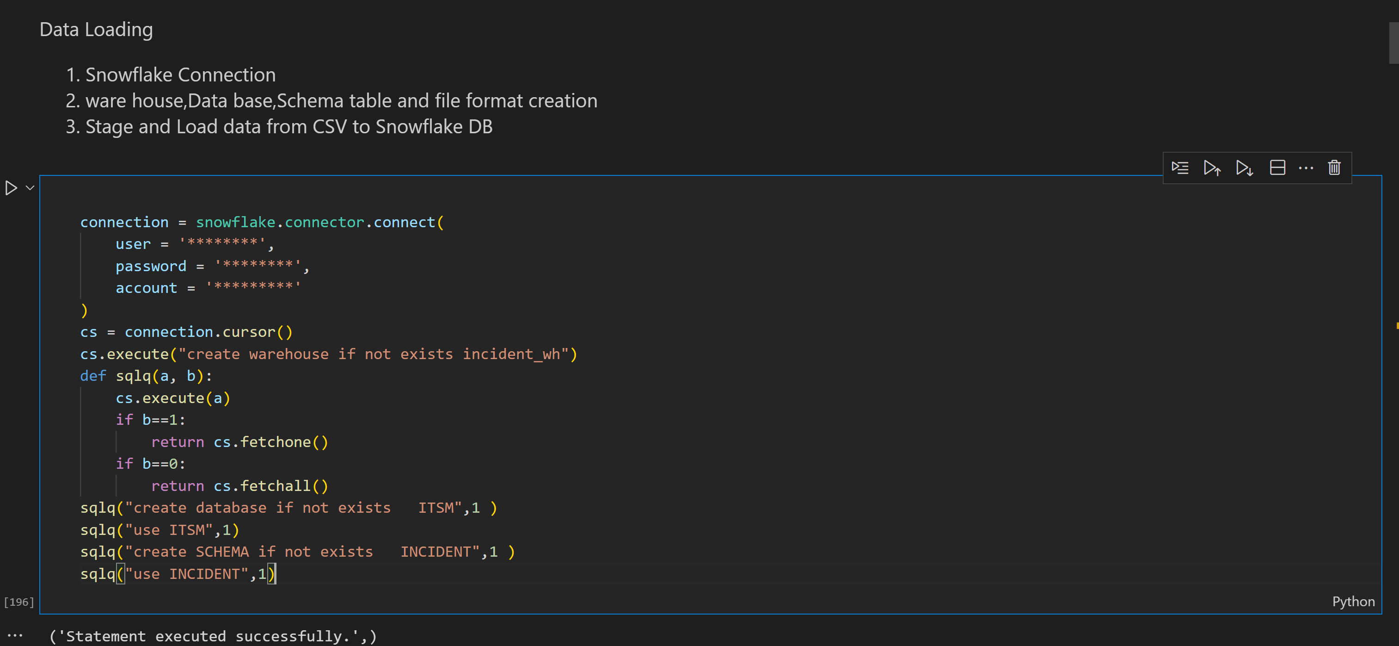
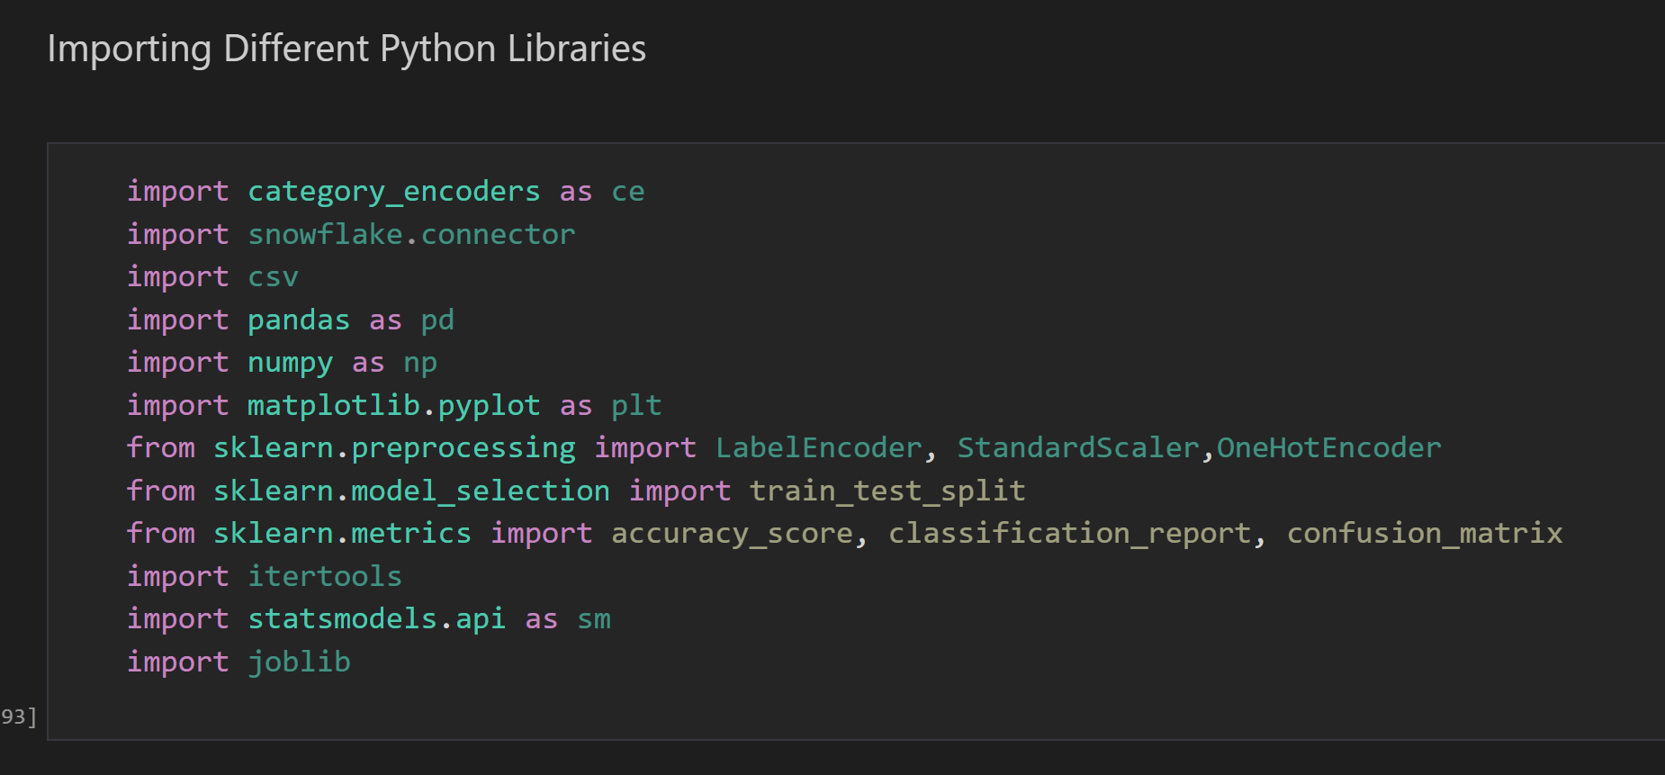
Case study solution design
STEP 1: Data Loading
Loading CSV into Snowflake DB involves the serious of steps
Log in into the snowflake account.
Create/Use the database and schema.
Create Table in Snowflake using Create Statement.
Load the CSV file from local system to the staging of the Snowflake.
Copy the data into Target Table.
Create File Format which describes a set of staged data.

Slide 8
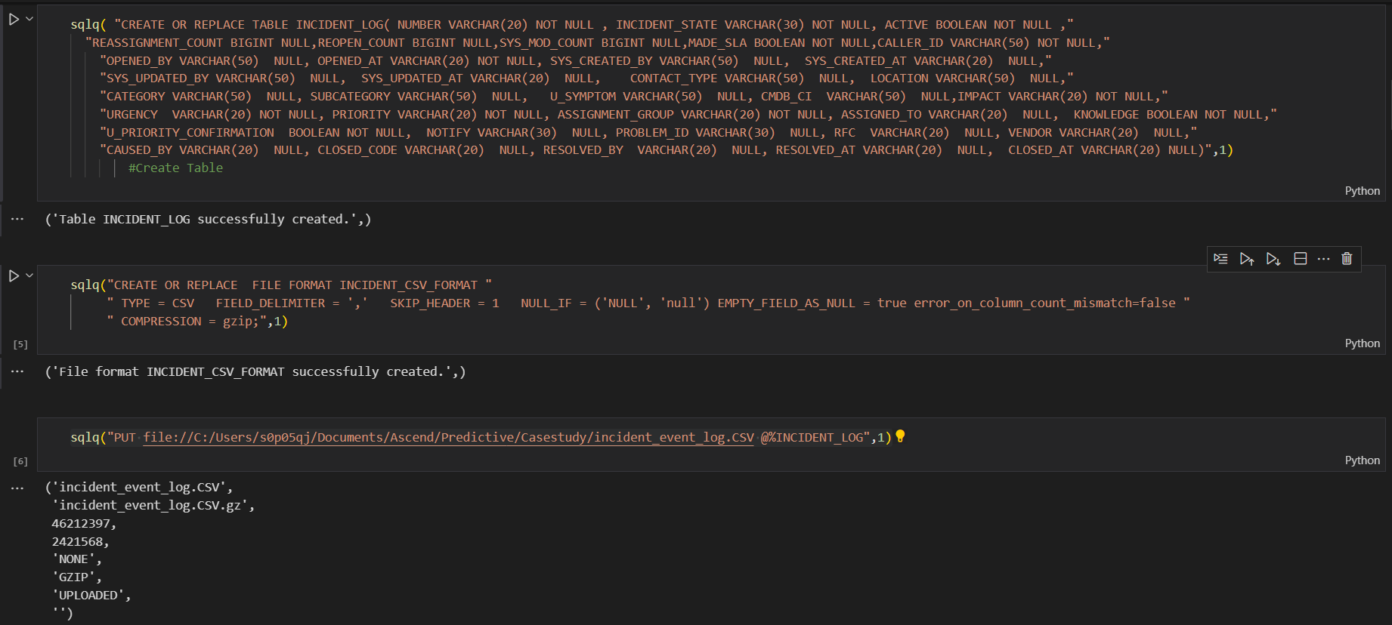
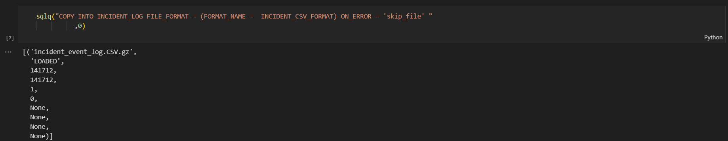
Case study solution design

Slide 9
Case study solution design
STEP 2: DATA PREPARATION
Data Cleaning and Transforming using Python
Select only the Closed state incident to predict the resolution time.
Handling the missing data and removing the duplicates.
Transformed the Opened at and Resolved at columns date format
Calculate and introduce the Resolution time column using Opened at and Resolved at columns.
Load the formatted data into another snowflake table.

Slide 10
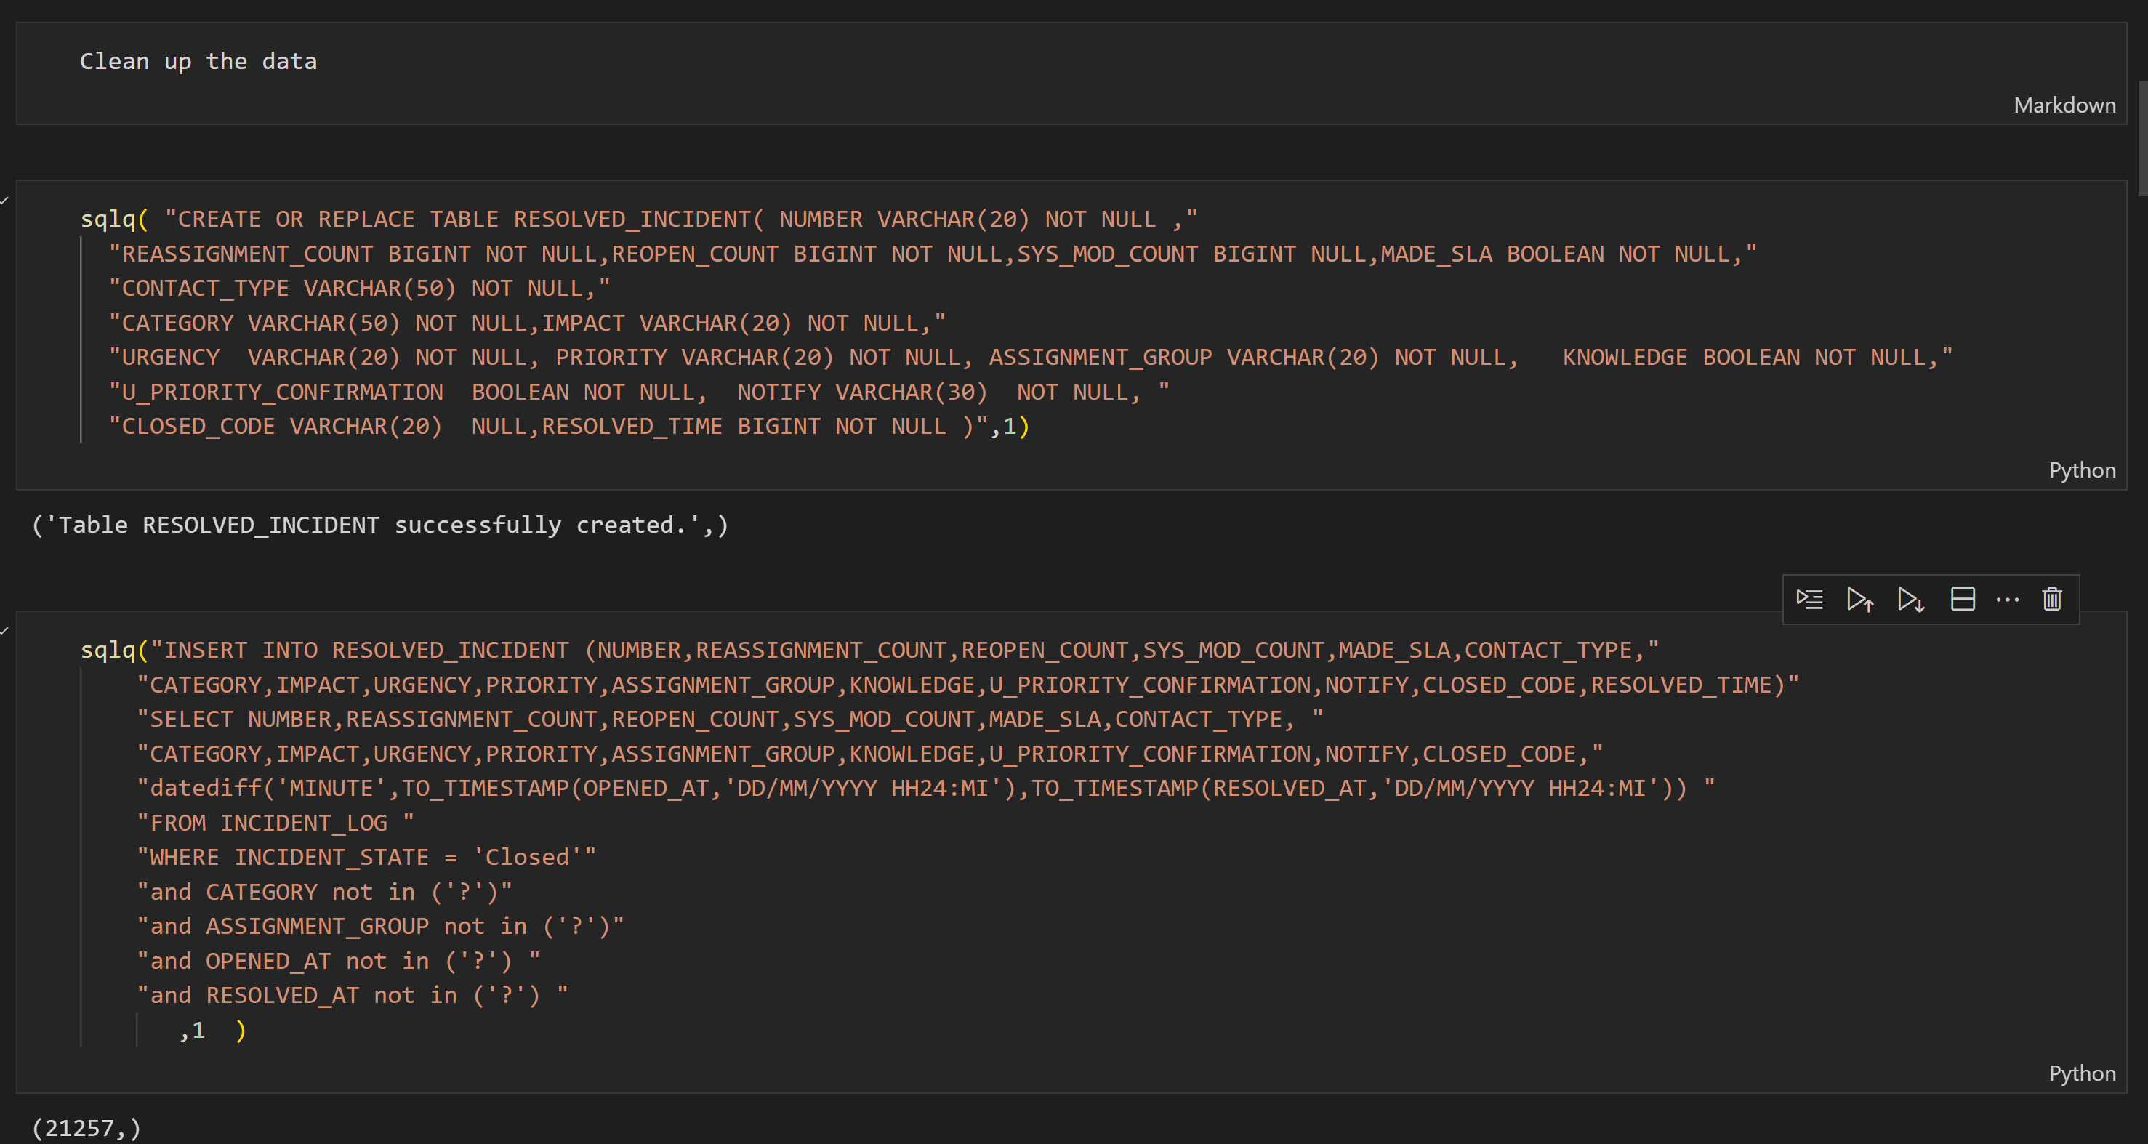
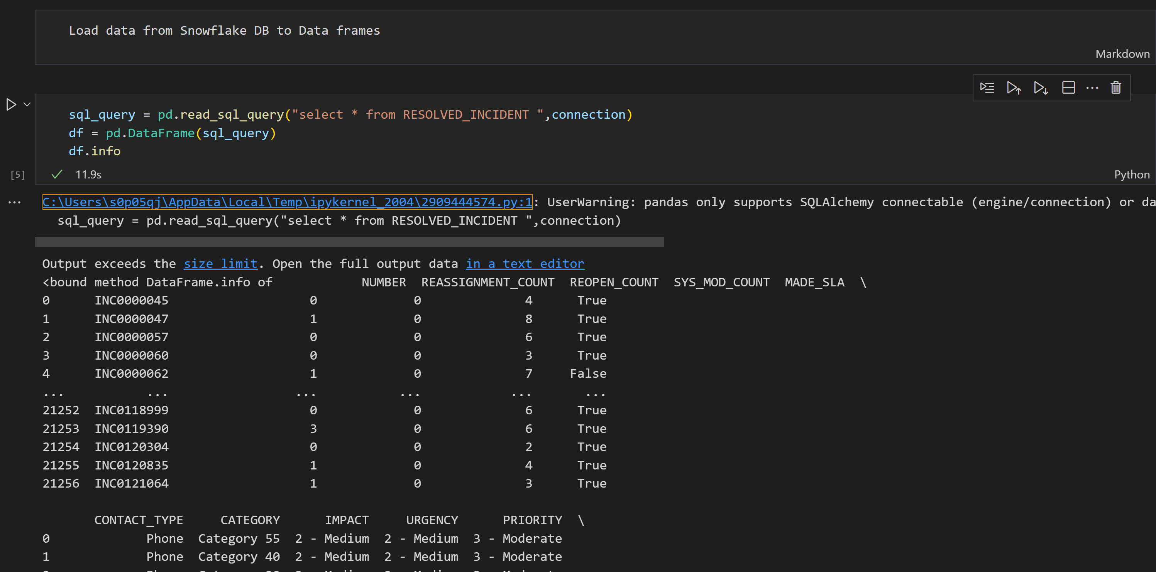
Case study solution design

Slide 11
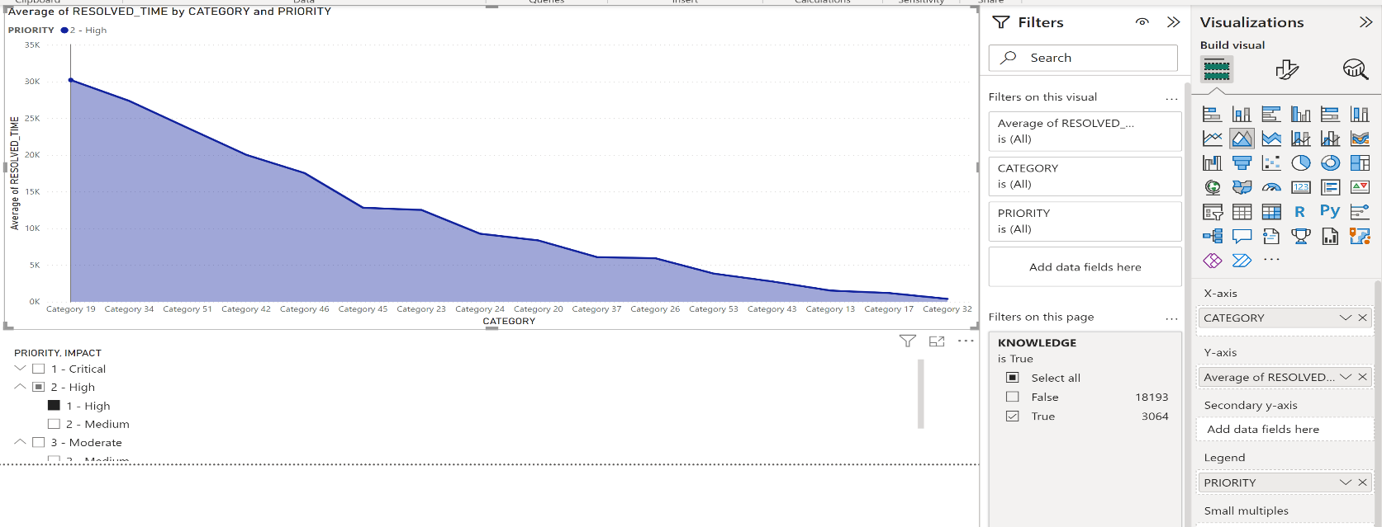
Case study solution design
STEP 3: DATA EXPLORATION
Data visualization
Formatted csv file has been given as an input to PowerBI.
Identifying the key elements to figure out the most relevant columns that are required to predict the resolution time from the report.
Generating the visualization report.

Slide 12
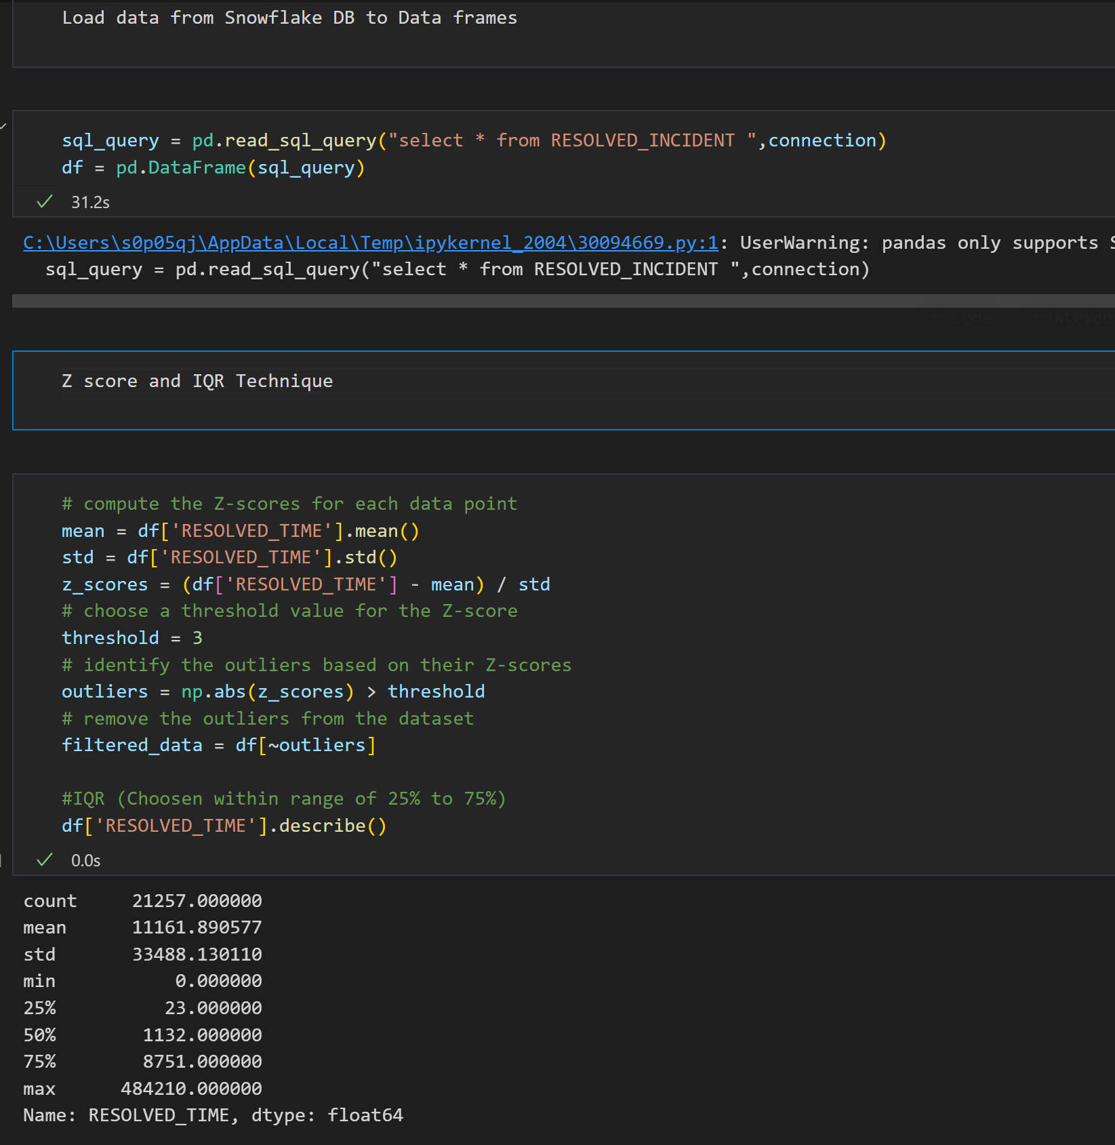
Case study solution design
NORMALIZATION AND STANDARDIZATION TECHNIQUES
We have worked on both Z-score and IQR techniques.
In IQR method, we have chosen the data between the range of 25% to 75%
In Z-score, we have chosen the threshold as 3 to identify the outliers.
Based on the accuracy we have chosen Z-score over IQR method to identify the outliers.

Slide 13
Case study solution design
Feature engineering is a critical step in predictive analysis that involves selecting and transforming the most relevant features in the data set to improve the accuracy of the predictive model.
STEP 4: FEATURE ENGINEERING
Identify the relevant data
Feature Selection: Choose the most relevant features by examining their correlation with the target variable and their importance in the context of the business problem.
Feature Encoding:
Label encoding used for an ordinal variables such as Priority, Impact, Urgency and Knowledge.
One-hot encoding used for a nominal variables such as Category and Assignment Group.

Slide 14
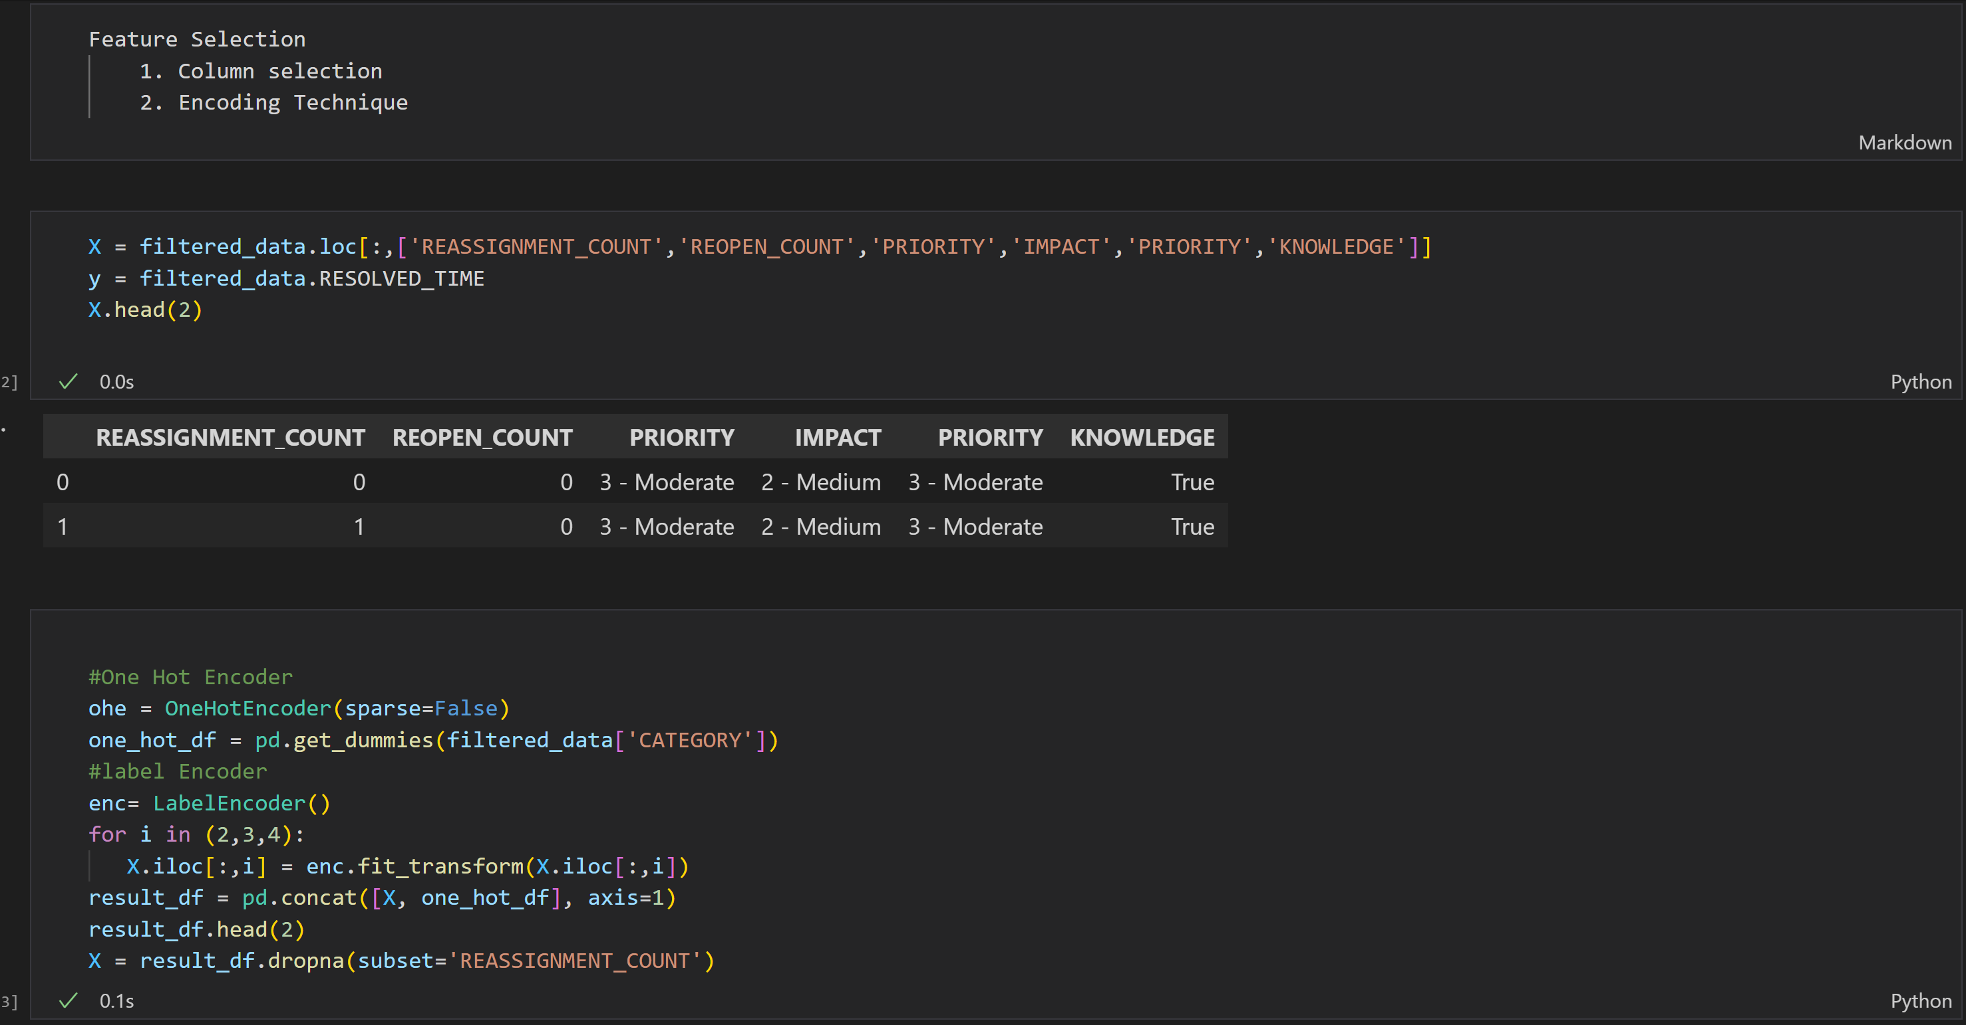
Case study solution design

Slide 15
Case study solution design
We have selected the below mentioned columns as a key factor for predicting the incident resolution time based on the feature engineering selection.
Name | Description | Role | Level
resolution_time | Value has been calculated by taking the time difference between "Opened at" and "Resolved at" column | Target | Contineous
knowledge | Boolean attribute that shows whether a knowledge base document was used to resolve the incident (1-True, 0-False) | Input | Binary
reassignment_count | Number of times the incident has the group, or the support analysts changed | Input | Interval
reopen_count | Number of times the incident resolution was rejected by the caller | Input | Interval
assignment_group | Identifier of the support group in charge of the incident | Input | Nominal
category | First-level description of the affected service | Input | Nominal
contact_type | Categorical attribute that shows by what means the incident was reported | Input | Nominal
notify | Categorical attribute that shows what notifications were generated for the incident | Input | Nominal
impact | Description of the impact caused by the incident (1-High; 2-Medium; 3-Low) | Input | Ordinal
priority | Value calculated by the system based on impact and urgency (1-Critical; 2-High; 3-Moderate; 4-Low) | Input | Ordinal
urgency | Description of the urgency informed by the user for the incident resolution (1-High; 2- Medium; 3-Low) | Input | Ordinal

Slide 16
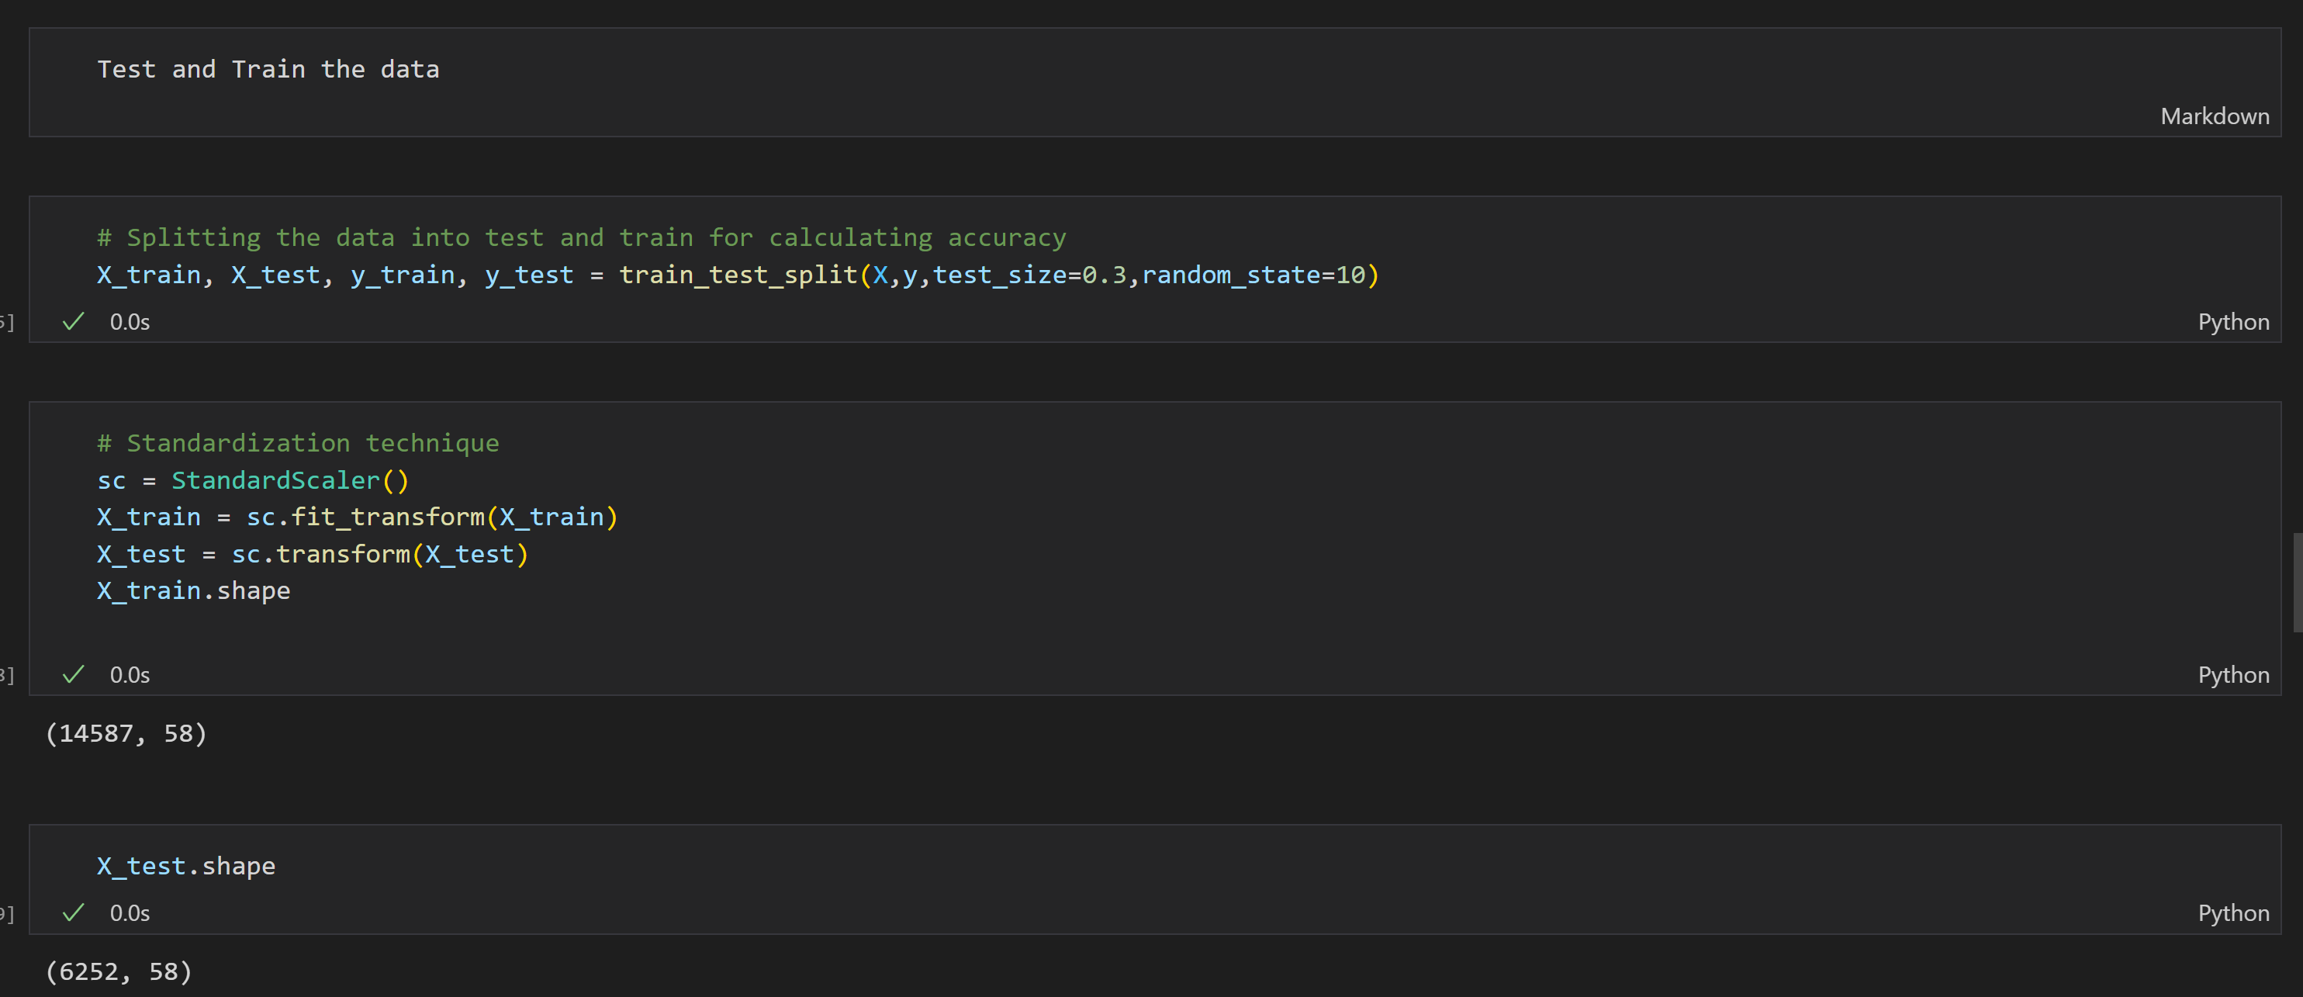
Case study solution design
STEP 5: MODEL DEVELOPMENT
Test and train the data
After the label encoding, train-test split procedure is applied on data to estimate the performance of machine learning algorithms they are used to make predictions on data.
Train Dataset: Used to fit the machine learning model.
Test Dataset: Used to evaluate the fit machine learning model.
The train_test_split function accepts the following parameter values:
arrays: These are the arrays or matrices that need to be split.
test_size: This is the size of the test subset.
random_state: This parameter value controls how the data is shuffled before being split.

Slide 17
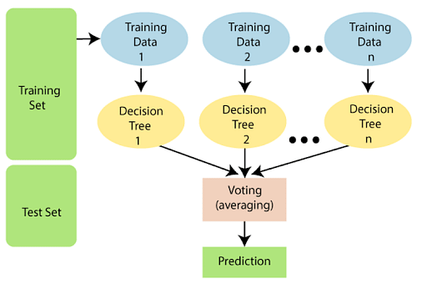
Case study solution design
STEP 5: MODEL VALIDATION
Validate the predictive model
We are using different machine learning algorithms such as SVM, K- Nearest Neighbor, Random Forest, Decision Tree for identify the accuracy and precision for the model.
Comparatively, Random forest algorithm provided the best accuracy and precision.
Step 1
Step 1
Select random samples from a given data or training set.
Step 2
Step 2
This algorithm will construct a decision tree for every training data.
Step 3
Step 3
Voting will take place by averaging the decision tree.
Step 4
Step 4
Finally, select the most voted prediction result as the final prediction result

Slide 18
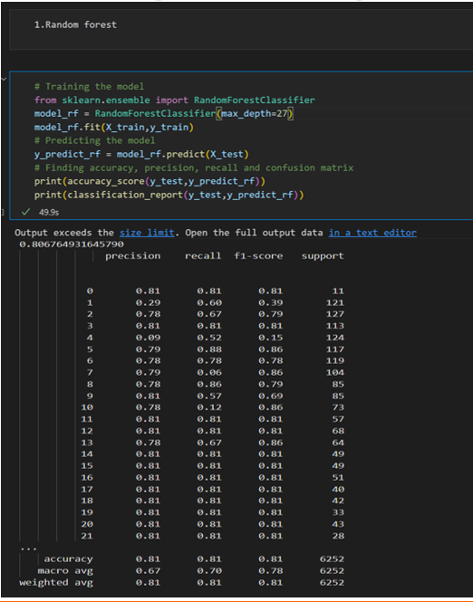
Case study solution implementation
We have got 81% accuracy by using Random Forest algorithm.
It can handle data very effectively, whether it is binary, continuous, or categorical.
One of the finest aspects of the Random Forest is that it can accommodate missing values, making it an excellent solution for anyone who wants to create a model quickly and efficiently.

Slide 19
Learnings & enhancements
In this predictive module, we have learnt about data modeling, feature extraction and different machine learning algorithms.
Additionally, in this case study we have learnt about how to integrate snowflake and python and learned to deal with huge data.
We have gained knowledge about different statistical techniques used in feature engineering to extract the most relevant features from the data.
Incidents are the key metrics to improve the project efficiency and customer satisfaction for any support project. Hence predicting the estimated resolution time for incidents will help us to better mange the SLA and improve the resolution time for the incidents in future.
By continuously refining and optimizing the predictive model, can unlock valuable insights and make data-driven decisions that drive better results.
We can automate the process of updating the predictive model to incorporate new data as it becomes available. This can be achieved using online learning algorithms, which update the model in real-time as new data is fed into the system.

Slide 20
What has been your manager’s feedback
"ASCEND program is really helpful in exploring and understanding the learn new tools and technologies such as Grafana, Prometheus, Power BI and other automation-based tools and technologies. It helps the associate to come out of their comfort zone and try something new. However, the classes need to be more productive and focused. Coaching and learning needs to be precise and well planned to achieve greater results.“
Subin Rai, Manager II
OMS Application
subin.rai.a.x@walmart.com

Slide 21
Thank You

