Slide 1

J.K.K.NATTARAJA COLLEGE OF ENGINEERING AND TECHNOLGY
Mentor Name :
S.Murugashankar
TEAM MEMBERS :
R. Sathishkumar
R.Sowmiya
A.Mekala
M.Saranya
S.Deepa

Slide 2

Predicting Future
Sales

Slide 3
Sales Data Analysis:
Data Collection and Preparation
The first step in sales data analysis is collecting and preparing the data. This involves identifying the relevant data sources, cleaning the data, and transforming it into a usable format.
Exploratory Data Analysis
The next step is to perform exploratory data analysis to identify trends and patterns in the data. This involves using statistical techniques and visualizations to uncover insights and relationships in the data.

Slide 4
Trends and Patterns :
Seasonal Trends
Our sales data analysis revealed that there are seasonal trends in our sales, with higher sales during the holiday season and lower sales during the summer months.
Product Trends
We also noticed that certain products have been more popular than others, such as our new line of eco-friendly products.
Customer Trends
.
Our analysis also showed that our customer base is shifting towards younger and more environmentally conscious consumers

Slide 5
Sales Forecasting Models:
Time Series Analysis
This model uses historical sales data to identify trends and patterns over time.
﻿
This model uses various independent variables to predict future sales, including economic indicators and marketing campaigns.
ng
This model uses algorithms to analyze large amounts of data and identify patterns that can be used to predict future sales.

Slide 6
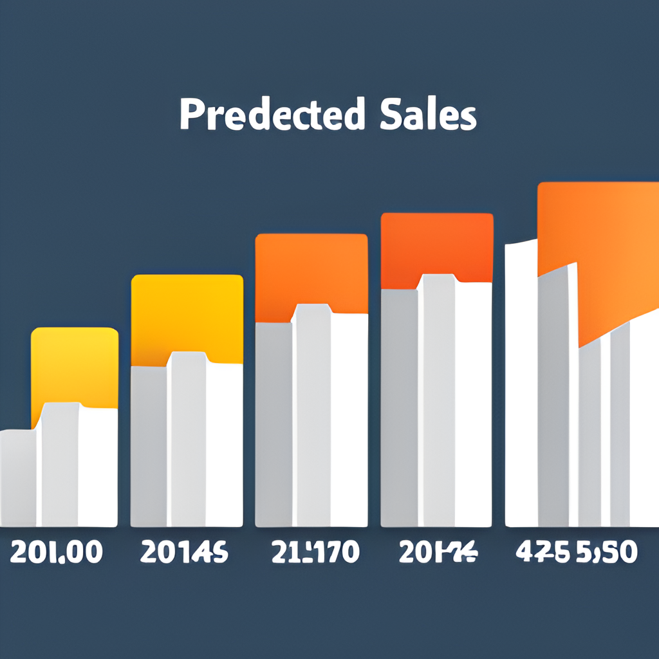
Future Sales Prediction:
Based on our analysis of sales data and evaluation of forecasting models, we have identified several key trends and patterns that can inform our future sales predictions.
Seasonality: Our sales tend to peak during the holiday season, so we can expect a spike in sales during that time
Customer behavior: We have observed that our customers tend to purchase more items when they receive promotional discounts, so we can increase .our sales by offering more discounts and promotions.

Slide 7
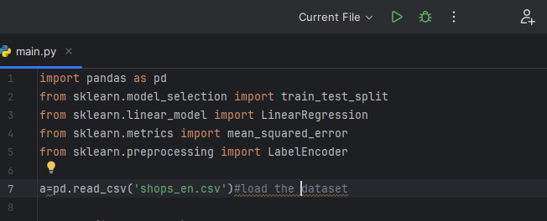
:
IMPORTING PACKAGES:

Slide 8
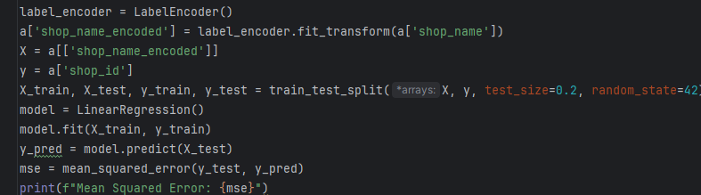
MODEL :

Slide 9
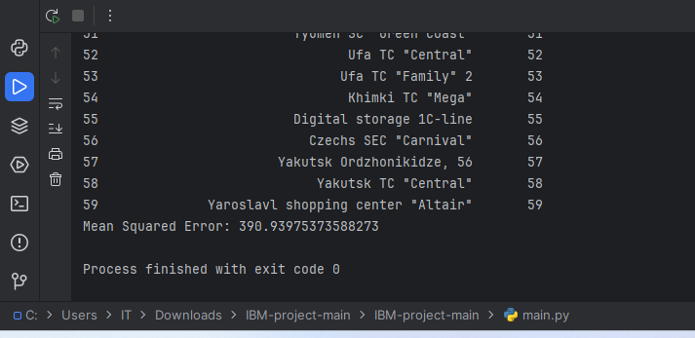
OUTPUT :

Slide 10
THANK YOU

