Slide 1

J.K.K.NATTARAJA COLLEGE OF ENGINEERING AND TECHNOLGY
Mentor Name :
S.Murugashankar
TEAM MEMBERS :
R. Sathishkumar
R.Sowmiya
A.Mekala
M.Saranya
S.Deepa

Slide 2
Phase 5: Project Documentation & Submission
Topic: In this section we will document the complete project and prepare it for submission.

Slide 3

project tittle:
Future sales prediction.

Slide 4
INTRODUCTION
Predicting future sales is a crucial aspect of business operations and strategic planning for retailers, manufacturers, and service providers.
It involves using historical data, market analysis, and various forecasting techniques to estimate the quantity and value of products or services that a business is expected to sell in the coming days, weeks, months, or even years.
These predictions are valuable for a range of purposes, including inventory management, revenue forecasting, resource allocation, and decision-making. on
Exploratory Data Analysis

Slide 5
Importance: Accurate sales predictions are essential for businesses to optimize their operations, improve efficiency, and make informed decisions. They help companies avoid overstocking or understocking inventory, plan marketing and promotional strategies, allocate resources effectively, and meet customer demand.
Data Sources: To predict future sales, businesses gather data from various sources, including historical sales records, market trends, customer behavior, economic indicators, and external factors such as weather patterns, holidays, and social events. This data is used to identify patterns, correlations, and trends that can aid in forecasting.
Methods and Techniques:
Time Series Analysis: This method focuses on analyzing past sales data to identify patterns and seasonality. It uses techniques like moving averages and exponential smoothing.
Regression Analysis: Regression models consider multiple variables, such as price, promotions, and advertising spend, to predict sales. They help understand the impact of each variable on sales.

Slide 6
Forecast Horizon: Sales predictions can be short-term (daily or weekly) or long-term (monthly or yearly). The choice of forecast horizon depends on the business's needs and the stability of the market.
Challenges: Sales prediction is not without its challenges. Factors like sudden market disruptions, unforeseen events, and changes in consumer behavior can make accurate forecasting difficult. However, businesses can work to improve the robustness of their models and incorporate adaptive strategies to address such challenges.
Continuous Improvement: The effectiveness of sales prediction models can be enhanced through continuous monitoring and refinement. Businesses should regularly update their models to reflect changing market conditions and improve accuracy.

Slide 7
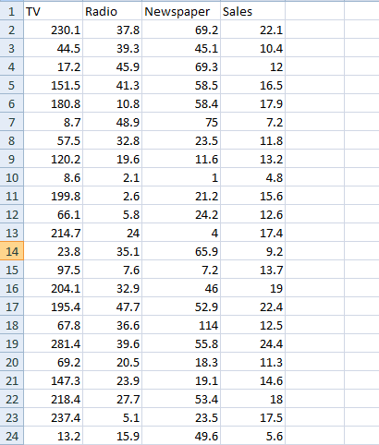
Dataset Link: https://www.kaggle.com/datasets/chakradharmattapalli/future-sales-prediction
Given Dataset:

Slide 8
Here's a list of tools and software commonly used in the project:
programming language: Python is the most popular language for machine learning due its extensive libraries and frameworks.
Integrated Development Environment (IDE): - Choose an IDE for coding and running machine learning experiments. Some popular options include Jupyter Notebook, Google Colab, or traditional IDEs like PyCharm.
Data Visualization Tools: - Tools like Matplotlib, Seaborn, or Plotly are essential for data exploration and visualization.

Slide 9

Machine Learning Libraries:
- You'll need various machine learning libraries, incliding:-
- scikit-learn for building and evaluating machine learning models.
- TensorFlow or PyTorch for deep learning, if needed.
- XGBoost, LightGBM, or CatBoost for gradient boosting models.
Data Preprocessing Tools: Libraries like pandas help with data cleaning, manipulation, and processing.

Slide 10
1.DESIGN THINKING AND PRESENT IN FORM OF DOCUMENT
1.Empathize:
Understand the needs and challenges of all stakeholders involved in the house price prediction process, including homebuyers, sellers, real estate professionals, appraisers, and investors.
➢ Conduct interviews and surveys to gather insights on what users value in property valuation and what information is most critical for their decision-making.
2.Define:
➢ Clearly articulate the problem statement, such as "How might we predict house prices more accurately and transparently using machine learning?"
➢ Identify the key goal

Slide 11
1.DESIGN THINKING AND PRESENT IN FORM OF DOCUMENT
1. Empathize (Understanding the Problem):
Interview stakeholders: Gather insights from store managers, inventory teams, and data analysts to understand their pain points and requirements.
Data analysis: Examine historical sales data to identify trends, seasonality, and external factors influencing sales.
2. Define (Problem Statement and Ideation):
Clearly define the problem statement: Create a specific problem statement, such as "Develop a future sales prediction system to optimize inventory management."
Ideation: Brainstorm potential solutions, including data sources, forecasting methods, and technology platforms.

Slide 12
3. Ideate (Generating Solutions):
Generate a range of ideas: Encourage creative thinking among the project team. Consider methods such as time series analysis, machine learning, and market research for sales prediction.
Consider external factors: Explore incorporating external data sources, such as weather forecasts, holidays, and economic indicators.
4. Prototype (Designing Solutions):
Create prototypes: Develop initial models and systems for sales prediction. This may involve selecting and configuring forecasting algorithms, data pipelines, and visualization tools.
Iterative design: Continuously refine and improve the prototypes based on feedback and emerging insights.

Slide 13
Test (Testing Prototypes):
Evaluation: Test the prototypes on a subset of historical data to assess their accuracy and reliability. Use metrics like Mean Absolute Error (MAE) or Root Mean Squared Error (RMSE) for evaluation.
User feedback: Collect feedback from stakeholders and end-users to refine the solution.
6. Implement (Developing the Solution):
Full-scale development: Develop the future sales prediction system using the chosen solution and technology stack.
Integration: Integrate the system with the company's existing data infrastructure and inventory management tools.

Slide 14

7. Evaluate (Monitoring and Feedback):
Ongoing monitoring: Continuously monitor the performance of the sales prediction system in real-world scenarios.
Feedback loop: Establish a feedback loop for stakeholders to provide input on system improvements and to adapt to changing market conditions.

Slide 15
2.DESIGN INTO INNOVATION
Innovative Data Collection and Preparation:
  Seek new data sources that may not have been traditionally used for sales prediction, such as social media data, competitor data, or sensor data.
  Employ advanced data preprocessing techniques to handle unconventional data types.
Cutting-Edge Model Selection and Training:
  Explore state-of-the-art machine learning algorithms and deep learning techniques to enhance prediction accuracy.
  Experiment with ensemble models and hybrid models that combine different approaches for innovative predictions.
Innovative Testing and Validation:
Implement A/B testing and controlled experiments to assess the impact of innovative features.
Collaborate with domain experts to validate the relevance and accuracy of predictions

Slide 16
3.BUILD LOADING AND PREPROCESSING THE DATA SET
Data collection:
To predict future sales, collecting historical sales data, customer behavior, and external market trends is crucial. Combining this data allows for accurate predictive modeling, enabling informed decision-making and improved sales forecasting.
Load the Dataset:
Import relevant libraries, such as pandas for data manipulation and numpy for numerical operations.
Load the dataset into a pandas DataFrame for easy data handling.

Slide 17
Program
import pandas as pd df = pd.read_csv('/kaggle/input/future-sales-prediction/Sales.csv') df.head()
Output:
TV Radio Newspaper Sales
0 230.1 37.8 69.2 22.1
1 44.5 39.3 45.1 10.4
2 17.2 45.9 69.3 12.0
3 151.5 41.3 58.5 16.5
4 180.5 10.8 58.4 17.9

Slide 18
4.PERFORMING DIFFERENT ACTIVITIES LIKE FEATURE ENGINEERING, MODEL TRAINING EVALUATION etc.,
Visualisation and Pre-Processing of Data:
Exploratory Data Analysis (EDA)
import plotly.express as px figure = px.scatter(df, x='Sales', y='TV', size='TV', trendline='ols', title='Relationship Between Sales and TV Advertising') figure.update_traces(marker=dict(line=dict(width=2, color='DarkSlateGrey')), selector=dict(mode='markers'))
figure.update_layout
( xaxis_title='Sales',
yaxis_title='TV Advertising',
legend_title='TV Ad Size',
plot_bgcolor='white' )

Slide 19
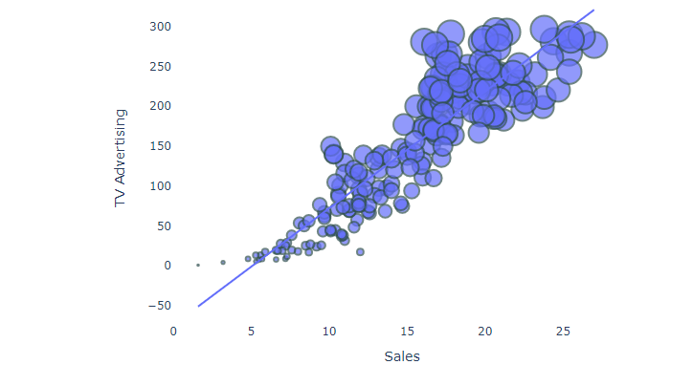
Output:

Slide 20
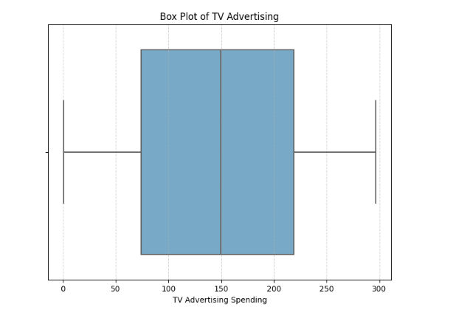
Data Preprocessing:
import seaborn as sns
import matplotlib.pyplot as plt
# Create the box plot plt.figure(figsize=(8, 6))
sns.boxplot(x='TV', data=df, palette='Blues')
plt.title('Box Plot of TV Advertising')
plt.xlabel('TV Advertising Spending')
plt.grid(axis='x', linestyle='--', alpha=0.6)
# Show the plot
plt.show()
Output:

Slide 21
Modelling and Evaluation:
Input:
X = df[['TV', 'Radio', 'Newspaper']]
y = df['Sales']
from sklearn.model_selection import cross_val_score
# Performing 5-fold cross-validation (can be adjusted to the desired number of folds)
num_folds = 5
# Function to perform cross-validation and calculate metrics in percentage
def perform_cross_validation(model, X, y, num_folds):
mse_scores = -cross_val_score(model, X, y, cv=num_folds, scoring='neg_mean_squared_error')
rmse_scores = np.sqrt(mse_scores)
mae_scores = -cross_val_score(model, X, y, cv=num_folds, scoring='neg_mean_absolute_error')
r2_scores = cross_val_score(model, X, y, cv=num_folds, scoring='r2')
return mse_scores, rmse_scores, mae_scores, r2_scores

Slide 22
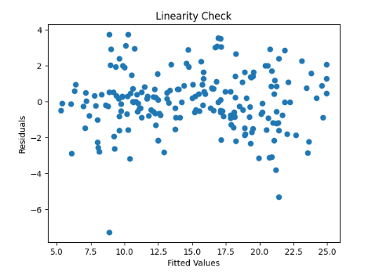
Output:

Slide 23
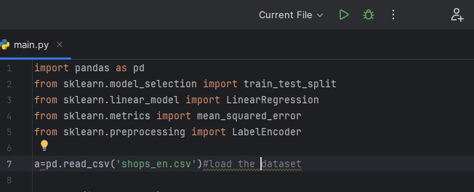
:
IMPORTING PACKAGES:

Slide 24
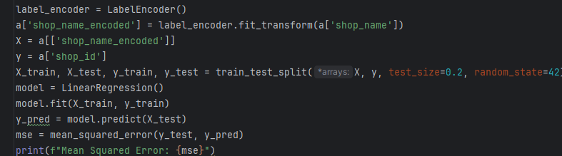
MODEL :

Slide 25
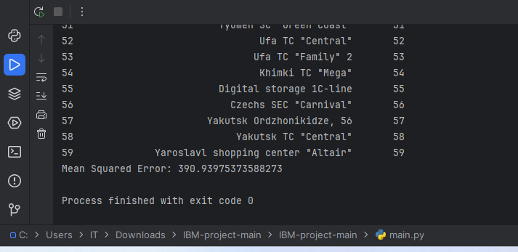
OUTPUT :

Slide 26
THANK YOU

