Slide 1
Face Detection,Gender And Age Prediction using Convolutional Neural Networks
Guide
Dr.s.Sridhar
Student name
Sathishkumar R
2018246044

Slide 2
INTRODUCTION
Face detection is a computer technology being used in a variety of applications that identifies human faces in digital images.
Face detection also refers to the psychological process by which humans locate and attend to faces in a visual scene.
It is analogous to image detection in which the image of a person is matched bit by bit. Image matches with the image stores in database. Any facial feature changes in the database will invalidate the matching process.

Slide 3
PROPOSE STATEMENT
There are system that exclude the usage of external devices for person system attributes such as fingerprints ,voice ,iris. these types of system are heavily based on computer vision .
The proposed system for face recognition tasks combining various modern approaches.

Slide 4
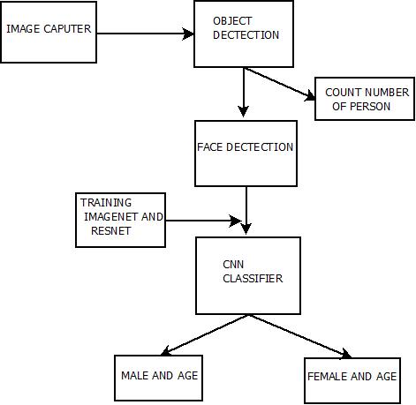
BLOCK DIAGRAM

Slide 5
OBJECTIVES
By this system different types of applications like person monitoring system, building security etc.

Slide 6
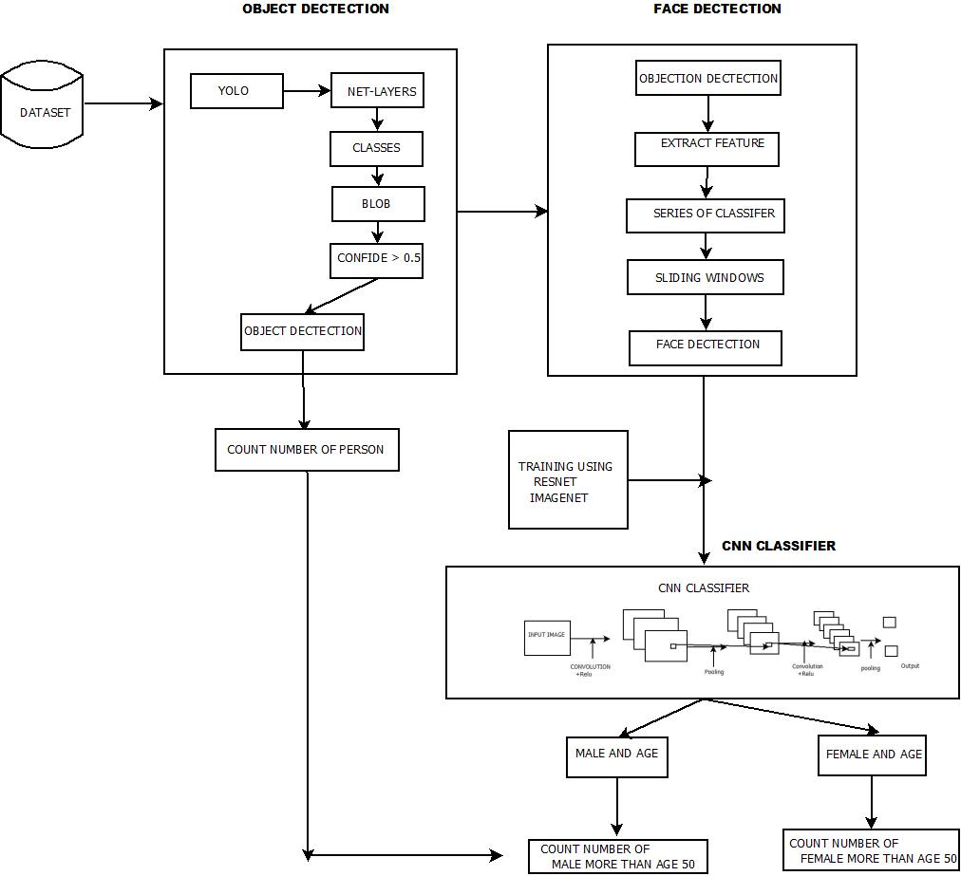
MODULE
DIAGRAM

Slide 7
Module
Object detector
YOLOV3
VIOLA-JONES ALGORTHM
HAAR CASCADE
Convolutional Neural Networks
RESNET AND IMAGENET

Slide 8
Object detector
Yolo is used to classifier to be an object detector
It divides the image into grid by 13X13 cells
Cells is responsible for predicting 5 bounding boxes.
A bounding box describes the rectangle that enclose an object.
Output as confidence > 0.5

Slide 9
Object detector
X, Y, Width, Height for the bounding box’s rectangle
The confidence score
Yolo was trained on the PASCAL VOC dataset
20 different classes
The probability distribution over the classes

Slide 10
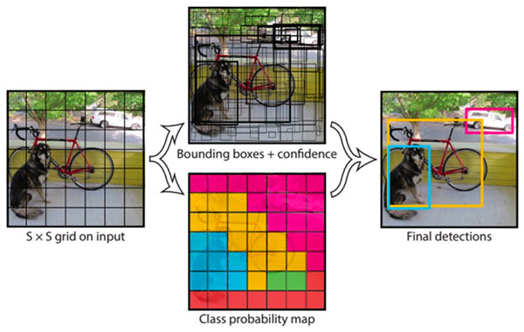
YOLO
It divides the image into grid by 13X13 cells
Cells is responsible for predicting 5 bounding boxes.

Slide 11
VIOLA-JONES ALGORTHM
Extract features from an images and use those features to classify objects
Series of classifiers cascade to identify objects in a image.
They are trained to identify one type of objects
Extract features using sliding windows of rectangular blocks.

Slide 12
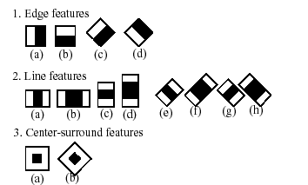
HAAR FEATURES
These features are single valued and are calculated by subtracting.
The sum of pixel intensities under the white rectangle from the black rectangle.

Slide 13
Convolutional Neural Networks
Deep Learning algorithm which can take in an input image, assign importance to various aspects.
Input- A Matrix of pixel values in the shape of width, height.
Convolution- The ultimate purpose of this layer is to receive a feature map.

Slide 14
Convolutional Neural Networks
Pooling Layer- Similar to the Convolutional Layer, the Pooling layer is responsible for reducing the spatial size of the Convolved Feature.
Fully Connected Layer (FC Layer)- In a fully connected layer, we flatten the output of the last convolution layer and connect every node of the current layer with the other node of the next layer.

Slide 15
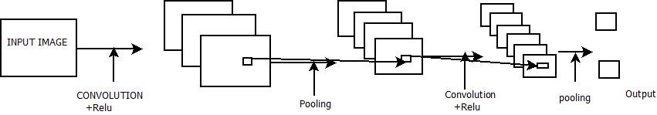
CNN ARCHITECTURE

Slide 16
DATASET
Dataset XM2VTS,ORL, AR.
Extend Yale B, and LFW

Slide 17
PLATFORM AND TOOLS USED
Python
Keras
Labelme
Opencv
Tenserflow

Slide 18
THANK YOU

