Slide 1
Weather Forecast App -Solution Document
SathishKumar Rajendran
06/03/2022

Slide 2
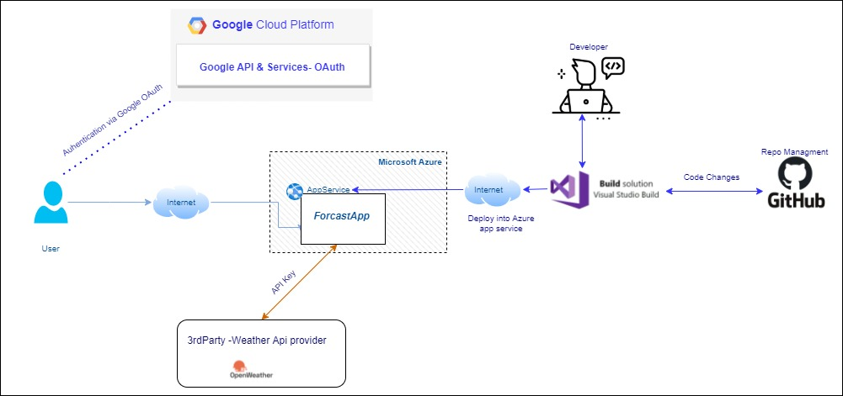
Current solution Design

Slide 3
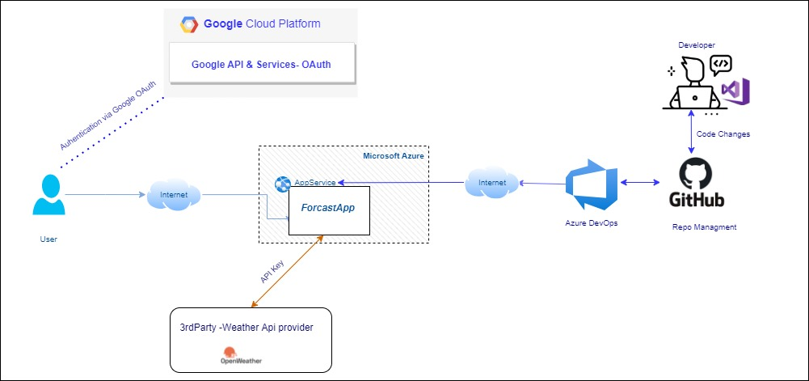
Proposed solution using Azure DevOps

Slide 4
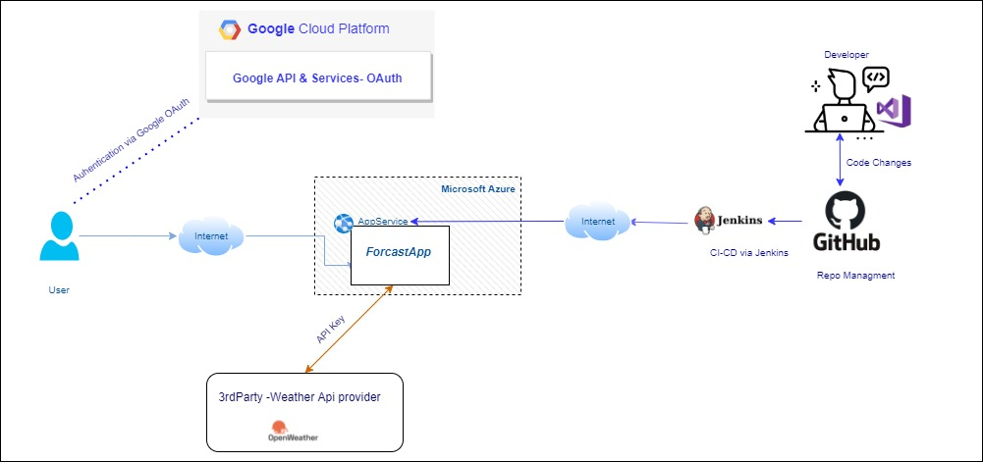
Proposed solution using Jenkins

