Slide 1
Federated Continual Self-Supervised Vision via Prototype-Anchored Distillation
(SDG - 9)
Student Name: Sathish Kumar R
Guide Name: Dr. Meenakshi K

Slide 2
Abstract
A privacy-preserving framework enabling continuous self-supervised learning on edge devices. It consolidates evolving knowledge across heterogeneous domains, effectively preserving past representations while reducing communication overhead.

Slide 3
Problem Statement
Current AI systems fail to adapt in real-world scenarios because they rely on static, centralized training that cannot process unlabeled, private data streams without suffering from catastrophic forgetting.

Slide 4
Existing Problems
Catastrophic forgetting
Data heterogeneity
Privacy constraints
Limited label availability
Inefficient adaptation
Notes:
List what are all the problems/gaps in your problem area

Slide 5
Objectives
Develop a framework that enables scalable and privacy-preserving learning.
Achieve robust learning across evolving data distributions.
Ensure efficient long-term knowledge retention while minimizing catastrophic forgetting.
Notes:
List down the objectives of your project as bulleted points. Max 3.
This includes the whole work of Phase I and Phase II

Slide 6
Literature Review
Paper Name | Journal | Year | Datasets Used | Main Contributions | Other Observations
Global Prototype Distillation for Heterogeneous Federated Learning | Scientific Reports (Nature Portfolio) | 2024 | CIFAR-10, CIFAR-100 | Proposes a global prototype distillation mechanism to handle model and data heterogeneity in federated learning, focusing on knowledge transfer via prototypes rather than parameter aggregation. | Emphasizes communication-efficient learning and robustness to heterogeneous client models. Exact experimental setup and datasets are not inferable from citation alone.
FedPAD: Aggregation-Free Federated Learning with Prototype-based Adaptive Distillation | Knowledge-Based Systems | 2025 (online first) | Not specified | Introduces FedPAD, an aggregation-free federated learning framework that relies on prototype-based adaptive distillation instead of weight averaging. | Notable for avoiding standard federated aggregation; suggests improved scalability and stability under heterogeneity. Dataset details are not available from citation alone.
Prototype Similarity for Federated Unsupervised Learning | IEEE Transactions on Neural Networks and Learning Systems (TNNLS) | 2024/2025 (Early Access) | Not specified | Proposes a prototype similarity–based learning objective for federated unsupervised/self-supervised learning settings. | Focuses on representation alignment across clients without labels. Specific datasets and training protocols are not stated in citation.

Slide 7
Literature Review
Paper Name | Journal | Year | Datasets Used | Main Contributions | Other Observations
Parameterized Data-Free Knowledge Distillation for Heterogeneous Federated Learning | Knowledge-Based Systems | 2025 | Image Net | Presents a parameterized, data-free knowledge distillation method for heterogeneous federated learning, addressing privacy constraints and catastrophic forgetting. | Data-free setting implies no access to raw client data. Exact benchmarks and datasets are not specified in the citation.
Mitigating Catastrophic Forgetting in Continual Learning Using Gradient-based Methods: A Review | International Journal of Advanced Computer Science and Applications (IJACSA) | 2025 | Not applicable (Survey paper) | Provides a comprehensive review of gradient-based methods for mitigating catastrophic forgetting in continual learning. | Survey/review paper; synthesizes prior work rather than introducing new datasets or models.

Slide 8
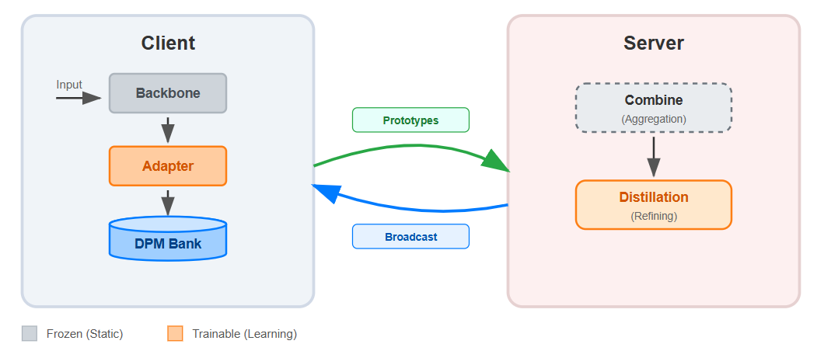
Proposed Architecture

Slide 9
Proposed Module
Information-Bottlenecked Adapter
Projective Feature Orthogonalizer
Distributed Prototype Memory Bank
Prototype-Oriented Distillation Engine

Slide 10
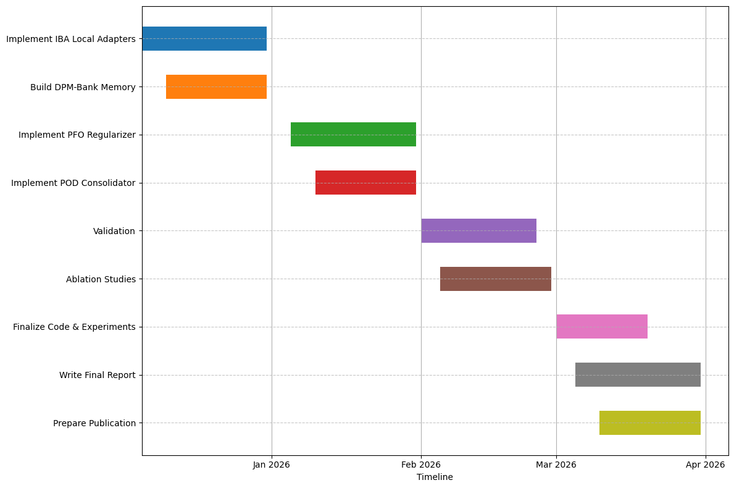
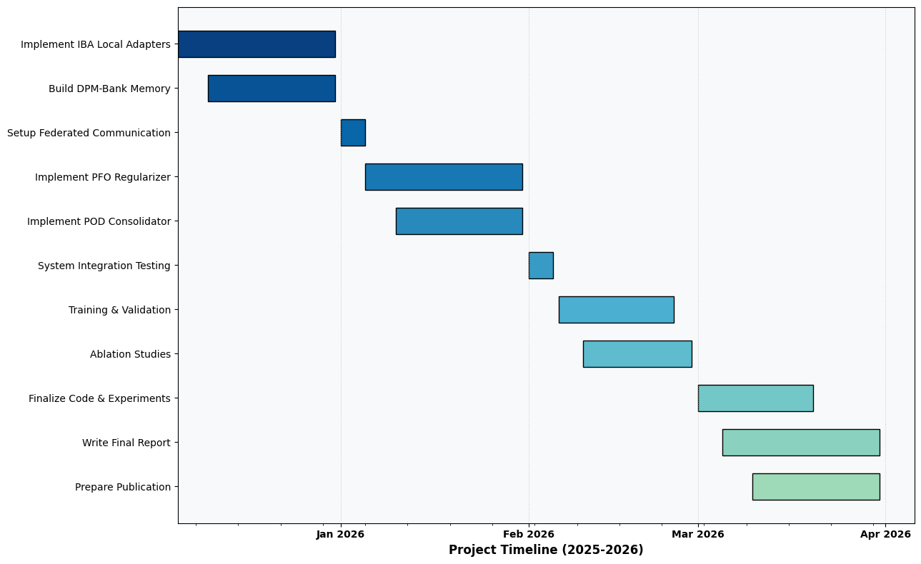
Timeline
Dec: Build IBA-Local Adapters & DPM-Bank Memory
Jan: Implement PFO-Reg & POD-Consolidator Logic
Feb: Validation and Ablation Studies
Mar: Finalize Report & Submission

Slide 11
Thank You

Slide 12
DataSet Description
Notes:
Give the below details of the data
Source of Data
Description – number of rows, column names

Slide 13
Proposed Methodology
Notes:
With a flow chart/work flow diagram, explain the modules of Phase I and Phase II

Slide 14
Algorithm Used
Notes:
Phase I Workflow or Objectives addressed in Phase I

Slide 15
Implementation Details
Notes:
Language Used
Package Used
Algorithms Used

Slide 16
Results and Discussion
Notes:
Detail the contributions done in Phase I

Slide 17
Paper Submission Details
Notes:
Screen shot of acknowledgement proof
Conference/Journal details

Slide 18
Conclusion
Notes:
Result Tables
Result Graphs

Slide 19
Future Work
Notes:
Bulleted points for Phase II Plan

Slide 20
References
Notes:
List the references In IEEE format. Minimum 5, Max 10.

