Slide 1
Executive Decision Report
Business Intelligence Capstone: Profit Growth Strategy from Sales Analytics
Prepared by: YOUR NAME | Date: DD-MM-YYYY

Slide 2
Executive summary: fixing discounts and scaling South can add about $43K profit a year
Key findings
Recommendations
Expected impact
Revenue $3.36M, margin 17.0%, up 4.6% in 2025
Orders with discounts above 20% lose $40 each on average
South earns 35% of revenue; top 20% of customers earn 37%
R1: Cap discounts at 20% with approval rules
R2: Scale the South region playbook
R3: Launch a top-customer retention programme
Gain: $43.3K per year
Investment: $15.1K
Blended ROI: 187%, payback 4.2 months
Executive Decision Report | 2

Slide 3
Business context: growth is slow and discounting is eroding margin
Situation
Objectives
Revenue was $1.11M in 2023, $1.10M in 2024, $1.15M in 2025
19.5% of orders lose money
Profit is spread unevenly across regions and customers
Stop margin leakage from discounting
Grow profit in the strongest region
Protect revenue from the top customers
Decision: approve a three-part, $15.1K plan
Executive Decision Report | 3

Slide 4
Methodology: 4,000 orders over 36 months analysed in Python
Data
Preparation
Techniques
Sample sales dataset, 4,000 orders
696 customers, 4 regions, 3 categories
Jan 2023 to Dec 2025
Duplicates removed
Dates parsed, missing values dropped
Margin % and month fields derived
KPI and trend analysis
Segmentation by region, category, customer
Three-scenario ROI modelling
Executive Decision Report | 4

Slide 5
Performance snapshot: $3.36M revenue at a 17.0% margin, up 4.6% in 2025
$3.36M
$0.57M
17.0%
+4.6%
Revenue
Profit
Margin
Growth 2025
Executive Decision Report | 5

Slide 6
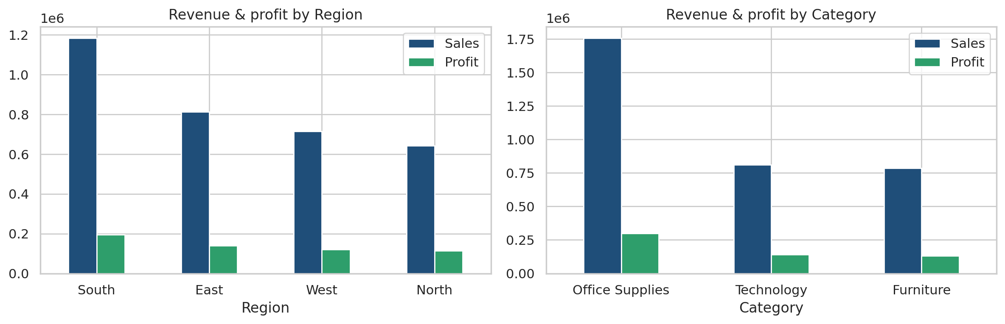
Revenue driver 1: South and Office Supplies carry the business
So what?
South earns 35% of revenue and Office Supplies 52%: protect both and copy the South playbook elsewhere.
Executive Decision Report | 6

Slide 7
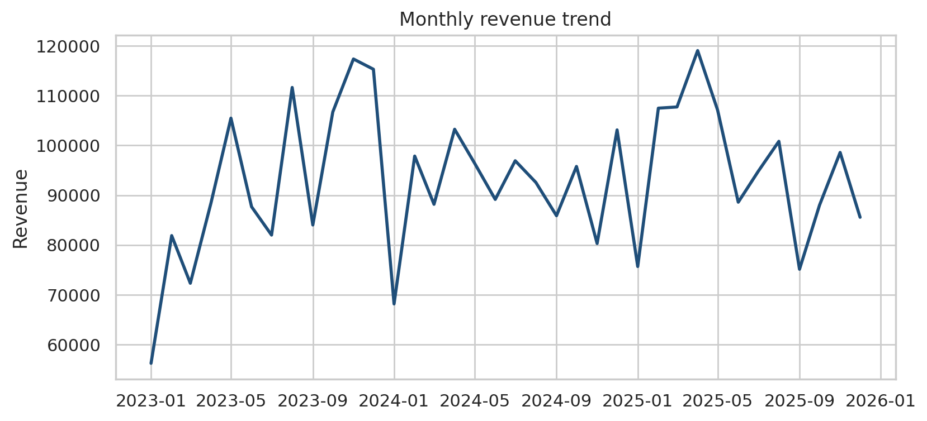
Revenue driver 2: monthly revenue is volatile with no clear upward trend
So what?
Annual revenue moved -1.0% then +4.6%
Growth is not coming from volume alone
Margin and mix are the levers to pull
Executive Decision Report | 7

Slide 8
Revenue driver 3: the top 20% of customers generate 37% of revenue
So what?
Concentration is moderate, not extreme
About 139 customers drive $1.25M
Retention here has a high payoff
Executive Decision Report | 8

Slide 9
Risk areas: deep discounts put about $33K of profit at risk
Margin leakage
Loss-making orders
823 orders with discount above 20% lose $40 each on average, $33.0K in total
19.5% of all orders lose money, a $34.6K drag on profit
Concentration
Data limitations
South is 35% of revenue; the top 20% of customers are 37%
Sample data over 36 months; costs and uplift rates are assumptions
Executive Decision Report | 9

Slide 10
Recommendation 1: cap discounts at 20% and require approval above it
Action
Rationale
Expected impact
Set a 20% hard cap in the order system
Manager approval for exceptions
Review discount use monthly
823 orders above 20% lose $40 each on average
Removing half of those losses is realistic
Cheap to implement, fast to prove
Annual gain: $17.1K
Investment: $3.4K
ROI: 408%, payback 2.4 months
Executive Decision Report | 10

Slide 11
Recommendation 2: scale the South region playbook to other regions
Action
Rationale
Expected impact
Document what South does differently
Pilot in East, then North and West
Add targeted sales capacity
South profit is $196K, the largest region
An 8% profit lift is a modest target
Proven model reduces execution risk
Annual gain: $15.7K
Investment: $6.7K
ROI: 133%, payback 5.1 months
Executive Decision Report | 11

Slide 12
Recommendation 3: launch a retention programme for the top 20% of customers
Action
Rationale
Expected impact
Name an account owner per top customer
Loyalty pricing without deep discounts
Quarterly business reviews
Top 20% give 37% of revenue
A 5% profit uplift on this group is conservative
Retention costs less than acquisition
Annual gain: $10.6K
Investment: $5.0K
ROI: 111%, payback 5.7 months
Executive Decision Report | 12

Slide 13
ROI projections: 187% expected return with payback in about four months
Annual gains and investment in $K; scenarios from ROI_Calculator.xlsx
Recommendation | Invest | Conservative | Expected | Optimistic | Payback
R1 Discount cap | 3.4 | 10.2 (205%) | 17.1 (408%) | 22.2 (561%) | 2.4 mo
R2 Scale South | 6.7 | 9.4 (40%) | 15.7 (133%) | 20.4 (204%) | 5.1 mo
R3 Retention | 5.0 | 6.4 (27%) | 10.6 (111%) | 13.8 (174%) | 5.7 mo
Total | 15.1 | 26.0 (72%) | 43.3 (187%) | 56.3 (273%) | 4.2 mo
Assumptions: conservative 60%, optimistic 130% of expected gain. R1 recovers 50% of losses on discounts above 20%; R2 lifts South profit 8%; R3 lifts top-customer profit 5%. Costs are 5% of revenue times 2-4%.
Executive Decision Report | 13

Slide 14
Implementation timeline: pilot in month 1, full rollout by month 6
Pilot (Month 0-1)
Rollout (Month 2-4)
Optimize (Month 5-6)
Activities: set discount cap; map South playbook
Owner: Operations lead
KPI: loss-making orders %
Activities: extend to East, North, West; assign account owners
Owner: Business head
KPI: revenue and margin per region
Activities: review results, adjust caps and loyalty terms
Owner: Analytics team
KPI: ROI achieved vs 187% plan
Executive Decision Report | 14

Slide 15
Decisions requested and next steps
Decisions needed from leadership
Appendix & links
Approve $15.1K budget for the three initiatives
Name an owner for each recommendation
Green-light the discount-cap pilot next month
GitHub: github.com/YOUR-USERNAME/executive-decision-report
Notebook: Final_Analysis_YourName.ipynb
ROI model: ROI_Calculator.xlsx
Executive Decision Report | 15

