Slide 1

St. Joseph’s College of Engineering and Technology, Thanjavur
Department of Mechanical Engineering
Machine Learning Surrogate Model for Rapid Prediction of Lift and Suction Peak of NACA 4-Digit Airfoils
Track: Artificial Intelligence in Aerospace
Dr. S. R. Sathishkumar, [Staff Name]
[Student 1], [Student 2], [Student 3], [Student 4]
ICAAN–2026 · Saranathan College of Engineering, Tiruchirappalli · 15–16 October 2026
Notes:
Presenter 1: Greet the audience, introduce the team and say the title. One line: we built a computer model that predicts how much lift an aircraft wing section produces, in a fraction of a millisecond.

Slide 2
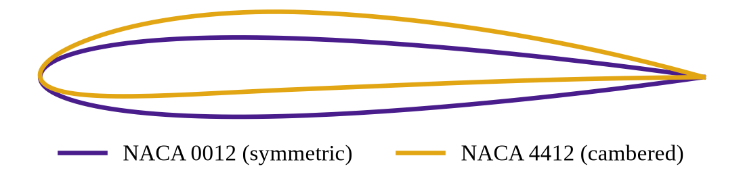
Why do we need fast airfoil prediction?
An airfoil is the cross-section of a wing; its shape decides the lift
Designing a UAV wing means testing hundreds of shapes and angles
Each test needs a flow calculation (CFD or panel method) – slow when repeated
Idea: train a machine learning model once, then predict instantly
Same thickness (12%), different camber → different lift
Notes:
Explain with a hand gesture: the curved (cambered) shape gives more lift than the symmetric one at the same angle. Engineers must check many such shapes, which takes time. Our idea is to replace the slow calculation with a trained ML model.

Slide 3
Objectives
1
2
3
Build and validate a panel-method solver for NACA 4-digit airfoils in Python
Generate a dataset of 3,000 airfoil cases (shape + angle of attack)
Train and compare Linear Regression, Random Forest and ANN models to predict CL and Cp,min
Notes:
Presenter 1: Read the three objectives. Build a solver, make data with it, and teach ML models from the data.

Slide 4
Understanding NACA 4-digit airfoils
NACA 2412
Inputs to our model
Camber m: 0 – 6%
Camber position p: 20 – 60%
Thickness t: 8 – 18%
Angle of attack α: −4° to 12°
Outputs
Lift coefficient CL
Suction peak Cp,min
2
Maximum camber = 2% of chord
4
Position of max camber = 40% of chord
12
Maximum thickness = 12% of chord
Notes:
Presenter 2: The four digits describe the shape. 2412 means 2% camber at 40% chord and 12% thickness. These shape numbers plus the angle of attack are the four inputs; lift coefficient and suction peak are the two outputs.

Slide 5
Methodology
1
2
3
4
5
Airfoil geometry
Panel method
Dataset
ML training
Prediction
NACA 4-digit equations, 160 panels
Hess–Smith source–vortex solver
3,000 random cases
80% train, 20% test
CL and Cp,min in < 0.01 ms
Tools: Python, NumPy, scikit-learn, Matplotlib
Notes:
Presenter 2: Walk left to right. We draw the airfoil with equations, split its surface into 160 small panels, solve the flow, repeat for 3,000 random shapes and angles, then teach the ML model with this data.

Slide 6
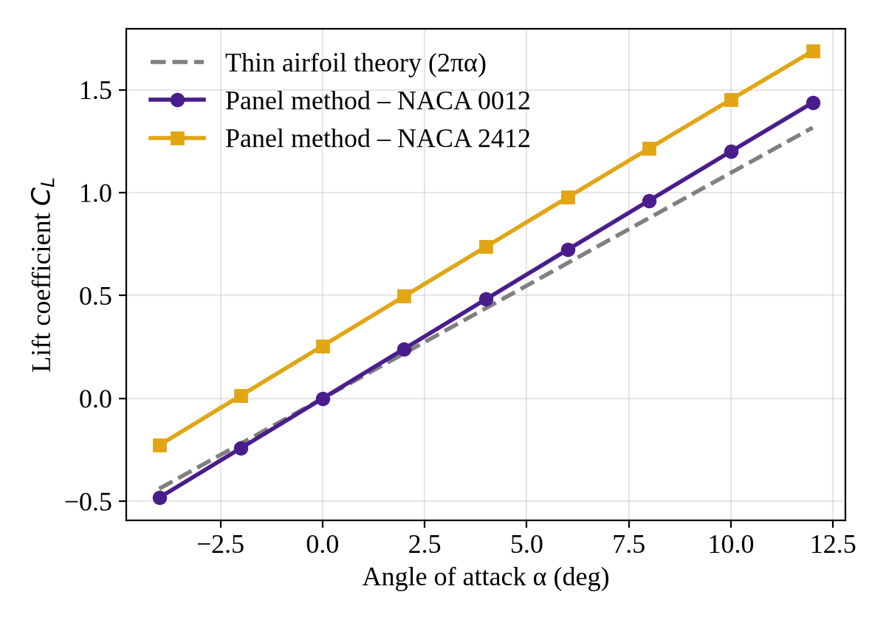
Panel method validation
0.120 /°
Lift-curve slope, NACA 0012
Theory: 0.110 /° (thin plate); thickness adds ≈ 9%
-2.13°
Zero-lift angle, NACA 2412
Thin airfoil theory: −2.08°
Notes:
Presenter 3: Before trusting the data we checked the solver. The straight lines match theory: the symmetric airfoil gives zero lift at zero angle, and the cambered 2412 gives zero lift at about minus 2 degrees, exactly as theory predicts.

Slide 7
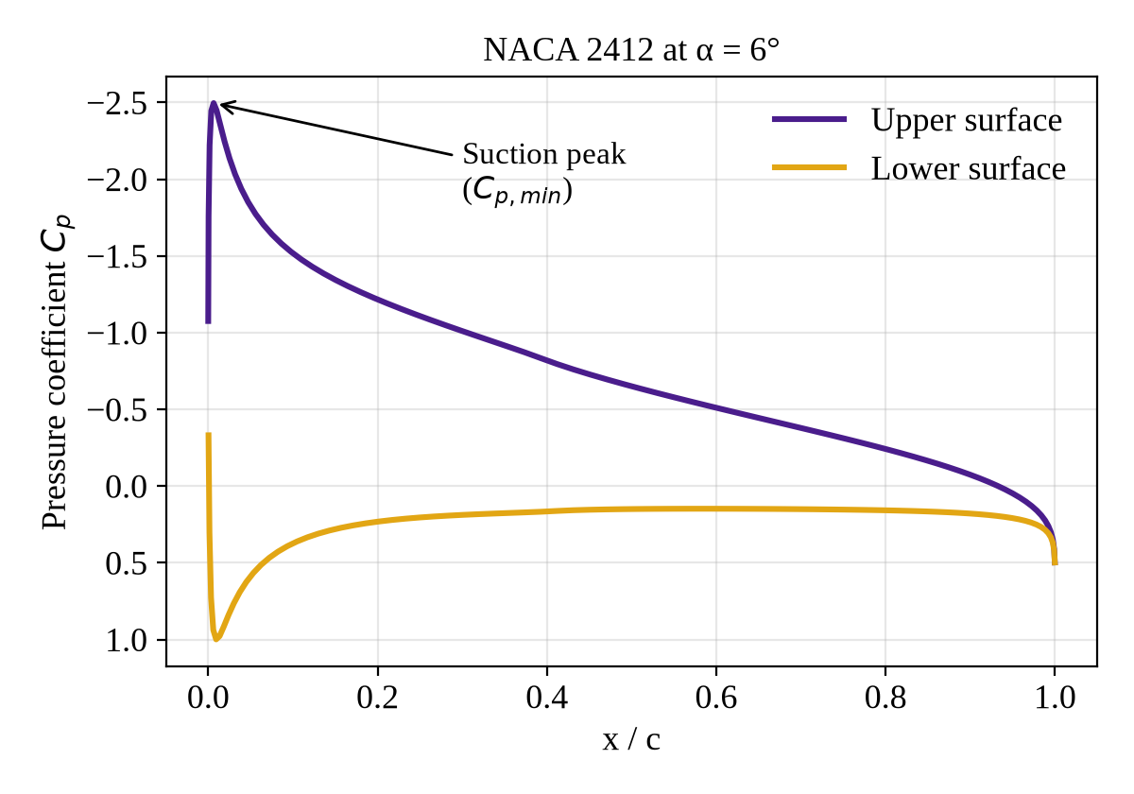
Pressure distribution and suction peak
Lower pressure on the upper surface lifts the wing
Cp,min is the strongest suction, near the leading edge
A sharp suction peak warns of flow separation and stall
Cp,min changes strongly (nonlinearly) with angle and thickness – a harder target for ML
Notes:
Presenter 3: The purple curve is the top surface, gold is the bottom. The gap between them is the lift. The tall spike near the front is the suction peak; designers watch it because a very sharp peak leads to stall.

Slide 8
Machine learning models compared
Linear Regression
Random Forest
Artificial Neural Network
Fits a straight-line relation between inputs and output. Fast and simple.
Averages 300 decision trees. Handles nonlinear data.
2 hidden layers × 64 neurons. Learns complex nonlinear patterns.
Dataset: 3,000 cases · Training: 2,400 · Testing: 600 · Metrics: R² and mean absolute error (MAE)
Notes:
Presenter 4: We tried three models from simple to advanced. R squared close to 1 means the prediction matches the solver almost perfectly; MAE is the average error.

Slide 9
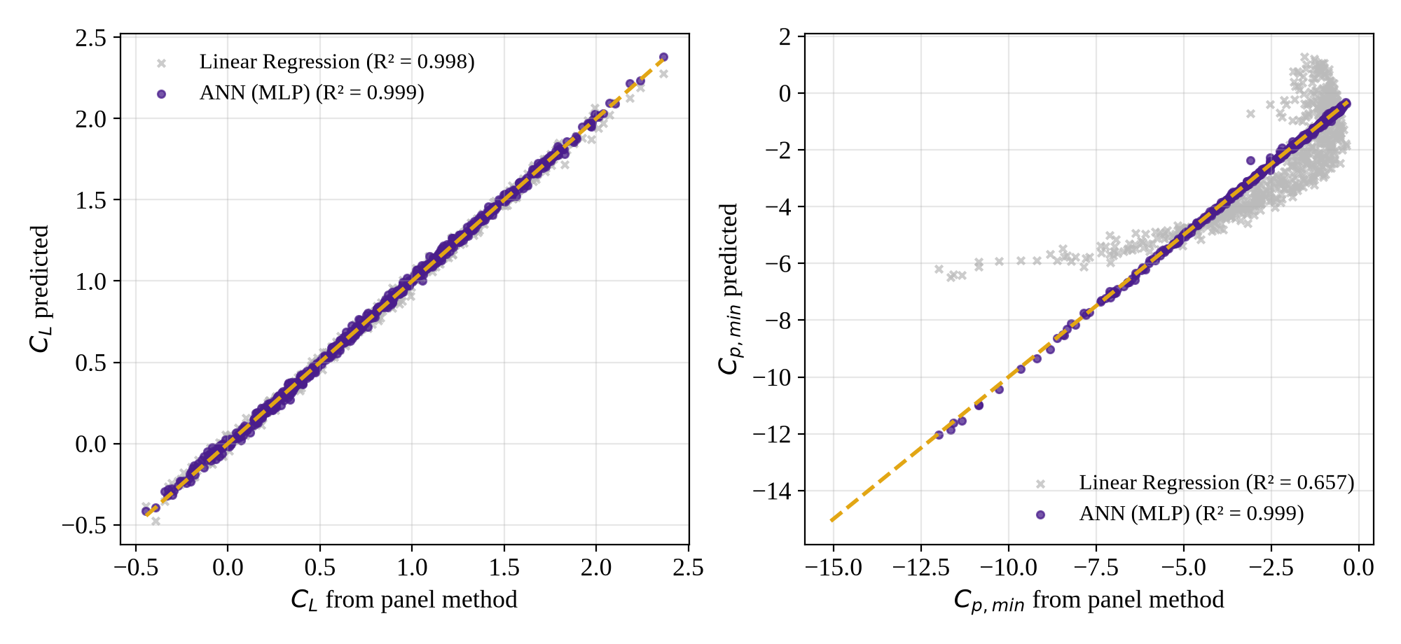
Results: prediction accuracy on test data
Model | R² (CL) | MAE (CL) | R² (Cp,min) | MAE (Cp,min)
Linear Regression | 0.998 | 0.021 | 0.657 | 0.938
Random Forest | 0.997 | 0.025 | 0.985 | 0.132
ANN (MLP) | 0.999 | 0.016 | 0.999 | 0.042
Linear regression fails on the nonlinear suction peak; the ANN is accurate for both outputs
Notes:
Presenter 4: All models predict lift well because lift is almost a straight line with angle. But for the suction peak, linear regression scores only 0.66 while the ANN scores 0.999. In the plots, points on the dashed line are perfect predictions.

Slide 10
Key findings
0.999
~1,500×
86%
R² of ANN for both CL and Cp,min
faster than the panel method per prediction
of lift variation explained by angle of attack (camber: 14%)
Notes:
Presenter 4: Three numbers to remember: 0.999 accuracy, about 1,500 times faster, and angle of attack is the biggest factor for lift, followed by camber.

Slide 11
Conclusion and future work
Conclusion
Future work
Validated panel solver matches thin airfoil theory
ANN surrogate predicts CL and Cp,min with R² = 0.999
Predictions are about 1,500× faster – useful for quick UAV wing-section design
Add viscous effects (XFOIL / CFD) to capture drag and stall
Extend to NACA 5-digit and custom airfoil shapes
Use the surrogate for automatic airfoil optimisation
Limitation: inviscid, incompressible flow – drag and stall are not modelled
Notes:
Presenter 1: Summarise and be honest about the limitation: our flow model has no viscosity, so it cannot predict drag or stall. That is our next step.

Slide 12
References
I. H. Abbott and A. E. von Doenhoff, Theory of Wing Sections, Dover Publications, 1959.
J. L. Hess and A. M. O. Smith, “Calculation of potential flow about arbitrary bodies,” Progress in Aerospace Sciences, vol. 8, pp. 1–138, 1967.
J. Katz and A. Plotkin, Low-Speed Aerodynamics, 2nd ed., Cambridge University Press, 2001.
J. D. Anderson, Fundamentals of Aerodynamics, 6th ed., McGraw-Hill, 2017.
F. Pedregosa et al., “Scikit-learn: Machine learning in Python,” Journal of Machine Learning Research, vol. 12, pp. 2825–2830, 2011.

Slide 13
Thank you
Questions?
Department of Mechanical Engineering, St. Joseph’s College of Engineering and Technology, Thanjavur

