Slide 1
Handwritten Form Recognition using YOLO and TrOCR with Layout Aware Error Correction

Slide 2
Outline
Team Introduction
Problem Statement
Methodology
Detection Model
Field Matching Mechanism
OCR Model
Error Correction
Benchmarks
Final Results
Challenges and Key Learnings
Future Work
1
DeHaDo-AI Challenge
NCVPRIPG 2025, IIT Jammu

Slide 3




Team Introduction: Tokenwise
Sathishkumar
Iniya
Muthukumar
Satishkumar
Anand
Sr. Scientist
Sr. Consultant
Data Scientist
Secure Traces
Scientist, IGCAR
IGCAR
2
DeHaDo-AI Challenge
NCVPRIPG 2025, IIT Jammu

Slide 4
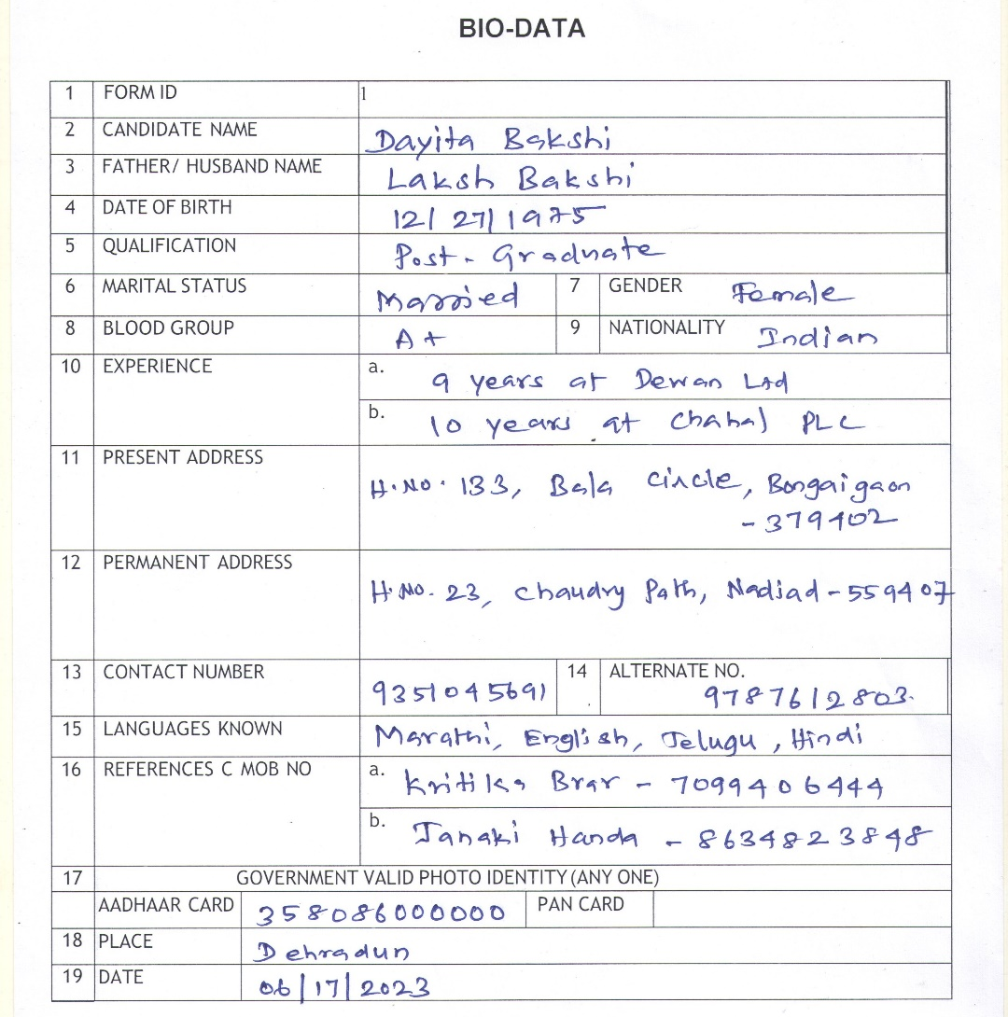
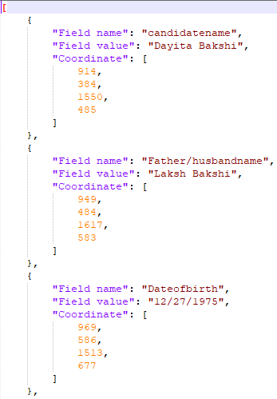
Problem Statement
3
DeHaDo-AI Challenge
NCVPRIPG 2025, IIT Jammu

Slide 5
Related Work
Layout LM
Donut Model
Detection + OCR
Understands semantic
structure of the document
Understands semantic
structure of the document
Simple and Highly
modular
✓
✓
✓
Proven record on layout
recognition tasks
Proven record in form
Recognition tasks
Performance debugging is
possible
✓
✓
✓
✗
✗
✗
Not directly suitable for
images with handwritten text
Not directly suitable for
images with handwritten text
Requires training of each
module individually
Training requires labelled
key value pairs
Training requires complex
hardware
✗
✗
✗
High time complexity
4
DeHaDo-AI Challenge
NCVPRIPG 2025, IIT Jammu

Slide 6
Model Architecture
Bounding Box
Coordinates
Fields +
Coordinates
Fields +
Text
Detection Model
Field Matching
OCR Model
Post Processing
Form Field
Text
Reference
Coordinates
5
DeHaDo-AI Challenge
NCVPRIPG 2025, IIT Jammu

Slide 7
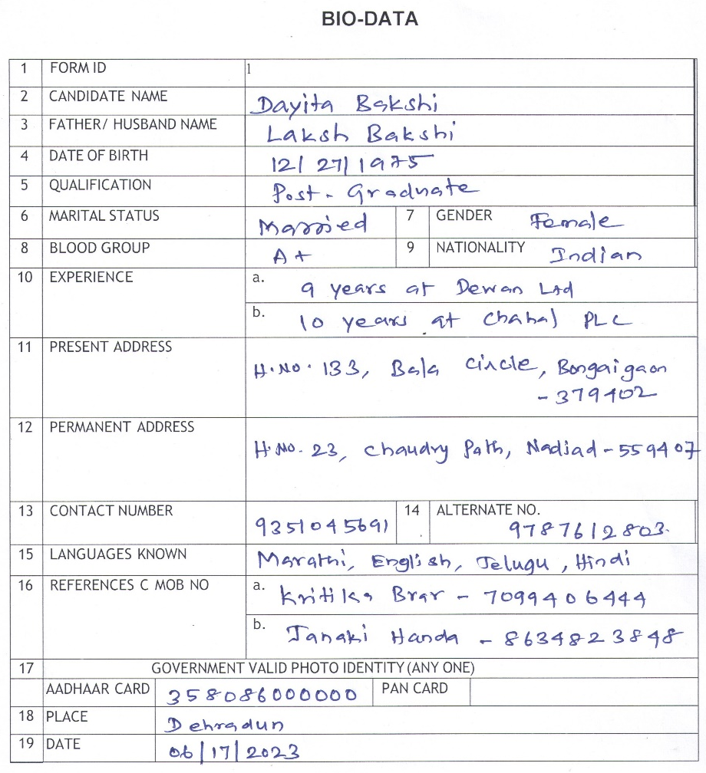
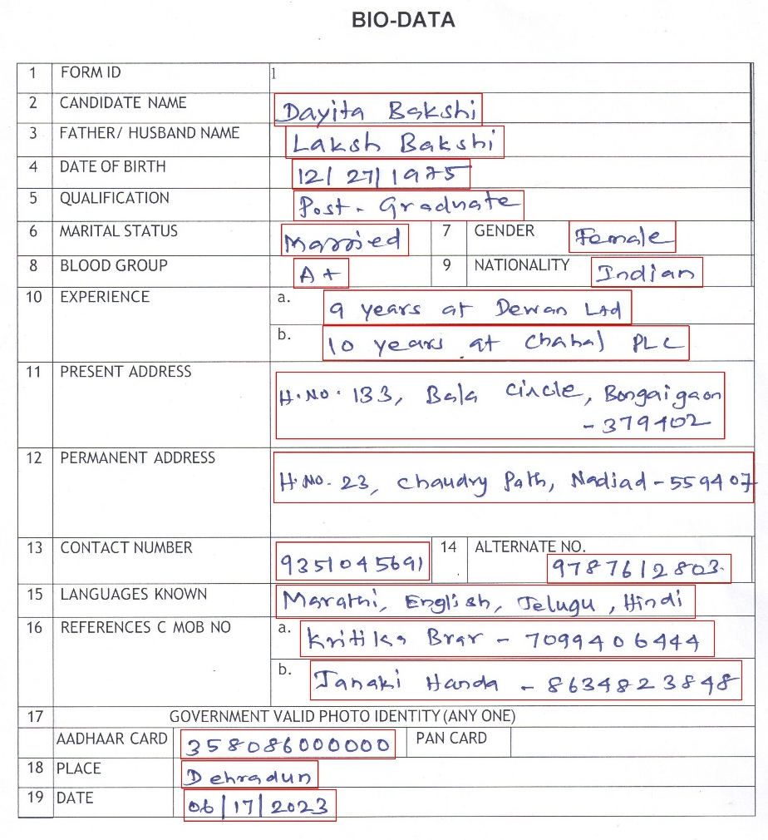
Field Detection Model
YOLO
Parameters | Value
Version | v8 medium
Parameters | 25M
Input Size | 640 X 640
Conf | 0.25
IOU | 0.4
6
DeHaDo-AI Challenge
NCVPRIPG 2025, IIT Jammu

Slide 8
Field Detection Model: YOLO Results
Actual
Positive
Negative
20382
209
Positive
Prediction
254
NA
Negative
📦 mAP@0.5 : 92.6%
🎯 Precision : 98.9%
🔍 Recall : 98.7%
⚖️ F1 Score : 98.8%
7
DeHaDo-AI Challenge
NCVPRIPG 2025, IIT Jammu

Slide 9

Field Matching
Normalization
Input Form
Bounding Boxes
Norm
IOU
Field
names
Ref. Form Bounding Boxes
Norm
8
DeHaDo-AI Challenge
NCVPRIPG 2025, IIT Jammu

Slide 10





OCR Model
Cropped Fields
TrOCR
Text
Parameters | Value
Type | ViT
Version | TrOCR-Large
Pre-Trained | IAM Dataset
Parameters | 580M
Input Size | 1000x1000
IOU | 0.4
HNO 133, Bala Circke, Bongaigan
Dayita Bakshi
358086000000
06/07/2023
A+
9
DeHaDo-AI Challenge
NCVPRIPG 2025, IIT Jammu

Slide 11
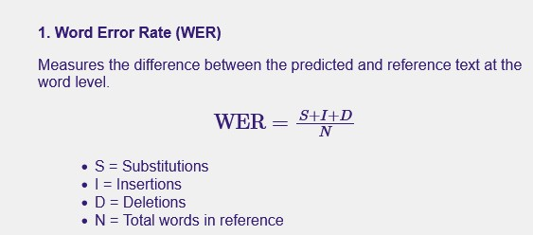
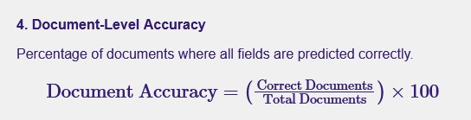
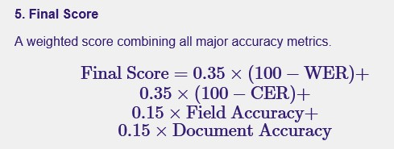
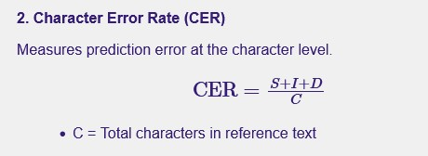
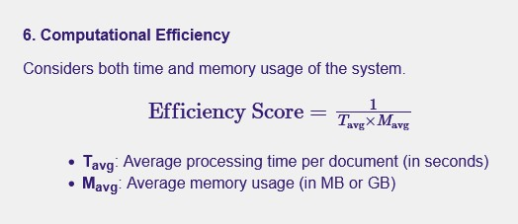
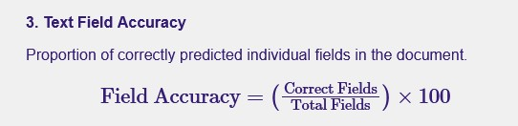
OCR Evaluation Metrics
10
DeHaDo-AI Challenge
NCVPRIPG 2025, IIT Jammu

Slide 12
OCR Results
CER
WER
11
DeHaDo-AI Challenge
NCVPRIPG 2025, IIT Jammu

Slide 13
Layout Aware Error Correction
Fix Incorrect Character
Format Validation
Autocorrect Text
Misrecognized characters are corrected
In Date, / is detected one
In alphabet only fields, B/O is detected as 8/0
Limit numerical fields to numbers
Aadhar to Numeric only,
Name to Text only
Fields with predefined values are autocorrected based on training data
Nationality: Indian
Marital Status: Married/Single
DeHaDo-AI Challenge
NCVPRIPG 2025, IIT Jammu

Slide 14
Benchmarks: CTC based OCR Model
Cropped Image
CNN Layer
Parameters | Value
Type | CTC OCR Model
CNN Layers | 3
Bi-LSTM Layers | 2
Parameters | 9M
Batch Size | 128
Epochs | 250
Bidirectional LSTM
LSTM
LSTM
LSTM
LSTM
CTC Loss Layer
Output Text
DeHaDo-AI Challenge
NCVPRIPG 2025, IIT Jammu

Slide 15
Benchmark Results
Model | CER | WER | Field Accuracy | Final Score
YOLO + Tesseract | 72.54 | 159.32 | 2.24 | -10.81
YOLO + Custom OCR | 37.58 | 46.93 | 62.58 | 40.51
YOLO + TrOCR | 29.79 | 114.12 | 6.27 | 20.56
YOLO + TrOCR + Layout Aware Post Processing | 15.82 | 41.62 | 47.52 | 57.02
DeHaDo-AI Challenge
NCVPRIPG 2025, IIT Jammu

Slide 16


Challenges and Learnings
Resource constraints in Fine tuning complex models
Performance debugging
Cleaning the dataset
Custom built models are flexible though not powerful
Domain knowledge Matters
Pre and Post processing improves accuracy
DeHaDo-AI Challenge
NCVPRIPG 2025, IIT Jammu

Slide 17

Future Work
Finetune the architecture of custom OCR Model
Combine detection and recognition into unified training pipeline
Cloud deployment
Extend it to general form recognition
DeHaDo-AI Challenge
NCVPRIPG 2025, IIT Jammu

Slide 18
Acknowledgement
Sincere Thanks to DeHaDo-AI Challenge organizers for the opportunity to work on a real-world handwritten form recognition problem and for curating a valuable dataset.
Grateful to IIT Jammu for selecting and presenting our work at the NCVPRIPG Conference.
DeHaDo-AI Challenge
NCVPRIPG 2025, IIT Jammu

Slide 19
Thank you!
DeHaDo-AI Challenge
NCVPRIPG 2025, IIT Jammu

