Slide 1
Shopping analysis & prediction
CAPSTONE PROJECT
Presented By:
Sathish
9513- Jayaraj Annapackiam CSI College Of Engineering
B.E Mechanical Engineering

Slide 2
OUTLINE
Problem Statement
Proposed System/Solution
System Development Approach
Algorithm & Deployment
Result
Conclusion
Future Scope
References

Slide 3
Problem Statement
Develop a comprehensive online shopping platform that caters to a wide range of products and provides an exceptional user experience. The platform should allow users to browse products, add items to their cart, and proceed through a seamless checkout process. Implement features for users to create accounts, manage their profiles, track orders, and receive notifications about promotions and order statuses. Ensure robust security measures for handling sensitive information such as payment details. Additionally, integrate analytics to track user behavior, gather feedback, and optimize the platform for improved performance and customer satisfaction. The goal is to create a user-friendly, secure, and efficient online shopping experience that encourages repeat business and fosters customer loyalty.

Slide 4
Proposed Solution
User Registration and Authentication:
Allow users to register accounts with email verification and password authentication.
Implement social media login options for added convenience.
Product Catalog:
Develop a product catalog with categories, filters, and search functionality.
Include product details, images, prices, availability, and customer reviews.
Shopping Cart and Checkout:
Enable users to add products to their shopping cart and proceed to checkout.
Implement a secure checkout process with multiple payment options (credit/debit cards, PayPal, etc.).
Include features like order summary, shipping address selection, and order confirmation.
User Profiles and Account Management:
Provide users with personalized profiles where they can manage orders, view order history, and update personal information.
Allow users to save favorite items, create wishlists, and receive personalized recommendations.
Order Tracking and Notifications:
Enable order tracking with real-time updates on order status and delivery.
Implement email/SMS notifications for order confirmations, shipment tracking, and delivery alerts.

Slide 5
System Approach
Requirement Gathering:
Conduct thorough research and gather requirements from stakeholders, including users, administrators, and vendors.
Identify key features, user roles, security requirements, and integration needs.
Design and Architecture:
Database Design: Design a database schema to store product information, user data, orders, transactions, and other relevant data.
System Architecture: Choose an appropriate architecture (e.g., monolithic, microservices) based on scalability, performance, and maintenance requirements.
User Authentication and Authorization:
Implement user authentication mechanisms (e.g., email/password, social login) and authorization controls to ensure secure access to user-specific features and data.
Product Catalog and Inventory Management:
Develop a product catalog with categories, filters, search, and sorting functionalities.
Implement inventory management features to track product availability, stock levels, and updates in real-time.
Shopping Cart and Checkout:
Enable users to add products to their cart, update quantities, and proceed to checkout.
Implement a secure checkout process with multiple payment gateways, shipping options, and order summary.

Slide 6
Algorithm & Deployment
Shopping Algorithm:
User Registration and Authentication:
Users register with their email and password.
Authentication is done through a secure mechanism such as JWT (JSON Web Tokens).
Product Listing and Search:
Products are listed with details like name, description, price, category, and availability.
Users can search for products based on keywords, categories, or filters.
Shopping Cart Management:
Users can add products to their cart, update quantities, and remove items.
The cart state is maintained for each user session.
Checkout Process:
Users proceed to checkout with items in their cart.
They provide shipping details, select payment method, and confirm the order.
Payment Processing:
Payment information is securely collected and processed using a payment gateway (e.g., Stripe, PayPal).
Transactions are confirmed and receipts are generated.
Order Fulfillment:
Orders are processed for fulfillment, including inventory deduction and shipment preparation.
Users receive order confirmation and tracking information.

Slide 7
Deployment
Infrastructure:
Choose a reliable hosting provider for deployment, such as AWS, Google Cloud, or Azure.
Use scalable infrastructure to handle varying levels of traffic and demand.
Server Configuration:
Configure servers with necessary software dependencies (e.g., web server, database server) and security measures (firewalls, SSL certificates).
Database Management:
Choose a database system suitable for the application's data needs (e.g., MySQL, PostgreSQL, MongoDB).
Set up database backups, replication, and monitoring for data integrity and availability.
Monitoring and Logging:
Set up monitoring tools for performance monitoring, error tracking, and log management.
Monitor server metrics, application health, and user activities for proactive management.
Backup and Disaster Recovery:
Implement regular backups of data and configurations to prevent data loss in case of failures or disasters.
Have a disaster recovery plan in place to restore operations quickly in case of downtime.
Load Testing:
Conduct load testing to simulate heavy user traffic and identify performance bottlenecks.
Optimize application performance based on load testing results.
User Support and Feedback:
Provide customer support channels (e.g., live chat, email support) for user inquiries and issues.
Gather user feedback through surveys, ratings, and reviews to improve the platform continuously.

Slide 8
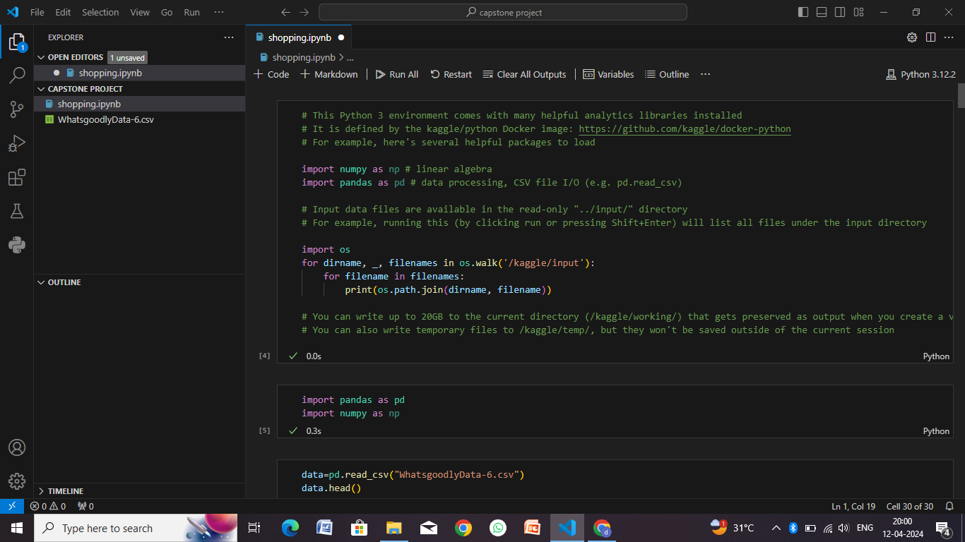
Result

Slide 9
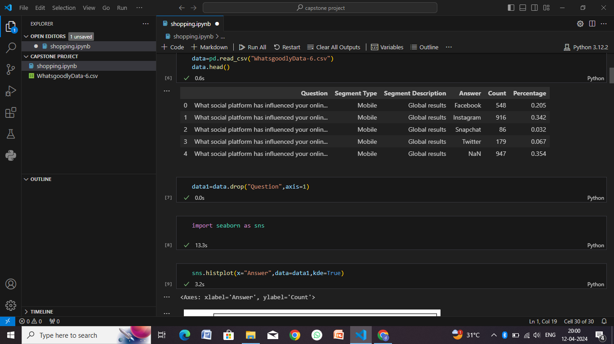

Slide 10
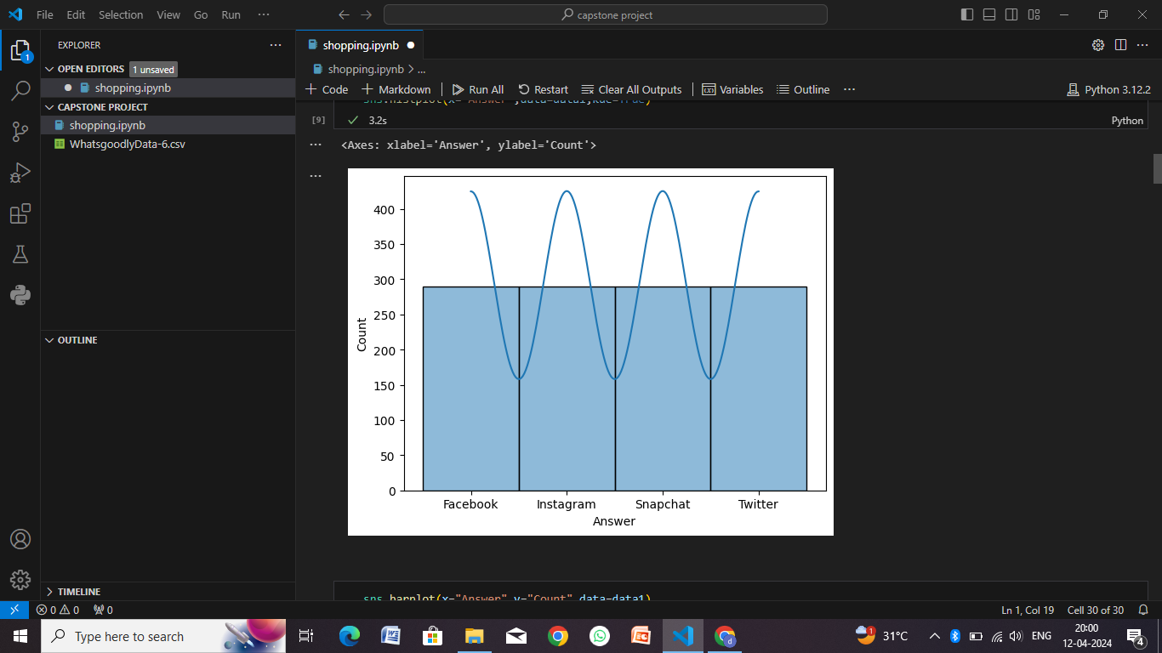

Slide 11
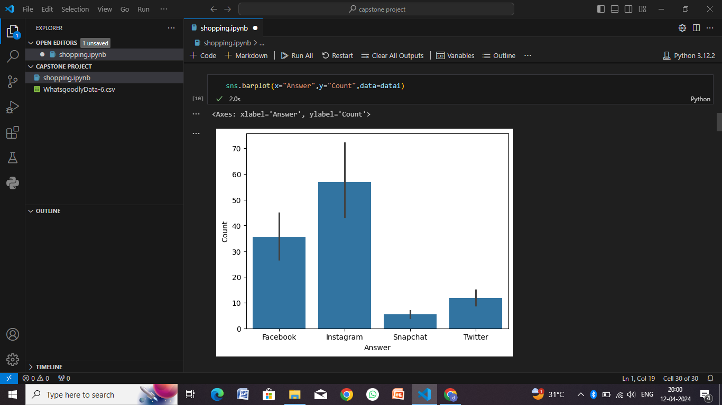

Slide 12
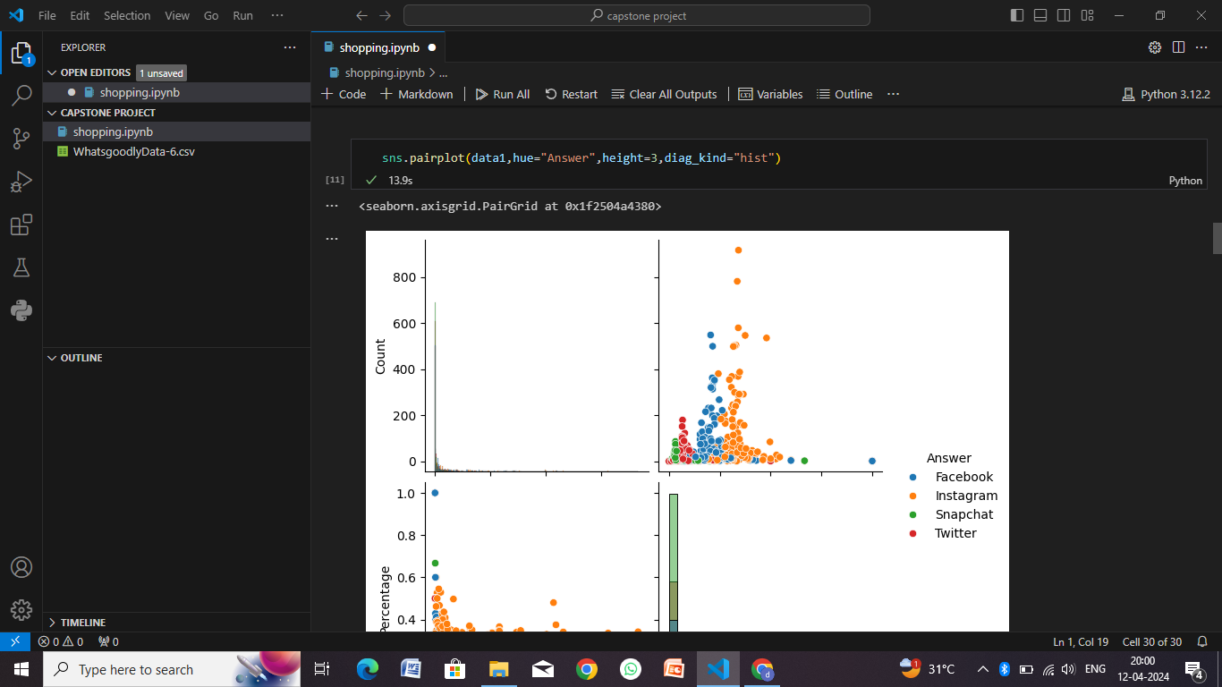

Slide 13
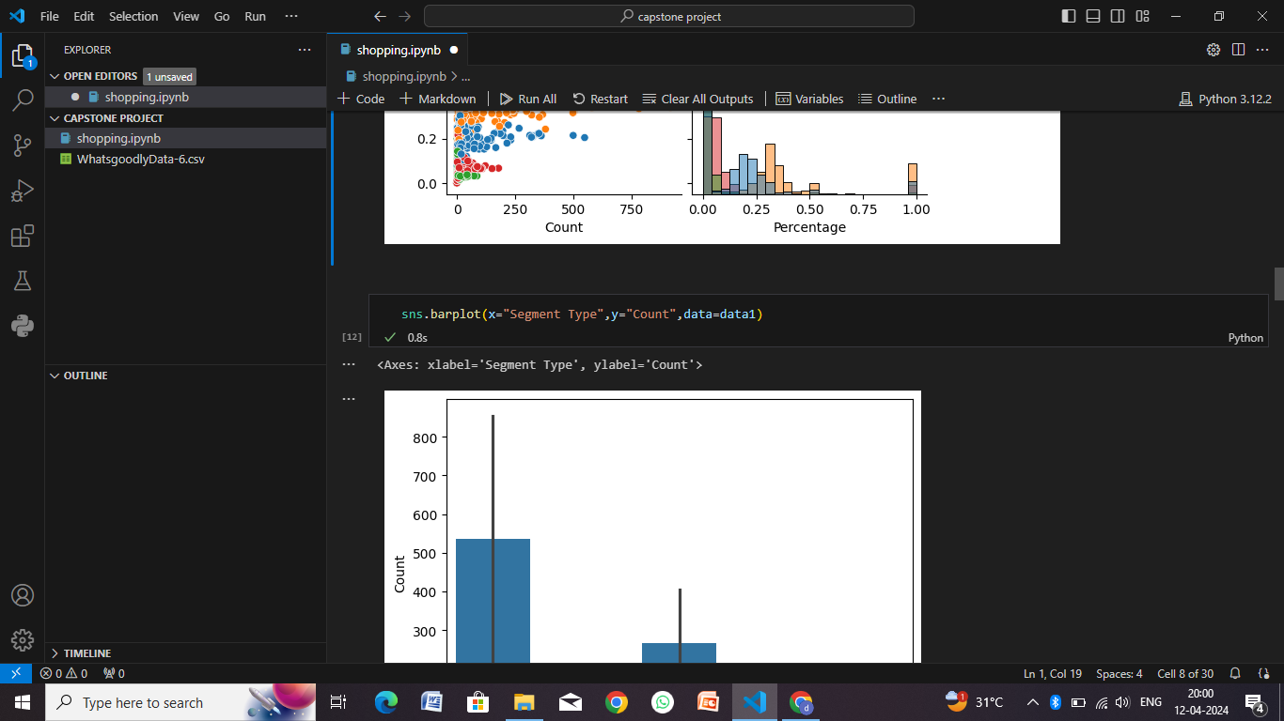

Slide 14
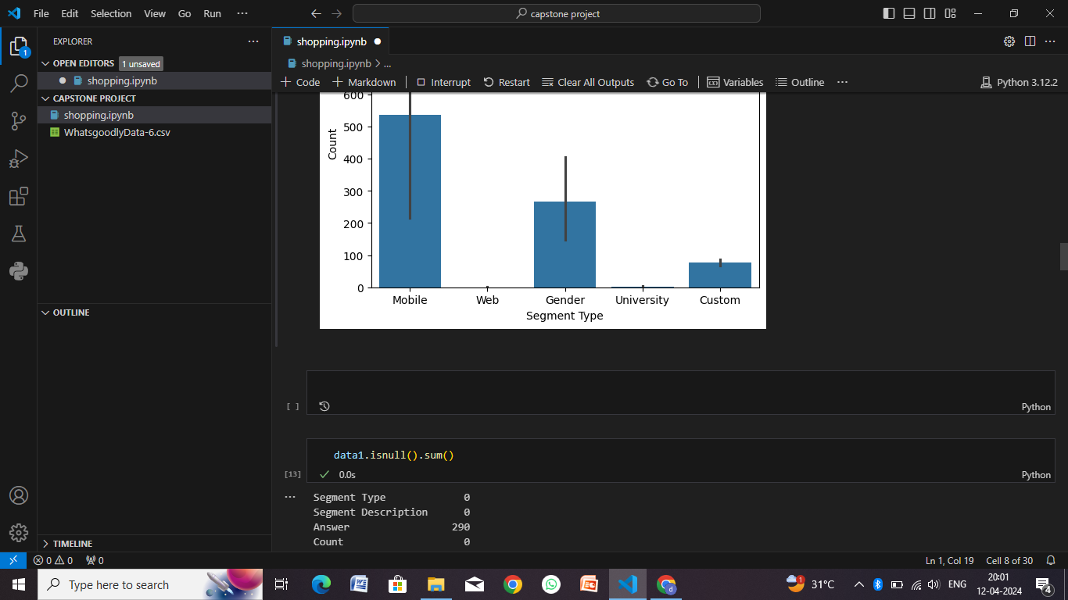

Slide 15
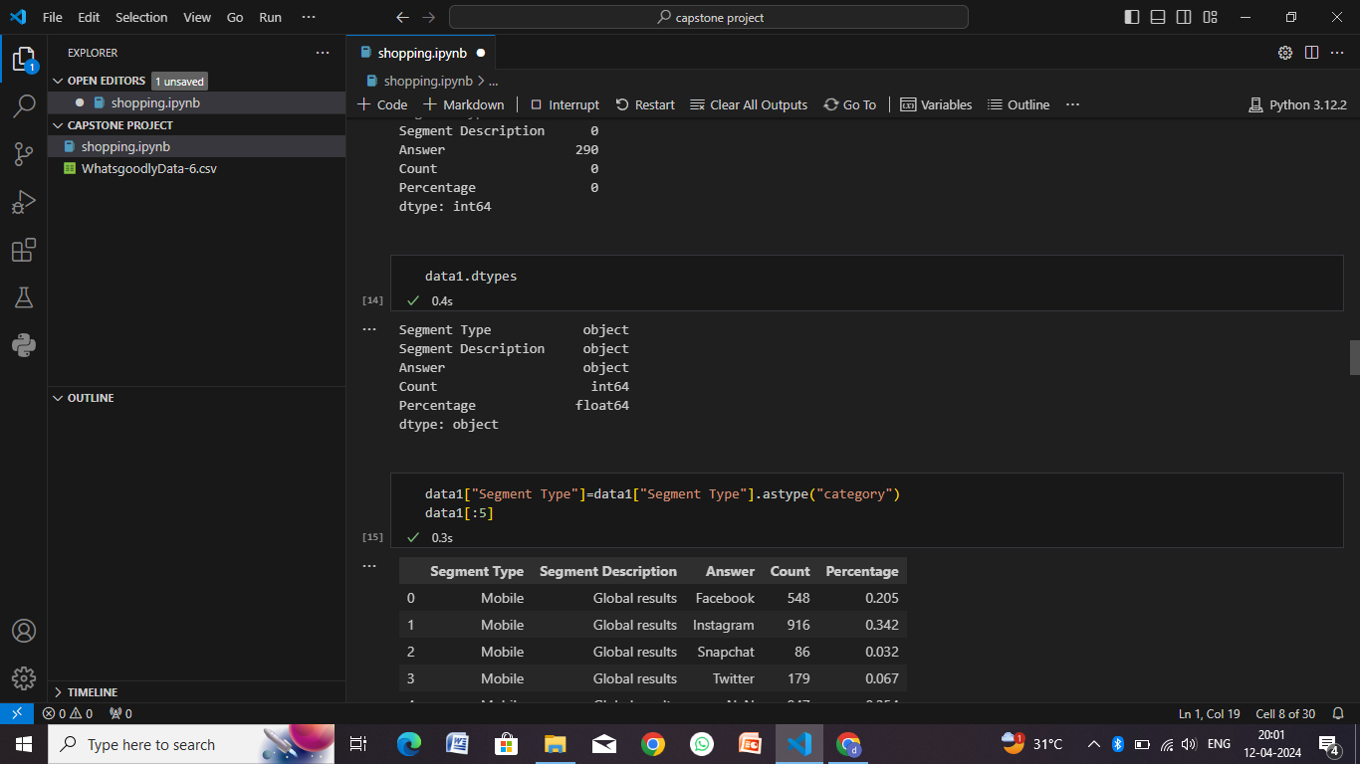

Slide 16
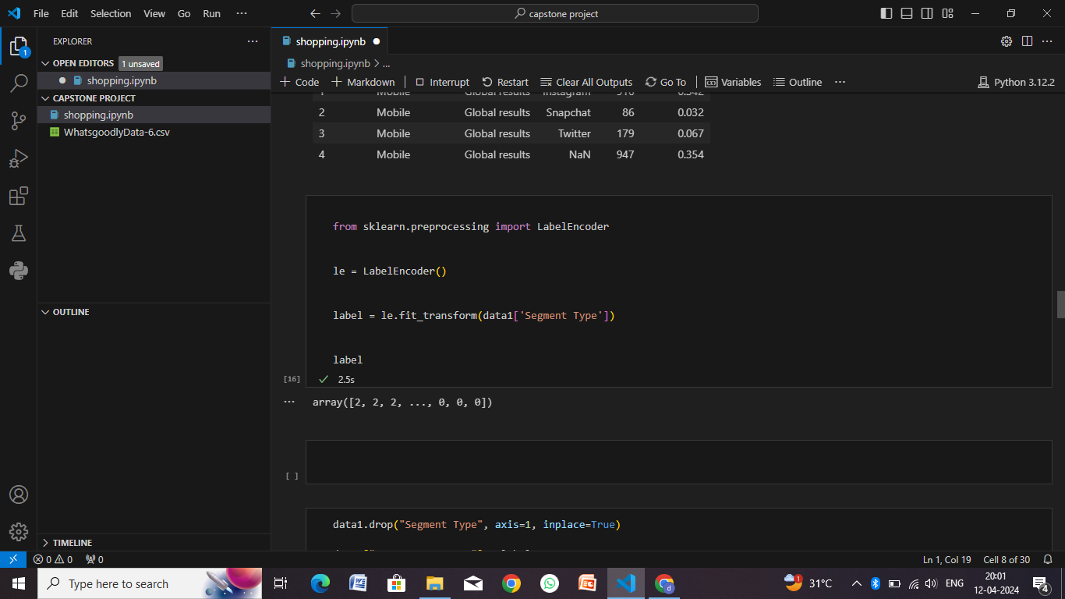

Slide 17
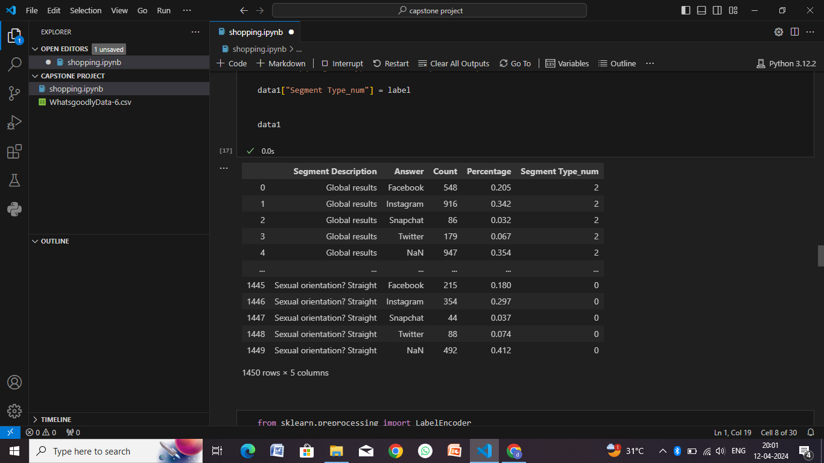

Slide 18
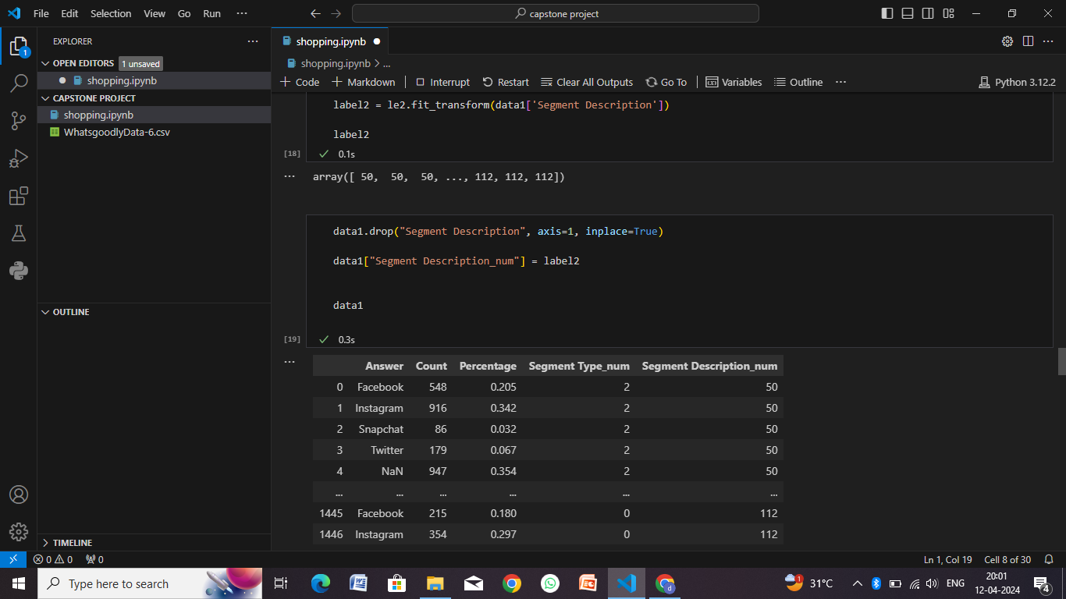

Slide 19
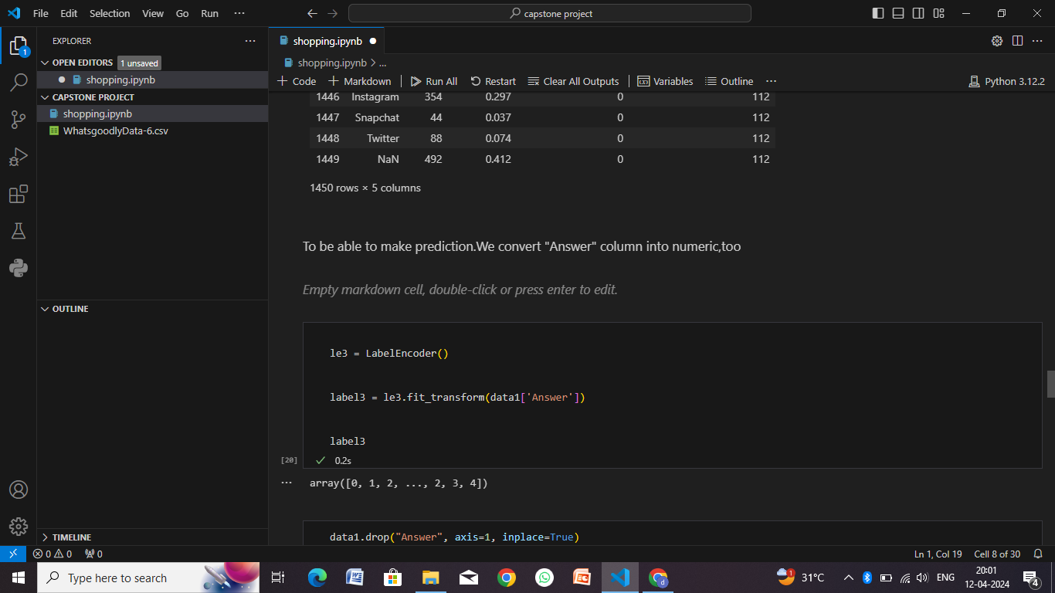

Slide 20
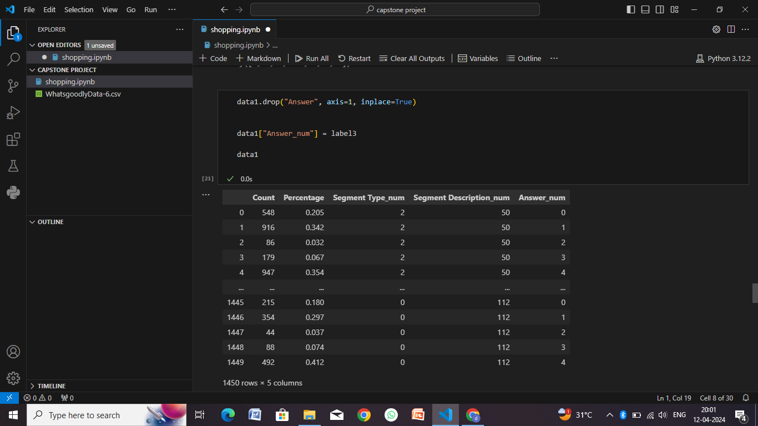

Slide 21
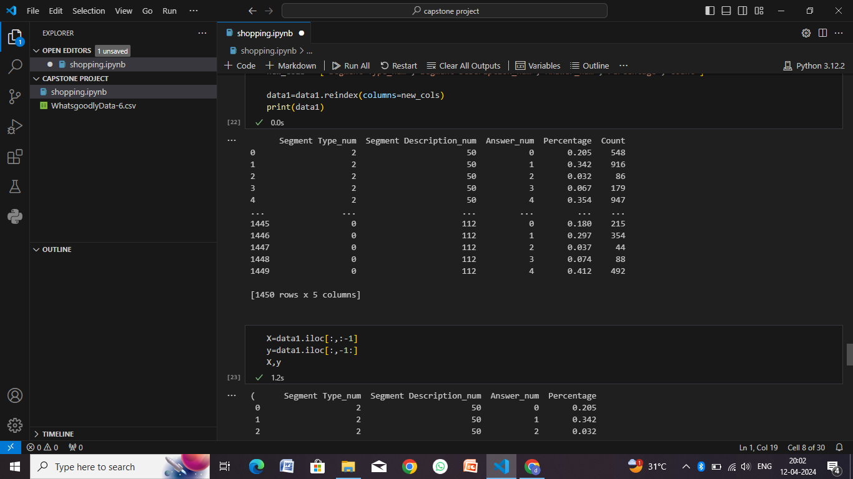

Slide 22
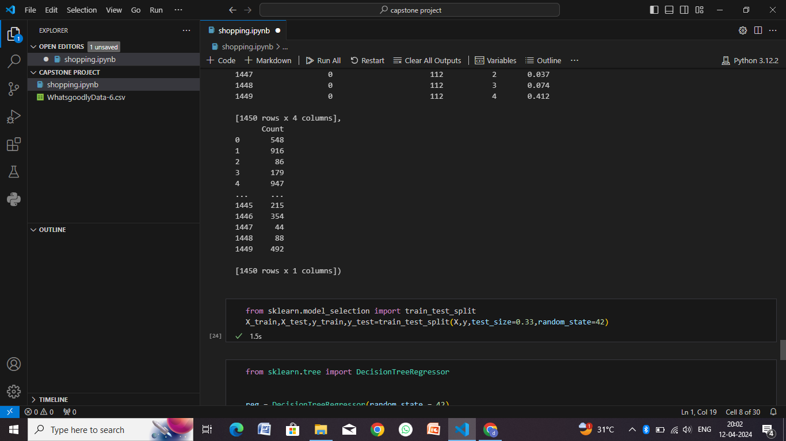

Slide 23
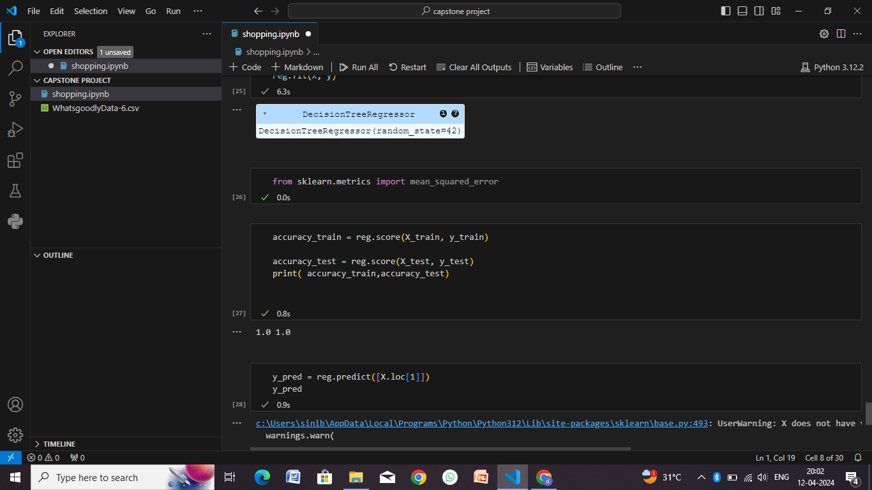

Slide 24
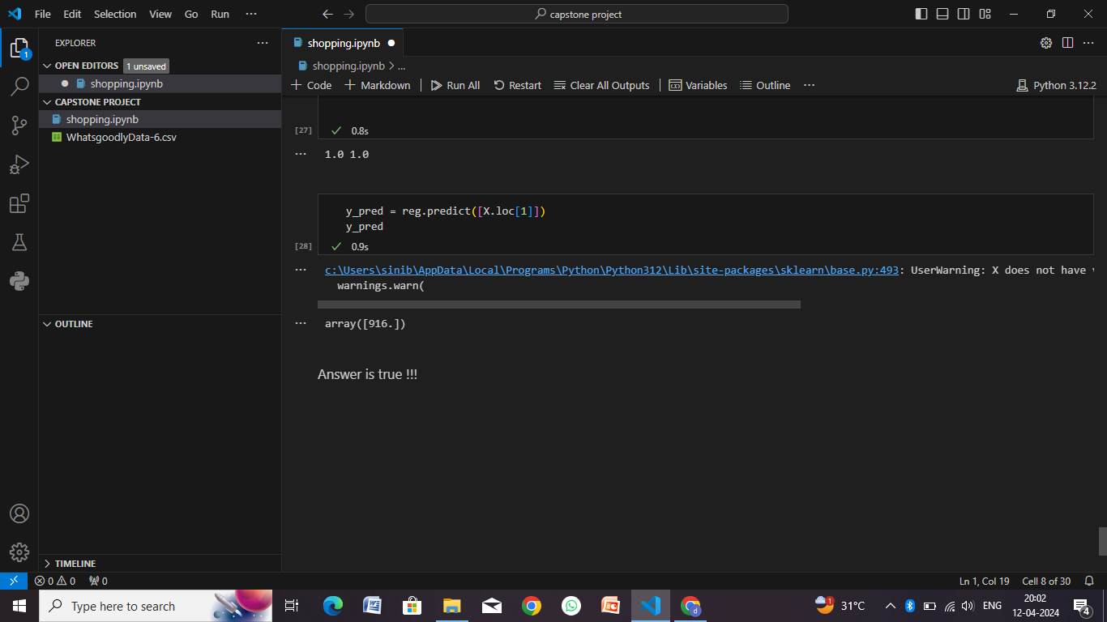

Slide 25
Conclusion
developing a comprehensive shopping system requires careful consideration of various aspects ranging from user experience to deployment strategies. Here are the key points summarizing the approach and considerations:
User-Centric Approach: Focus on providing a seamless and intuitive user experience throughout the shopping journey, from product browsing to checkout and post-purchase support.
Feature-Rich Functionality: Include essential features such as user registration/authentication, product catalog, search/filtering options, shopping cart management, secure checkout, payment processing, order tracking, and user account management.
Security and Compliance: Implement robust security measures to protect user data, transactions, and sensitive information. Comply with industry standards and regulations (e.g., PCI DSS for payment processing, GDPR for data privacy) to ensure data security and legal compliance.
Scalability and Performance: Design the system architecture for scalability, with considerations for load balancing, auto-scaling, caching, and optimized database management. Conduct performance testing and optimization to handle varying levels of user traffic and maintain system responsiveness.
Deployment Best Practices: Choose a reliable hosting provider, configure servers with necessary software dependencies and security measures, implement CI/CD pipelines for automated testing and deployment, monitor system metrics, and have backup/disaster recovery plans in place.
Continuous Improvement: Gather user feedback, monitor analytics, and conduct regular updates and enhancements to improve the platform's functionality, performance, and user satisfaction. Incorporate new technologies and trends (e.g., AI/ML for personalized recommendations, AR/VR for immersive experiences) to stay competitive and meet evolving user expectations.

Slide 26
Future scope
The future of shopping platforms holds exciting possibilities, with advancements in technology and changing consumer behaviors driving innovation. Here are some key areas of future scope for shopping systems:
Personalization and AI Integration
Voice Commerce
Augmented Reality (AR) and Virtual Reality (VR)
Social Commerce
Mobile Commerce (M-Commerce)
Block chain and Crypto currency Integration
Subscription-Based Models
Green and Sustainable Shopping
Omni-Channel Integration
Data Analytics and Personal Data Protection

Slide 27
References
Websites and Online Resources:
Shopify Blog (https://www.shopify.com/blog): Provides articles, guides, and resources for e-commerce entrepreneurs and businesses.
Econsultancy (https://econsultancy.com): Offers research, reports, and articles on digital marketing, e-commerce trends, and customer experience.
Retail Dive (https://www.retaildive.com): Covers news, insights, and analysis related to retail and e-commerce industry trends.
E-commerce Platforms and Tools:
Shopify (https://www.shopify.com): A popular e-commerce platform for building online stores, managing inventory, and processing payments.
WooCommerce (https://woocommerce.com): A WordPress plugin for creating customizable e-commerce websites with features like product listings, checkout, and shipping.
Industry Reports and Research:
Forrester Research (https://www.forrester.com): Offers research reports, insights, and analysis on e-commerce trends, customer behavior, and market forecasts.
Statista (https://www.statista.com): Provides statistics, charts, and infographics on retail and e-commerce industry trends, consumer spending, and market analysis.

Slide 28
THANK YOU

