Slide 1




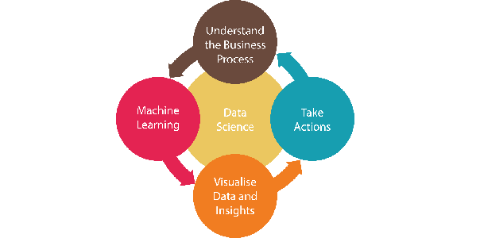
Predict Customer Churn in Banking Industry Sathish Manthani | email: smanthani@my365.bellevue.edu
Introduction
Deliverables
Conclusion
Customers are the most valuable assets of any business. Retaining customers has become the basic need of the organizations regardless of the industry.
The cost of acquiring a new customer is at least 6 times higher than retaining an existing customer in the finance industry. Besides, an existing customer generates relatively more revenue than a new customer.
So, banks or credit card institutions must find ways to predict who is going to leave next. Banks should analyze such customer’s recent activity for any issues they faced and expedite resolving them, target them for promotions, and start communicating with them to ensure he/she stays satisfied with the services.
Discuss the problem statement and approach to solution using CRISP-DM methodology
Explain lifecycle of customer relationship with bank
Explore the various steps involved in modeling and identify the variables that matter most with regards to customer churn
CRISP-DM methodology can be used to identify the features and characteristics in the banking datasets of customers who are about to churn.
Target high-value customers to start with because their churn really matters.
These approaches can also be used to predict other aspects of customer behavior like when a customer would go on a vacation or buy a car so that targeting him with relevant offers would maximize the revenue.
Literature
Developing a prediction model for customer churn from electronic banking services using data mining https://www.researchgate.net/publication/306388481_Developing_a_prediction_model_for_customer_churn_from_electronic_banking_services_using_data_mining
Predicting Customer Churn For A Credit Card Company: https://www.galitshmueli.com/data-mining-project/predicting-customer-churn-credit-card-company
Preventing Bank Customer Churn: https://www.kaggle.com/kmalit/bank-customer-churn-prediction
Introduction to Churn Prediction in Python: https://www.datascience.com/blog/churn-prediction-python
Predicting Financial Account Churn: https://www.elderresearch.com/hubfs/Resources/Elder_Research_Case_Study_Predicting_Account_Churn_in_Retail_Banking.pdf
Reducing Customer Attrition with Machine Learning for Financial Institutions: https://www.sas.com/content/dam/SAS/support/en/sas-global-forum-proceedings/2018/1769-2018.pdf
Why Data Science?
Data science provides powerful algorithms and predictive models for the extraction of knowledge from huge amounts of data.
Banking companies deal with a high volume of transactional data in structured/unstructured data platforms every day.
So, we need data science to make sense of that data and extract useful information to understand customer churn management.
Acknowledgements
Thanks to the new age internet, which includes acm.org, medium.com, Kaggle sites and research papers. They made my life easy! Special thanks to my wife for keeping quiet while I work on assignments.

