Slide 1
Expenditures
File created on: 6/27/2020 11:53:50 AM

Slide 2
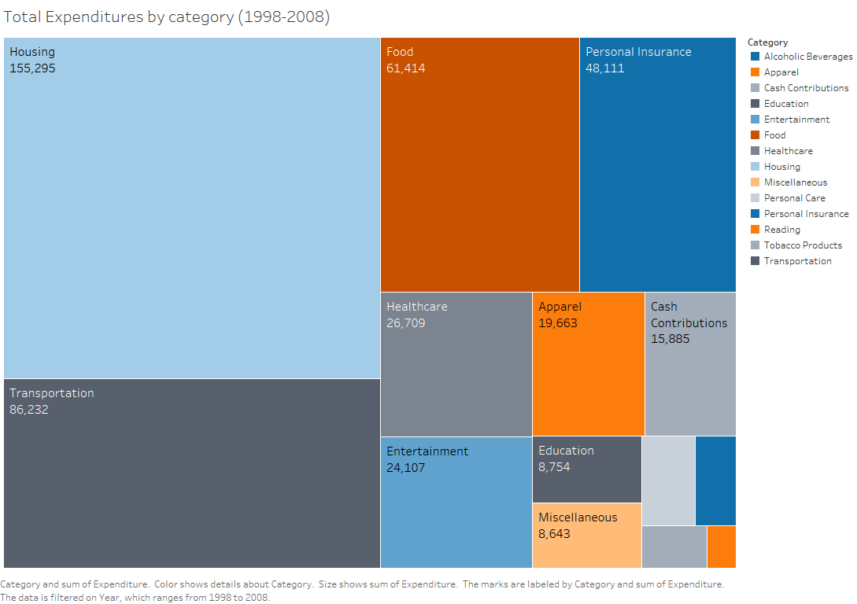

Slide 3
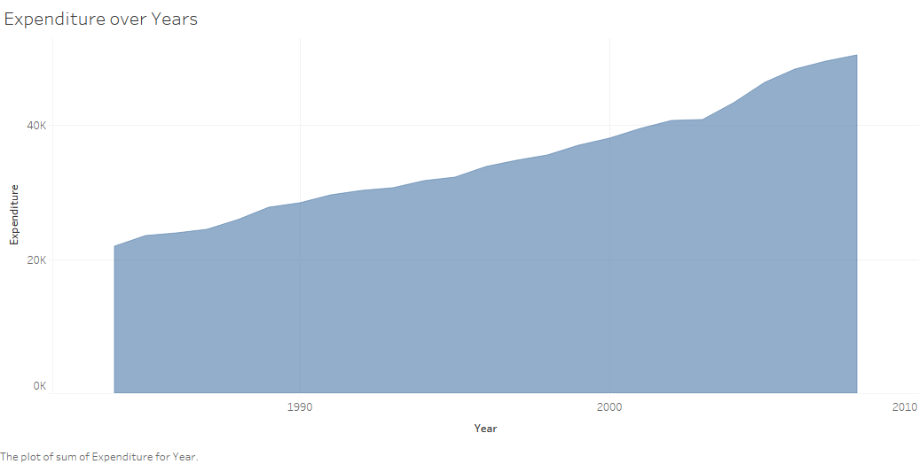

Slide 4
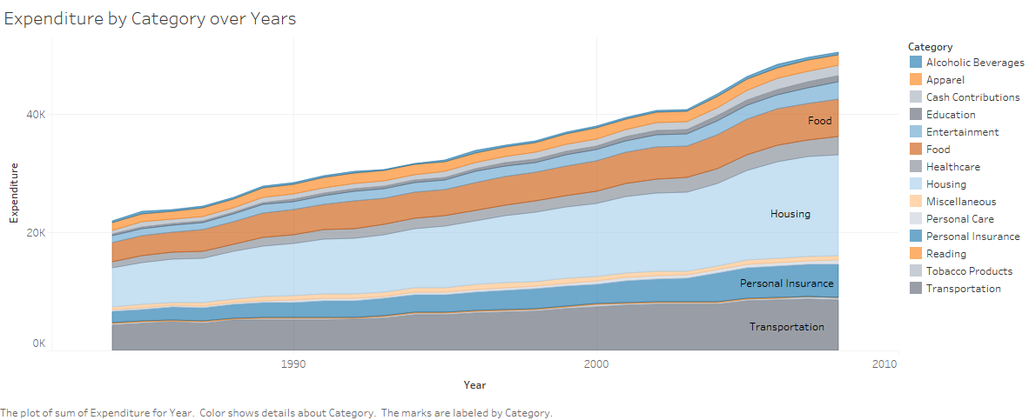

Slide 5
