Slide 1
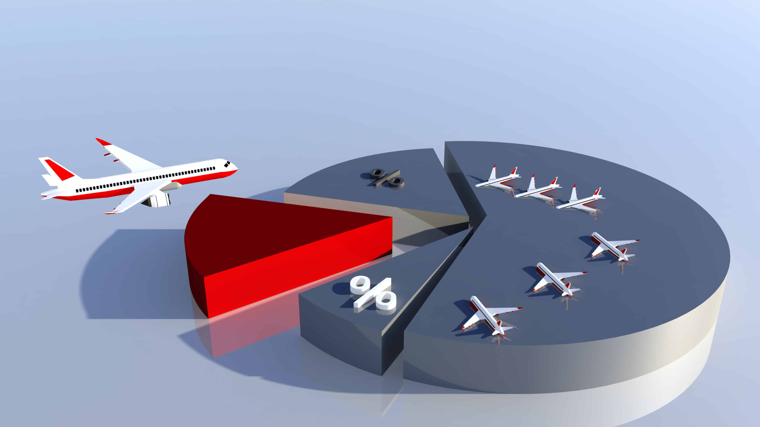
Airlines Safety
Executive Summary
Author: Sathish MAnthani

Slide 2
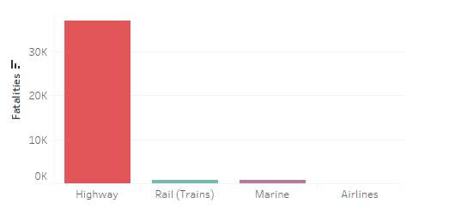
Airline Vs Car Fatalities
Airlines Vs Car crashes
Airline crashes fell by more than half in 2019 compared to 2018. The historic low was in 2017, which saw only two fatal air accidents which resulted in the loss of 13 lives. (Source: Afar.com)
According to National Transportation Safety Board 1.13 fatalities per 100 million vehicle miles traveled.
Traffic Casualties By Mode in 2017
Highway: 37,133
Rail (Trains): 761
Marine (Boats & Other Watercraft): 694
Commercial Airlines: 0
2017 transportation casualty figures show that individuals are far more likely to die on a highway, train or boat than in an airplane.

Slide 3

Airline Fatalities in 1985-99 Vs 2000-14
There is a significant drop in airline fatalities in 2000-14 compared to 1985-99
That means airline fatalities are less like occur today than couple of decades ago. This could be due to advancement in technology and improved safety measures

Slide 4
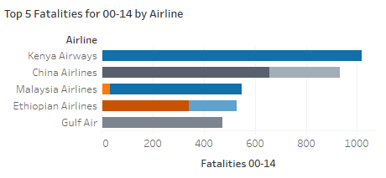
Top 5 Airlines with most fatalities
Kenya Airlines has high fatalities in 2000-14 but didn’t have any fatality in prior period.
China Airlines looks to be unsafe to travel as it has fatalities in both time frames.
If you notice, all these airlines are not operated by First-world countries.

Slide 5
Summary
Airline fatalities are declining with time. Advancement in technology is increasing the safety of air travel.
Americans have a 1 in 114 chance of dying in a car crash and 1 in 9,821 in air travel. [Source: Fortune.com]
Airlines are clearly safer way of traveling than any other transportation mode
In 2000-14 period, only 5% of total fatalities occurred by airline operated by first-world country. 95% of fatalities occurred in rest of the world airlines.
First-world countries have far less air incidents and fatalities than airlines operated by other countries. So, the advancement in technology and increased safety measures are probably keeping the air travel safer in first world countries.

Slide 6

​“A person would have to fly on average once a day every day for 22,000 years before they would die in a U.S. commercial airplane accident according to recent accident rates.” ​-Dr. Arnold Barnett, MIT Thank you

