Slide 1
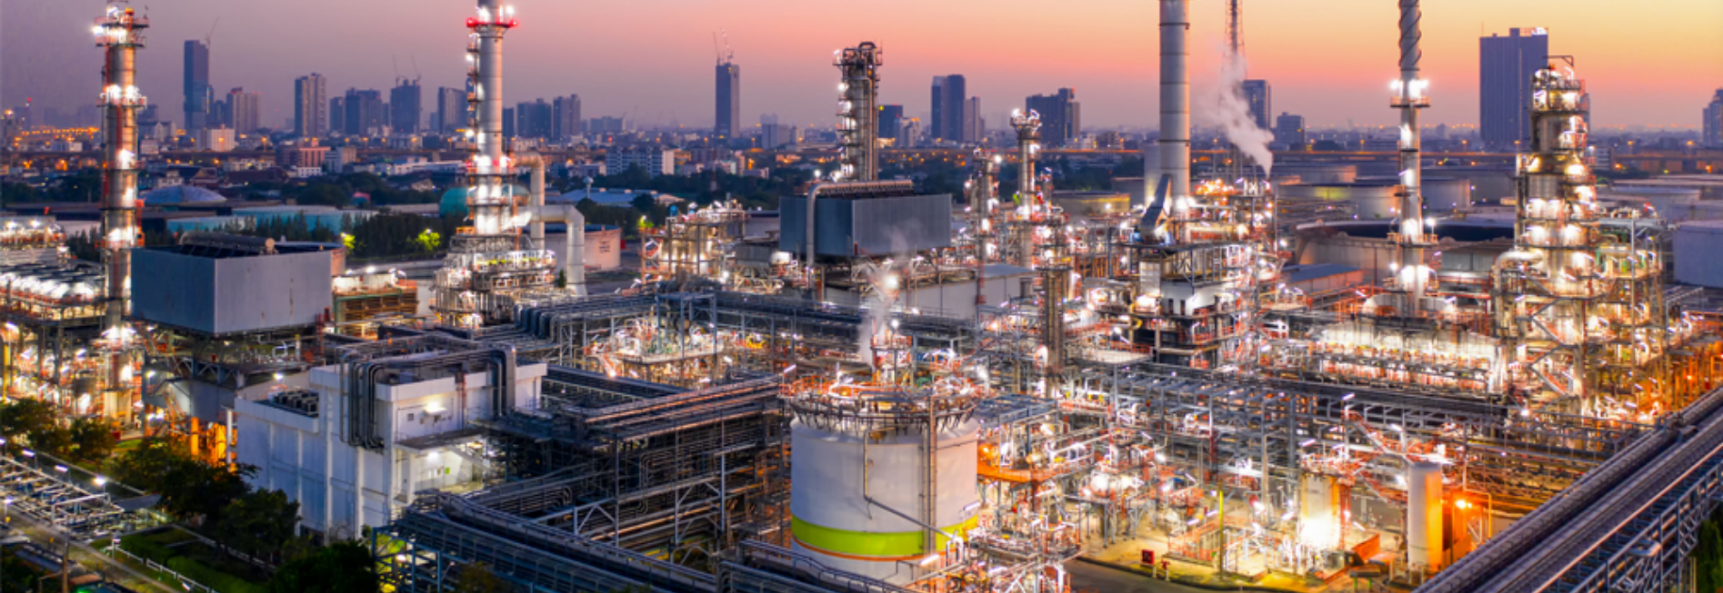



VALVE TECH TESTING & SERVICES W.L.L

Slide 2
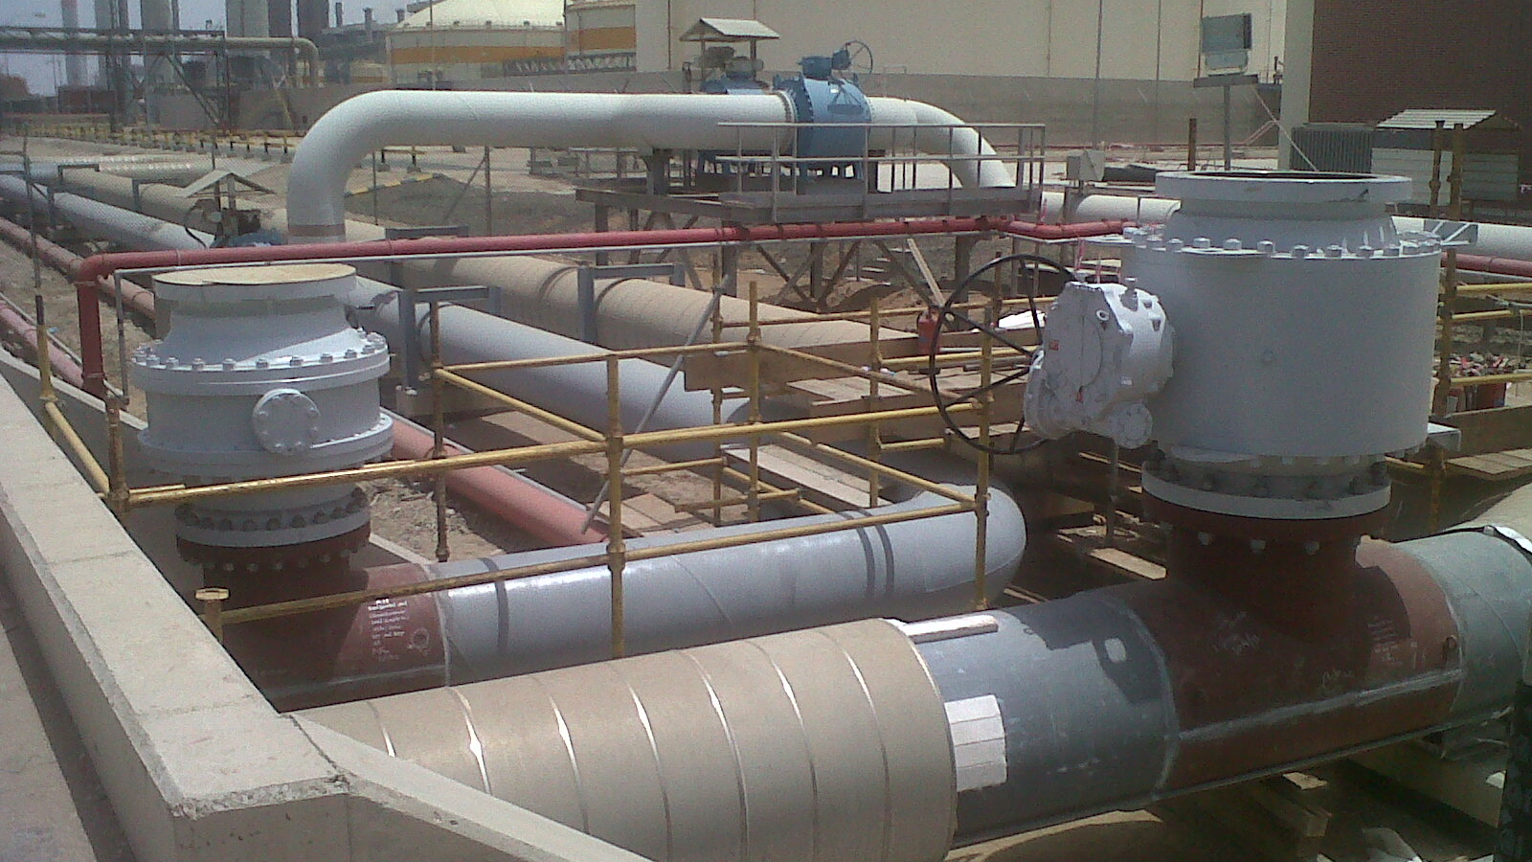
Pipeline Intervention – Hot Tapping Services
Hot Tapping is a process of creating a new connection to an existing system without the need for shutdown, isolation, drainage or purging, which in turn reduces downtime and costs.
The General set-up consists of a Hot Tap Split Tee and Permanent Isolation Valve.

Slide 3
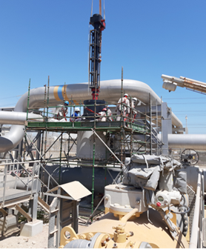
Hot Tapping
Hot Tapping can be performed on pipes, tanks and vessels up to 72” and with a maximum pressure threshold of 1480 PSI.
Suitable temperatures can be up to a maximum of 250°C depending on pressure.
Hot Tapping is suitable for Oil, Gas, Water, Petrochemicals, Hydrocarbons amongst others and materials of Carbon Steel, Stainless Steel, Ductile Iron, Cast Iron, HPDE, PVC, Asbestos and many more.

Slide 4
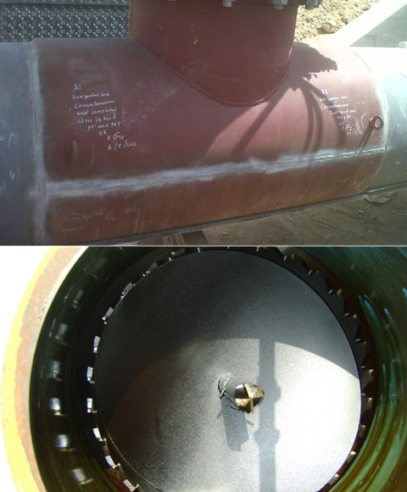
Hot Tapping
Hot Tapping requires a Split Tee to be welded or mechanically clamped to the existing pipe.
The Split Tee will then undergo NDT and be hydrostatically pressure tested to 1.5x operating pressure to ensure it’s integrity.
A Gate/Ball Valve will be installed and another Hydrostatic test will be performed to ensure no leaking joints.
Then we are ready to install the Hot Tap Machine and begin the drilling operation.
The pipe piece or ‘coupon’ is retrieved using a pilot drill with attached ‘U’ wires. This ensures the cut piece of pipe is removed after completion of the drilling.

Slide 5
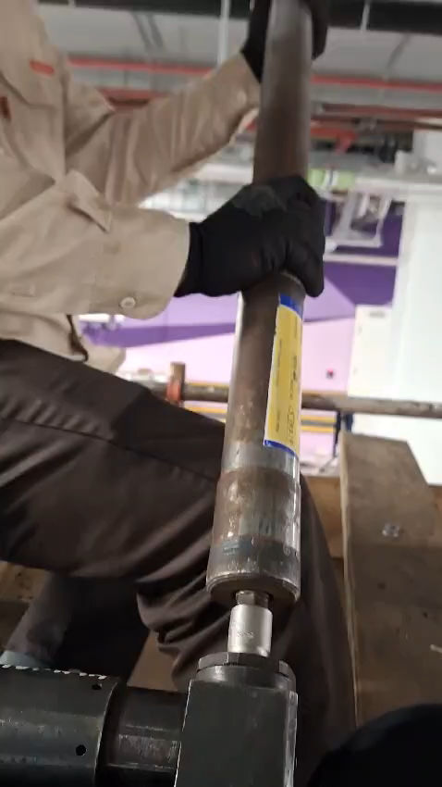
Hot Tapping Drilling

Slide 6
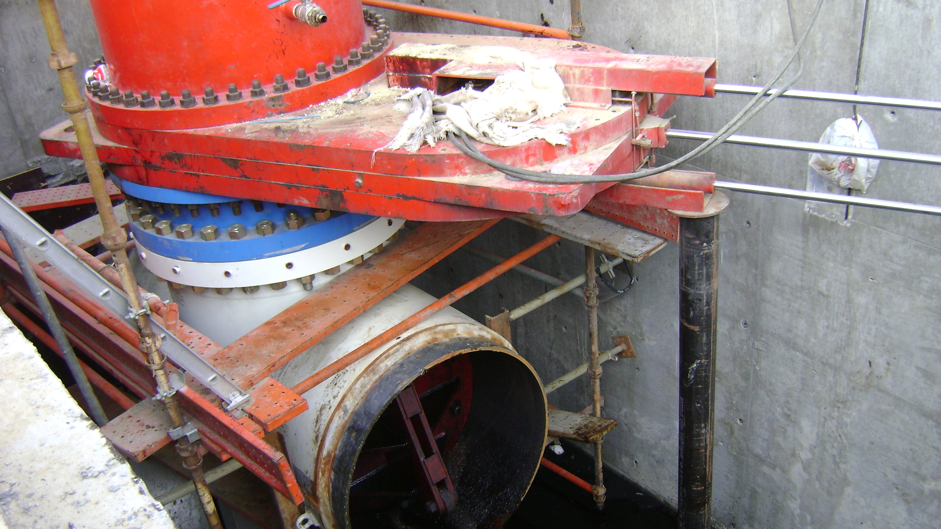
Pipeline Intervention – Line Stopping Services
Line Stopping is a process of isolating part of an existing system without the need for shutting down the entire unit. Smaller sections can be isolated enabling modifications or repairs without affecting the supply/process, by utilizing bypasses.

Slide 7
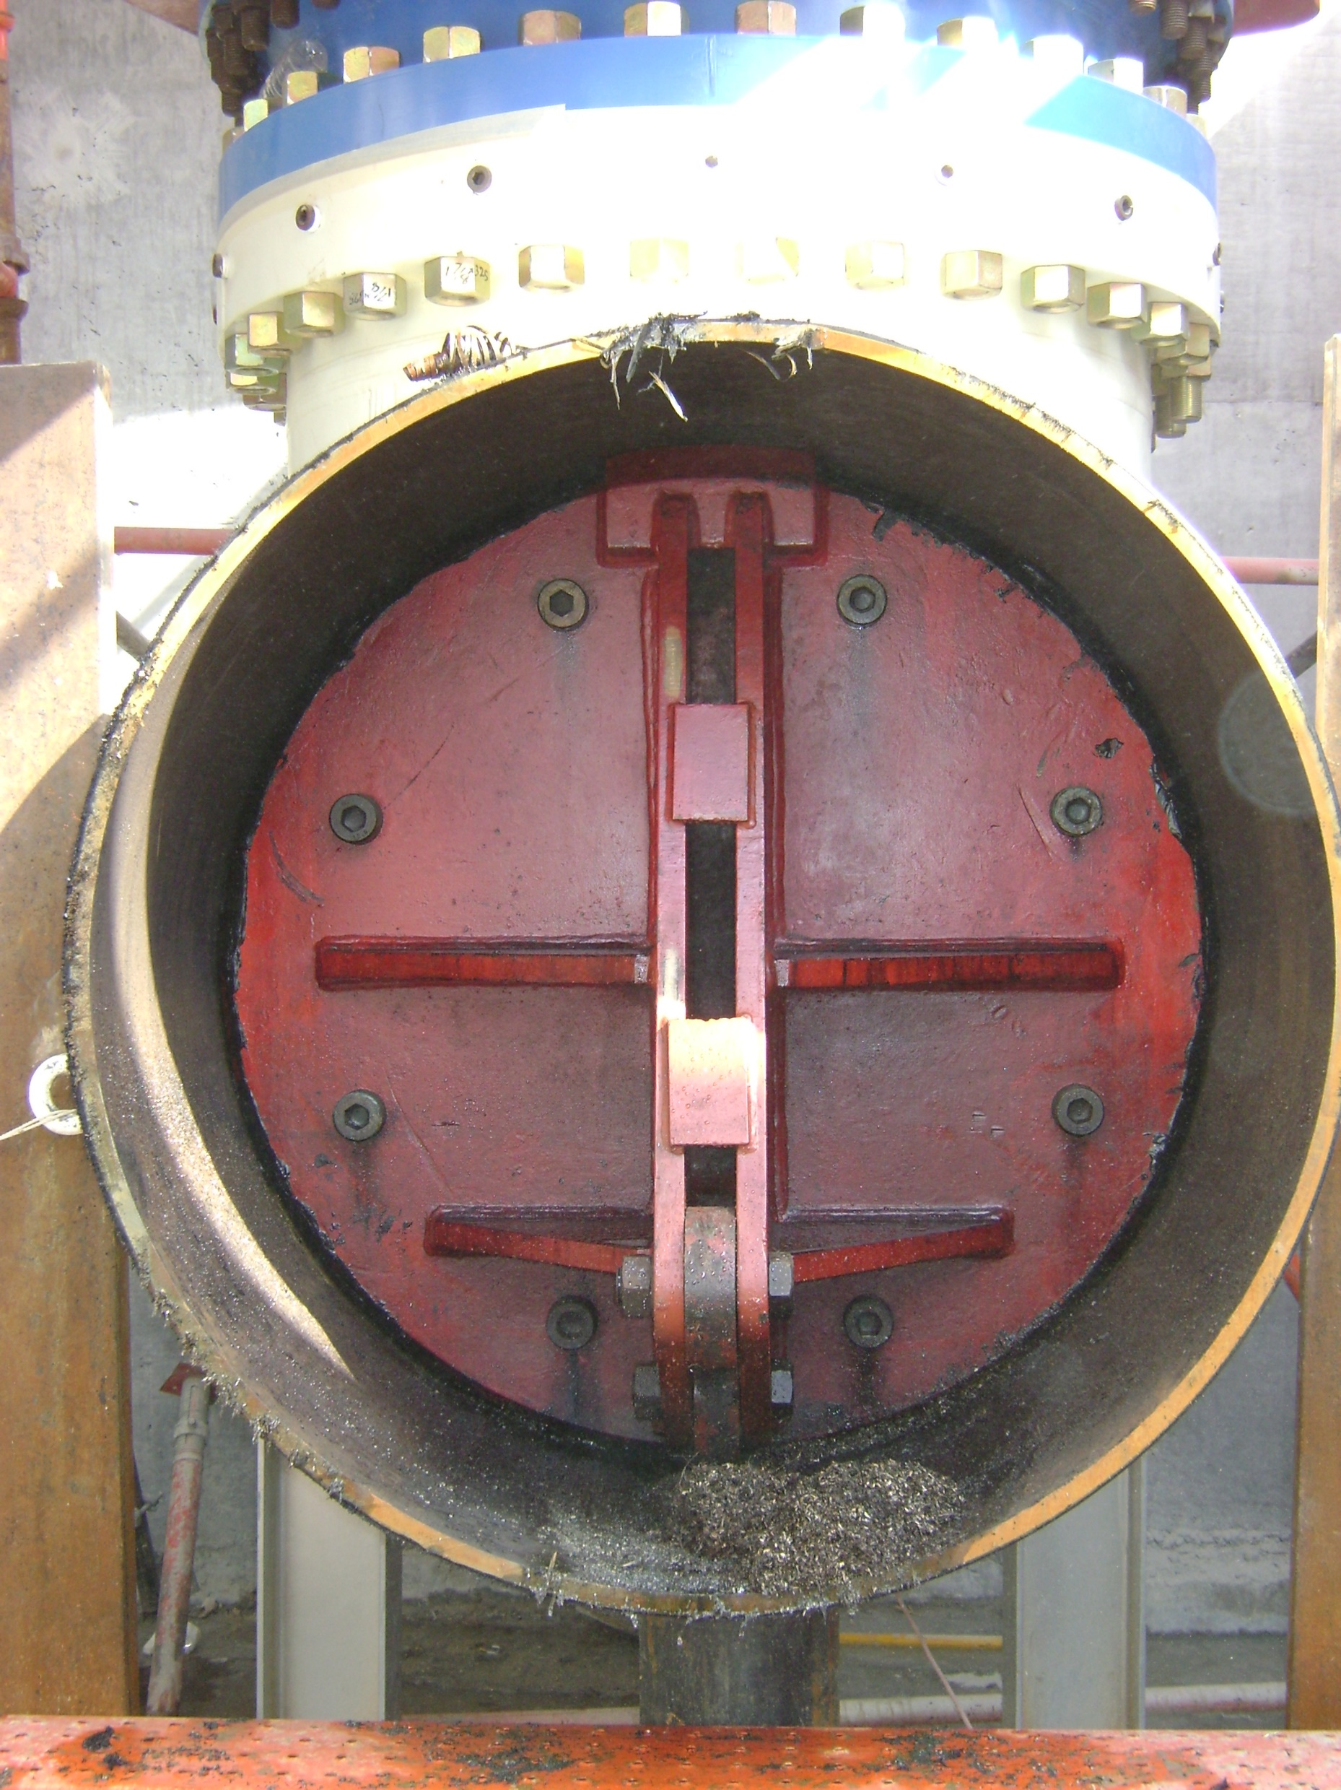
Line Stops
Line Stops can be utilized for long term major modification work where existing system isolation points don’t exist.
Or they can be used for short term quick modifications/repairs where downtime is crucial to the operations of the plant.
There are multiple types of Line Stops depending on the size, product, pressure and temperature.
These include mechanical, bag stop, freezing and rubber expansion.

Slide 8
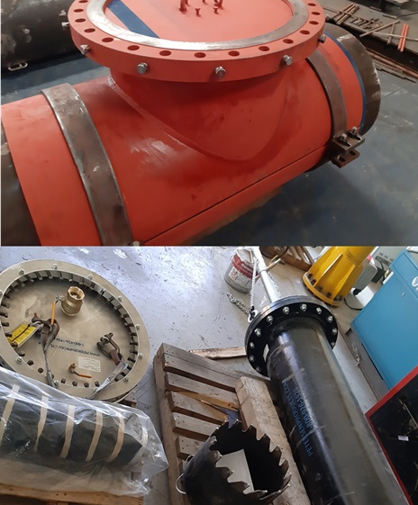
Line Stops
Line Stops are installed after a Hot Tap connection has been completed with 2 key differences:
A temporary Sandwich Valve is used instead of a Gate/Ball Valve
The Split Tee contains a completion plug which is installed to enable the temporary valve to be removed
Line Stops can be installed in tandem with Hot Taps which provide a temporary bypass, which is key to ensuring zero interruptions to processes during the modification/repair work.

Slide 9
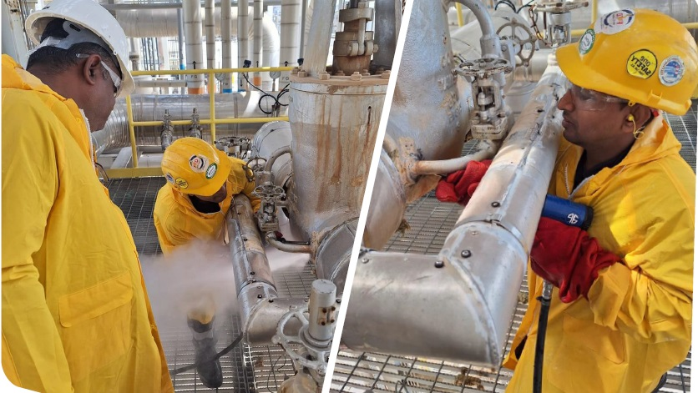
Pipeline Intervention – Online Leak Sealing
Online Leak Sealing is required when unplanned or emergency situations arise where leaking joints, pipes, elbows, flanges etc can potentially cause serious safety concerns for the personnel and the associated plant and equipment.

Slide 10
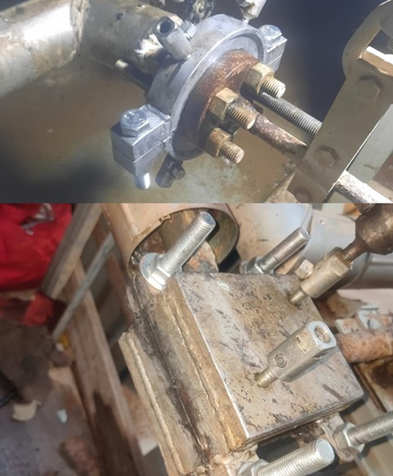
Leak Sealing
Leak Sealing is utilized to repair leaking pressurized pipes and components (steam, gas, oil, chemicals) without shutting down the plant, avoiding costly downtime and risks.
We apply custom mechanical clamps and sealing compounds around the leak, safely containing it under normal operating conditions (high temps/pressures) for either a short-term (depending on outage schedule) or long-term solution.

Slide 11
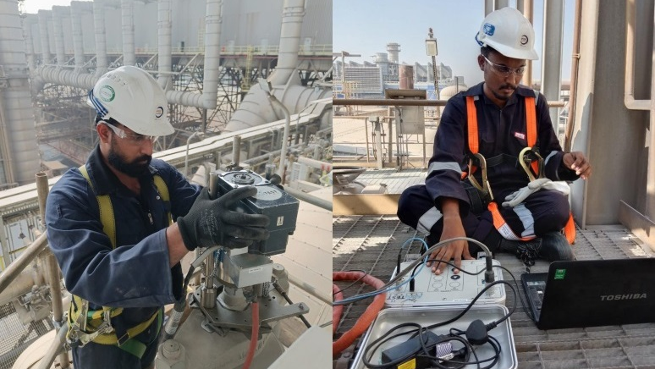
Trevi-Testing Safety Valves
Safety Valves are Vital for Equipment & Personnel safety in any Industry. Periodic testing of safety valve while equipment is in service is the guiding principle of Trevi-test. This means that testing can be performed under normal operating conditions.

Slide 12
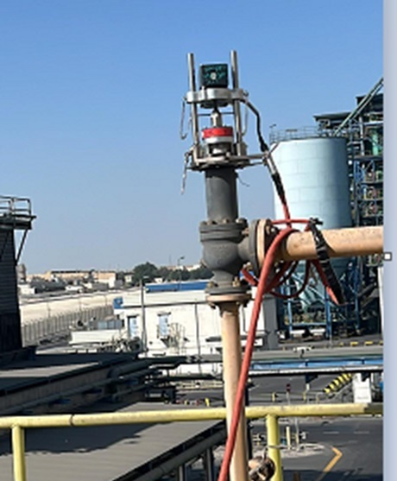
Trevi-Test
Trevi-test utilizes the most advanced Software and fully automated system developed by Accutest, which helps eliminate human error.
From automatic Calibration of sensors to output of the Final test results, the totally computerized operation delivers superior performance with regard to setup, ease of use and accuracy of reporting.
Light weight, Compact design for Portability in the Plant with accuracy +/- 1% in testing the Set Value of Safety Valves On-line

Slide 13
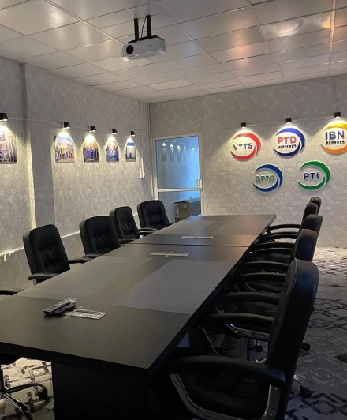
Contact Us
Valve Tech Testing & Services
(Power Tech Group of Companies)
Road 4819, Block 948,
Kingdom of Bahrain
adam@powertechtesting.com
Tel #: +973 77900018
Mob #: +973 666 22 538

