Slide 1
MILITARY COLLEGE OF ELECTRONICS AND MECHANICAL ENGINEERING
FACULTY OF ELECTRONICS
CE DEPARTMENT
COURSE NO. AESC (COMN) – 01 (C)
TECHNICAL PRESENTATION ON
COMMUNICATION EQUIPMENT FOR AIRBORNE EARLY WARNING AND CONTROL
SYNDICATE - 03
CFN SANTRAM
CFN SANDEEP
CFN MHARNOR PRAKSH MANIK
CFN KANDALA KARUNA NAIDU
DIRECTING STAFF
LT COL KUSHAL GANGULY
ASST DIRECTING STAFF
NB SUB K G RAO
HMT S M JAT

Slide 2
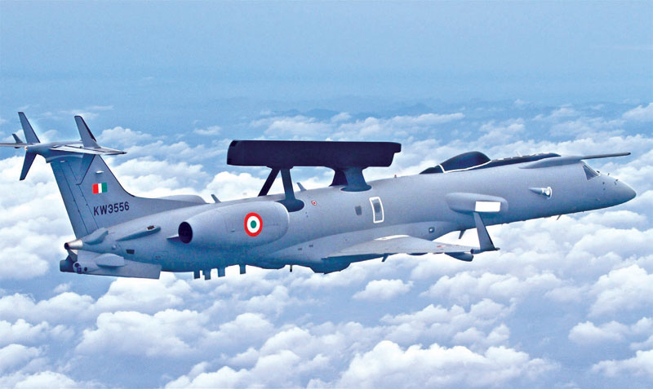
AIM
The Aim of this presentation is to explain about the communication equipment for Airborne Early Warning and Control ( AEW&C ) briefly and acquire knowledge about this equipment.

Slide 3
PREVIEW
INTRODUCTION
KEY COMPONENTS OF AEW&C
COMMUNICATION EQUIPMENT IN AEW&C
WORKING
CURRENT SYSTEMS
APPLICATIONS
ADVANTAGES
DISADVANTAGES
CONCLUSION

Slide 4
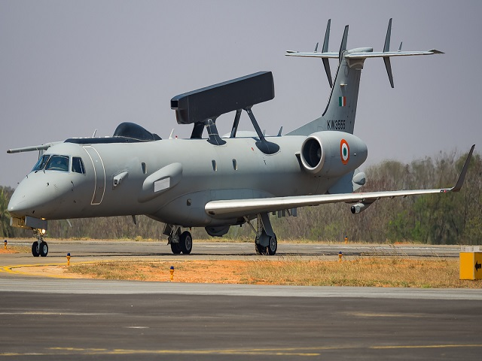
INTRODUCTION
AEW&C IS A VITAL TECHNOLOGY FOR SURVEILLANCE, RECONNAISSANCE, AND COMMAND AND CONTROL.
PURPOSE:
IT DETECTS AND TRACKS AIRBORNE AND SURFACE TARGETS, PROVIDING REAL-TIME INFORMATION TO ENHANCE DECISION-MAKING.
SIGNIFICANCE:
AEW&C PLAYS A CRITICAL ROLE IN MILITARY DEFENSE, DISASTER RESPONSE, AND AIRSPACE MANAGEMENT.

Slide 5
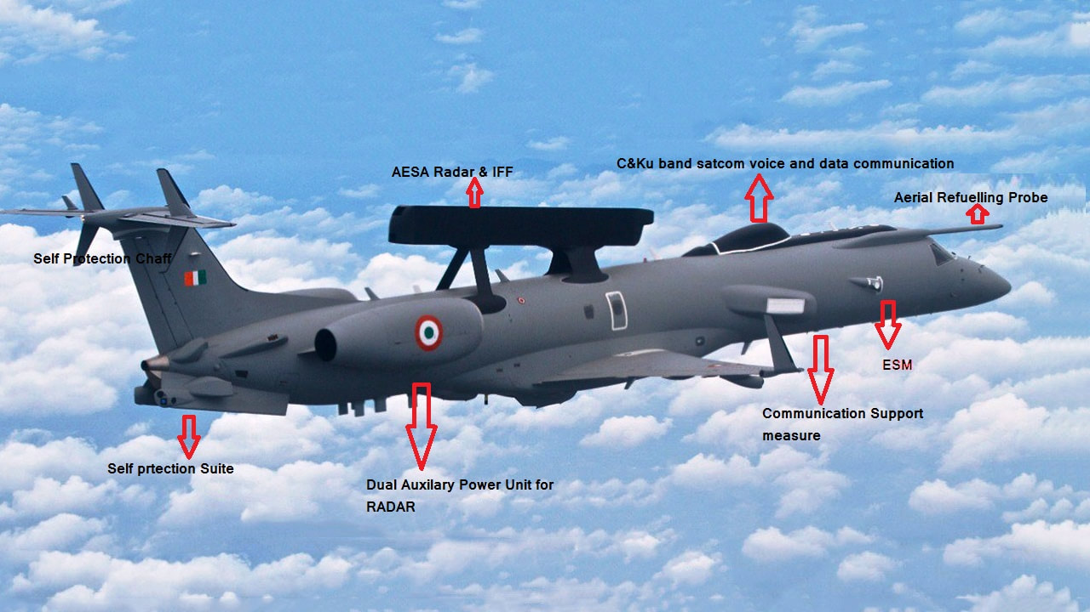
KEY COMPONENTS OF AEW&C
KEY COMPONENTS OF AEW&C

Slide 6
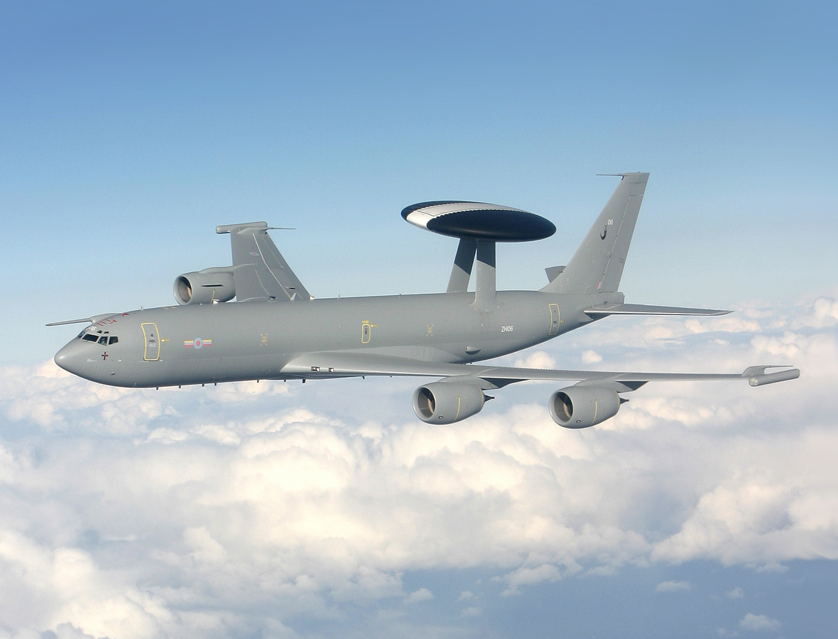
KEY COMPONENTS OF AEW&C
AIRCRAFT PLATFORM: SPECIALIZED AIRCRAFT EQUIPPED WITH RADAR SYSTEMS, SENSORS, AND COMMUNICATION EQUIPMENT.
RADAR SYSTEMS: RADAR TECHNOLOGY FOR LONG-RANGE TARGET DETECTION AND IDENTIFICATION.
COMMUNICATION SYSTEMS: REAL-TIME DATA TRANSMISSION BETWEEN AIRCRAFT AND GROUND STATIONS.

Slide 7
COMMUNICATION EQUIPMENT IN AEW&C
DATA LINKS
ANTENNAS
SATELLITE COMMUNICATION (SATCOM) TERMINALS
ENCRYPTION DEVICES
MULTIPLEXERS AND DATA PROCESSORS
SECURE VOICE COMMUNICATION SYSTEMS
LINE-OF-SIGHT (LOS) RADIOS
GROUND COMMUNICATION STATIONS
REDUNDANCY SYSTEMS

Slide 8
WORKING
AEW&C SYSTEMS WORK BY DEPLOYING RADAR-EQUIPPED AIRCRAFT TO SURVEIL THE OPERATIONAL ENVIRONMENT, DETECT AND TRACK OBJECTS OF INTEREST, PROCESS DATA TO ASSESS THREATS, COMMUNICATE INFORMATION TO COMMAND CENTERS AND UNITS, AND FACILITATE COMMAND AND CONTROL FUNCTIONS. THESE SYSTEMS PROVIDE EARLY WARNING, ENHANCE SITUATIONAL AWARENESS, AND SUPPORT DECISION-MAKING IN MILITARY OPERATIONS.
AIRCRAFT DEPLOYMENT:
SPECIALLY EQUIPPED AIRCRAFT, LIKE AWACS PLANES, ARE DEPLOYED
RADAR SURVEILLANCE:
RADAR SYSTEMS SCAN THE AIRSPACE AND TERRAIN, DETECTING OBJECTS.

Slide 9
WORKING
OBJECT DETECTION:
RADAR DATA IDENTIFIES OBJECTS AND DETERMINES THEIR LOCATION AND SPEED.
DATA PROCESSING:
COMPUTERS ANALYZE DATA TO ASSESS THREATS AND CREATE A COMPREHENSIVE PICTURE.
COMMUNICATION:
INFORMATION IS RELAYED TO COMMAND CENTERS AND UNITS IN REAL-TIME.
COMMAND AND CONTROL:
AEW&C PLATFORMS FACILITATE DECISION-MAKING AND COORDINATION IN MILITARY OPERATIONS.

Slide 10
CURRENT SYSTEMS
NETRA AEW&C – INDIA
PHALCON AEW&C - ISRAEL (OPERATED BY INDIA)
WEDGETAIL AEW&C - AUSTRALIA (OPERATED BY INDIA)
KAMOV KA-31 AEW&C - RUSSIA (OPERATED BY INDIA)
E-3 SENTRY (AWACS) - COUNTRY: UNITED STATES
E-2 HAWKEYE - COUNTRY: UNITED STATES
KJ-2000 AEW&C - COUNTRY: CHINA
ETC.

Slide 11
APPLICATIONS
DEFENSE PREPAREDNESS: ENHANCED DEFENSE CAPABILITIES AND IMPROVED THREAT MANAGEMENT.
DISASTER RESPONSE: SUPPORTS SEARCH, RESCUE, AND RELIEF OPERATIONS.
BORDER SECURITY: SAFEGUARDING NATIONAL AIRSPACE AND BORDERS.
THREAT DETECTION: IDENTIFICATION AND COUNTERING OF THREATS EFFECTIVELY.
COORDINATION: ENHANCED COORDINATION AMONG AIR AND NAVAL FORCES.

Slide 12
ADVANTAGES
SITUATIONAL AWARENESS:
COMPREHENSIVE VIEW OF OPERATIONAL SURROUNDINGS.
QUICK DECISIONS:
REAL-TIME DATA FOR INFORMED AND PROMPT DECISION-MAKING.
COORDINATION:
EFFECTIVE COORDINATION AMONG DIFFERENT FORCES.
FORCE MULTIPLIER:
AMPLIFY THE CAPABILITIES OF EXISTING MILITARY ASSETS, OPTIMIZING RESOURCE UTILIZATION.
COASTAL AND BORDER SECURITY:
THEY AID IN MONITORING AND SECURING MARITIME AND LAND BORDERS, CURBING UNAUTHORIZED ACTIVITIES.

Slide 13
DISADVANTAGES
TECHNOLOGICAL CHALLENGES: OVERCOMING TECHNICAL HURDLES FOR ADVANCED AEW&C SYSTEMS.
RESOURCE INTENSIVE: REQUIRES ADVANCED RADAR SYSTEMS, SENSORS, AND COMMUNICATION TOOLS.
TRAINING AND MAINTENANCE: ENSURING SKILLED PERSONNEL AND REGULAR MAINTENANCE.
SIZE AND MOBILITY: RELATIVELY LARGE AND MAY REQUIRE EXTENSIVE INFRASTRUCTURE, LIMITING THEIR AGILITY AND DEPLOYMENT OPTIONS.

Slide 14
CONCLUSION
IN CONCLUSION, AIRBORNE EARLY WARNING AND CONTROL (AEW&C) SYSTEMS ARE INDISPENSABLE ASSETS FOR MODERN ARMED FORCES. THEY PROVIDE EARLY WARNING, ENHANCE COMMAND AND CONTROL, SUPPORT AIR DEFENSE, CONDUCT ELECTRONIC WARFARE, ASSIST IN SEARCH AND RESCUE MISSIONS, PROTECT NAVAL FORCES, CONTRIBUTE TO NATIONAL SECURITY, AND REDUCE OPERATIONAL RISKS. THESE CAPABILITIES MAKE AEW&C PLATFORMS A CORNERSTONE OF CONTEMPORARY MILITARY OPERATIONS, ENSURING THE SAFETY AND EFFECTIVENESS OF ARMED FORCES AROUND THE WORLD. THEIR ROLE IN MAINTAINING SITUATIONAL AWARENESS, ENABLING RAPID RESPONSE, AND SAFEGUARDING NATIONAL SOVEREIGNTY UNDERSCORES THEIR SIGNIFICANCE IN SAFEGUARDING PEACE AND SECURITY.

Slide 15
ANY QUESTION ?

Slide 16
Kjnn
Kjnn
JAI HIND

