Slide 1
Angular: Getting Started
INTRODUCTION

Slide 3

Angular Is …
A JavaScript framework
For building client-side applications Using HTML, CSS and JavaScript

Slide 4
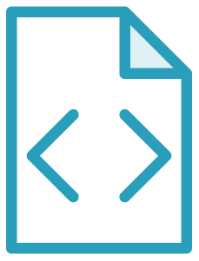

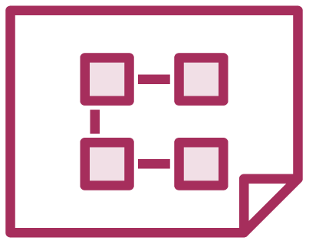

Why Angular?
Expressive HTML
Powerful Data Binding
Modular By Design
Built-in Back-End Integration

Slide 5

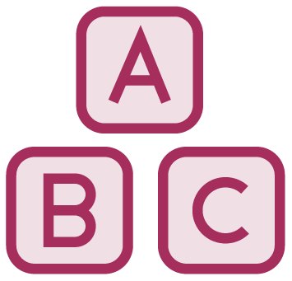


Why a New Angular?
Built for Speed
Modern
Simplified API
Enhances Productivity

Slide 6

Module Overview
Anatomy of an Angular Application
Getting the Most from This Course Sample Application
Course Outline

Slide 7
Anatomy of an Angular Application
Application
Component
Component
Component
…
=
+
+
Services

Slide 8
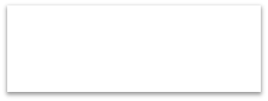


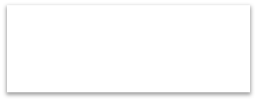

Component
Class
Component
=
Template
+
Properties
+
Metadata
Methods

Slide 9
Angular Modules
Root
Angular Module
Feature Angular Module
Component
Component
Component
Component
Component
Component
Component
Component

Slide 10
Prerequisites
Required
Helpful
Not Required
JavaScript
HTML
CSS
Object-oriented programming (OOP) concepts
C++, C#, Java, …
Prior knowledge of Angular
Prior knowledge of TypeScript

Slide 11
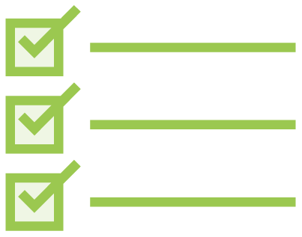
Checklist
Review module concepts
Code along assistance Revisit as you build

Slide 12

Demo
Sample Application in Action

Slide 13
Sample Application Architecture
Welcome Component
index.html
App Component
Product List Component
Star Component
Product Detail Component
Product Data Service

Slide 14
First Things First
Introduction to Components
Course Outline
Templates, Interpolation, and Directives
Data Binding & Pipes More on Components
Building Nested Components Services and Dependency Injection Retrieving Data Using Http Navigation and Routing
Angular Modules
Building, Testing and Deploying with the CLI

