Slide 1
First Things First

Slide 3
Module Overview
Selecting a Language
Selecting an Editor
Setting up an Angular Application About Modules

Slide 4

JavaScript Language Specification
ECMAScript (ES)
ES 3
ES 5
ES 2015 (formerly known as ES 6)
- Must be transpiled

Slide 5
Selecting a Language
ES 5
ES 2015
TypeScript
Dart
Runs in the browser
No compile required
Lots of new features (classes, let, arrow, etc.)
Superset of JavaScript
Strong typing
Great IDE tooling
No
JavaScript

Slide 6

What Is TypeScript?
Open source language
Superset of JavaScript Transpiles to plain JavaScript Strongly typed
- TypeScript type definition files (*.d.ts)
Class-based object-orientation

Slide 7

Learning More
TypeScript Playground
http://www.typescriptlang.org/Playground/
Pluralsight Courses "TypeScript Fundamentals" "AngularJS with TypeScript" "Using ES6 with TypeScript"

Slide 8
TypeScript Editors
Visual Studio
Visual Studio Code WebStorm
Atom Eclipse
Others

Slide 9
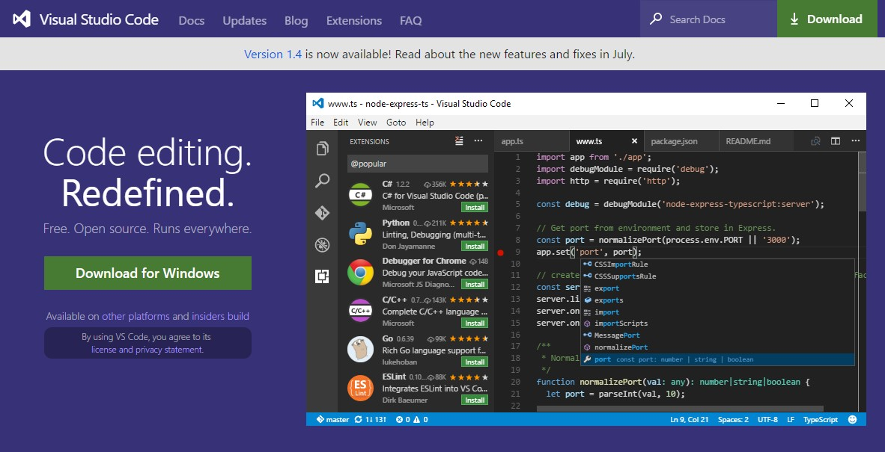
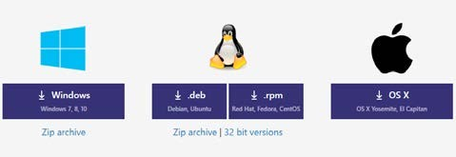
Visual Studio Code
https://code.visualstudio.com/

Slide 10
Learning More
Visual Studio Code Site
https://code.visualstudio.com/
Pluralsight Course
"Visual Studio Code"

Slide 11

Setting up Our Environment
npm
Set up the Angular application

Slide 12

npm
Node Package Manager
Command line utility
Installs libraries, packages, and applications
https://www.npmjs.com/

Slide 13
Setting up an Angular Application
Create an application folder
Add package definition and configuration files
Install the packages
Create the app's Angular Module
Create the main.ts file
Create the host Web page (index.html)

Slide 14
Setting up an Angular Application
Manually perform each step
Download the results of these steps
https://github.com/angular/quickstart
Angular CLI
https://github.com/angular/angular-cli
Starter files
https://github.com/DeborahK/Angular- GettingStarted

Slide 15


Modules
AngularJS Modules
TypeScript Modules
ES 2015
Modules
Angular Modules

Slide 16
ES 2015 Modules
Export
Import
product.ts
product-list.ts
export class Product{
}
import { Product } from './product'
Transpile
product.js
function Product() {
}

Slide 17
Angular Modules
Root
Angular Module
Feature Angular Module
Shared Module
Component
Component
Component
Component
Component
Component
Component
Component
Component

Slide 18
Modules
Angular Modules
Code files that
organize the application into cohesive blocks of functionality
Organize our application Modularize our application Promote application boundaries
ES Modules
Code files that import or export something
Organize our code files
Modularize our code Promote code reuse

Slide 19






Web Server
Web Browser
URL Request (www.mysite.com)
index.html
Response
JavaScript

Slide 20
Summary
Selecting a Language
Selecting an Editor
Setting up an Angular Application About Modules

Slide 21
Application Architecture
Welcome Component
index.html
App Component
Product List Component
Star Component
Product Detail Component
Product Data Service

Slide 22
Application Architecture
Welcome Component
index.html
App Component
Product List Component
Star Component
Product Detail Component
Product Data Service

Slide 23
Application Architecture
Welcome Component
index.html
App Component
Product List Component
Star Component
Product Detail Component
Product Data Service

