Slide 1
Templates, Interpolation, and Directives

Slide 3





Component
Class
Component
=
Template
+
Properties
+
Metadata
Methods

Slide 4
Module Overview
Building a Template
Using a Component as a Directive Binding with Interpolation Adding Logic with Directives

Slide 5
Application Architecture
Welcome Component
index.html
App Component
Product List Component
Star Component
Product Detail Component
Product Data Service

Slide 6
Component
app.component.ts
import { Component } from '@angular/core';
@Component({
selector: 'pm-root', template: `
<div><h1>{{pageTitle}}</h1>
<div>My First Component</div>
</div>
`
})
export class AppComponent {
pageTitle: string = 'Acme Product Management';
}

Slide 7
Defining a Template in a Component
Inline Template Inline Template Linked Template
template: "<h1>{{pageTitle}}</h1>"
template: `
<div>
<h1>{{pageTitle}}</h1>
<div>
My First Component
</div>
</div>
templateUrl:
'./product-list.component.html'
`
ES 2015
Back Ticks

Slide 8
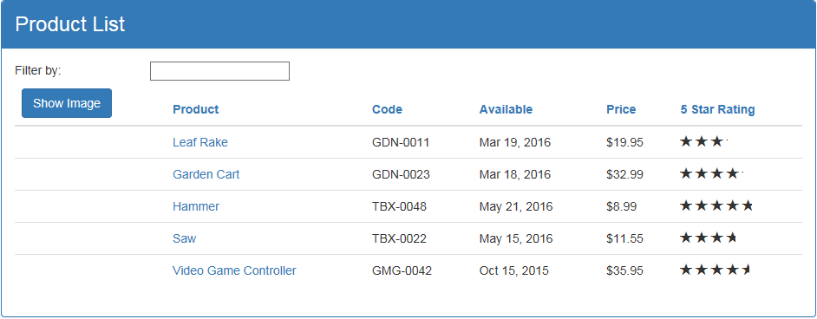
Product List View

Slide 9
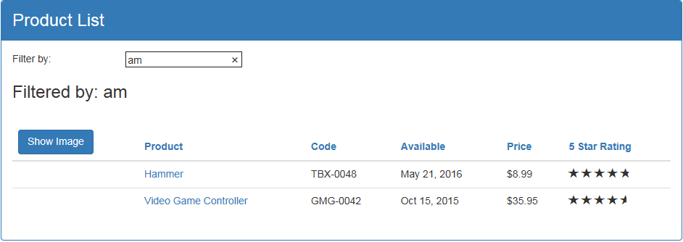
Product List View

Slide 10
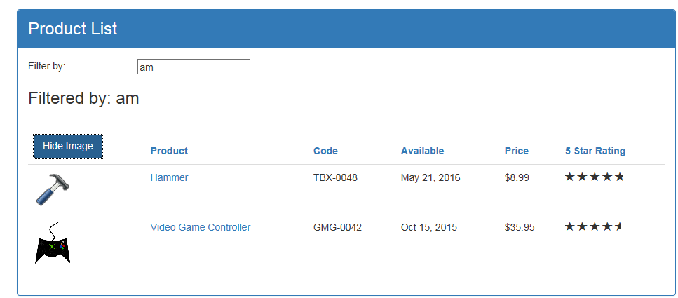
Product List View

Slide 11
Product List View
http://getbootstrap.com/

Slide 12
Building the Component
product-list.component.ts
import { Component } from '@angular/core';
@Component({
selector: 'pm-products',
templateUrl: './product-list.component.html'
})
export class ProductListComponent { pageTitle: string = 'Product List';
}

Slide 13
Using a Component as a Directive
app.component.ts
product-list.component.ts
@Component({ selector: 'pm-root', template: `
<div><h1>{{pageTitle}}</h1>
<div>My First Component</div>
</div>`
})
export class AppComponent { }
@Component({
selector: 'pm-products', templateURL:
'./product-list.component.html'
})
export class ProductListComponent { }

Slide 14
Using a Component as a Directive
app.component.ts
product-list.component.ts
@Component({ selector: 'pm-root', template: `
<div><h1>{{pageTitle}}</h1>
<pm-products></pm-products>
</div>`
})
export class AppComponent { }
@Component({
selector: 'pm-products', templateURL:
'./product-list.component.html'
})
export class ProductListComponent { }

Slide 15
AppModule
BrowserModule
AppComponent
Imports Exports Declarations Providers Bootstrap

Slide 16
AppModule
BrowserModule
AppComponent
ProductList - Component
Imports Exports Declarations Providers Bootstrap

Slide 17



Binding
Coordinates communication between the component's class and its template and often involves passing data.
Class
Template
Properties
Methods

Slide 18
Interpolation
Template
Class
<h1>{{pageTitle}}</h1>
{{'Title: ' + pageTitle}}
{{2*20+1}}
{{'Title: ' + getTitle()}}
export class AppComponent { pageTitle: string =
'Acme Product Management';
}getTitle(): string {...};
}
<h1 innerText={{pageTitle}}></h1>

Slide 19
Directive
Custom HTML element or attribute used to power up and extend our HTML.
Custom
Built-In

Slide 20
Custom Directives
app.component.ts
product-list.component.ts
@Component({ selector: 'pm-root', template: `
<div><h1>{{pageTitle}}</h1>
<pm-products></pm-products>
</div>
`
})
export class AppComponent { }
@Component({
selector: 'pm-products',
templateURL:
'./product-list.component.html'
})
export class ProductListComponent { }

Slide 21
Angular Built-in Directives
•
•
*ngIf: If logic
*ngFor: For loops
Structural Directives

Slide 22
*ngIf Built-In Directive
<div class='table-responsive'>
<table class='table' *ngIf='products && products.length'>
<thead> ...
</thead>
<tbody> ...
</tbody>
</table>
</div>

Slide 23
*ngFor Built-In Directive
Template input variable
<tr *ngFor='let product of products'>
<td></td>
<td>{{ product.productName }}</td>
<td>{{ product.productCode }}</td>
<td>{{ product.releaseDate }}</td>
<td>{{ product.price }}</td>
<td>{{ product.starRating }}</td>
</tr>

Slide 24
for…of vs for…in
for…of
Iterates over iterable objects, such as an array.
Result: di, boo, punkeye
let nicknames= ['di', 'boo', 'punkeye'];
for (let nickname of nicknames) { console.log(nickname);
}
for…in
Iterates over the properties of an object.
Result: 0, 1, 2
let nicknames= ['di', 'boo', 'punkeye'];
for (let nickname in nicknames) { console.log(nickname);
}

Slide 25
*ngFor Built-In Directive
<tr *ngFor='let product of products'>
<td></td>
<td>{{ product.productName }}</td>
<td>{{ product.productCode }}</td>
<td>{{ product.releaseDate }}</td>
<td>{{ product.price }}</td>
<td>{{ product.starRating }}</td>
</tr>

Slide 26
Checklist: Component as a Directive
product-list.component.ts
@Component({
selector: 'pm-products', templateURL:
'./product-list.component.html'
})
export class ProductListComponent { }
app.component.ts
app.module.ts
@Component({ selector: 'pm-root', template: `
<div><h1>{{pageTitle}}</h1>
<pm-products></pm-products>
</div>`
})
export class AppComponent { }
@NgModule({
imports: [ BrowserModule ], declarations: [
AppComponent, ProductListComponent ],
bootstrap: [ AppComponent ]
})
export class AppModule { }

Slide 27
Summary
Building a Template
Using a Component as a Directive Binding with Interpolation Adding Logic with Directives

Slide 28
Application Architecture
Welcome Component
index.html
App Component
Product List Component
Star Component
Product Detail Component
Product Data Service

Slide 29
Application Architecture
Welcome Component
index.html
App Component
Product List Component
Star Component
Product Detail Component
Product Data Service

