Slide 1
Building Nested Components

Slide 2

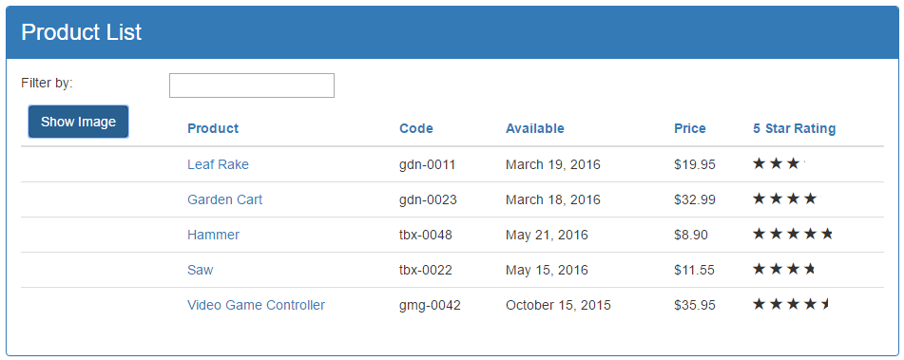
Using a Component
As a Directive
As a Routing target
App Component OR Nested Component
Full page style view
<body >
<pm - roo t >< /pm - roo t >
< / body >

Slide 3
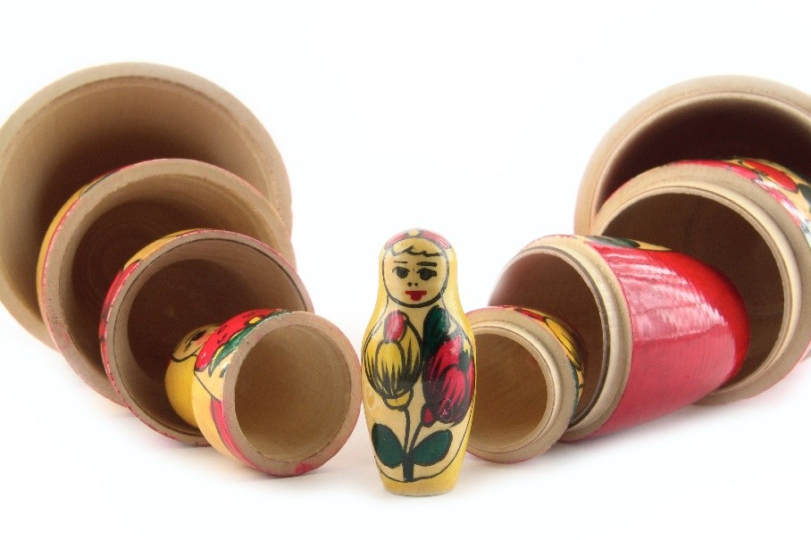
What Makes a Component Nest-able?
Its template only manages a fragment of a larger view
It has a selector
It optionally communicates with its container

Slide 4

Module Overview
Building a Nested Component
Using a Nested Component
Passing Data to a Nested Component Using @Input
Raising an Event from a Nested Component Using @Output

Slide 5
Application Architecture
Welcome Component
index.html
App Component
Product List Component
Star Component
Product Detail Component
Product Data Service

Slide 6
Building a Nested Component
Container Component
Template
Nested Component
<pm-star> </pm-star>
Template
Class
Class

Slide 7
Building a Nested Component
Container Component
Template
Nested Component _{</pm-star>}
Template
<pm-star>
Input
Output
Class
Class

Slide 8
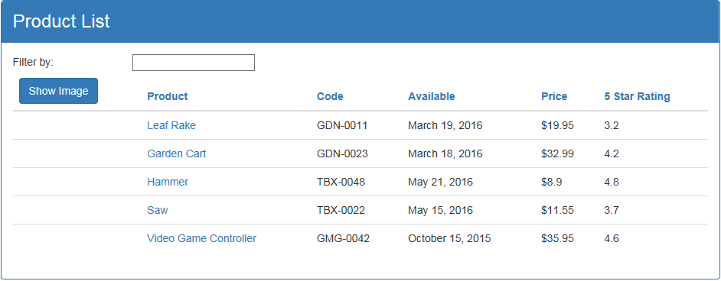
Product List View

Slide 9
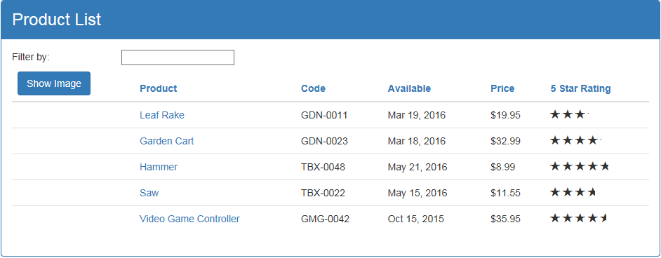
Product List View

Slide 10
Using a Nested Component as a Directive
product-list.component.ts
star.component.ts
@Component({
selector: 'pm-products',
templateURL: './product-list.component.html'
})
export class ProductListComponent { }
@Component({ selector: 'pm-star',
templateURL: './star.component.html'
})
export class StarComponent { rating: number;
starWidth: number;
}
product-list.component.html
<td>
{{ product.starRating | number }}
</td>

Slide 11
Using a Nested Component as a Directive
product-list.component.ts
star.component.ts
@Component({
selector: 'pm-products',
templateURL: './product-list.component.html'
})
export class ProductListComponent { }
@Component({ selector: 'pm-star',
templateURL: './star.component.html'
})
export class StarComponent { rating: number;
starWidth: number;
}
product-list.component.html
<td>
<pm-star></pm-star>
</td>

Slide 12
Telling Angular About Our Component
app.module.ts
...
import { StarComponent } from './shared/star.component';
@NgModule({ imports: [
BrowserModule, FormsModule ],
declarations: [ AppComponent, ProductListComponent, ConvertToSpacesPipe, StarComponent ],
bootstrap: [ AppComponent ]
})
export class AppModule { }

Slide 13
Passing Data to a Nested Component (@Input)
Container Component
Template
Nested Component _{</pm-star>}
Template
<pm-star>
Input @Input()
Class
Class

Slide 14
Passing Data to a Nested Component (@Input)
product-list.component.ts
star.component.ts
@Component({
selector: 'pm-products',
templateURL: './product-list.component.html'
})
export class ProductListComponent { }
@Component({ selector: 'pm-star',
templateURL: './star.component.html'
})
export class StarComponent { @Input() rating: number; starWidth: number;
}
product-list.component.html
<td>
<pm-star></pm-star>
</td>

Slide 15
Passing Data to a Nested Component (@Input)
product-list.component.ts
star.component.ts
@Component({
selector: 'pm-products',
templateURL: './product-list.component.html'
})
export class ProductListComponent { }
@Component({ selector: 'pm-star',
templateURL: './star.component.html'
})
export class StarComponent { @Input() rating: number; starWidth: number;
}
product-list.component.html
<td>
<pm-star [rating]='product.starRating'>
</pm-star>
</td>

Slide 16
Raising an Event (@Output)
Container Component
Template
Nested Component _{</pm-star>}
<pm-star>
Template
@Input()
@Output()
Input
Output
Class
Class

Slide 17
Raising an Event (@Output)
product-list.component.ts
star.component.ts
@Component({
selector: 'pm-products',
templateURL: './product-list.component.html'
})
export class ProductListComponent { }
@Component({ selector: 'pm-star',
templateURL: './star.component.html'
})
export class StarComponent { @Input() rating: number; starWidth: number;
@Output() notify: EventEmitter<string> =
new EventEmitter<string>();
}
product-list.component.html
<td>
<pm-star [rating]='product.starRating'>
</pm-star>
</td>

Slide 18
Raising an Event (@Output)
product-list.component.ts
star.component.ts
@Component({
selector: 'pm-star',
templateURL: './star.component.html'
})
export class StarComponent {
@Input() rating: number;
starWidth: number;
@Output() notify: EventEmitter<string> =
new EventEmitter<string>();
onClick() {
this.notify.emit('clicked!');
}
}
star.component.html
<div (click)='onClick()'> ... stars ... </div>
@Component({
selector: 'pm-products',
templateURL: './product-list.component.html'
})
export class ProductListComponent { }
product-list.component.html
<td>
<pm-star [rating]='product.starRating'>
</pm-star>
</td>

Slide 19
Raising an Event (@Output)
product-list.component.ts
star.component.ts
@Component({
selector: 'pm-star',
templateURL: './star.component.html'
})
export class StarComponent {
@Input() rating: number;
starWidth: number;
@Output() notify: EventEmitter<string> =
new EventEmitter<string>();
onClick() {
this.notify.emit('clicked!');
}
}
star.component.html
<div (click)='onClick()'> ... stars ... </div>
@Component({
selector: 'pm-products',
templateURL: './product-list.component.html'
})
export class ProductListComponent { }
product-list.component.html
<td>
<pm-star [rating]='product.starRating' (notify)='onNotify($event)'>
</pm-star>
</td>

Slide 20
Raising an Event (@Output)
product-list.component.ts
star.component.ts
@Component({
selector: 'pm-star',
templateURL: './star.component.html'
})
export class StarComponent {
@Input() rating: number;
starWidth: number;
@Output() notify: EventEmitter<string> =
new EventEmitter<string>();
onClick() {
this.notify.emit('clicked!');
}
}
star.component.html
<div (click)='onClick()'> ... stars ... </div>
@Component({
selector: 'pm-products',
templateURL: './product-list.component.html'
})
export class ProductListComponent { onNotify(message: string): void { }
}
product-list.component.html
<td>
<pm-star [rating]='product.starRating' (notify)='onNotify($event)'>
</pm-star>
</td>

Slide 21
Nest-able Component's Public API
Container Component
Template
Nested Component _{</pm-star>}
<pm-star>
Template
@Input()
@Output()
Input
Output
Class
Class

Slide 22
Application Architecture
Welcome Component
index.html
App Component
Product List Component
Star Component
Product Detail Component
Product Data Service

