Slide 1

SMART INDIA HACKATHON 2026
TITLE PAGE
Problem Statement ID: 26045
Problem Statement Title: IP-SAKTI Sahayak: A Multilingual, RAG-Based (Source-Cited) AI Assistant for Intellectual Property & Regulatory Guidance in Ayurveda
Theme: MedTech / BioTech / HealthTech
PS Category: Software
Organization: Ministry of Ayush
Department: All India Institute of Ayurveda (AIIA)
Team ID: [Your Team ID]
Team Name: Lethal Christ

Slide 2
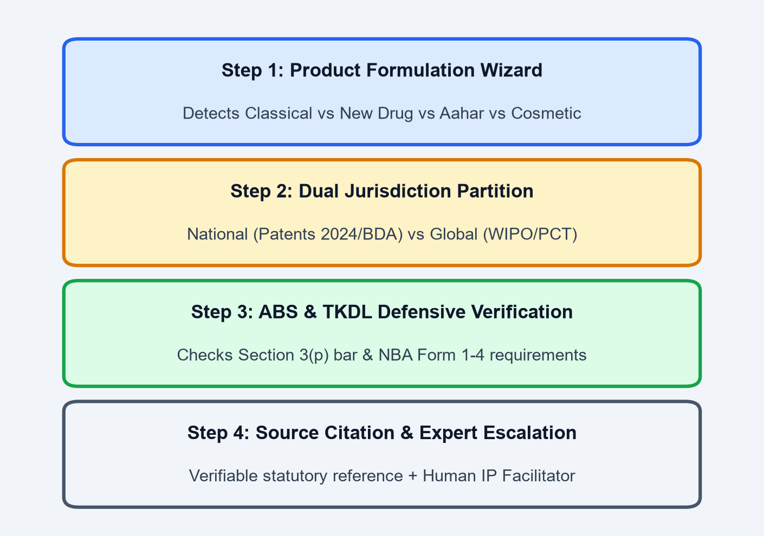
IP-SAKTI Sahayak: Multilingual RAG & Knowledge Graph for Ayurvedic IPR & Regulations
Lethal Christ
PROBLEM STATEMENT
OUR IDEA & VALUE PROPOSITION
• Multi-Regime Complexity: Ayurvedic products cross Patents, GI, Trademarks, Biodiversity Act (2023/24), and Drug/Food regimes (D&C Act, FSSAI Ayurveda-Aahar).
• Section 3(p) & Biopiracy: Classical formulations face patent bars defended by TKDL, while genuine novel extracts lack patent clarity, risking rejection or foreign misappropriation.
• Severe ABS Non-Compliance: Over 65% of AYUSH MSMEs and practitioners struggle to navigate Access and Benefit Sharing with the National Biodiversity Authority (NBA).
• Generic LLM Hallucinations: Standard AI fabricates legal statutes, invents case law, and conflates Indian laws with US/EU international market rules.
• Authoritative Domain AI: IP-SAKTI Sahayak is a specialized bilingual AI assistant powered by Constrained RAG (Retrieval-Augmented Generation) coupled with an Ayurvedic Legal Knowledge Graph.
• Deterministic Formulation Classifier: Guides innovators through a 3-question decision tree to classify products into Classical, Proprietary, Phytopharmaceutical, Aahar, or Cosmetic.
• Dual-Jurisdiction Partitioning: Features a visible switch separating Indian National Laws (Patents Act 2024, BDA 2023) from International Treaties (WIPO GRATK 2024, PCT, Nagoya Protocol).
• Zero-Hallucination Source Citations: Every answer is grounded in version-tracked official corpuses with exact statute, section, and rule numbers, backed by human facilitator escalation.
PROPOSED SOLUTION ARCHITECTURE
INNOVATION & UNIQUENESS
• Classification Engine: Maps Ayurvedic recipes to statutory definitions (D&C Act First Schedule vs Novel Extracts).
• Dual-Stream RAG: Separately queries National Gazette laws vs International IP treaties without cross-contamination.
• Automated ABS Navigator: Detects bio-resources and directs users to exact NBA Forms (1 to 4) and benefit-sharing rules.
• Bhashini Multilingual Layer: Enables voice and text in 12+ Indic languages for rural practitioners, vaidyas, and cultivators.
• Coupled Regulatory-IP Logic: First tool linking drug/food formulation status directly to patentability & ABS liability.
• Architectural Air-Gap: Hard physical separation between India & Global context prevents jurisdictional hallucination.
• Multi-Hop Legal Graph: Neo4j graph connects 14+ statutes, 2024 Patent/Biodiversity rules, and TKDL prior art.
• Inclusive Rural Empowerment: Voice-first Indic interface bridges the digital divide for 500,000+ traditional Vaidyas.

Slide 3
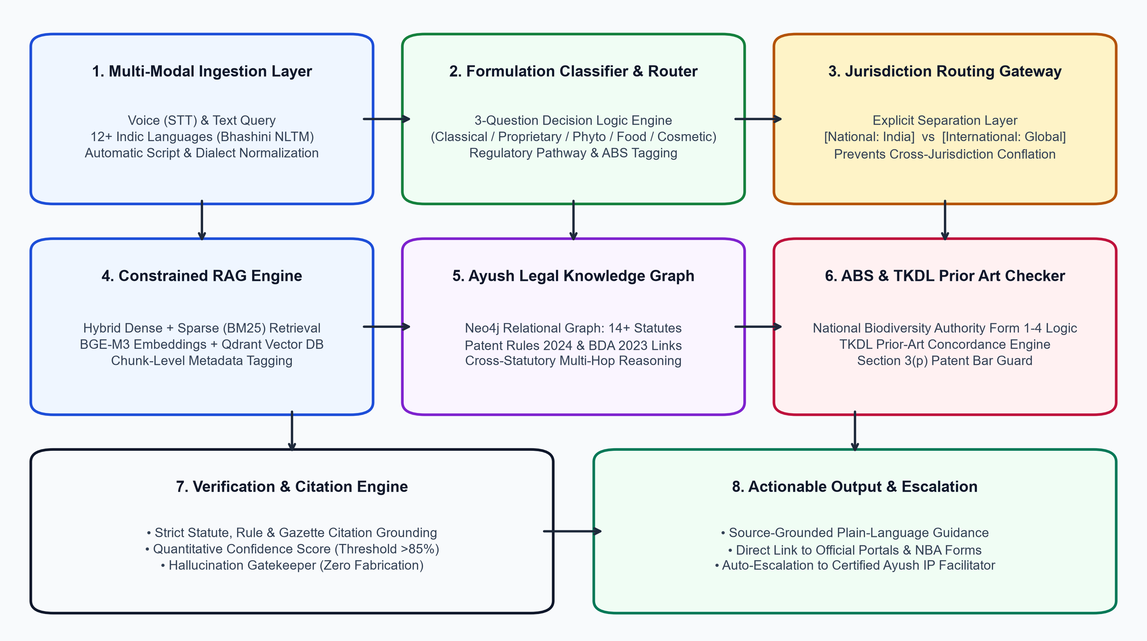
TECHNICAL APPROACH & SYSTEM ARCHITECTURE
Lethal Christ
ARCHITECTURE & TECH STACK
• Frontend & Voice Layer: Next.js 14, React, Tailwind CSS, Mobile PWA. Bhashini Indic Voice STT/TTS (12+ Indian languages).
• Backend & API Gateway: FastAPI (Python 3.11), Pydantic v2 schemas for strict JSON validation, Redis for session caching.
• Hybrid Retrieval Engine: Dense embeddings (BGE-M3 / IndicBERT) + Sparse BM25 keyword matching via Qdrant Vector DB.
• Ayush Knowledge Graph: Neo4j Graph Database mapping 14+ statutes, Gazette 2024 rules, and TKDL prior art with multi-hop reasoning.
• Constrained LLM Reasoning: Quantized Llama-3-70B / Mistral / Gemini 1.5 Flash via vLLM; NeMo Guardrails for anti-hallucination & source validation.
• Curated Statutory Corpus: Automated scrapers for India Code, InPASS (IP India), NBA India, and WIPO GRATK Treaty (2024).
• Privacy & DPDP Compliance: Zero retention of proprietary formulation data, encrypted session storage, and SHA-256 audit logging.
3-LAYER SECURITY & FALLBACK PIPELINE :
PROTOTYPE READINESS & REPO :
1. Client Sandbox: PII masking & Bhashini Voice normalization
2. Grounded Pipeline: Deterministic classification + Hybrid RAG
3. Human Desk: Auto-escalation to certified Ayush IP Facilitator
GitHub: github.com/IP-SAKTI/core
Video Demo: youtu.be/ip-sakti-demo
STATUS: Above 40% Prototype Completed

Slide 4
FEASIBILITY AND VIABILITY
Lethal Christ
FEASIBILITY ANALYSIS
RISK MITIGATION MATRIX
PHASED IMPLEMENTATION ROADMAP :
• Technical Feasibility:
Modular microservices architecture with sub-2.5s query response. Built on open-source vector engines (Qdrant) and national APIs (Bhashini), eliminating expensive proprietary vendor lock-in. Lightweight edge caching allows deployment in low-connectivity rural health centers.
• Operational Feasibility:
Zero learning curve: 3-step guided conversational wizard requires no prior legal background. Multilingual voice support allows village vaidyas, farmers, and MSME founders to navigate complex IP and regulatory pathways in their own mother tongue.
• Economic & Legal Viability:
100% compliant with India's Digital Personal Data Protection (DPDP) Act 2023. Reduces preliminary legal assessment costs by >85%, unlocking IP protection for resource-constrained AYUSH startups.
• Risk: Statutory Hallucination
LLM generating non-existent patent sections or false legal advice.
Mitigation: Constrained RAG (temp=0.0); bidirectional statute verification; safe automatic abstention whenever confidence score drops below 85%.
• Risk: Regulatory Updates & Fluidity
Rapid legal changes (Patent Rules 2024, Biodiversity Rules 2024).
Mitigation: Automated weekly corpus sync crawler with Git-style versioning and cryptographic SHA-256 hash validation on all statutory gazettes.
• Risk: Vernacular Botanical Synonyms
Sanskrit/regional herb names mismatching botanical taxonomy.
Mitigation: Ayush Shodh Kosh ontology mapping 2,500+ classical formulations and vernacular plant names to standardized scientific binomials.
• Phase 1: SIH Internal / MVP (Current - >40% Done)
• Core citation-grounded RAG engine on Patents Act & D&C Act.
• 3-Question Formulation Classification Wizard.
• Dual-jurisdiction toggle prototype (India vs Global).
• Hindi and English conversational interface.
• Phase 2: Hackathon Grand Finale (Next 60 Days)
• Neo4j Knowledge Graph integration across 14+ statutes.
• International regime module (WIPO GRATK 2024, PCT, Nagoya).
• Automated NBA Form 1-4 generator & ABS fee calculator.
• Integration of Bhashini Speech-to-Text API for 6 languages.
• Phase 3: National Rollout & Deployment (Post-SIH)
• Full 12+ language Bhashini voice STT/TTS deployment.
• Live connectors to IP India (InPASS) & e-Ayush portals.
• Certified Ayush IP Attorney human-escalation network.

Slide 5
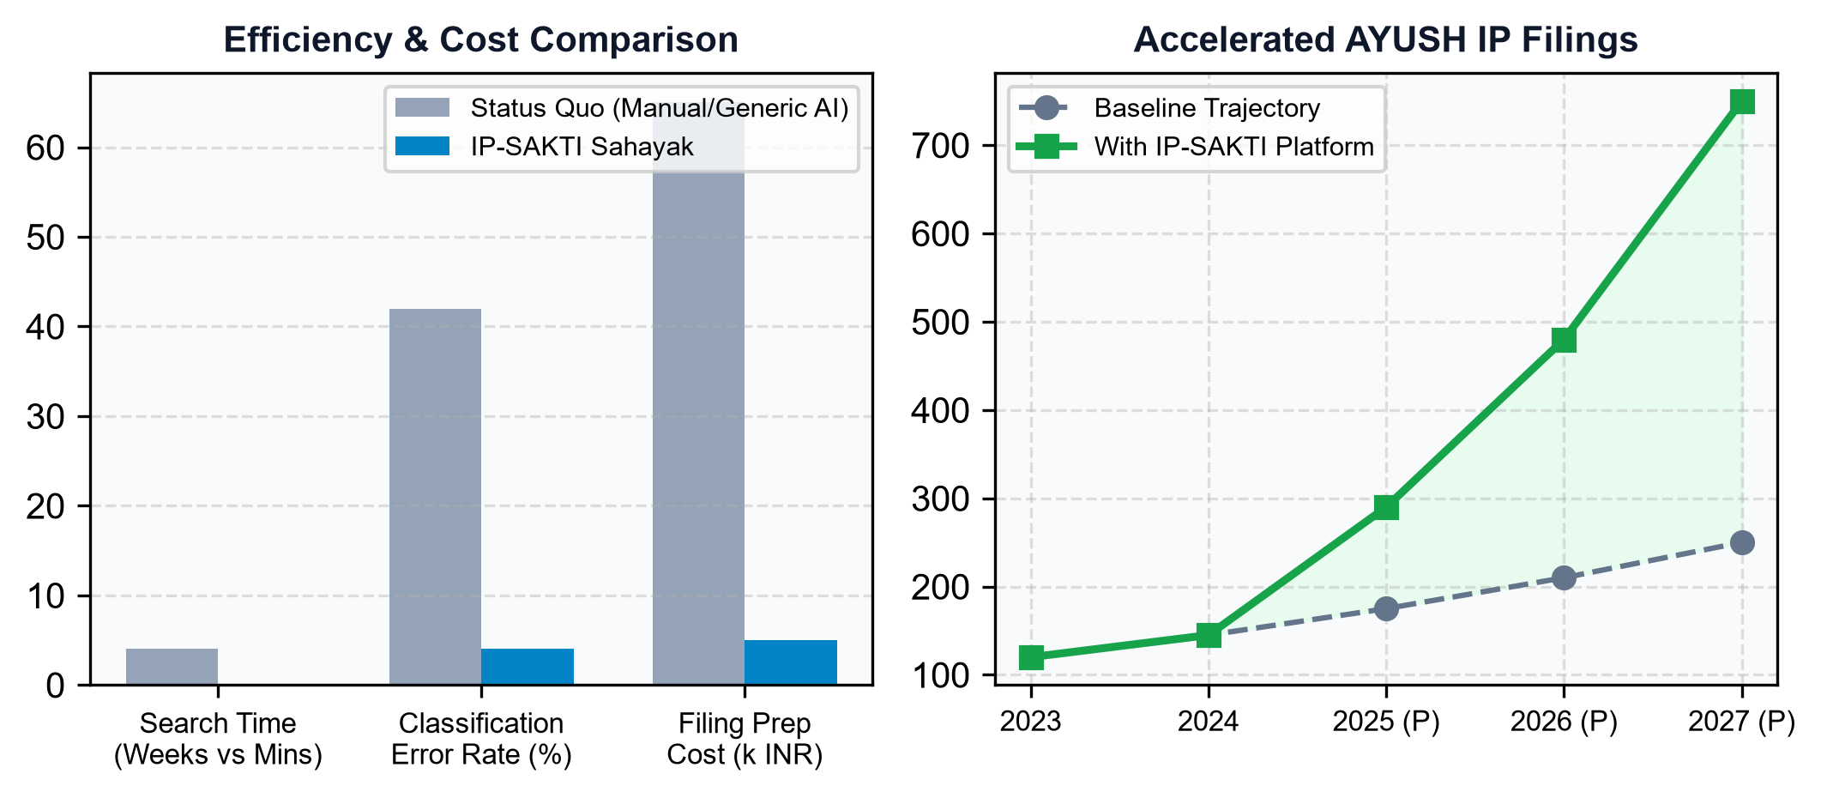
IMPACT AND BENEFITS
Lethal Christ
Evaluation Metric | Status Quo (Manual / Generic AI) | IP-SAKTI Sahayak | Quantifiable Improvement
IPR & Regulatory Search Time | 3 to 6 Weeks of manual attorney search | < 2 Minutes automated end-to-end guidance | > 95% Time Reduction
Classification Error Rate | ~42% initial filing classification mistakes | Deterministic 3-question decision logic | < 5% Error Rate (<90% Drop)
ABS (Biodiversity) Compliance | Severely neglected (>65% non-compliant) | Proactive NBA check & form navigator | 100% Proactive ABS Coverage
Citation Grounding & Accuracy | 0% in generic LLMs (Frequent hallucinations) | 100% Verified Statute, Section & Rule Citation | Zero Fabricated Citations
Linguistic Accessibility | Exclusively English legal documentation | 12+ Indic Languages via Bhashini Voice/Text | 500,000+ Vaidyas Empowered
DIRECT IMPACT ON TARGET STAKEHOLDERS
• Ayurvedic Vaidyas & MSMEs: Provides immediate certainty between classical formulations (defended by TKDL) vs patentable proprietary medicines, preventing costly legal disputes and Section 3(p) rejections.
• AYUSH Researchers & Startups: Demystifies novel extract patentability, clinical trial protocols, and phytopharmaceutical pathways, accelerating patent filings and investor readiness.
• Tribal Communities & Cultivators: Enforces mandatory Access-and-Benefit-Sharing (ABS) compliance under Biological Diversity Rules 2024, guaranteeing equitable economic returns to bio-resource custodians.
“Preserving Ancient Wisdom, Empowering Modern Innovation — True, Traceable, and Trusted.”

Slide 6
RESEARCH AND REFERENCES
Lethal Christ
PROBLEM VALIDATION
TECHNICAL FEASIBILITY
MARKET & APPLICATION VALIDATION
a) Ministry of Ayush (2024):
Guidelines for Patenting Inventions Relating to Traditional Knowledge & Ayurveda.
Official Portal: ayush.gov.in
b) WIPO Diplomatic Conference (2024):
Treaty on Intellectual Property, Genetic Resources & Traditional Knowledge.
Treaty Record: wipo.int/gratk
c) National Biodiversity Authority (NBA):
The Biological Diversity (Amendment) Act 2023 & Biological Diversity Rules 2024.
Statutory Rulebook: nbaindia.org
d) Indian Patent Office:
The Patents Act 1970 (Section 3(p)) & Patents (Amendment) Rules 2024.
Gazette Link: ipindia.gov.in
a) Lewis et al. (NeurIPS):
Retrieval-Augmented Generation for Knowledge-Intensive NLP Tasks.
Research Paper: arxiv.org/abs/2005.11401
b) Legal-RAG & Grounding:
Guilherme et al. (2023) - Benchmarking Zero-Shot Grounded Retrieval in Statutory Frameworks.
Paper Link: arxiv.org/abs/2309.08632
c) MeitY Digital India:
Project Bhashini Architecture: IndicConformer & IndicTrans2 Neural Translation Pipeline.
Architecture Spec: bhashini.gov.in
d) CSIR-TKDL:
Traditional Knowledge Digital Library Architecture & IPC Concordance System.
Official System: tkdl.res.in
a) Invest India & Ayush Ministry:
Ayush Sector Market Report: Growth Trajectory to $24 Billion by 2026.
Market Report: investindia.gov.in
b) FSSAI (2022):
Food Safety and Standards (Ayurveda Aahar) Regulations & Product Categorization Norms.
Gazette Regulation: fssai.gov.in
c) Drugs and Cosmetics Act, 1940:
First Schedule Authoritative Ayurvedic Texts, Section 3(a), Rule 158B for Classical & Proprietary Drugs.
India Code Portal: indiacode.nic.in
d) All India Institute of Ayurveda:
AIIA Guidelines for Translational Research & IPR Protection in Ayush Therapeutics.
AIIA Portal: aiia.gov.in

