Slide 1
7th AI Vision
7
th
Enterprise AI Video Surveillance Platform
A multi-tenant, GPU-accelerated security SaaS platform featuring 11+ AI detection modules, real-time alert push, guard operations management, and full compliance tools — deployable on Windows via native desktop app or web browser.
11 AI Modules
Multi-Tenant
Real-Time Push
PDPA Compliant
Windows Desktop
104
11+
10
3
Tests Passing
AI Modules
Cameras
Sites
Confidential — For Demonstration Purposes Only

Slide 2
Platform Overview
🔍 License Plate Recognition
👤 Face Recognition
Detect, read and match vehicle plates against block/allow watchlists in real time
ArcFace 512-d embeddings, VIP & blacklist matching, unknown-face alerting
🚧 Intrusion Detection
🦺 PPE Compliance
Restricted zone breach detection with polygon ROI, dwell-time tracking & SLA escalation
Hard-hat, vest, and safety-gear enforcement per camera zone
👥 Crowd Density Analysis
🔥 Fire & Smoke Detection
Real-time head-count, density heatmap, threshold-triggered alerts
Early fire/smoke warning with high-confidence multi-frame confirmation
🔫 Weapon Detection
📊 Behavior Analysis
Firearm and bladed-weapon detection with immediate critical alert + incident
Loitering, running, fighting, and abnormal motion classification
📷 Camera Tampering
📦 Abandoned Object
Detects spray, obstruction, and camera repositioning attacks
Flags unattended items exceeding configurable dwell thresholds
🏃 Slip / Fall Detection
Detects falls in elderly-care, warehouse and high-risk environments
All modules share a common Redis Streams pipeline, PostgreSQL RLS tenant isolation, real-time WebSocket push, and evidence chain-of-custody.

Slide 3
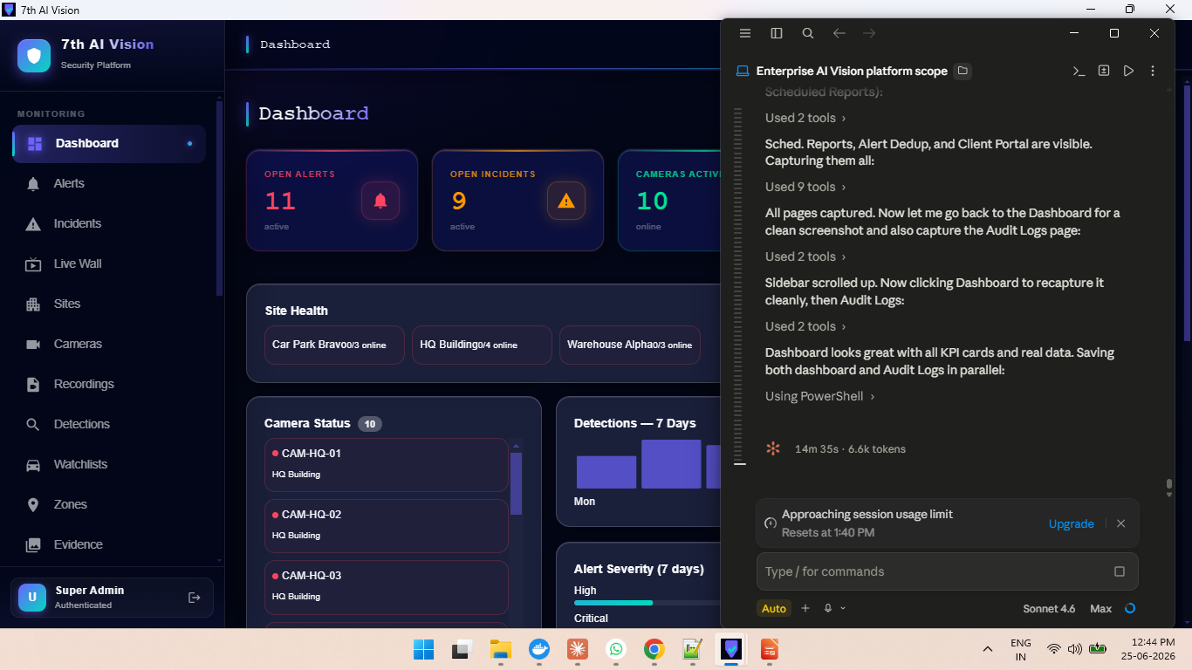
Live Security Dashboard
7th AI Vision
Real-time situational awareness across all sites, cameras, and AI modules
▸ Live KPI cards: Open Alerts, Incidents, Active Cameras, Detections today
▸ Site Health overview with per-site camera online status
▸ 7-day detection trend chart — all modules visualised
▸ Alert severity breakdown: Critical / High / Medium / Low
▸ Active notification channels display (email, webhook, SMS)
▸ Real-time WebSocket push — counts update instantly on new events
▸ Role-based view: Guards see assigned shifts; Admins see full tenant stats
▸ Dark glassmorphism UI — optimised for 24/7 control room environments
Real-Time
Multi-Site
Role-Based
WebSocket Push
Enterprise AI Video Surveillance — 7th AI Vision | Confidential

Slide 4
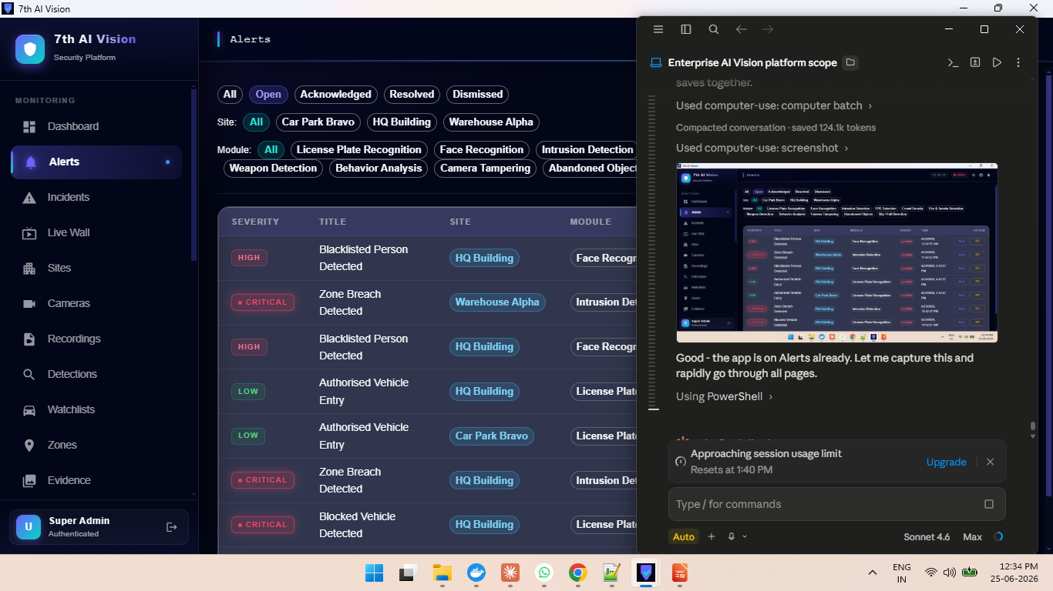
Smart Alert Management
7th AI Vision
AI-generated alerts with severity triage, module filtering, and one-click acknowledgement
▸ Alerts auto-generated by all 11 AI detection modules
▸ Severity levels: Critical (red), High (orange), Medium, Low, Info
▸ Filter by module: LPR, Face, Intrusion, PPE, Crowd, Fire, Weapon, Behavior, Tamper…
▸ Acknowledge or mark False Positive directly from the alert list
▸ Real-time badge counter updates as new alerts arrive via WebSocket
▸ Alert deduplication — no repeat alerts within configurable cooldown window
▸ Structured alert codes (e.g. lpr.blocklist_hit) for i18n-ready rendering
▸ Auto-escalation: unacknowledged High/Critical alerts escalate after SLA deadline
Auto-Generated
11 Modules
False Positive Flag
SLA Escalation
Enterprise AI Video Surveillance — 7th AI Vision | Confidential

Slide 5
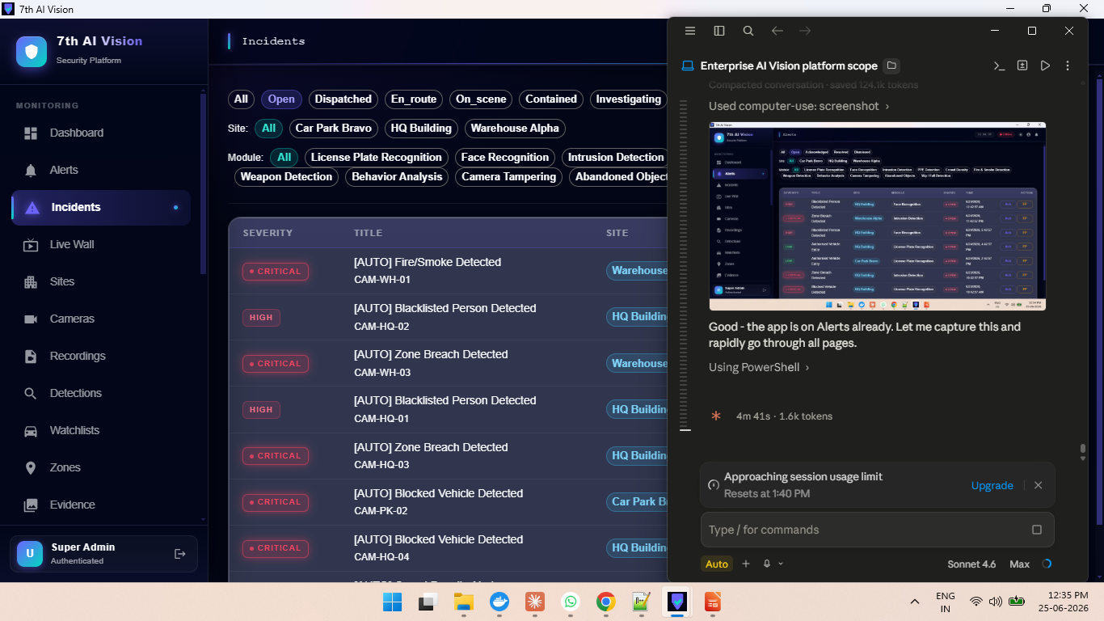
Incident Management & Workflow
7th AI Vision
From alert to resolution — full incident lifecycle with assignment, notes, and audit trail
▸ Auto-created incidents for high/critical severity detections
▸ Extended workflow states: Open → Acknowledged → In Progress → Escalated → Resolved
▸ Assign incident to any operator or supervisor user
▸ Incident notes timeline with timestamps and author tracking
▸ Multi-camera correlation: one incident can link multiple camera events
▸ Evidence chain-of-custody: snapshot images linked to each incident
▸ Dispatch integration: send guard to scene with ETA and custody tracking
▸ PDPA-compliant incident closure with data subject references
AUTO Badge
Multi-Camera
Dispatch
Full Audit Trail
Enterprise AI Video Surveillance — 7th AI Vision | Confidential

Slide 6
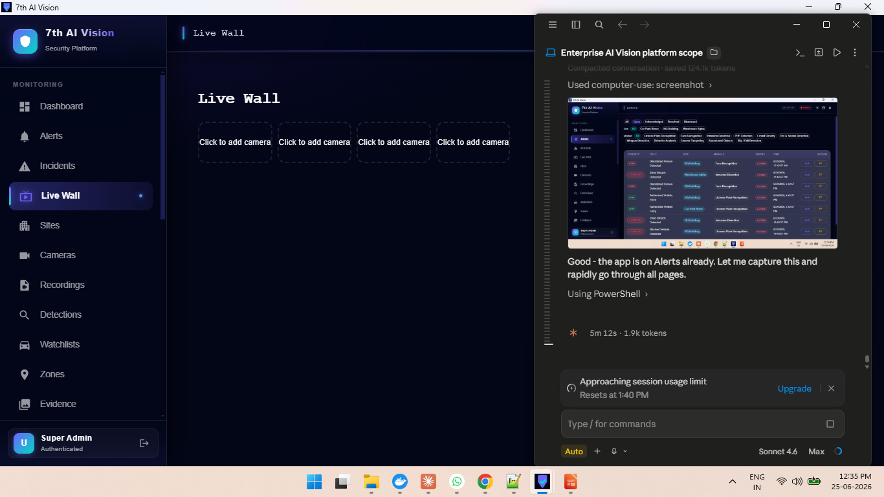
Live Wall — Multi-Camera Viewer
7th AI Vision
Watch up to 16 simultaneous live streams in configurable grid layouts
▸ Grid layouts: 1×1, 2×2, 3×3, 4×4 — up to 16 simultaneous live views
▸ Site-filtered camera picker — quickly add cameras to the wall
▸ Camera name + site label overlay on each cell
▸ Per-cell: Record button (start/stop clip), Full-screen expand, Remove
▸ MJPEG live streaming proxy — works through the same web/app server
▸ Recording: streams saved as MP4, listed in Recordings page for download
▸ Wall layout persisted to localStorage — survives refresh
▸ Available in both web dashboard and Windows desktop application
16 Streams
MJPEG Live
MP4 Recording
Persistent Layout
Enterprise AI Video Surveillance — 7th AI Vision | Confidential

Slide 7
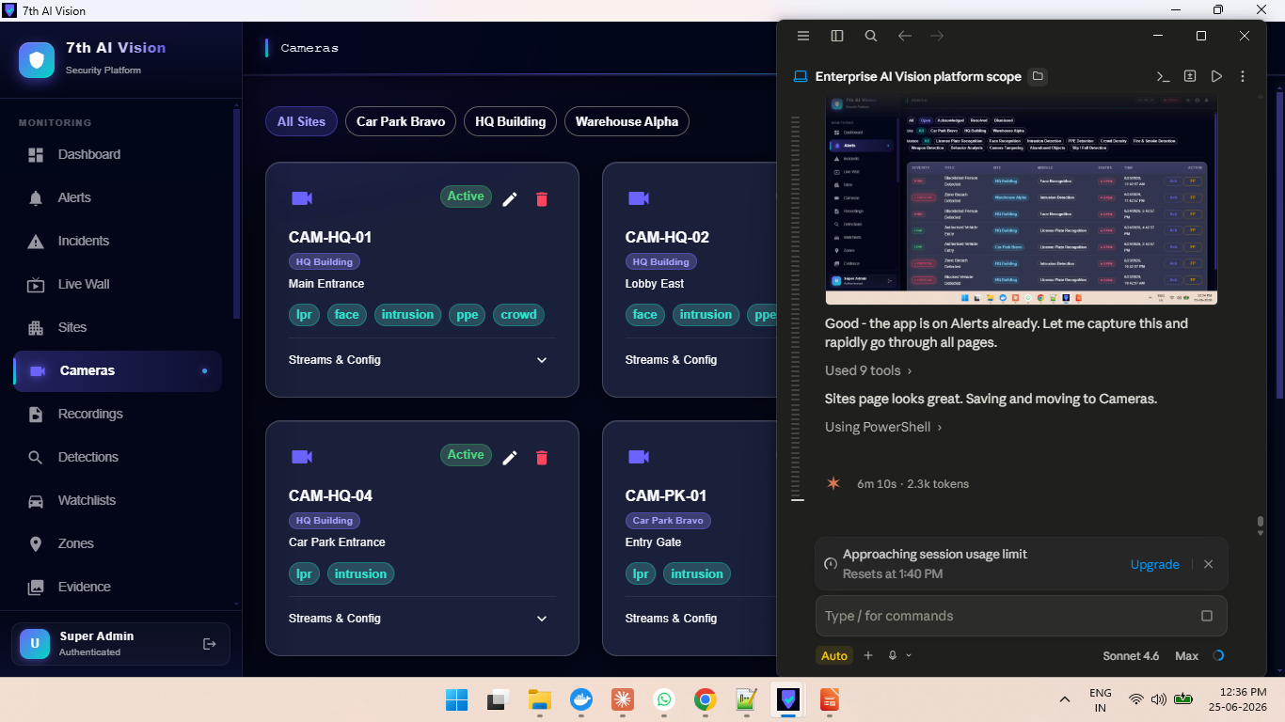
Sites & Camera Management
7th AI Vision
Hierarchical site → camera structure with RTSP stream validation and per-module AI tagging
▸ Sites group cameras by physical location (HQ Building, Warehouse, Car Park…)
▸ Per-camera AI module tags: lpr, face, intrusion, ppe, crowd, fire_smoke, weapon…
▸ Camera active/inactive status with real-time health monitoring
▸ RTSP stream URL + credential storage with live 'Test Connection' validation
▸ Connection validation returns resolution, FPS, and latency before saving
▸ Stream health monitoring: online → degraded → offline state machine
▸ Camera offline alerts pushed to notification channels automatically
▸ Per-tenant module licensing controls which AI features each camera can use
3 Sites
10 Cameras
RTSP Validation
AI Module Tags
Enterprise AI Video Surveillance — 7th AI Vision | Confidential

Slide 8
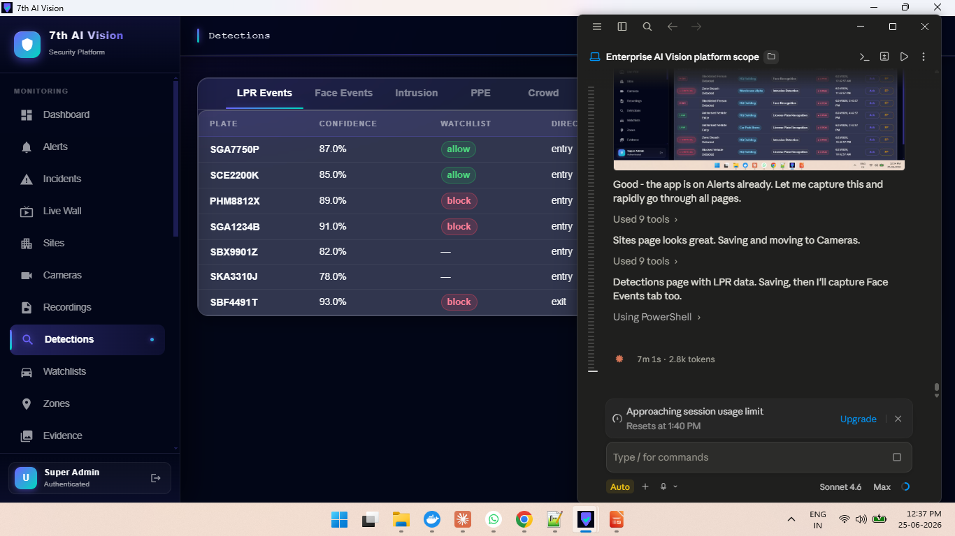
AI Detection Engine — 11 Modules
7th AI Vision
GPU-accelerated per-module workers with independent consumer groups and crash recovery
▸ LPR: YOLOv8 plate detection + PaddleOCR — reads plates at ≥55% confidence
▸ Face: InsightFace buffalo_l — 512-d ArcFace embeddings, cosine similarity match
▸ Intrusion: YOLOv8 person + Shapely polygon zone check, foot-point method
▸ PPE / Crowd / Fire / Smoke / Weapon / Behavior / Tamper / Abandoned / Fall
▸ Each module runs as an independent Docker service — scales GPU workers independently
▸ Redis Streams pipeline: XADD frames → XCONSUME per-module group → write DB
▸ Crash recovery: XPENDING → XCLAIM — no frame silently lost on worker restart
▸ Tenant-configurable thresholds via admin settings — no redeploy required
YOLOv8
InsightFace
Redis Streams
GPU Ready
Enterprise AI Video Surveillance — 7th AI Vision | Confidential

Slide 9
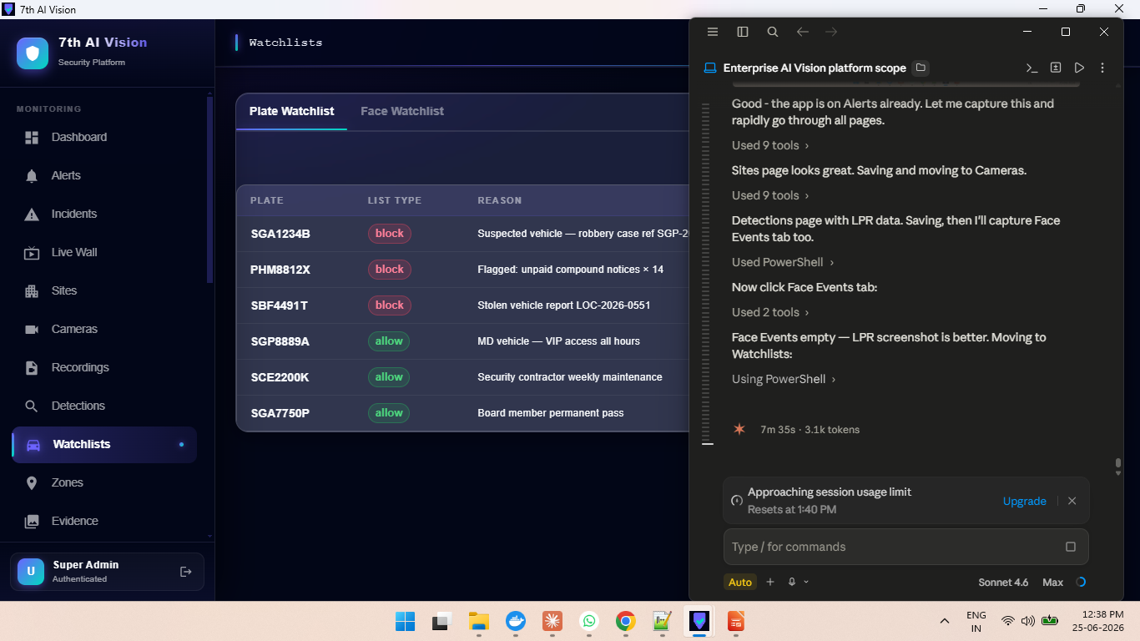
Smart Watchlist Management
7th AI Vision
Plate and face watchlists with block/allow classification and real-time matching
▸ Plate watchlist: block (stolen/suspect) and allow (VIP/authorised) entries
▸ Block hits → Critical alert + auto-incident; Allow hits → Low info alert only
▸ Face watchlist: 512-d ArcFace vector embeddings stored per person
▸ Face match threshold configurable per tenant (default 60% cosine similarity)
▸ Unrecognised faces generate low-severity 'Info' alerts — no noise suppression
▸ Entries include reason text and expiry date for time-limited blocks
▸ Police case reference fields for evidentiary integration
▸ All watchlist queries tenant-scoped via PostgreSQL RLS — cross-tenant leakage impossible
Block / Allow
ArcFace 512-d
Real-Time Match
Case Reference
Enterprise AI Video Surveillance — 7th AI Vision | Confidential

Slide 10
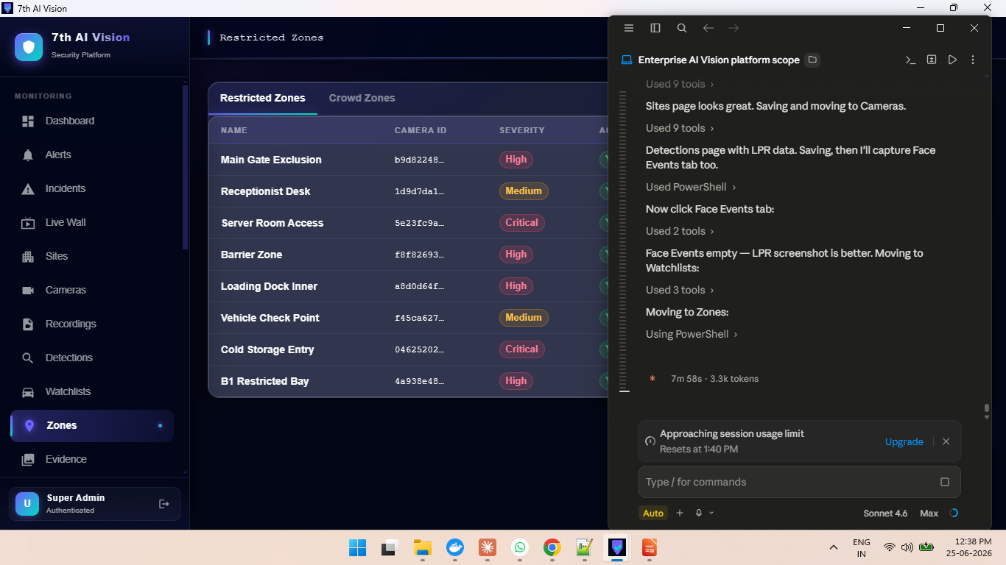
Restricted Zone Configuration
7th AI Vision
Polygon-based exclusion zones per camera with severity levels and dwell-time tracking
▸ Draw polygon zones on camera view — normalised 0..1 coordinates stored as JSON
▸ Severity per zone: Low, Medium, High, Critical — drives alert severity
▸ High/Critical zones auto-create incidents; Low/Medium alert only
▸ Redis-backed BreachTracker deduplicates — one alert per breach episode, not per frame
▸ Sliding TTL cooldown: person lingering keeps the breach active, doesn't re-alert
▸ Dwell-time tracking: how long a person was in the zone (seconds)
▸ 8 zones seeded across 3 sites: Main Gate, Server Room, Loading Dock, Cold Storage…
▸ Zones per camera; multiple zones supported simultaneously on same feed
Polygon ROI
4 Severity Levels
Dwell Tracking
Deduplication
Enterprise AI Video Surveillance — 7th AI Vision | Confidential

Slide 11
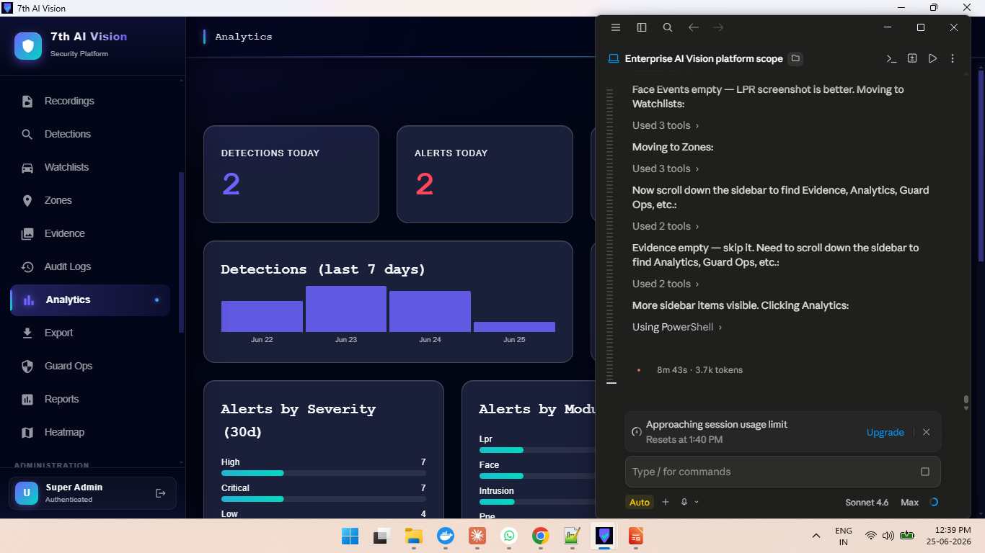
Analytics & Reporting Dashboard
7th AI Vision
30-day trend analysis across detections, alerts, incidents, and module breakdowns
▸ KPI row: Total detections (30d), Total alerts, Open alerts, Incident resolution count
▸ Detections by day — stacked bar chart per AI module
▸ Alerts by day — trend line with severity overlay
▸ Alerts by severity: Critical / High / Medium / Low breakdown
▸ Alerts by module — which AI modules are generating the most events
▸ Incident resolution time trend — SLA compliance monitoring
▸ All queries filterable by site and date range
▸ Export to CSV/Excel for compliance and management reporting
30-Day Trends
Module Breakdown
SLA Monitoring
CSV Export
Enterprise AI Video Surveillance — 7th AI Vision | Confidential

Slide 12
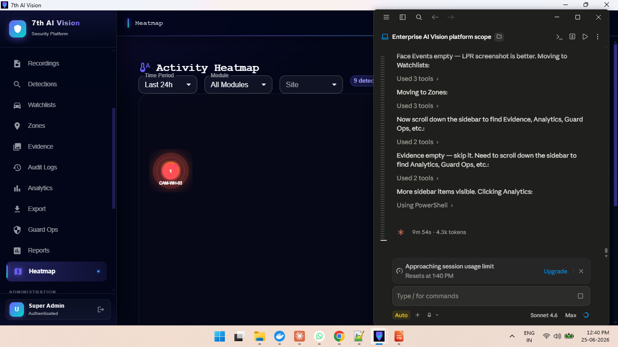
Activity Heatmap — Spatial Intelligence
7th AI Vision
Visual site map showing camera positions, detection density, and live alert status
▸ Camera positions shown on a floor-plan / spatial canvas
▸ Circle size = detection volume over selected time period
▸ Colour coding: Red (critical), Orange (high), Yellow (open alerts), Teal (activity)
▸ Pulsing ring animation = active critical alert on that camera
▸ Filter by: Time Period (Last 24h, 7d, 30d), Module, Site
▸ Top Cameras by Alerts leaderboard — identify hotspots instantly
▸ Summary badges: total detections, total alerts, critical count
▸ Instant navigation: click a camera bubble to open live feed or alert list
Spatial View
Alert Bubbles
Critical Pulse
Site Filter
Enterprise AI Video Surveillance — 7th AI Vision | Confidential

Slide 13
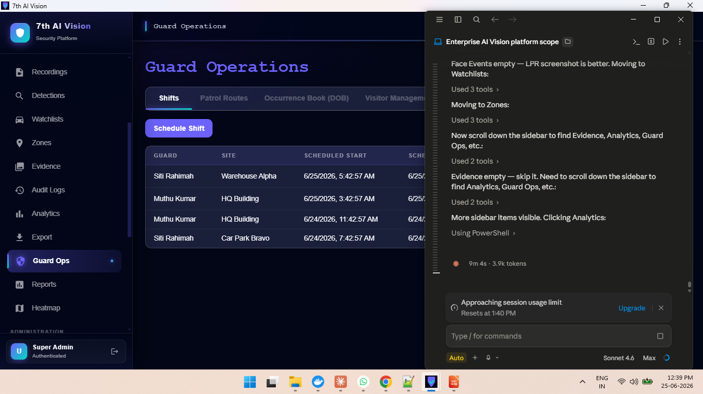
Guard Operations Management
7th AI Vision
Shift scheduling, patrol routing, checkpoint scanning, and visitor management
▸ Shift management: assign guards to sites with start/end times and handover notes
▸ Patrol routes: define waypoints with QR-code checkpoints for verification
▸ Mobile QR scanner: guard scans checkpoint, system logs GPS + timestamp proof
▸ SOS panic button on mobile app — immediate critical incident created
▸ Daily Occurrence Book (DOB): printable PLRD-compliant handover report
▸ Visitor management: pre-registration, arrival/departure logging, overstay alerts
▸ Overstay scheduler: auto-alert when visitor exceeds permitted duration
▸ Dispatch: assign guard to incident with ETA, custody chain tracking
Shift Mgmt
QR Checkpoints
DOB Report
Visitor Log
Enterprise AI Video Surveillance — 7th AI Vision | Confidential

Slide 14
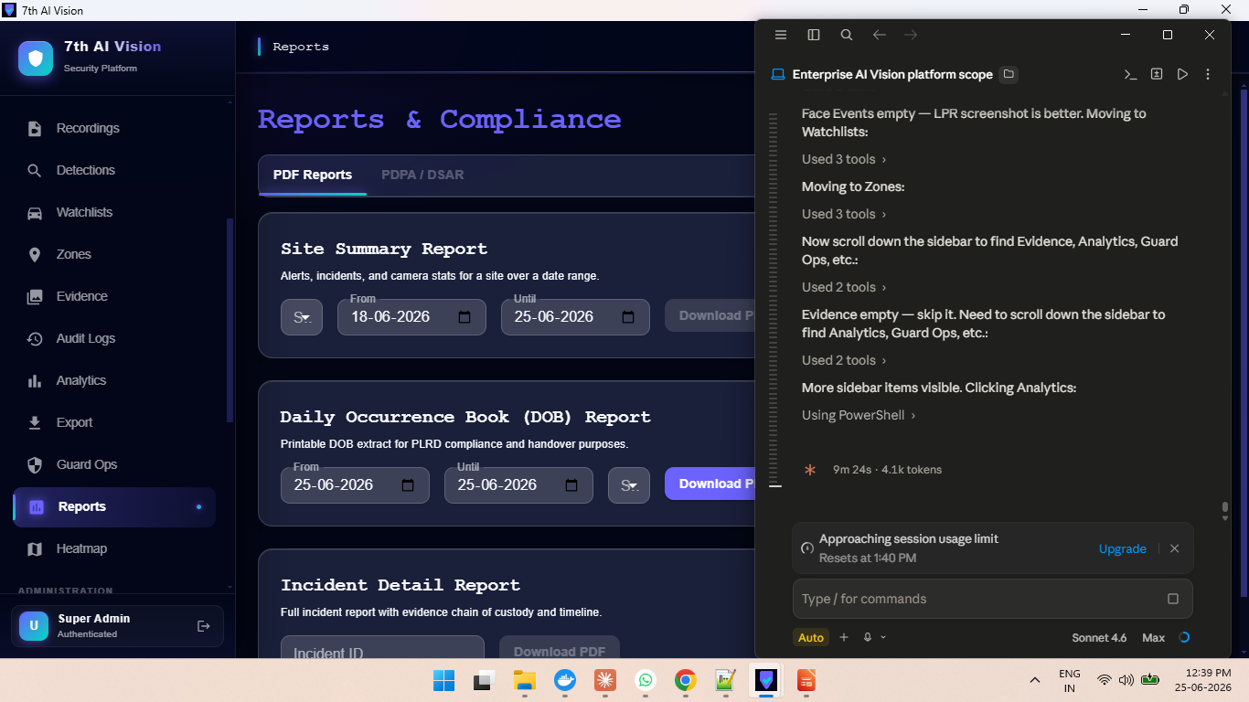
Reports & Compliance
7th AI Vision
PDF report generation, PDPA compliance tools, and DSAR request management
▸ Site Summary Report: alerts, incidents, camera stats over configurable date range
▸ Daily Occurrence Book (DOB): printable extract for PLRD compliance and handover
▸ Incident Detail Report: full report with evidence chain of custody and timeline
▸ PDPA / DSAR tab: manage Data Subject Access Requests with 30-day response tracking
▸ Privacy masking: configurable face/plate blurring for compliance exports
▸ All reports tenant-scoped — operators cannot access other tenants' data
▸ Blockchain-style audit log verification (Verify Chain button)
▸ Export history audit — every download logged with user, IP, timestamp
PDF Reports
PDPA/DSAR
Privacy Masking
Chain Verify
Enterprise AI Video Surveillance — 7th AI Vision | Confidential

Slide 15
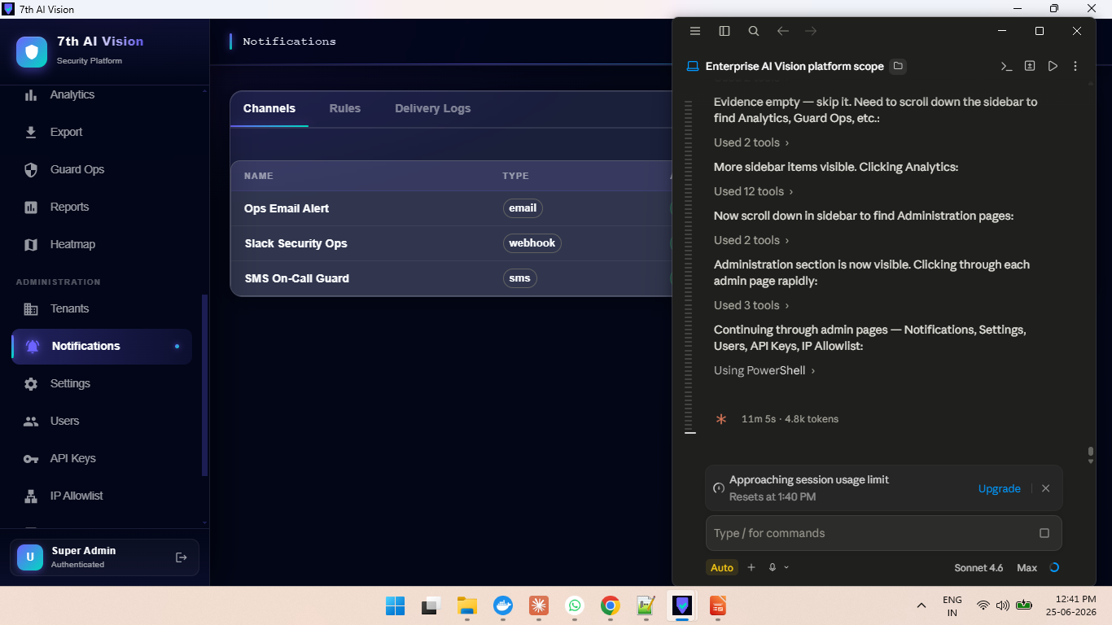
Multi-Channel Notification System
7th AI Vision
Email, SMS, and webhook delivery with rule-based routing and delivery logs
▸ Channels: Email (SMTP), SMS (Twilio), Webhook (Slack, Teams, custom)
▸ 3 active channels seeded: Ops Email Alert, Slack Security Ops, SMS On-Call Guard
▸ Rule engine: route specific alert types/severities to specific channels
▸ Delivery logs: track every notification sent with status and timestamp
▸ Test endpoint: fire a test notification to verify channel config
▸ Mobile push notifications: Expo FCM/APNs for iOS and Android apps
▸ Camera offline alerts automatically dispatched when connectivity drops
▸ Notification rules configurable per tenant by admin without code changes
Email / SMS / Webhook
Mobile Push
Delivery Logs
Rule Engine
Enterprise AI Video Surveillance — 7th AI Vision | Confidential

Slide 16
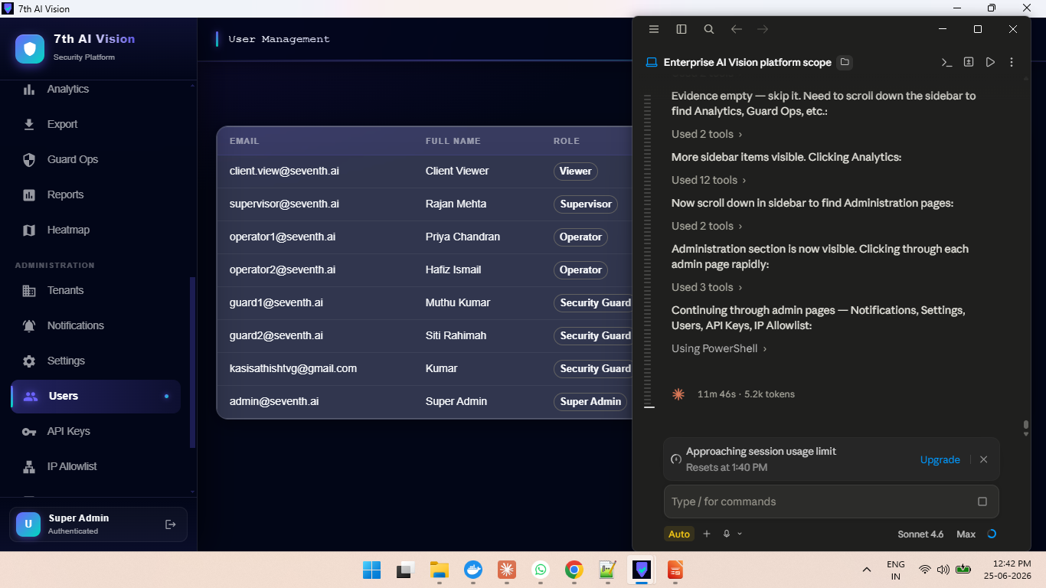
Administration & Security
7th AI Vision
Multi-tenant management, RBAC, 2FA, API keys, IP allowlist, and session control
▸ 6 RBAC roles: Super Admin, Admin, Supervisor, Operator, Security Guard, Viewer
▸ Per-tenant module licensing: enable/disable AI modules per tenant (8/11 active)
▸ Two-factor authentication (TOTP) — enforced per-tenant by admin policy
▸ Active session management: view and revoke sessions across devices
▸ Per-account login lockout after configurable failed attempts
▸ API key management with scoped permissions for programmatic access
▸ IP allowlist: restrict tenant access to approved CIDR ranges only
▸ All admin actions logged in tamper-evident audit trail (Verify Chain)
6 RBAC Roles
2FA/TOTP
IP Allowlist
Session Mgmt
Enterprise AI Video Surveillance — 7th AI Vision | Confidential

Slide 17
Windows Desktop Application
Native Electron app — full platform capability without a browser
▸ Packaged as native Windows .exe (NSIS installer + portable)
▸ First-run wizard: configure server URL (local or cloud deployment)
▸ System tray icon with real-time unread alert badge count
▸ Native Windows notifications for Critical/High severity alerts
▸ Auto-reconnect WebSocket with exponential backoff
▸ Offline mode indicator with graceful degradation
▸ No browser required — runs alongside other security software
▸ Electron wrapper reuses 100% of the React web frontend — zero code duplication
▸ Optional auto-start on Windows login via system settings toggle
Electron
NSIS Installer
System Tray
Native Push
Enterprise AI Video Surveillance — 7th AI Vision | Confidential

Slide 18
Technical Architecture
Production-ready microservice architecture — Docker Compose → Kubernetes ready
Clients
Web (React+MUI) • iOS/Android (Expo) • Windows (Electron)
API Gateway
FastAPI /api/v1 • Nginx reverse proxy • SlowAPI rate limiting
Real-Time
WebSocket /ws/live • Redis Pub/Sub fan-out • ConnectionManager
AI Workers
11 × independent Docker services • Redis Streams XCONSUME • GPU/CPU auto-detect
Data Store
PostgreSQL 16 + RLS • pgvector embeddings • pg_partman monthly partitions
Message Bus
Redis 7 • Streams (frame_jobs) • Pub/Sub (tenant_events)
Observability
Prometheus scrape • Grafana dashboards • Structured logging
Compliance
Audit log chain verify • PDPA/DSAR • Evidence SHA-256 checksums
Enterprise AI Video Surveillance — 7th AI Vision | Confidential

Slide 19
Deployment & Security Posture
On-premise or cloud — built for 7–10 year operational lifespan
Deployment
API Security
✓ Docker Compose (dev/on-prem)
✓ SlowAPI rate limiting (Redis-backed)
✓ Kubernetes-ready (Helm charts path)
✓ 5/min on login (brute-force protection)
✓ GPU passthrough via NVIDIA Container Toolkit
✓ CORS + CSP + X-Frame-Options headers
✓ Windows native Electron .exe
✓ API key scoping for programmatic access
Database
AI Pipeline
✓ PostgreSQL 16 with Row-Level Security
✓ Redis Streams crash recovery (XCLAIM)
✓ Monthly table partitioning (pg_partman)
✓ Model version tracked per detection row
✓ pgvector for 512-d face embeddings
✓ Tenant-configurable thresholds (no redeploy)
✓ 7-year audit log archival — never dropped
✓ 30-second TTL settings cache in workers
Auth & Access
Compliance
✓ JWT with per-kid signing key rotation
✓ PDPA-ready: DSAR management, masking
✓ TOTP two-factor authentication
✓ SHA-256 evidence checksums
✓ Per-account lockout (configurable attempts)
✓ Blockchain-style audit chain verification
✓ IP allowlist per tenant
✓ Semantic-versioned releases + rollback runbook
✓ Active session revocation
Enterprise AI Video Surveillance — 7th AI Vision | Confidential

Slide 20
7th AI Vision
Where AI Meets Physical Security
Built for enterprise. Proven in production. Ready to deploy.
◆ 11 AI detection modules — all running simultaneously per camera
◆ 104 / 104 automated backend tests passing
◆ Multi-tenant SaaS with PostgreSQL Row-Level Security
◆ Real-time WebSocket push — zero-polling alert delivery
◆ Native Windows desktop app + iOS/Android mobile app
◆ Full PDPA compliance with DSAR and privacy masking tools
Contact: sathishtvg@gmail.com
© 2026 Seventh AI Vision. All rights reserved.

