Slide 1
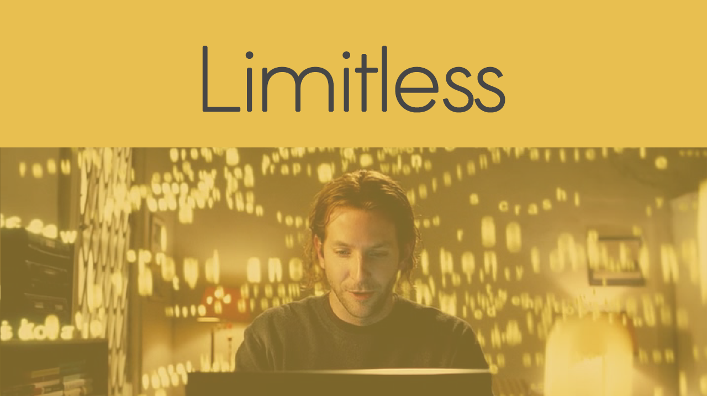
created by
Sathish VJ

Slide 2






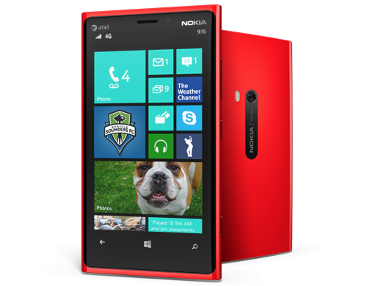
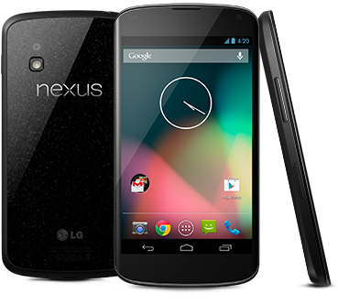
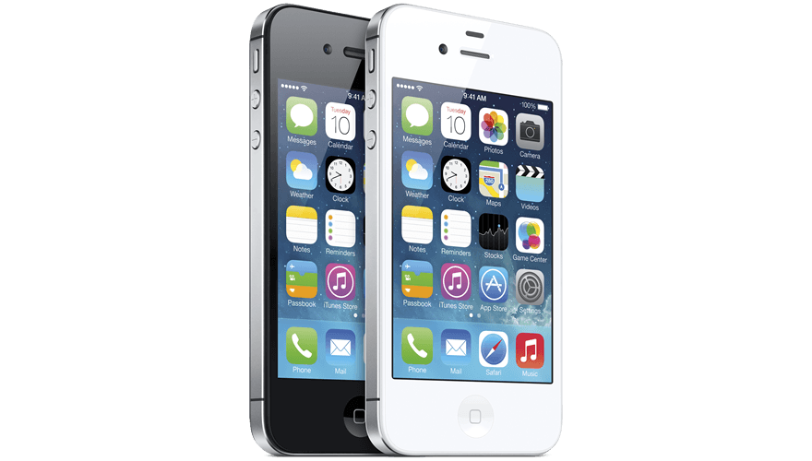

API
AngularJS, Ionic, HTML, CSS, JavaScript
works natively on Windows Phone, Android, iOS, …
https://github.com/sathishvj/limitless

Slide 3
What could be better
Data has gone from non-availability to abundance … social networks, devices, etc.
Abundant unmanageable data has been qualified and filtered … Frrole and similar APIs
Next milestone? Improve comprehension.

Slide 4
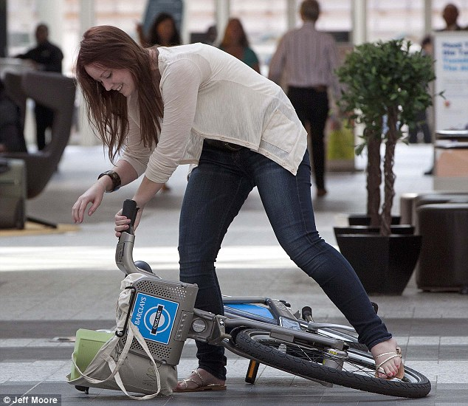


Speed Reading
Too Slow
Right Speed
Too Fast
Unsteady
Unsteady
Our brains can actually read much faster and with greater comprehension than we typically tend to do

Slide 5



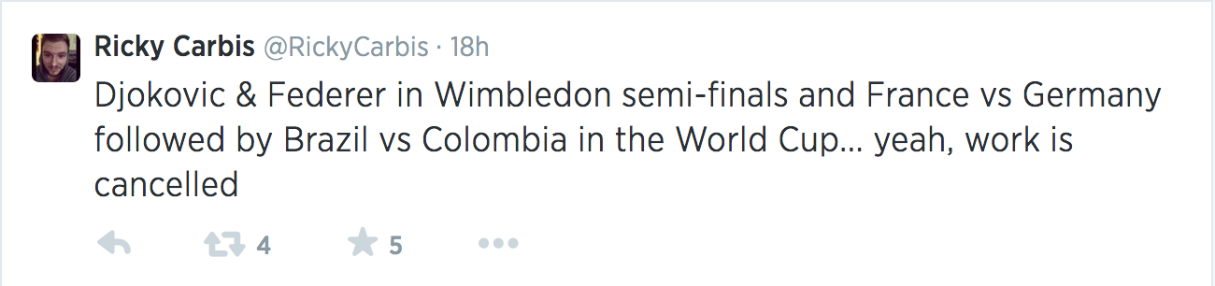


Multi-input Imagery
Our ability to read text can be enhanced through alternate inputs also

Slide 6
Volume of Data
Comprehension
of Information
Speed of
Reading

Slide 7
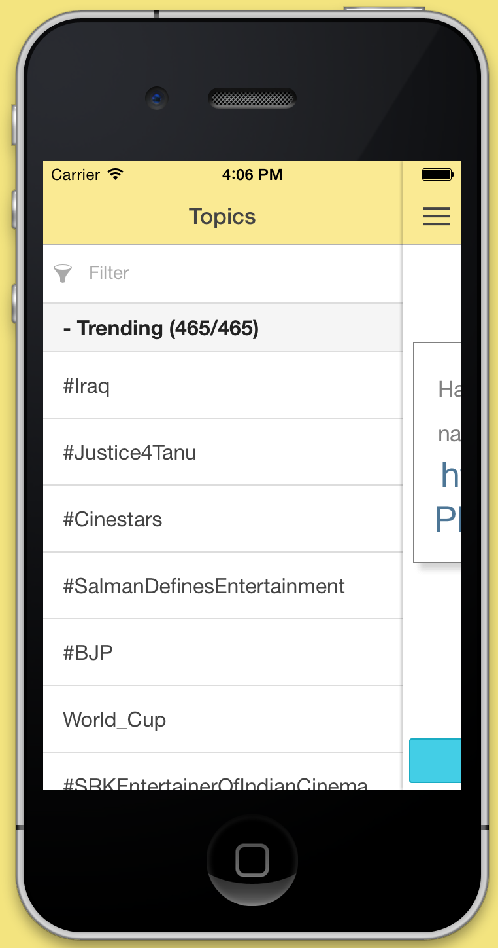
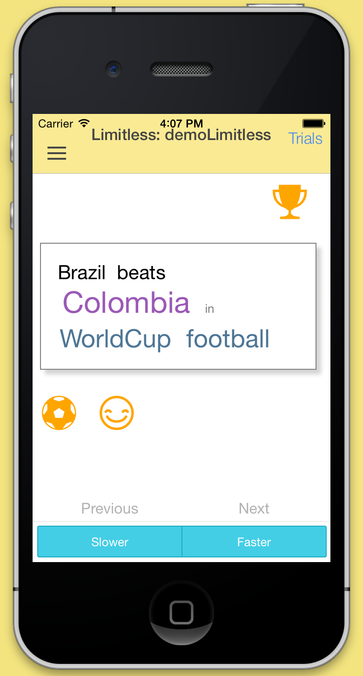
Demo

Slide 8
Bradley Cooper gets super human capabilities by taking a pill … he reads faster, comprehends better, retains information more, etc.
Thank You

