Slide 1
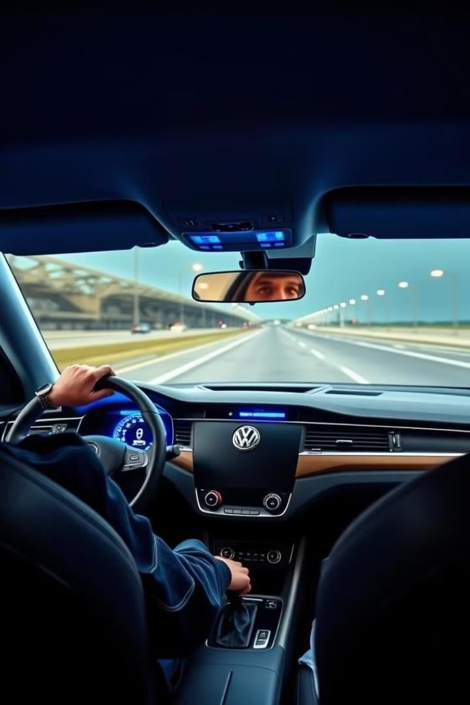
Facial Drowsiness Detection System for
Enhanced Road Safety
Driver fatigue is a major contributor to road accidents, resulting in
devastating consequences. Detection System addresses
Our innovative Facial Drowsiness this critical issue by leveraging
advanced machine learning algorithms to monitor driver alertness in real-time.
Bvritn’s

Slide 2
The Silent Killer: Driver Fatigue
Driver fatigue is a significant threat on our roads, often leading to impaired judgment, slowed reaction times, and increased risk-taking behavior. It's a silent killer, lurking behind countless accidents, and tragically, it's often overlooked as a contributing factor.
1
Reduced Alertness
Fatigue can significantly reduce a driver's ability to react quickly and appropriately to changing road conditions.
2
Impaired Decision-Making
Fatigued drivers may experience lapses in judgment, making poor decisions that could lead to dangerous situations.
3
Increased Risk-Taking
Fatigue can lead drivers to take unnecessary risks, such as speeding, tailgating, or ignoring traffic signals.
4
Drowsy Driving Statistics
According to the National Highway Traffic Safety
Administration (NHTSA), drowsy driving is responsible for an estimated 100,000+ car crashes each year in India.
Bvritn’s

Slide 3
Facial Drowsiness Detection System: A Revolutionary Revolutionary Solution
Our Facial Drowsiness Detection System uses cutting-edge technology to detect signs of fatigue in drivers and intervene before it leads to dangerous situations. This system utilizes advanced machine learning algorithms to monitor driver alertness and provide timely interventions.
1 2 3
Real-Time Facial Analysis
The system continuously monitors the driver's face, analyzing facial features such as eye closure, head nods, and yawns to detect signs of drowsiness.
Alert System Activation
Upon detecting drowsiness, the system triggers visual and auditory
Vehicle Intervention (Optional)
In cases of severe drowsiness, the
alerts to prompt the driver to regain focus, such as a flashing light or an audible buzzer.
system can activate vehicle interventions, such as gradually slowing down the vehicle and activating hazard lights to alert surrounding vehicles.
Bvritn’s

Slide 4
The Technology Behind the System
Our Facial Drowsiness Detection System relies on a sophisticated blend of hardware and software components, designed to accurately detect and respond to driver fatigue in real-time.
Hardware Software Data Analysis
A high-resolution camera captures
front-facing real-time
Machine Learning Algorithms
Facial Recognition Software
The system analyzes key facial features like eye closure, head
images of the driver's face.
(OpenCV, Dlib)
Image Processing Techniques
movements, and yawns to determine the driver's level of alertness.
Bvritn’s

Slide 5
Benefits of the Facial Drowsiness Detection System System
The Facial Drowsiness Detection System offers a compelling set of advantages, contributing to safer roads and a more secure driving experience for everyone.
Enhanced Road Safety
The system helps to prevent accidents caused by driver fatigue, significantly reducing the risk of collisions and potential injuries.
Increased Driver Awareness
The alerts provided by the system encourage drivers to take breaks when they need them, promoting better driving habits and a higher level of alertness.
Reduced Costs
By minimizing accidents and their associated costs, the system contributes to lower insurance premiums and reduced healthcare expenditures.
Improved Peace of Mind
The system provides drivers and their loved ones with added peace of mind knowing that technology is working to ensure their safety on the road.
Bvritn’s

Slide 6
Rigorous Testing and Real-World Validation
Our system has undergone extensive testing in a variety of real-world scenarios to ensure its reliability and effective
different driving conditions.
Test Case Description
Ambient Light The system was tested in various lighting conditions, including bright sunlight, dim light, and nighttime driving.
Result
The system successfully detected faces and eyes in all tested lighting conditions.
Driver Posture
Tests were conducted with drivers positioned in different ways, including centered, right-side, and left-side positions within the vehicle.
The system and eyes posture.
accurately detected faces regardless of the driver's
Spectacles
The system was tested with drivers wearing The system successfully detected eyes glasses to assess its ability to detect eyes through spectacles, demonstrating its accurately through lenses. robustness in real-world scenarios.
Head Tilt
The system was tested with drivers tilting their heads at various angles to evaluate its sensitivity to head movements.
The system successfully detected faces and eyes when head tilt was within 30 degrees from vertical plane.
Bvritn’s

Slide 7
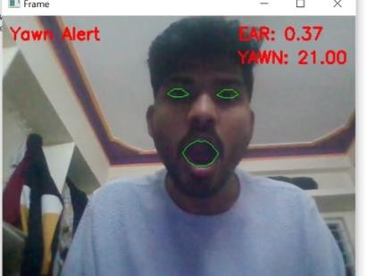
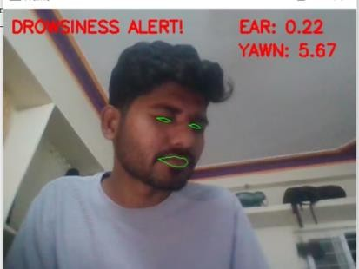
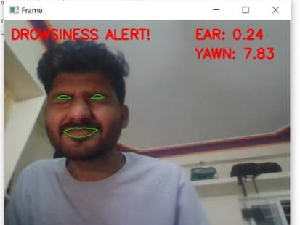
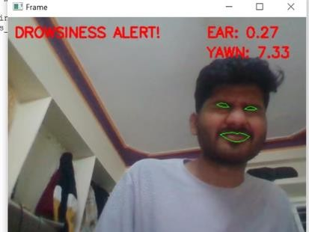
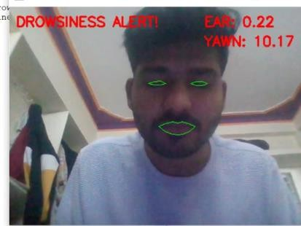
Testing and Real-World Validation
Bvritn’s

Slide 8

Future Development and Advancements
We are continuously working to enhance our Facial Drowsiness Detection System and integrate it seamlessly with advanced vehicle technologies. Our commitment lies in developing a truly innovative solution that contributes to safer roads and a brighter future of transportation.
AI-Driven Driver Monitoring
Our future development plans include implementing sophisticated AI algorithms to continuously monitor driver behavior, adapting to individual driving styles and personalized drowsiness thresholds. Example: Turning On correct Indicators.
Integration with Vehicle Controls
We are working on integrating our system with advanced vehicle controls, allowing for more proactive interventions like automatic lane changes and gentle braking in situations where drowsiness poses a significant threat. Example: Deceleration of speed using IOT integrated device/sensor.
Real-Time Data Analysis
The system will be designed to analyze real-time driving data, including speed, lane position, and road conditions, to provide more accurate drowsiness detection and personalized alerts. Example: Alerting the driver using alarm when caught dozing out.
Bvritn’s

Slide 9




Investment Opportunity: Partnering for a Safer Future Future
We are seeking investors who share our vision of safer roads and a future where technology plays a critical role in preventing accidents caused by driver fatigue. Your investment will not only contribute to a life- saving innovation, but also to a sustainable and thriving transportation ecosystem.
Attractive ROI
The market for driver safety technology is rapidly expanding, offering a compelling return on investment for forward- thinking investors.
Saving Lives
Our system has the potential to save lives and reduce the number of accidents caused by driver fatigue, making a tangible difference in road safety.
Cutting-Edge Technology
We are at the forefront of driver safety innovation, leveraging advanced machine learning and AI to create a truly groundbreaking solution.
Shaping the Future
By investing in our system, you'll be part of a movement towards a future of safer, more intelligent transportation.
Bvritn’s

Slide 10

Call to Action: Join Us in Driving Driving Change
We invite you to join us in driving change by investing in our Facial Drowsiness Detection System. Together, we can make a real difference in reducing accidents caused by driver fatigue, creating safer roads for everyone.
Bvritn’s

