Slide 1
ACTIVITY LIFE CYCLE
public class SupportActivity extends Activity implements LifecycleOwner, Component {
public class FragmentActivity extends SupportActivity implements ViewModelStoreOwner, OnRequestPermissionsResultCallback, RequestPermissionsRequestCodeValidator {
public class AppCompatActivity extends FragmentActivity implements AppCompatCallback, SupportParentable, DelegateProvider {
public class MainActivity extends AppCompatActivity {
-> MainActivity is the sub class of Activity Class

Slide 2
AppcompactActivity class:
If material design implementation is needed
Target android devices below API 21
FragmentActivity class:
If nested fragments needed
If design features don’t require material design for lower API levels
Activity class:
None of the above needed
All the features above are essential for professional applications

Slide 3
Activity Life Cycle Methods
OnCreate
onStart
onResume
onRestart
onPause
onStop
onDestroy

Slide 4
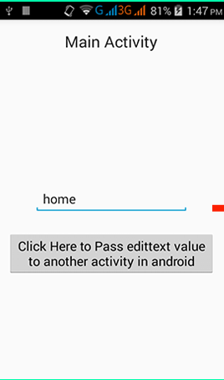
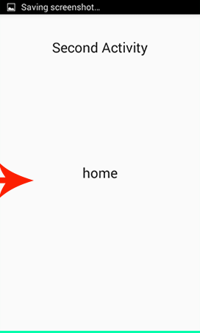
Activity Life Cycle

Slide 5
Activity Life Cycle
MainActivity
Second Activity
OnCreate
OnCreate
OnStart
OnStart
OnReStart
OnResume
OnResume
Activity Visible
Activity Visible
OnPause
OnPause
OnStop
OnStop
OnDestroy
OnDestroy

Slide 6
STACK AND ACTIVITY
2ND ACTIVITY
1ST ACTIVITY
STACK

Slide 7
Activity Life Cycle
onCreate() | Whenever an Activity starts running, the first method to get executed is onCreate(). This method is executed only once during the lifetime. If we have any instance variables in the Activity, the initialization of those variables can be done in this method. After onCreate() method, the onStart() method is executed.
onStart() | During the execution of onStart() method, the Activity is not yet rendered on screen but is about to become visible to the user. In this method, we can perform any operation related to UI components.
onResume() | When the Activity finally gets rendered on the screen, onResume() method is invoked. At this point, the Activity is in the active state and is interacting with the user.
onPause() | If the activity loses its focus and is only partially visible to the user, it enters the paused state. During this transition, the onPause() method is invoked. In the onPause() method, we may commit database transactions or perform light-weight processing before the Activity goes to the background.

Slide 8
Activity Life Cycle
onStop() | From the active state, if we hit the Home key, the Activity goes to the background and the Home Screen of the device is made visible. During this event, the Activity enters the stopped state. Both onPause() and onStop() methods are executed.
onDestroy() | When an activity is destroyed by a user or Android system, onDestroy() function is called.

Slide 9
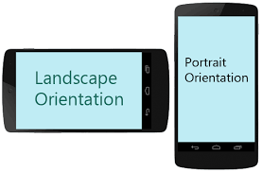
Screen Orientation and Activity Life cycle

Slide 10
Screen Orientation and Activity Life cycle
On rotation of Screen
Portrait to landscape or vice versa
Activity is destroyed
Activity is recreated fresh in requested orientation

Slide 11
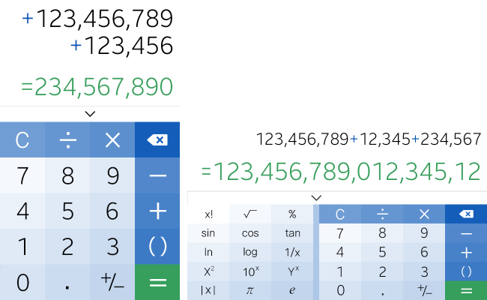
Consequences of Screen Orientation
OnCreate
OnStart
OnResume
Activity Visible
OnPause
Preserve the state of previous screen orientation
User should not know that the activity is destroyed
OnStop
OnDestroy

Slide 12
Solutions to Handle Screen Orientation
Restoring the Activity State
Activity is destroyed and recreated
Use onRestoreInstanceState and onSaveInstanceState
2. Handling configuration change yourself
Activity is not destroyed
Use onConfigurationChanged

Slide 13
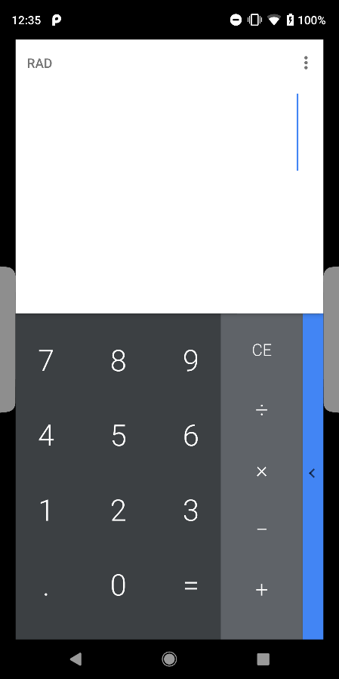
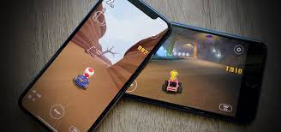
Method 1- Solution to Handle Screen Orientation
OnCreate
OnStart
OnRestoreInstanceState
OnResume
Activity Visible
OnPause
OnSaveInstanceState
OnStop
OnDestroy

Slide 14

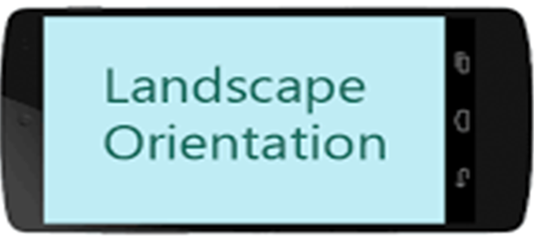
Method 2- Solution to Handle Screen Orientation
Handling Configuration Change
OnConfigurationChanged
Declare android:configchanged attribute in Manifest file under <activity>
Override onConfigurationChanged() in Activity class.

Slide 15
Summary- Solutions to Handle Screen Orientation
Method1
Is generally preferred and recommended
Against GuideLines
Not Recommended
Should be used only when restoring activity back is expensive and slow

