Slide 1
Android Components
ACTIVITY
SERVICE
BROADCAST RECEIVER
CONTENT PROVIDER

Slide 2
ACTIVITY
Anything that appears on the screen is basically an activity
Its an visual representation of an application- so whatever application the user interacts is basically possible because of the presence of an activity
An application can contain multiple activities

Slide 3
Intent
Intention to perform action
Contains a motive to trigger an event or to perform an action in the android OS or in any application
Basic functionality of this intent is to start an activity or launch an application

Slide 4
Start an activity
Start a service
Deliver a Broadcast for Broadcast receiver
INTENT

Slide 5
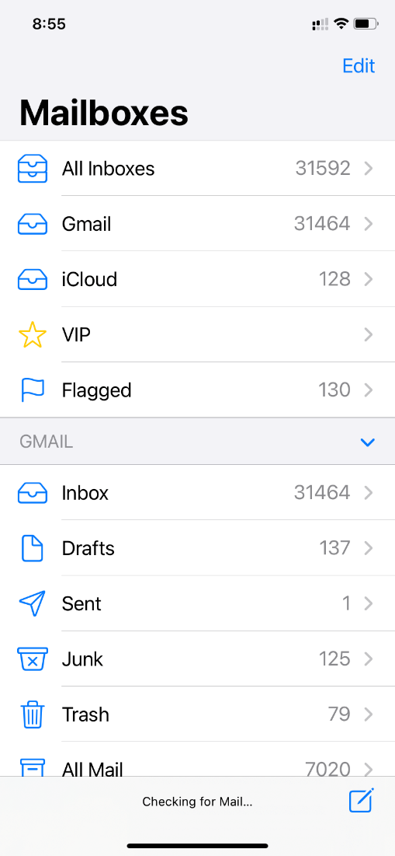
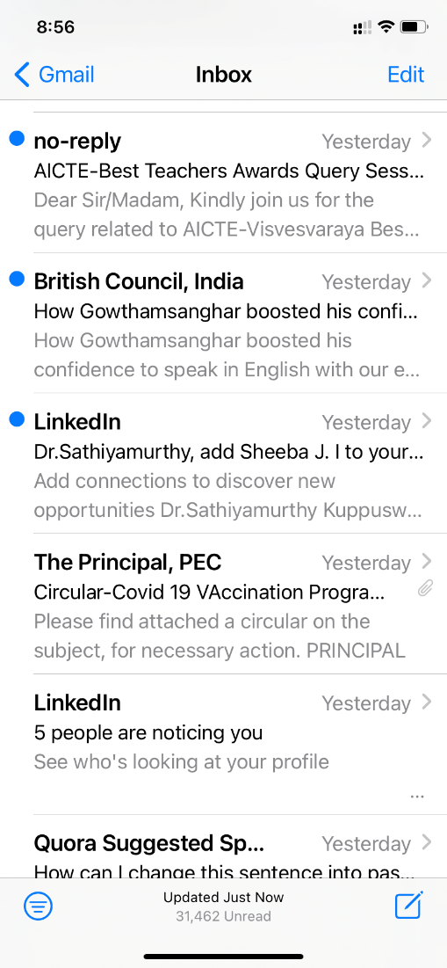
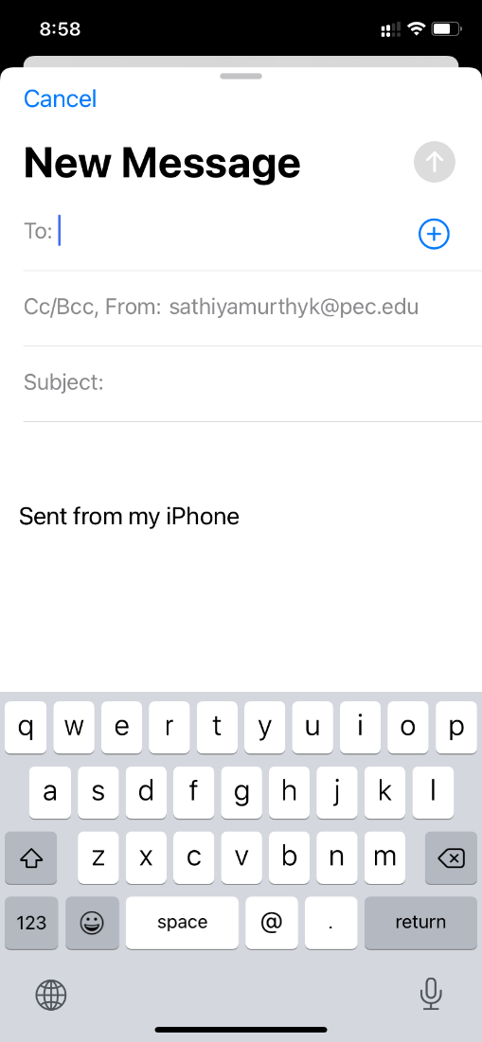
ACTIVITY
* Migration from 1 activity to another activity is possible with the help of special class Intent

Slide 6
SERVICE
Runs in Background
No UI
Can be started by activity
Can be started by Broadcast receiver
Examples
Playing music
Downloading or uploading an app

Slide 7
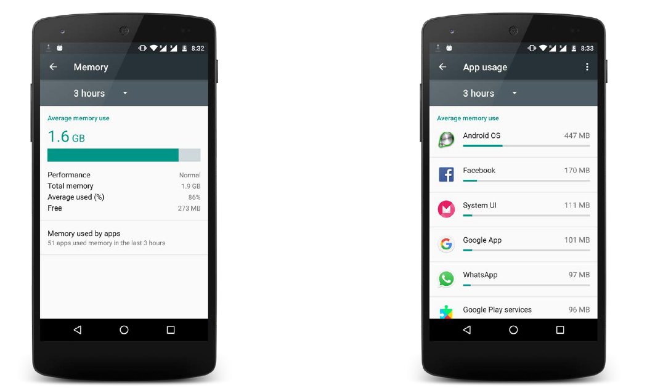

Slide 8
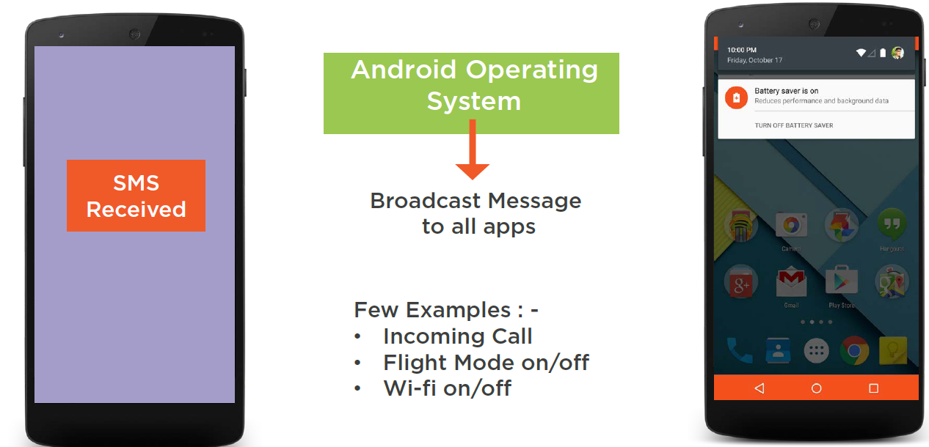
BROADCAST RECEIVER
Whenever there is some kind of disturbances then AOS broadcast messages to all applications

Slide 9
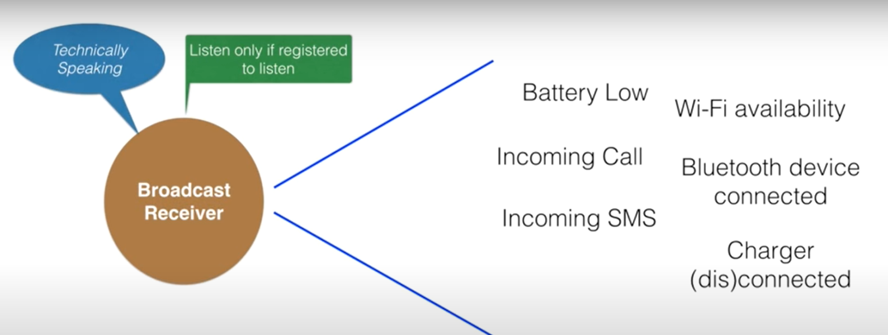
BROADCAST RECEIVER

Slide 10
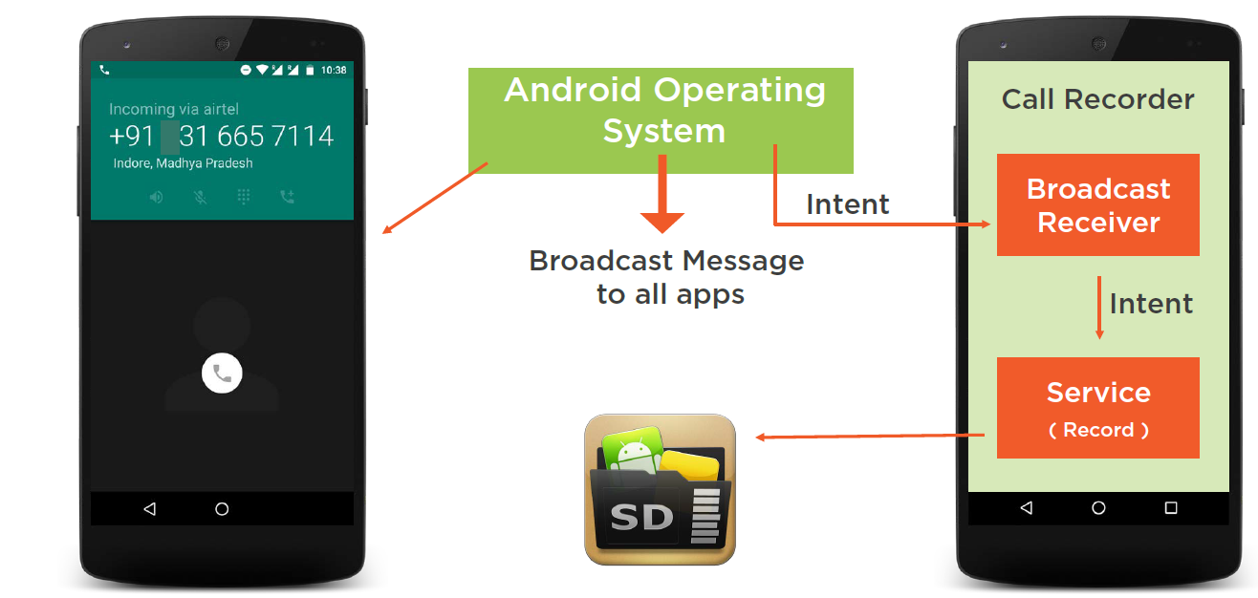
Broadcast receiver
Example – call recorder app registered for call receiver

Slide 11
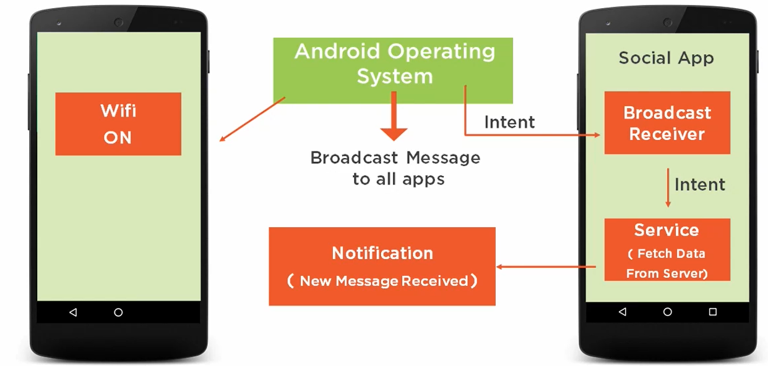
Broadcast receiver
Example for social media data update with WIFI on

Slide 12
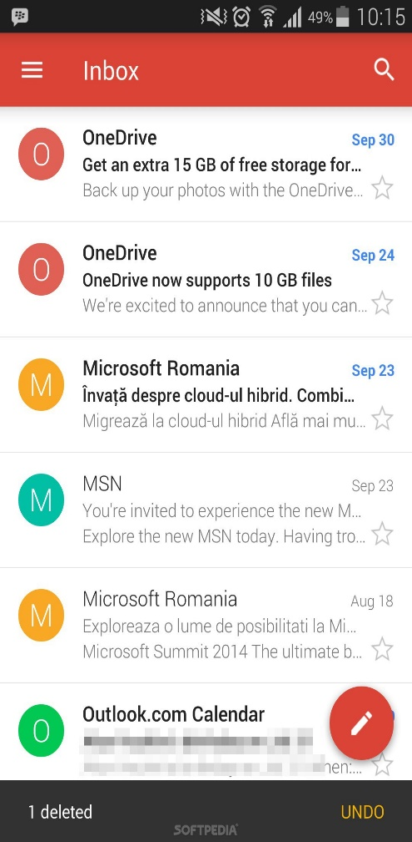
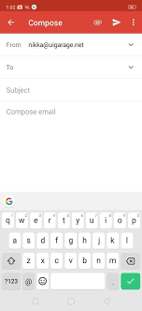
Using Activities to listen to Events
Intent
Navigate to second Activity
Event is Triggered

Slide 13
Event Handling
user
Button
Method Executed
Registered to
Event Listener Interface
View.OnClickListener

Slide 14
Event Handling: Downloading Example
Download Button
user
Button
Triggers
Event
Registered to
Download Started
OnClickListener
Android Framework
Action Performed
Event Listener
Calls a function

