Slide 1
COMMUNICATION
SENDING DATA TO A FRAGMENT FROM ACTIVITY
SENDING DATA TO ACTIVITY FROM FRAGMENT
INTER FRAGMENT COMMUNICATION

Slide 2
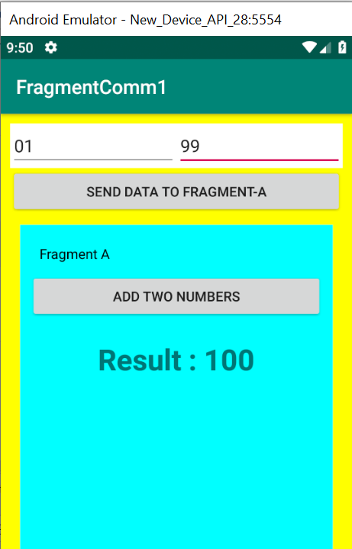
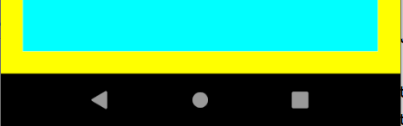
1. SENDING DATA TO A FRAGMENT FROM ACTIVITY
Using Bundle Object
Stores key/value pair
Using Fragment Object

Slide 3
2. SENDING DATA TO AN ACTIVITY FROM FRAGMENT
Activity implements MyListener
interface myListener
public void add(int num1,int num2)
@override
Public void add(int x, int y){
//add x +y
//show result
}
Fragment
activity.add(x,y)

Slide 4
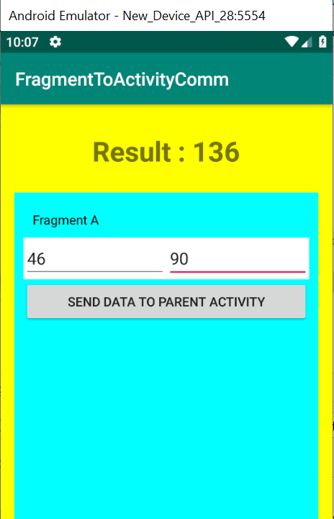
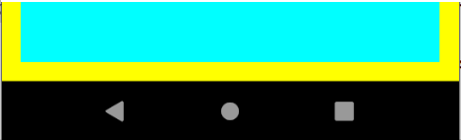
MainActivity extends Activity implements MyListener{
@override
Public void add(int num1, int num2) {
int result = num1 + num2;
txvResult.setText(“Result:”+ result);
}
}
Interface MyListener{
public void add(int num1, int num2);
}
Class FragmentA extends Fragment{
Private void sendData{
MyListener listener=(MyListener) getActivity();
Listener.add(23,17);
}
}

Slide 5
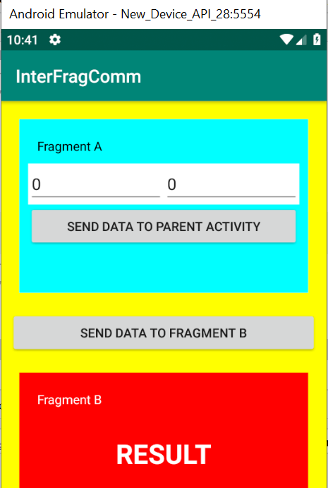
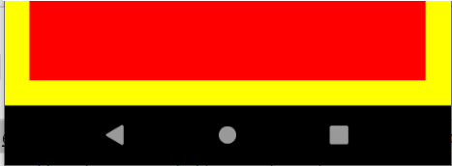
3. SENDING DATA FROM ONE FRAGMENT TO ANOTHER
Take input in Fragment A
- Get FirstNumber
- Get SecondNumber
Pass the Data to FragmentB
-Add Two numbers(FirstNumber + SecondNumber)
-Display the Result

Slide 6
COMMUNICATION BETWEEN TWO FRAGMENTS
Activity implements MyListener
interface myListener
Fragment A
activity.add(x,y)
public void add(int num1, int num2);
Pass data from fragmentA to Activity
Pass data from Activity to FragmentB
Add method in FragmentA
call add method in activity class to call
fragB.addTwoNumbers(x,y)
It executes addTwoNumbers in FragmentB
* not communicating directly but creating a communication gap between two fragments
@Override
Public void add(int x, int y){
fragB.addTwoNumbers(x,y) }
Activity
Fragment B
Public void addTwoNumbers(int a, int b) {
int result = a+b;
}

Slide 7
STEPS FOR SENDING DATA FROM ONE FRAGMENT TO ANOTHER
Create an interface MyListener
Define a callback method
Implement MyListener in Activity
Pass data from FragmentA to Activity
activity.add(x,y)
Pass data from Activity to FragmentB
FragB.addTwoNumbers(x,y)

