Slide 1
ANDROID FRAGMENTS

Slide 2
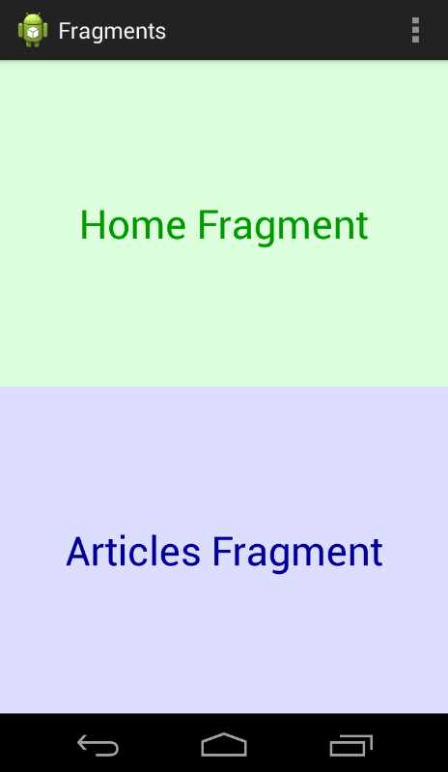
ANDROID FRAGMENTS
Fragments are found inside activity
One Activity can contain multiple Fragments
act_main.xml
Fragment A – Add
Fragment B - Add
Fragment A
Fragment B

Slide 3
FRAGMENT A
Fragment A – Add
Remove B - Remove
Fragment C – Add
Fragment D - Add
Fragment E – Add
Acts as a small chunk of UI
All Fragments are integral part of the main_activity.java (i.e its child elements)
FRAGMENT C
FRAGMENT D
FRAGMENT E

Slide 4
FRAGMENTS
Small Chunk of UI
Has its own life cycle
Can process its own events
Can be added/removed while parent activity is running
Introduced in API 11 – Honeycomb with the introduction of tablets
Backward compatible upto API 7
Act as a mini Activity

Slide 5
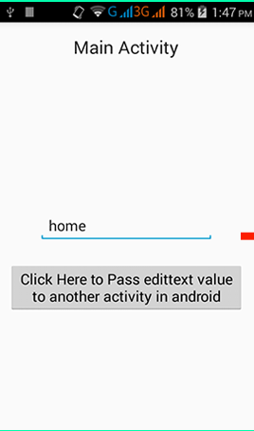
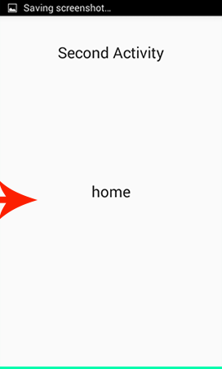
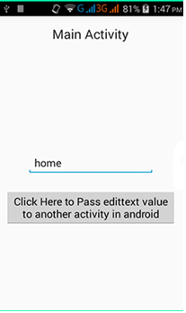
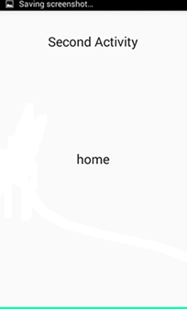
Activity
Activity + Fragment
Second Activity
Main Activity
Main Activity
Need two activities to display two kinds of layouts
Need only one Main activity to display two kinds of layouts

Slide 6
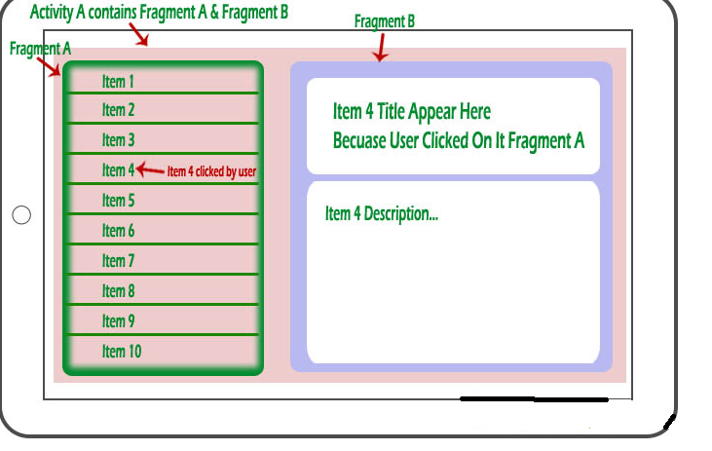

Slide 7
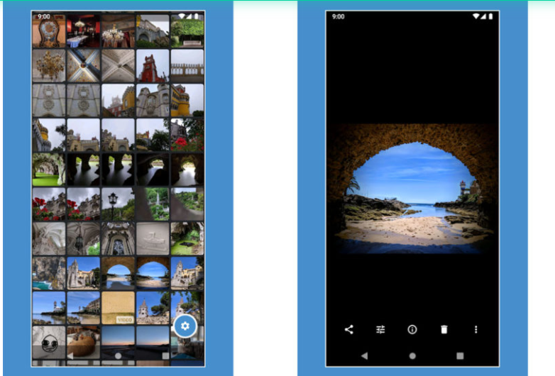
Image Gallery App
Main Activity
Second Activity

Slide 8

Image Gallery App - Tablet
Major Advantage of Fragments introduced with tablets
Enabling developers to effectively use space in the tablets
Image 1
Image 2
Image 2
Image 3
Image 4
Fragment A-List
Fragment B- Detailed View
Main Activity

Slide 9
Why Fragments?
Combine several fragments in single activity
Reuse same fragment across several activities
Make better use of larger screen space in Tablets
Support different layouts on portrait and landscape modes

Slide 10
Adding Fragments to Activity
Two Approaches
XML (less preferred)
Java / Programmatically (More Preferred)

Slide 11
1. Steps to create Fragment by XML
Create a subclass of Fragment
HelloFragment.java
Create a layout for fragment
fragment hello.xml
Link layout with Fagment subclass
override onCreateView()
Place the Fragment inside an Activity
<fragment> inside activity_main.xml

Slide 12
Fragment Manager
Interface to interact with fragment objects inside the Activity
Handles all Fragments inside one activity
FRAGMENT A
FRAGMENT A
Fragment Manager (interface)
FRAGMENT C
FRAGMENT C
FRAGMENT D
FRAGMENT D
FRAGMENT E
FRAGMENT E

Slide 13
Fragment Transaction
Fragment Transaction takes place
Fragment A – Add
Remove B - Remove
Fragment C – Add
Fragment D - Add
Fragment E – Add
Addition and removal of fragments are known as fragment Transactions
Takes place in Main Activity with help of Fragment Transaction class.
Fragment Transaction- API for performing a set of Fragment operations such as add, remove, replace.
FRAGMENT A
FRAGMENT C
FRAGMENT D
FRAGMENT E

Slide 14
2.Steps to create Fragments by Java/Programmatically
Create a subclass of Fragment
HelloFragment.java
Create a layout for fragment
fragment hello.xml
Link layout with Fagment subclass
override onCreateView()
Place the Fragment inside an Activity
Initialize Fragment Manager
Initialize Fragment Transaction
Start add/remove/replace operation
Commit the transaction

Slide 15
FRAGMENTS LIFECYCLE

Slide 16
FRAGMENTS LIFECYCLE
OnAttach
OnCreate
OnCreateview
OnActivityCreate
FRAGMENT A
OnStart
OnResume
Fragment Runnning
OnPause
OnStop
OnDestroyView
OnDestroy
OnDetach

Slide 17
FRAGMENTS TRANSACTIONS
Transaction Types
Add
Remove
Replace
Attach
Detach
Show
Hide

Slide 18
FRAGMENTS TRANSACTIONS
ADD
Create a new Fragment
Get the id of the container layout
Use add( ) to add the fragment
The Fragment is added to the container layout
Remove
Get the reference to the fragment to be removed
Use remove() to remove the fragment
The fragment is destroyed
Detached from the host activity

Slide 19
FRAGMENTS TRANSACTIONS
Replace
Get the id of the container layout
Get a reference to the new Fragment
Use replace( ) to replace the content fragment of the container layout
The new Fragment fills the container
The old fragment if any is destroyed

Slide 20
FRAGMENTS TRANSACTIONS
Detach
Get the reference to the fragment
Use detach() to detach the fragment from Activity UI
The fragment’s view is destroyed
The Fragment and its UI is detached from the host Activity
(object is present and it is not visible to the user)
Attach
Get the reference to the Detached fragment
Use attach() to reattach the fragment
The fragment’s view is recreated
The Fragment is re-attached to the activity and is visible

Slide 21
FRAGMENTS TRANSACTIONS
Hide
Get the reference to the fragment to hide
Use hide() to hide the fragment from Activity UI
The fragment’s view becomes invisible
The Fragment continue to be in Resumed state
Show
Get the reference to the Hidden fragment
Use show() to make it visible
The view of the fragment is now visible
Remains in Resumed state as it was earlier
Hide and show does not affect the states of the transactions

