Slide 1
EVENT HANDLING DEMO
3 Ways of Event Handling
Event Handling in Activity for other views
Image touched/clicked
OnTouchListener/OnClickListener
Checkbox Checked
OnCheckedChangeListener
RadioButton selected
OnCheckedChangeListener(RadioGroup)

Slide 2
SHARING DATA BETWEEN ACTIVITIES
Explicit Intent
Target Activity is known
Implicit Intent
Target Activity is not known

Slide 3
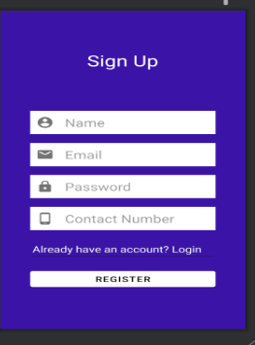
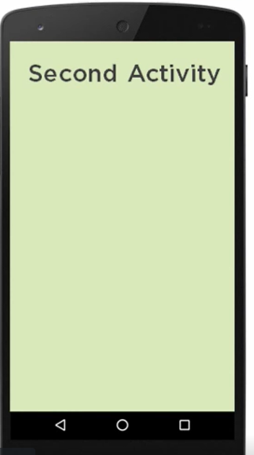
PASSING DATA ACROSS ACTIVITIES – EXPLICIT INTENT
EXPLICIT INTENT

Slide 4
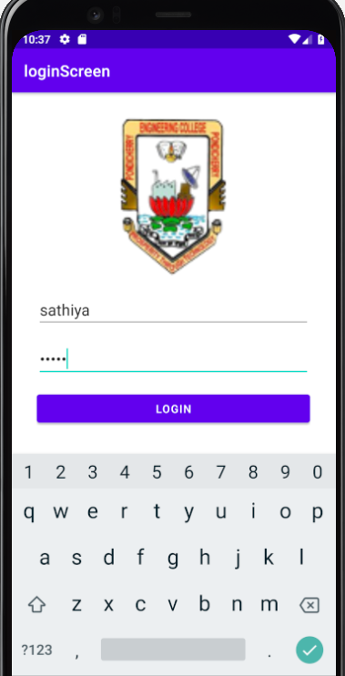
PASSING DATA ACROSS ACTIVITIES – EXPLICIT INTENT
EXPLICIT INTENT
Key : Value
“name”: “sathiya”
Welcome!
Sathiya

Slide 5
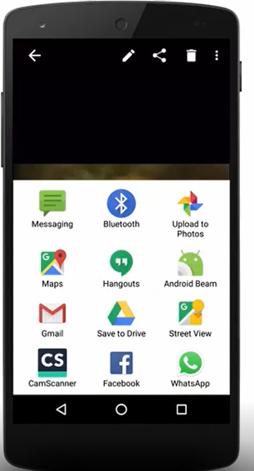
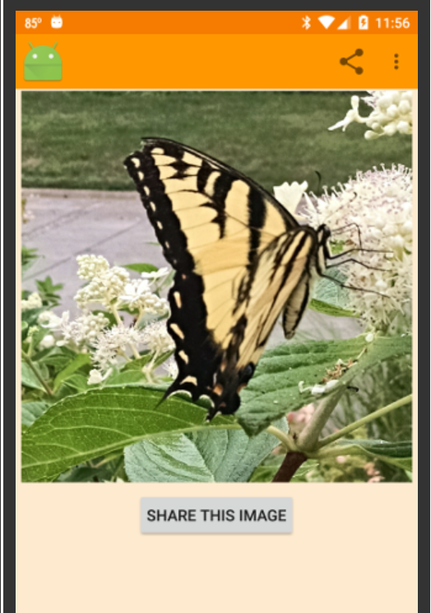
PASSING DATA ACROSS ACTIVITIES – IMPLICIT INTENT
IMPLICIT INTENT
Sharing Data Across different App Activities

Slide 6
EXPLICIT INTENT
Passing Data to another Activity
Using Bundle directly
Bundle stores the value in a key, value pair
Using Bundle indirectly

Slide 7
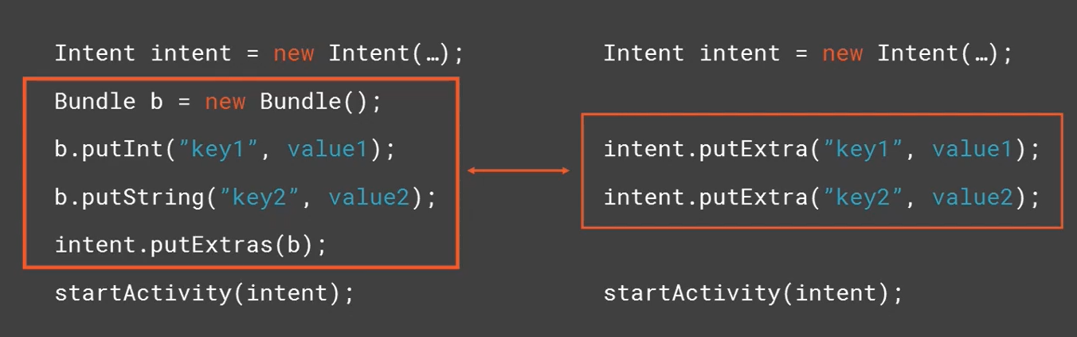
Sharing data across activities
Summarization of two approaches
Significance of Explicit Intent
Concept of Implicit Intent
Navigate from one activity to another
Passing Data from One activity to another
Using Bundle Directly and indirectly
Always declare activity in Manifest.xml

