Slide 1
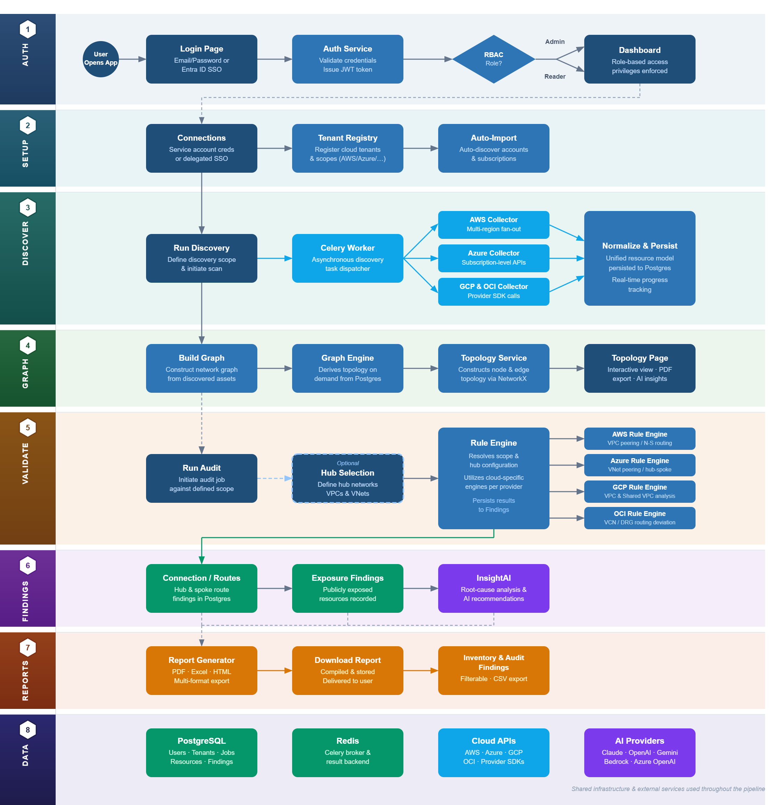
SYSTEM ARCHITECTURE & DATA FLOW
BASIC — Baseline Audit for Security Intelligence in the Cloud
User journey from authentication through discovery, analysis, and reporting — eight stages, left to right
User Action
Backend Process
Async Worker
AI Engine
Data Store
Output

