Slide 1
LMG2100R044
https://www.ti.com/product/LMG2100R044
https://www.ti.com/lit/ds/symlink/lmg2100r044.pdf?ts=1781319325488&ref_url=https%253A%252F%252Fwww.ti.com%252Fproduct%252FLMG2100R044%253FkeyMatch%253DLMG2100R044%2526tisearch%253Duniversal_search

Slide 2
Description
Supports 90 V continuous operation and 100 V pulsed operation.
Integrated 4.4 mΩ high-side and low-side GaN FETs.
Built-in high-side and low-side gate drivers.
Supports 3.3 V and 5 V logic inputs.
Built-in UVLO (Under Voltage Lockout) protection.
Zero reverse recovery charge (QRR = 0).
Low input capacitance (CISS) and output capacitance (COSS).

Slide 3
Internal Functional Blocks
High-side GaN FET
Low-side GaN FET
High-side gate driver
Low-side gate driver
Bootstrap circuit
UVLO protection
Gate voltage clamp circuit

Slide 4
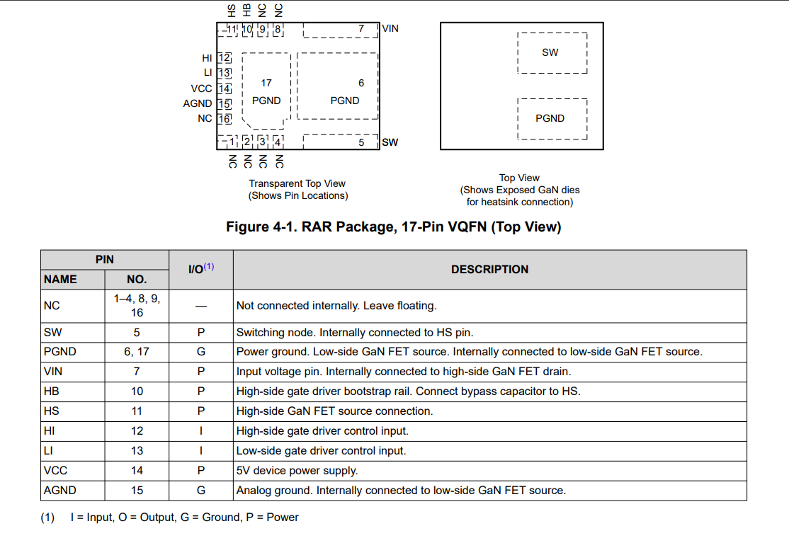
Pin Configuration

Slide 5
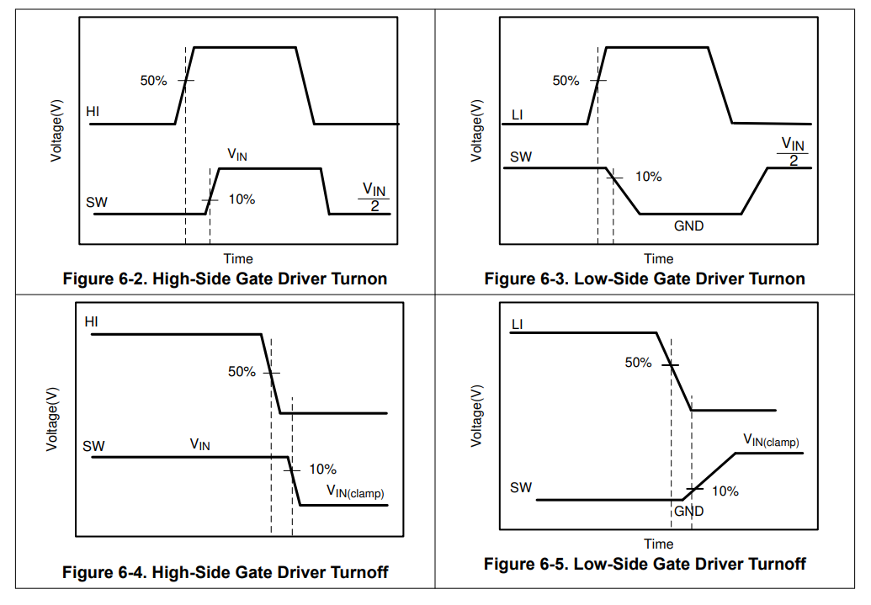

Slide 6
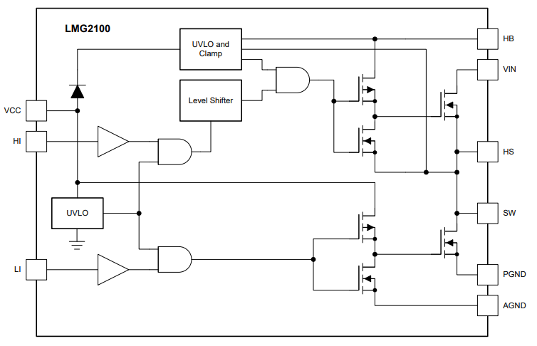

Slide 7
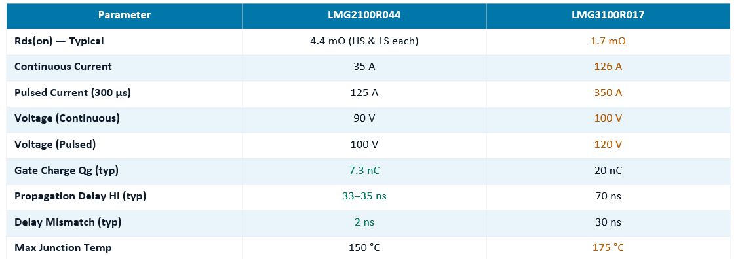
Difference from LMG3100R017

