Slide 1
NV6428
https://navitassemi.com/wp-content/plugins/gb-navitas-stock-checker/product_files/NV6428_70mO%20Max_Bi-Directional%20GaNFast_TOLT.pdf

Slide 2
FEATURES
Bi-Directional 4-Quadrant GaN power switch:
VSS 650V continuous / 800V transient
52m RSS(ON)_TYP_25C and 49A ISS(CONT_25C)
TOLT-16L thermally-enhanced, top-cooled
Zero reverse-recovery charge
Up to 2MHz operation
Integrated substrate clamp circuit between each source and the common substrate

Slide 3
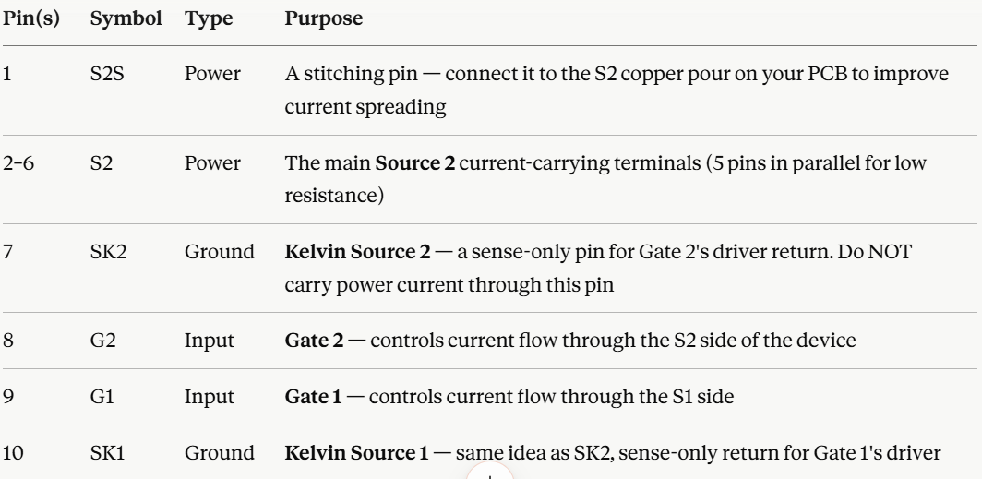
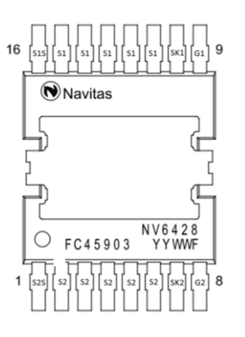
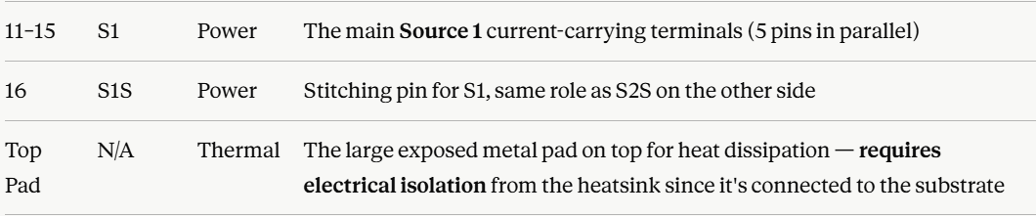
Pinout Diagram

Slide 4
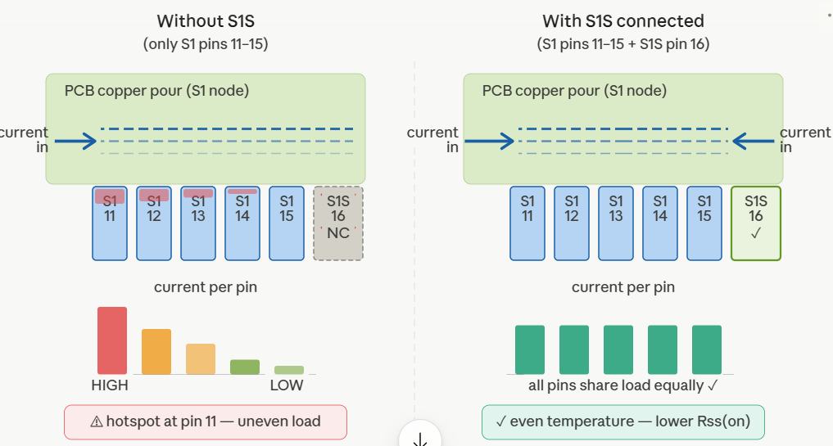

Slide 5
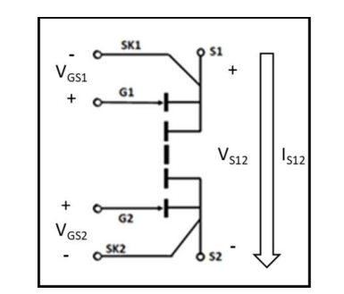
STRUCTURE

Slide 6
MODES
Mode 1 — both gates off (full block)
Mode 2 — G1 on, G2 off
Mode 3 — G1 off, G2 on
Mode 4 — both gates on (full conduct)

Slide 7
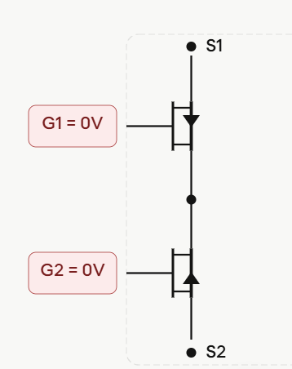
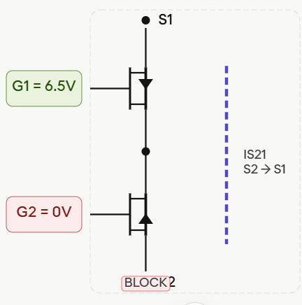
Mode 1 — both gates off (full block)
Mode 2 — G1 on, G2 off

Slide 8
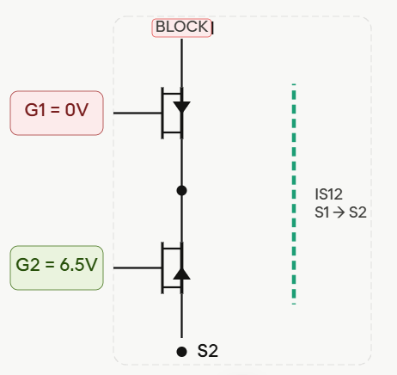
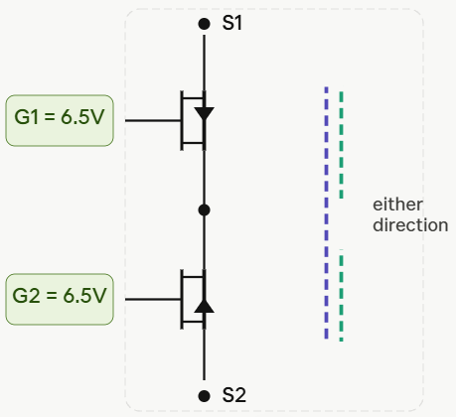
Mode 3 — G1 off, G2 on
Mode 4 — both gates on (full conduct)

Slide 9
