Slide 1
PMP23611
https://www.ti.com/tool/PMP23611#description
https://www.ti.com/lit/ug/slvt221/slvt221.pdf?ts=1781764557331&ref_url=https%253A%252F%252Fwww.ti.com%252Ftool%252FPMP23611
https://www.ti.com/lit/df/slvrbq7/slvrbq7.pdf?ts=1781764553199

Slide 2
System Description
The PMP23611 is a 48V to 5V, 300W automotive DC-DC buck converter
Regulated 5V output capable of delivering up to 50A load current.
Two-phase interleaved buck converter architecture
LM5137F-Q1 controller generates PWM signals and regulates the output voltage
LMG2100R044 integrated GaN half-bridge power stage for high-efficiency power conversion.

Slide 3

System Specifications

Slide 4

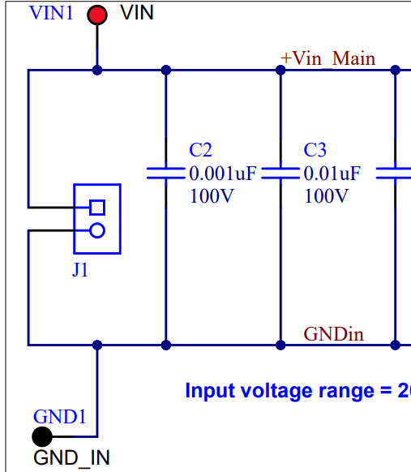

4-pin represents input and output

Slide 5
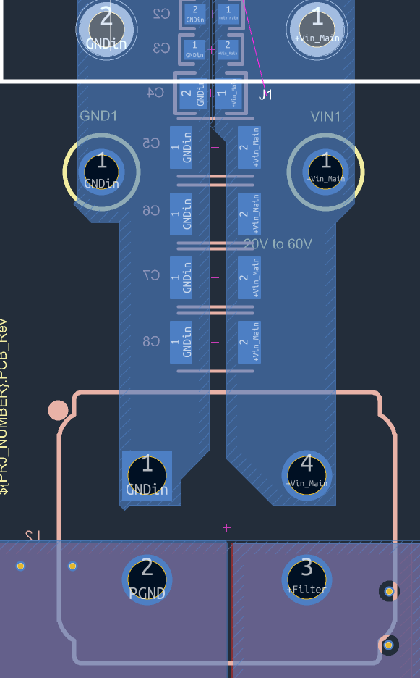
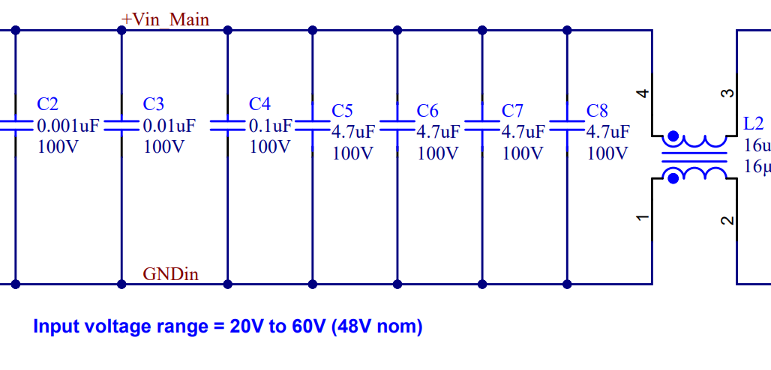
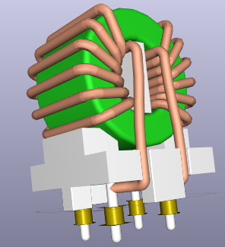

Slide 6
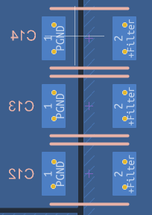
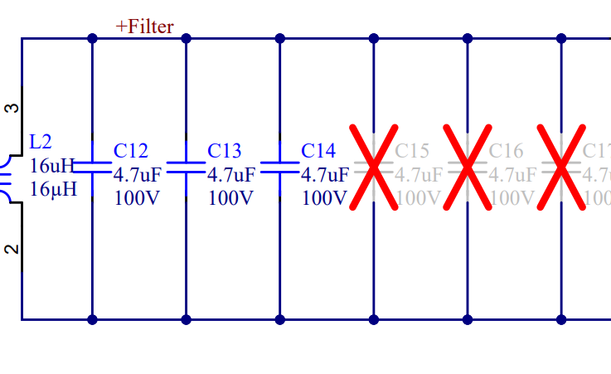
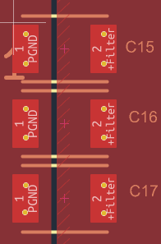

Slide 7
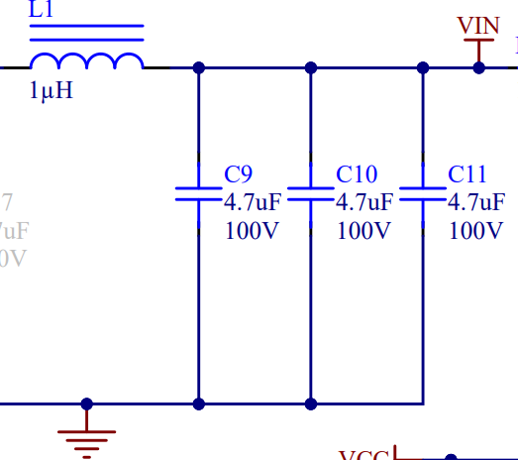


Slide 8
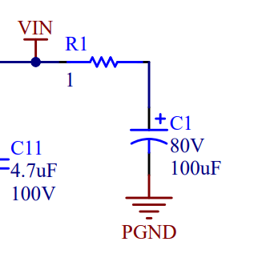
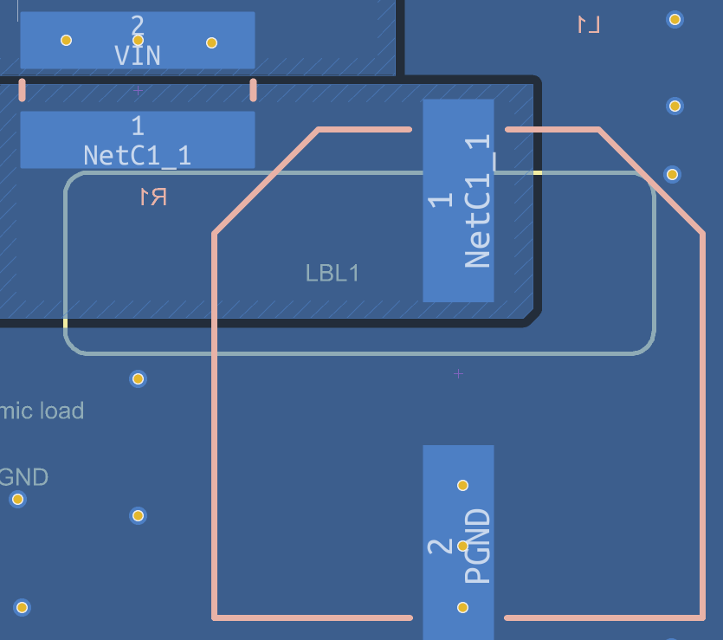

Slide 9
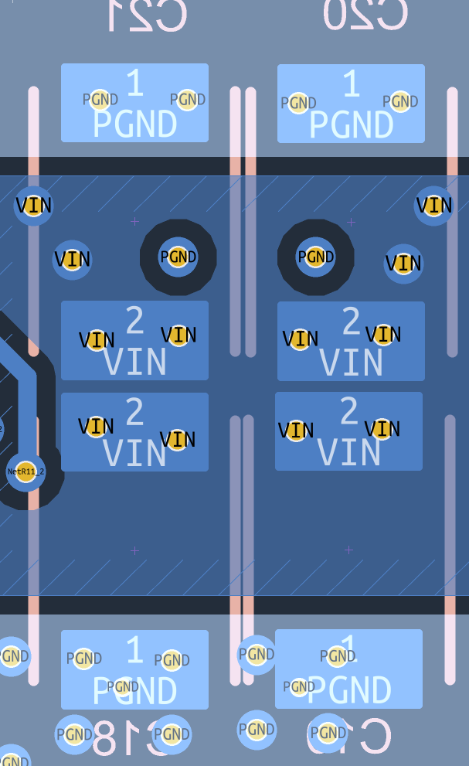
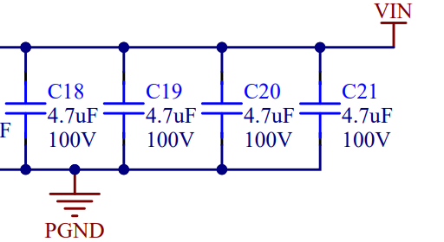

Slide 10
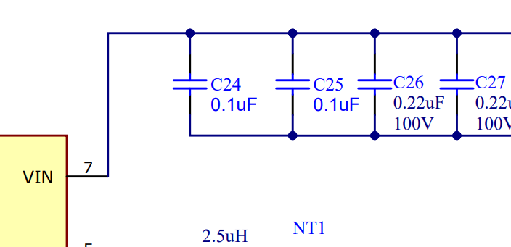

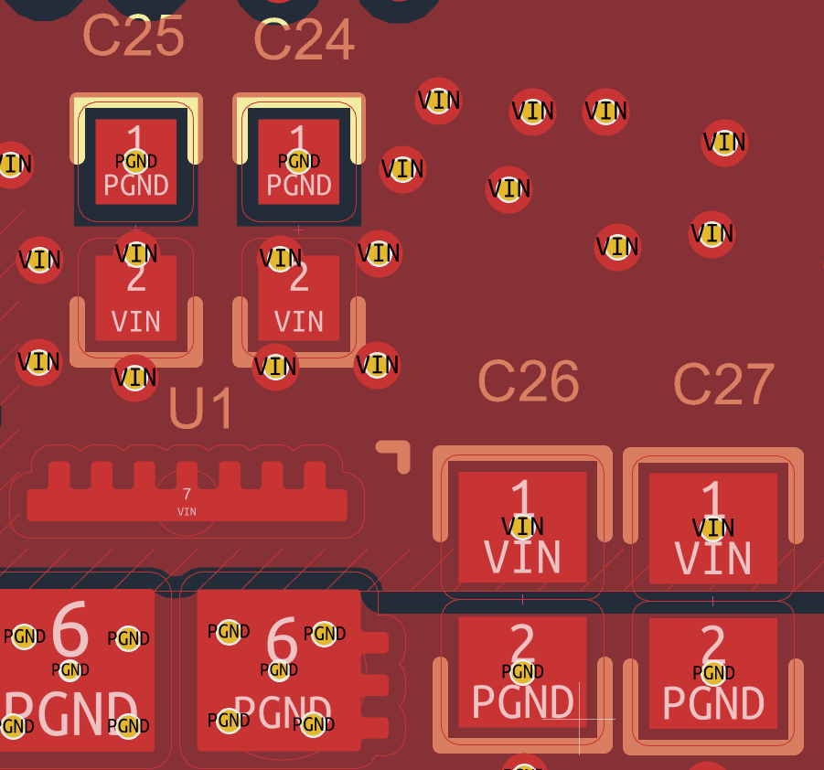

Slide 11
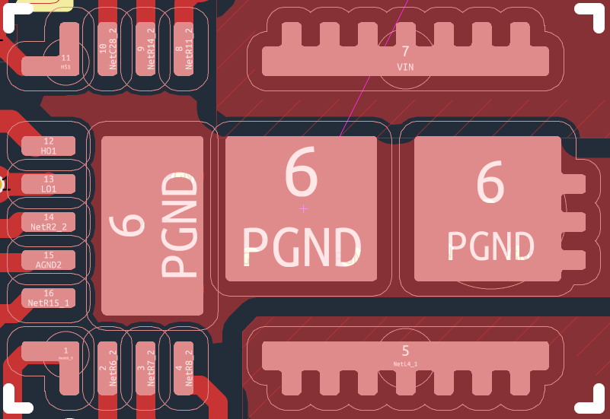
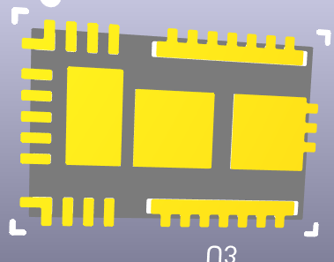

Slide 12
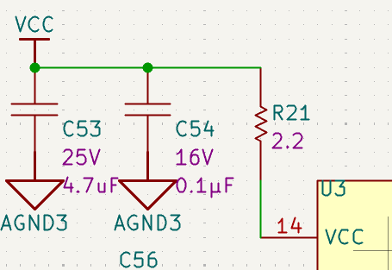
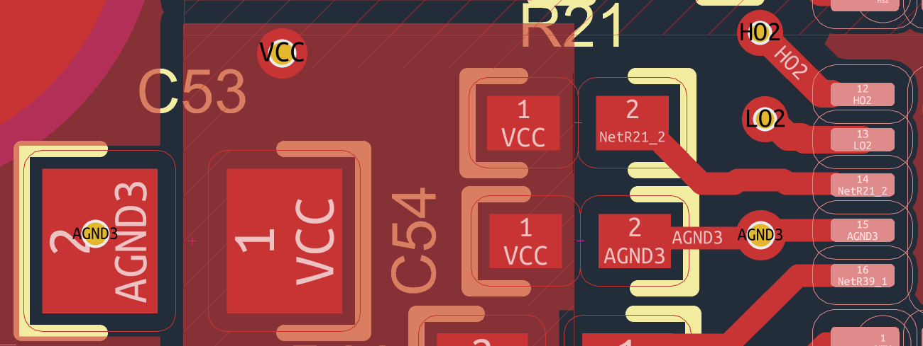

Slide 13

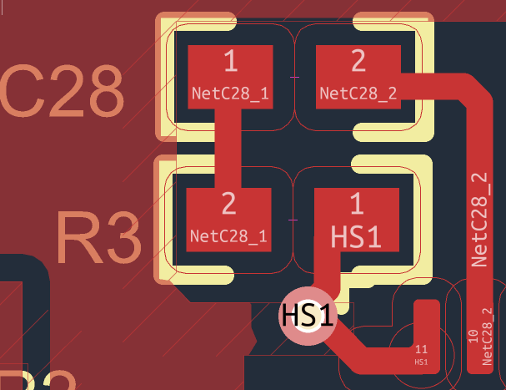

Slide 14


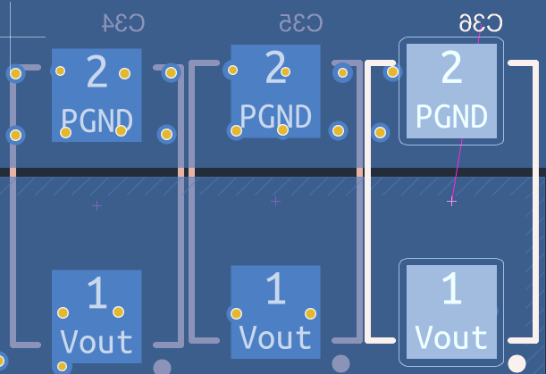

Slide 15



Slide 16
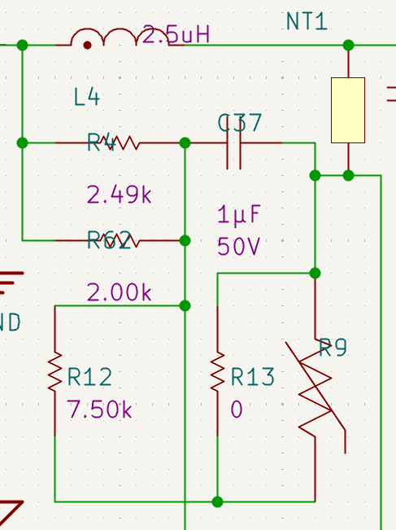
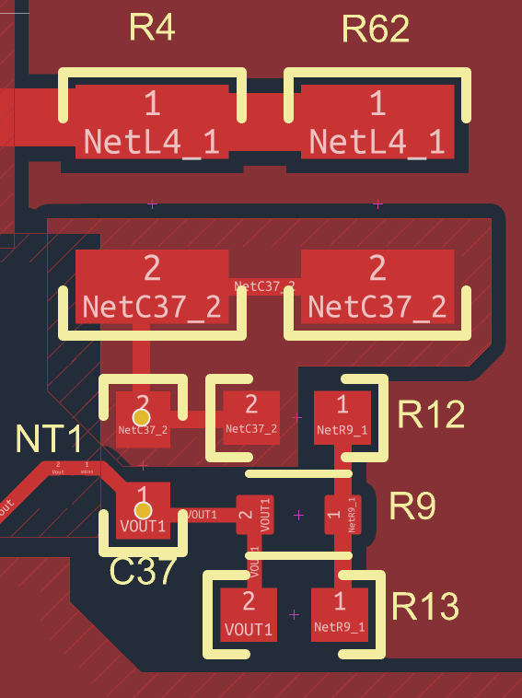

Slide 17
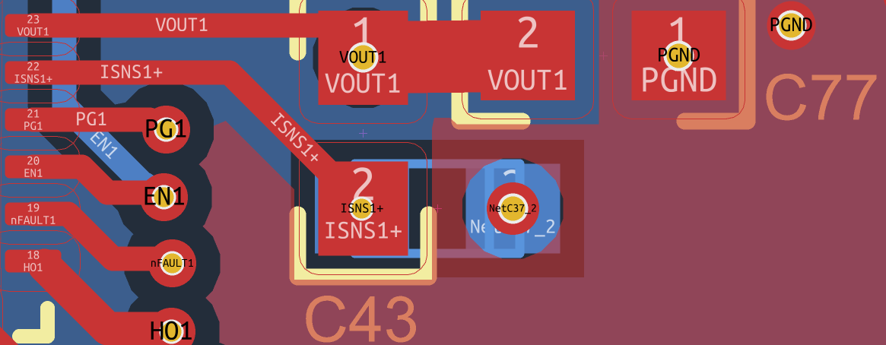
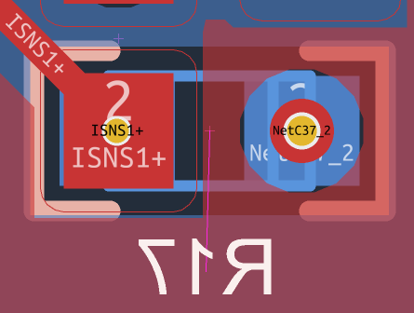


Slide 18
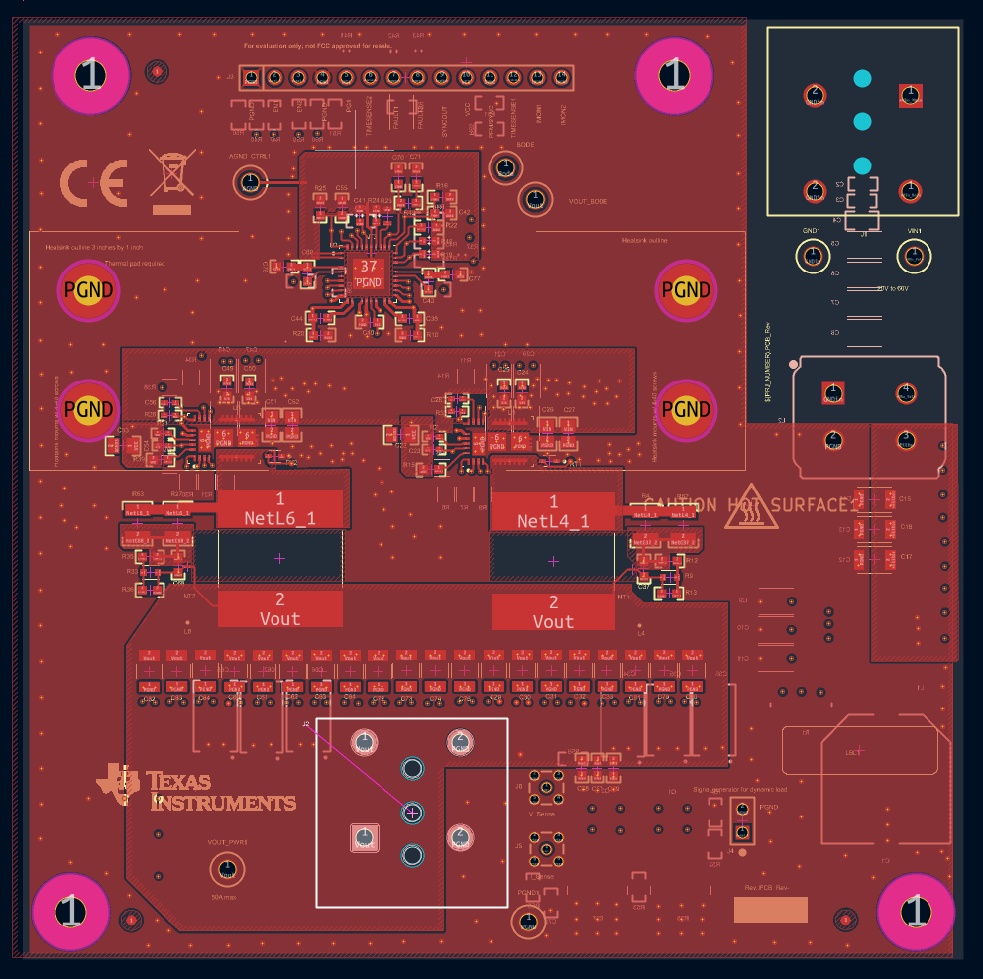

Slide 19
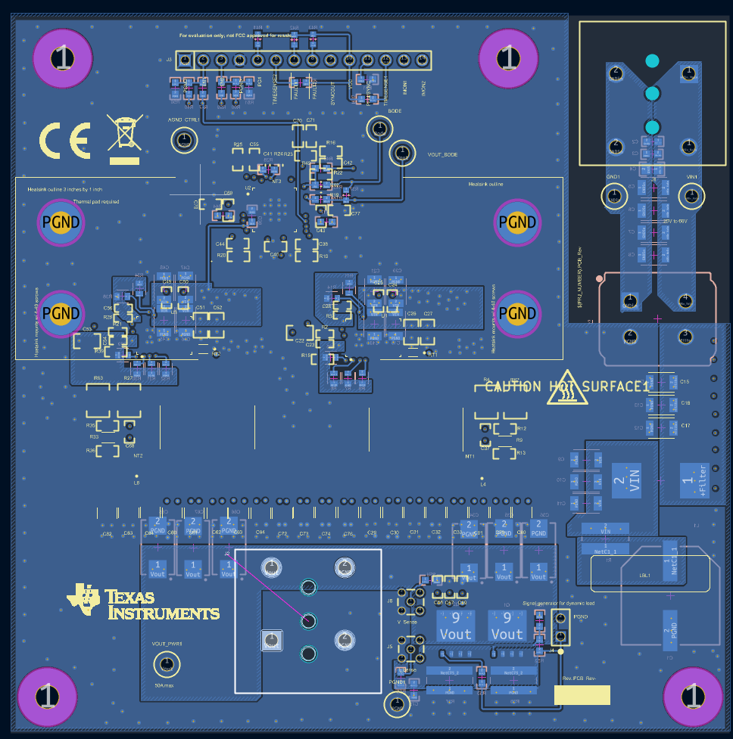

Slide 20
