Slide 1
TIDA-010936

Slide 2
Overview
TIDA-010936 is a three-phase GaN motor inverter reference design.
Converts a 12V–60V DC input into controlled three-phase AC output.
Generates precise motor voltages using GaN-based half-bridge power stages.

Slide 3
Features
Three LMG2100R044 GaN half-bridge modules
99.3% peak efficiency at 40 kHz PWM
16 A RMS continuous current
INA241A current-sense amplifier
AMC0106M05 isolated delta-sigma modulator

Slide 4
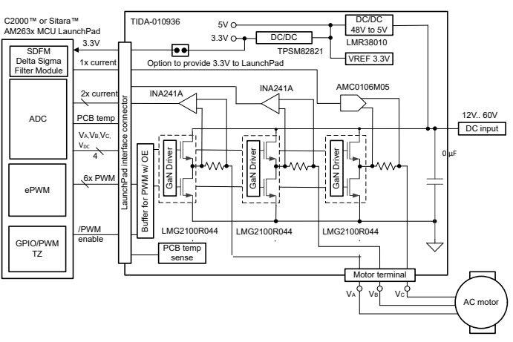

Slide 5
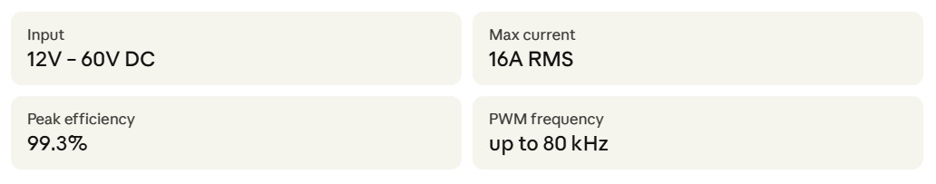
TIDA-010936
The TIDA-010936 is a motor inverter. Its one job is to take a raw DC supply (a 48V battery, power adapter, or bus) and turn it into the precisely controlled three-phase AC that a brushless motor needs to spin.

Slide 6
Function
DC supply — nominally 48V but can be anywhere from 12V to 60V.
The main power rail feeds directly into the GaN half-bridge modules to drive the motor.
A buck converter (LMR38010) steps the 48V down to a clean 5V rail. This supplies the GaN gate drivers.
A second module (TPSM82821) then steps 5V down to 3.3V for all the signal electronics like current sense amplifiers, voltage reference, PWM buffers, and optionally the MCU.
Brain - a C2000 or Sitara processor on a LaunchPad board. It runs a motor control algorithm (like Field-Oriented Control, FOC) that continuously calculates :
How fast and in which direction of motor.
What voltage each of the three motor phases needs right now.
Monitoring fault conditions exist.
From these calculations, the ePWM module inside the MCU generates 6 PWM signals.

