Slide 1
TIDA-050089
https://www.ti.com/tool/TIDA-050089
https://www.ti.com/lit/ug/tiduff3/tiduff3.pdf?ts=1781059229176
https://www.ti.com/lit/df/slvrbw5/slvrbw5.pdf?ts=1781090889314
https://www.ti.com/lit/df/slurb62/slurb62.pdf?ts=1781090894525

Slide 2
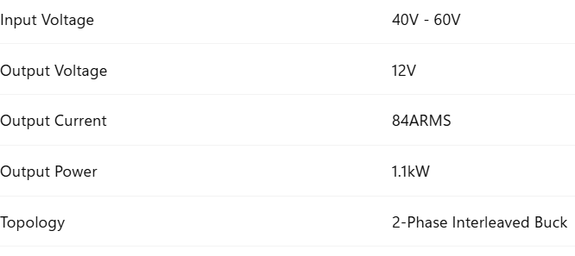
PURPOSE : 48V 12V

Slide 3
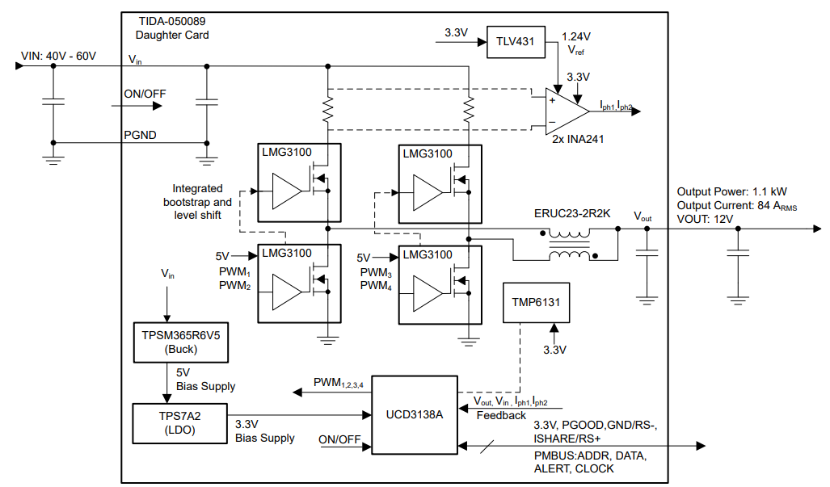
System Block Diagram

Slide 4
TPSM365R6V5(BUCK)
TPS7A2(LDO)
Function : 48V → 5V auxiliary buck power module.
Generates the 5V bias supply for the control circuitry.
No external compensation design required.
Function : Linear Dropout Regulator
Converts 5V → 3.3V.
Provides a clean, low-noise supply for sensitive control electronics.
Used to power UCD3138A, INA241, and TMP6131

Slide 5
TLV431
TMP6131
Function : Precision adjustable shunt reference
Generates a stable 1.24V reference voltage.
Used as the reference for INA241 current sensing.
Enables bidirectional current measurement (buck and boost operation).
Function : Linear PTC Temperature Sensor.
Resistance increases with temperature.
Used to monitor the temperature of the power stage.
Helps implement Over-Temperature Protection (OTP).

Slide 6
UCD3138A
Function : Digital Power Supply Controller
Acts as the brain of the converter.
Generates PWM signals for the GaN half-bridges.
Monitors VIN, VOUT, current, and temperature.
Implements UVLO, OVP, OCP, OTP, current balancing, and PMBus communication.

Slide 7
LAYOUT

Slide 8
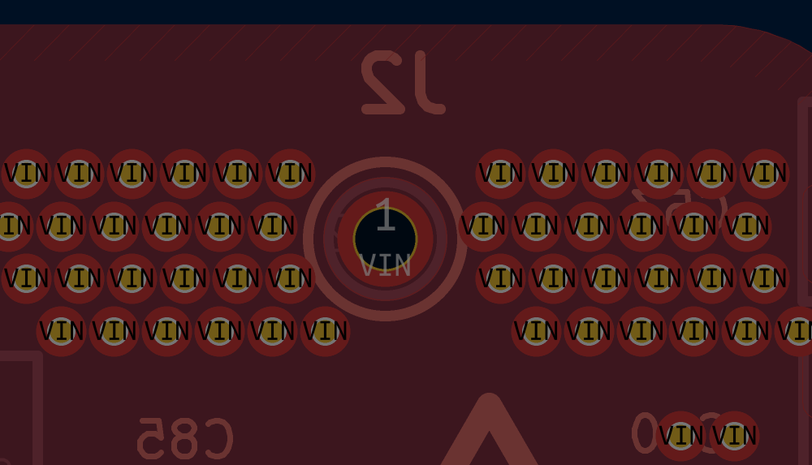
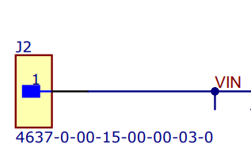

Slide 9
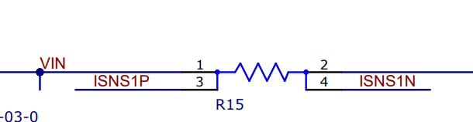
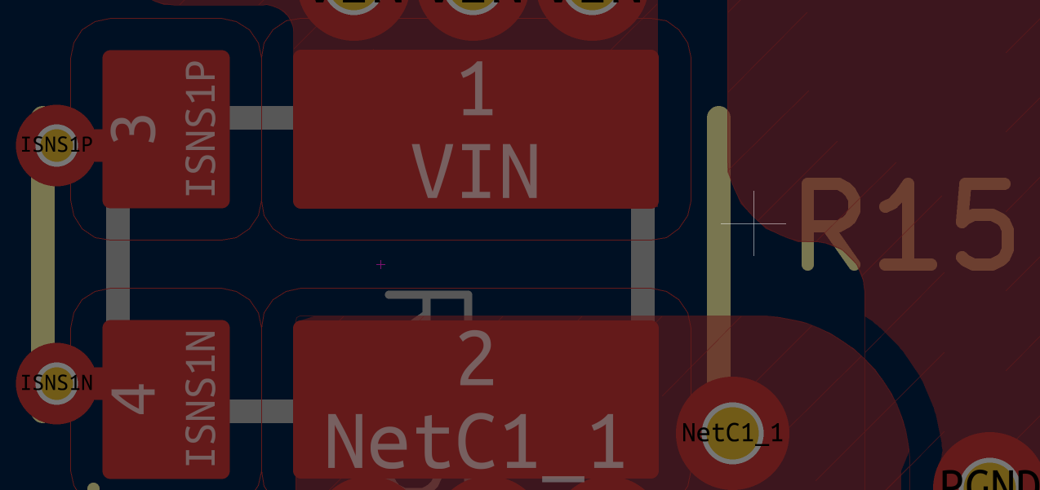

Slide 10
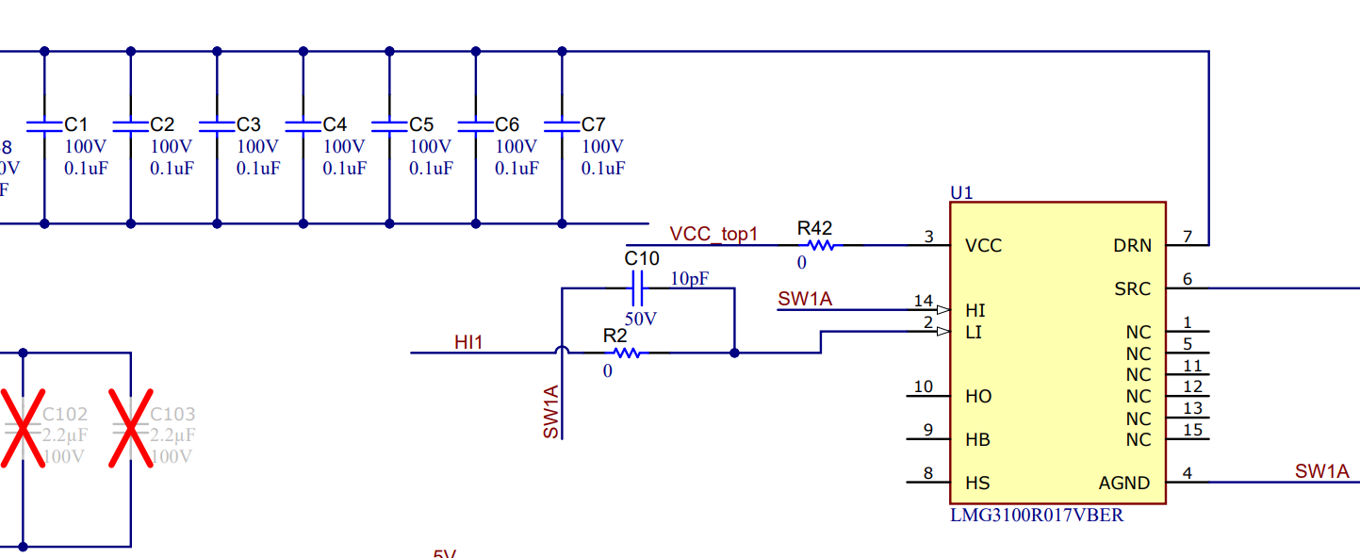
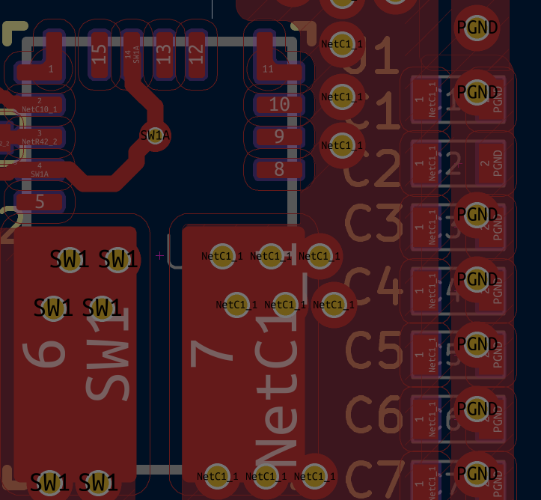

Slide 11
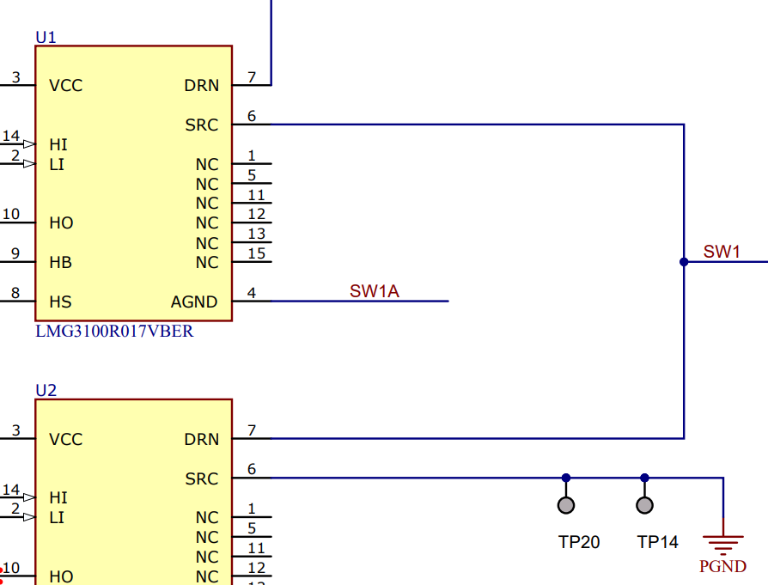
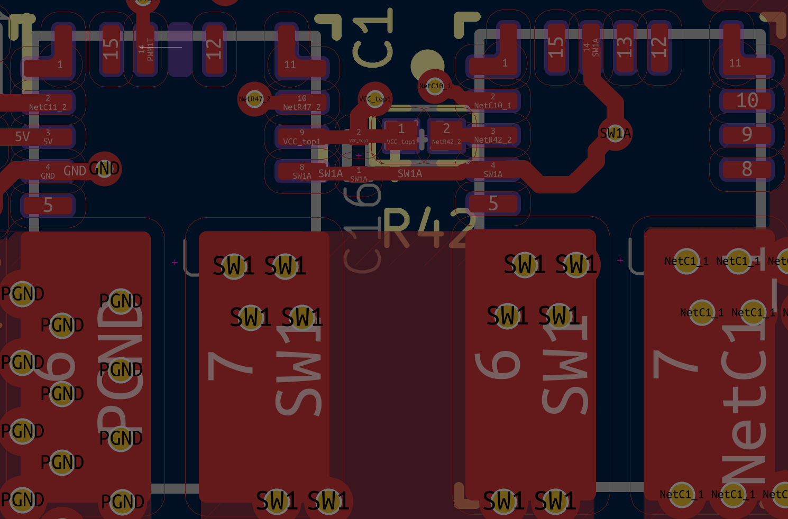

Slide 12
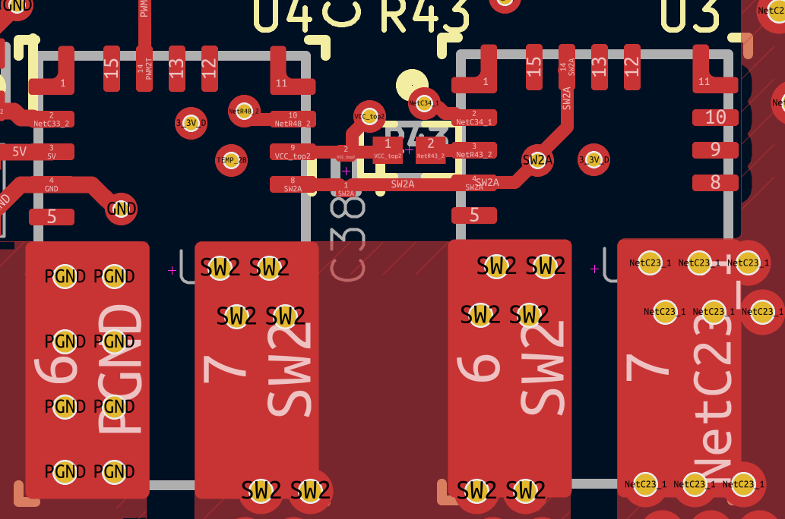
Same for another half bridge

Slide 13
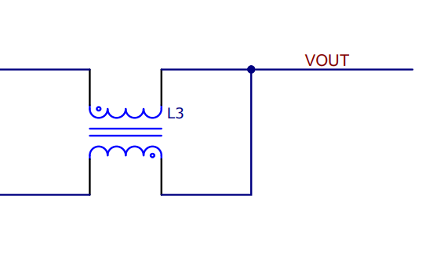
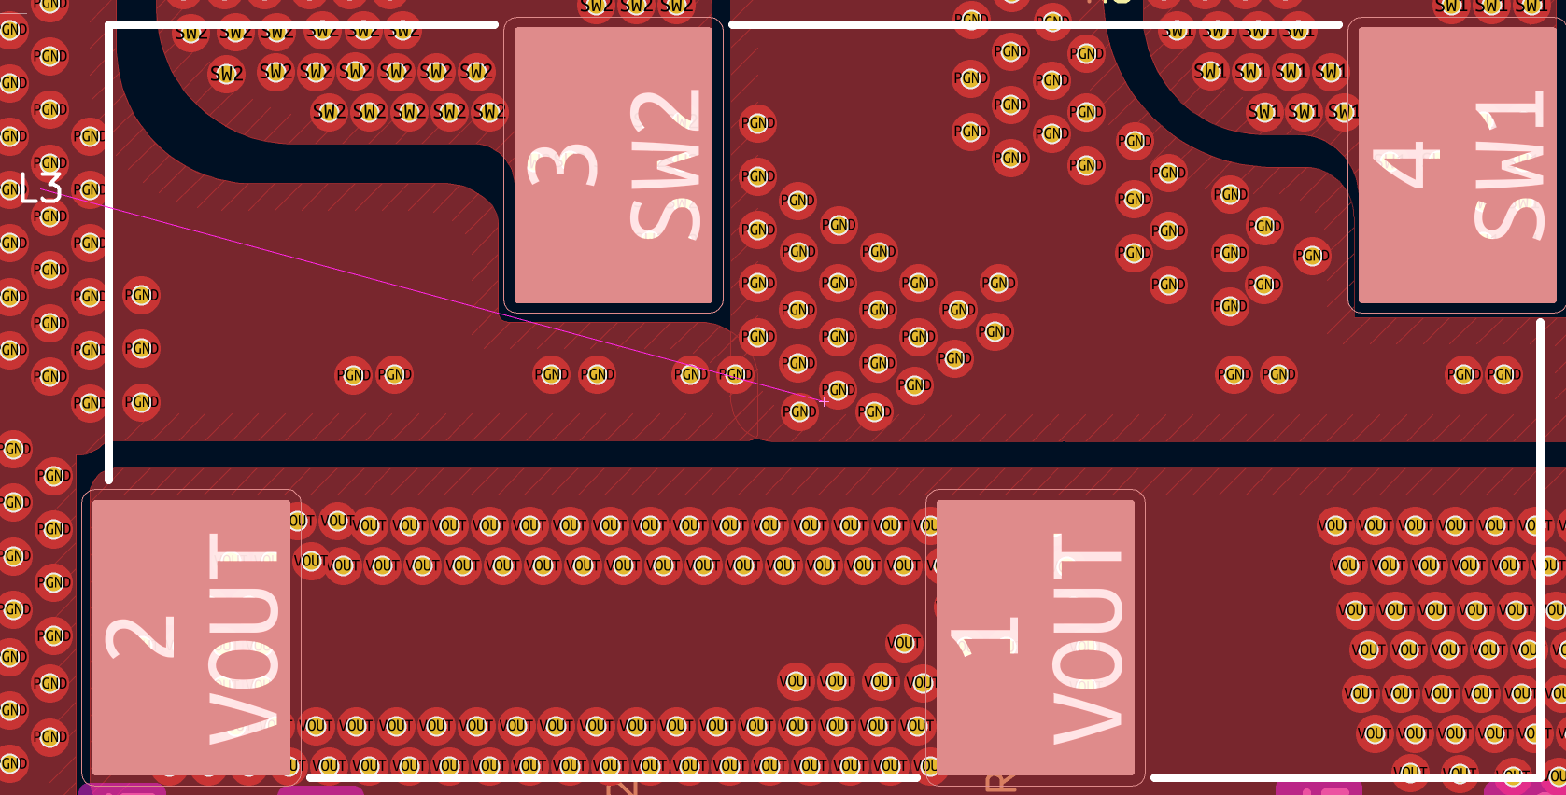
SW1
SW2

Slide 14
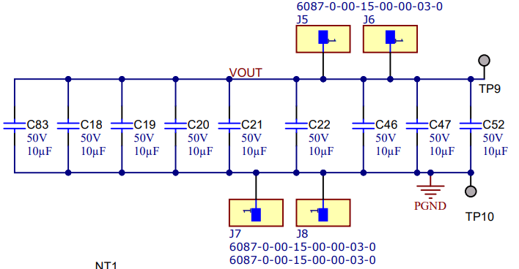
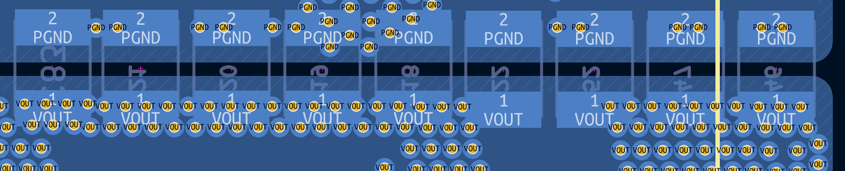

Slide 15
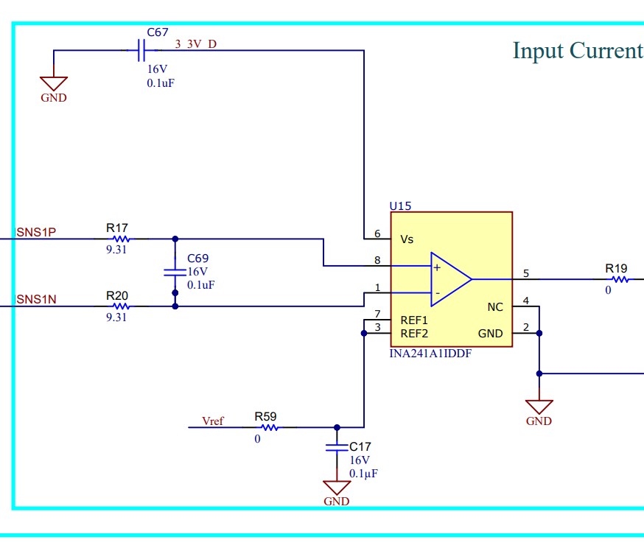
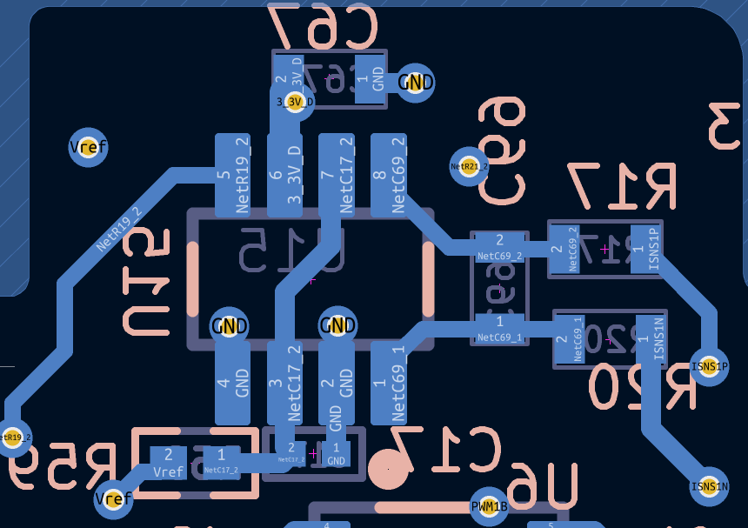

Slide 16
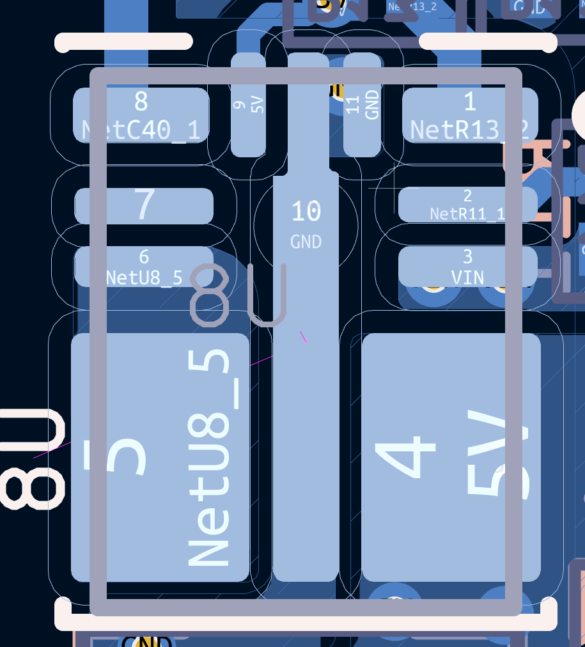
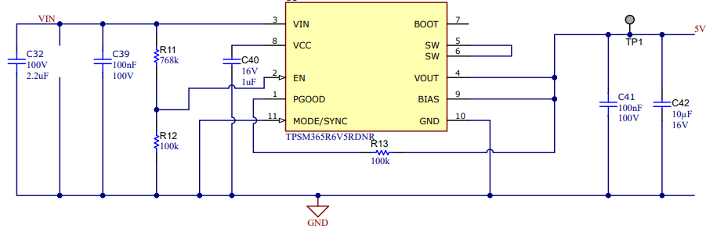

Slide 17
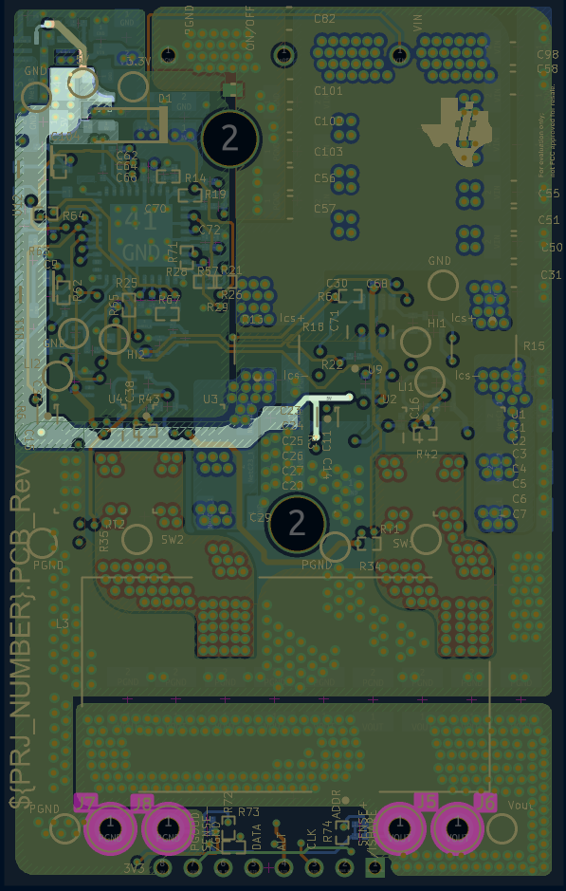
5V is generated using IC
It is given to U2 and U4 here

Slide 18
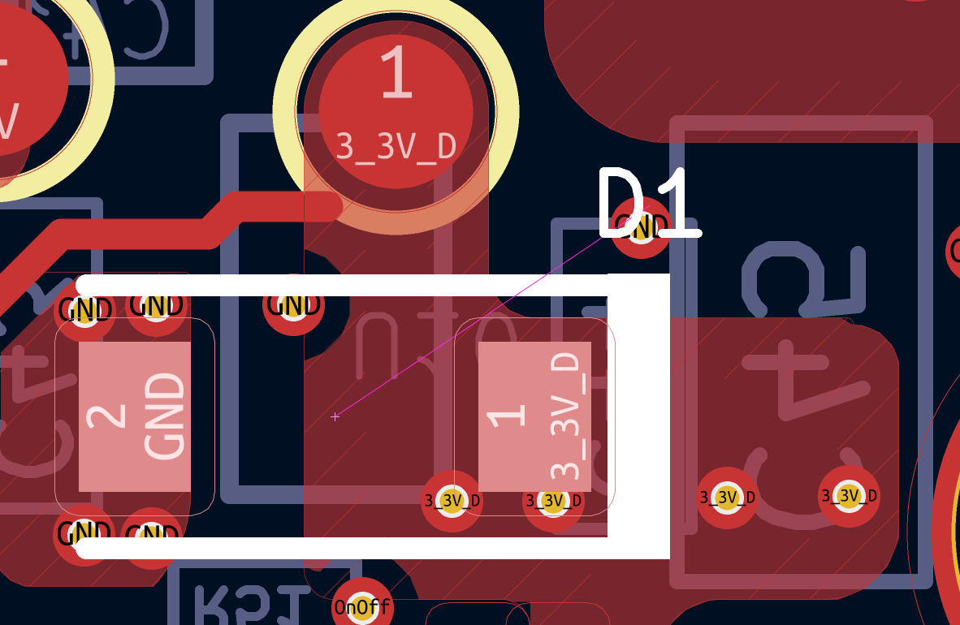
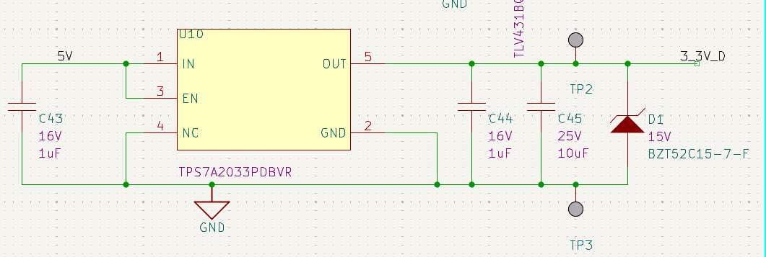
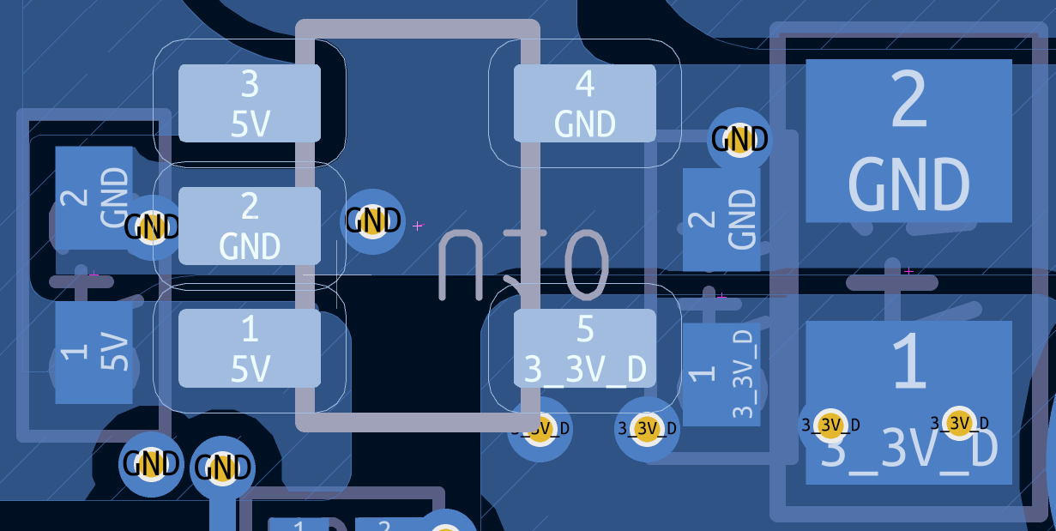

Slide 19
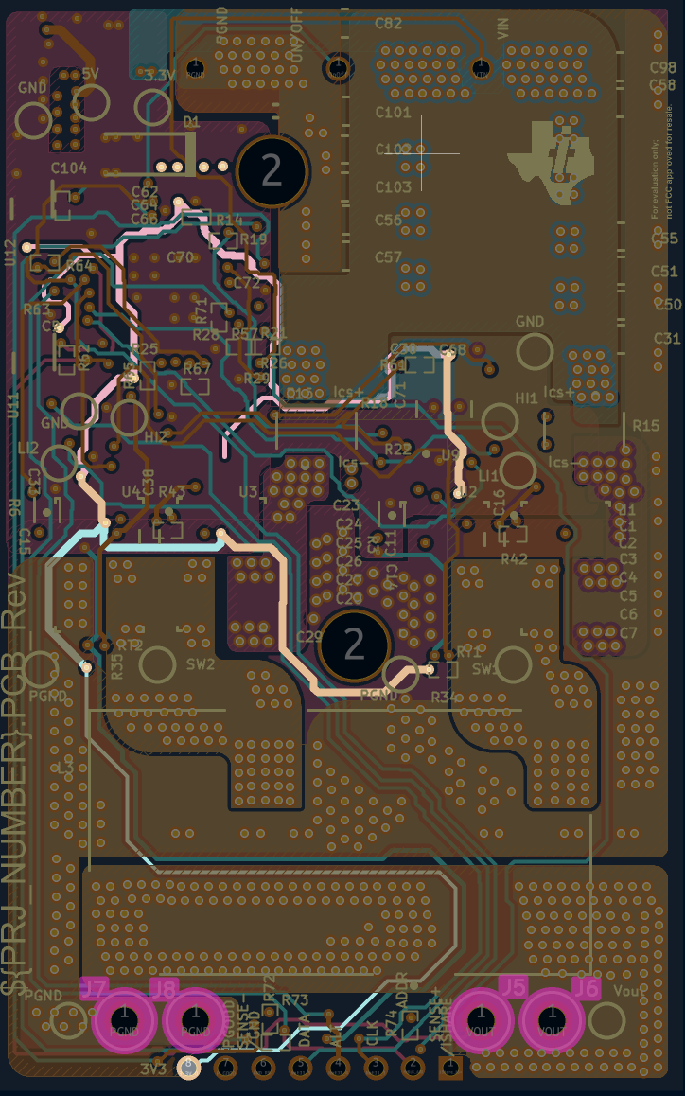
3.3V routed from IC to the current sense amplifier and output
Current Sense Amplifier
Output

Slide 20
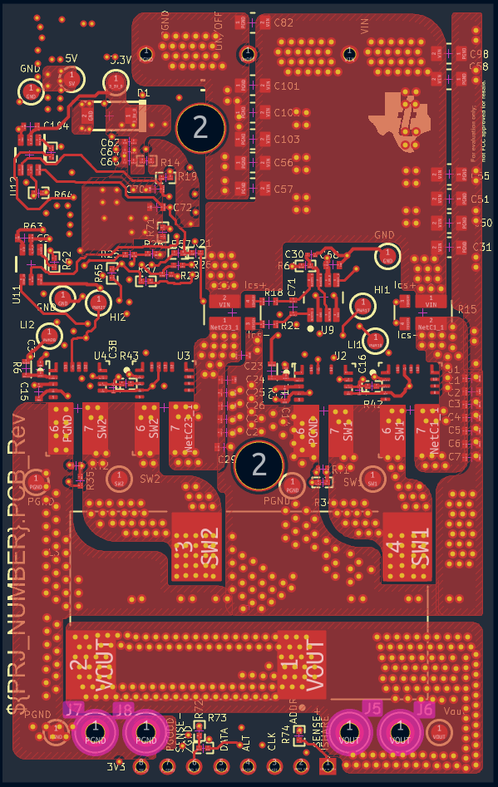
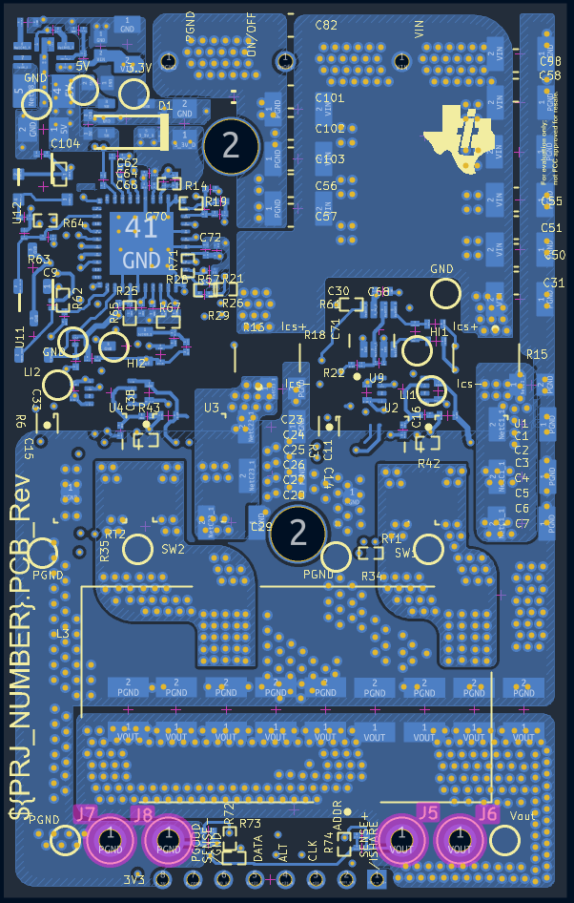
Current Flow

