Slide 1

Lending Club case study
Sathiyanathan Subramanian
Ushasis saha

Slide 2
Problem Description
Our consumer finance company faces the challenge of credit loss, where loan approvals to unlikely repayers may result in credit losses.
The dataset given contains information on past loan applicants and their default status.
Our objective is to understand how consumer and loan attributes influence loan default tendencies. Our goal is to mitigate credit loss by identifying the driver variables behind loan default

Slide 3
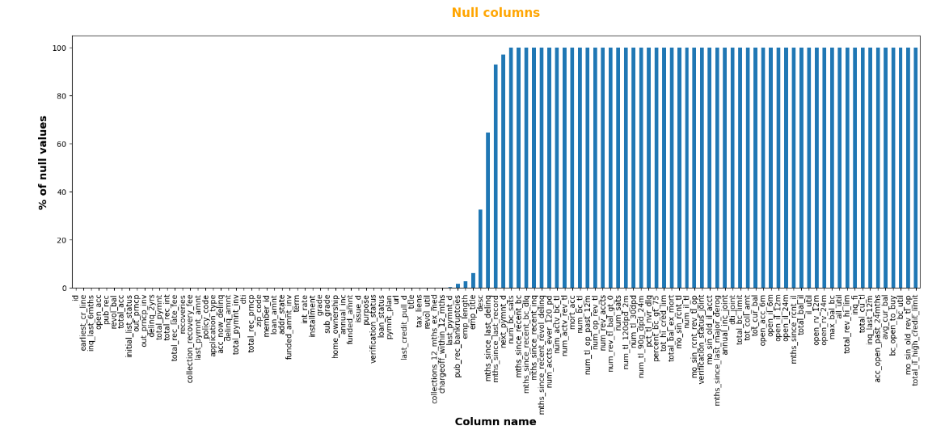
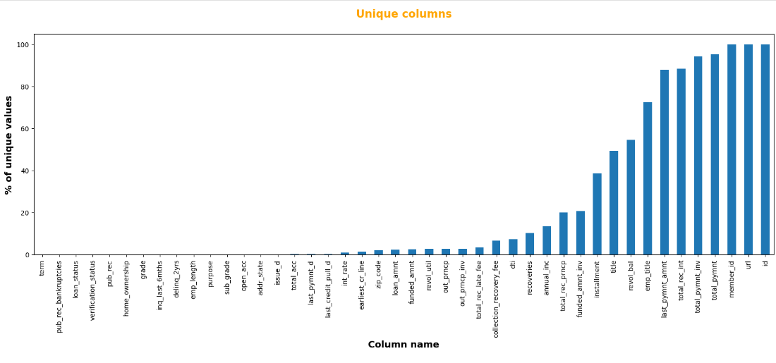
Approach
Ignored all null columns – There are 55 columns that are completely null
Ensured target variable integrity: No incorrect/null values identified
Removed columns with only one unique value across all records.
Columns with Categorical variables and high values for all records were removed Ex: ‘member_id ‘ this would have unique value for all rows unique
Removed variables related to post-loan recovery (e.g., 'recoveries', 'collection_recovery_fee') as they don't influence loan approval. Confirmed unique member IDs, ensuring each user has only one loan with the company.

Slide 4
Approach
Manipulation of Datatypes:
Handling Date and String Variables Appropriately
Data Quality Checks:
Identification and Treatment of Missing Values
Removal of Rows with 'current' Loan Status
Treat outliners
Data Segmentation:
Splitting the Data into Two Parts:
Defaulters
Fully Paid Cases

Slide 5
Approach
Classified Variables as Numeric and Categorical (Ordered, Unordered)
Univariate Analysis:
Numeric Variables: Distribution Plot comparing Paid vs. Defaulters
Ordered Categorical Variables: Segmented by Bucketing, Analyzed with Bar and Pie Charts
Unordered Categorical Variables: Analyzed with Grouped Line Chart, Bar Chart, Pie Chart, and Grouped Columns
Identified 10 Driver Variables Based on Count Analysis

Slide 6
Approach
Bivariate Analysis:
Numeric Variables:
Pair Plot: Visualizes correlations between numeric variables.
Categorical Variables:
Pivot Table + Heatmap: Illustrates correlations between categorical variables.
Identified Relationships:
Discovered 2 related categorical variables, 2 related numerical variables; reducing total driver variables to 9.

Slide 7
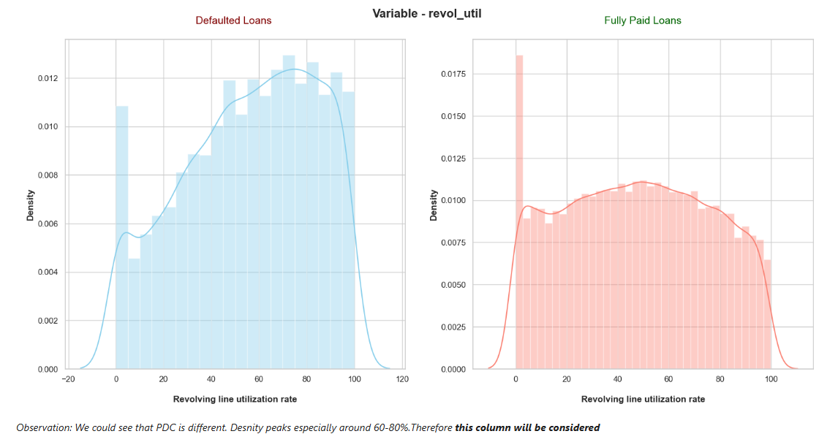
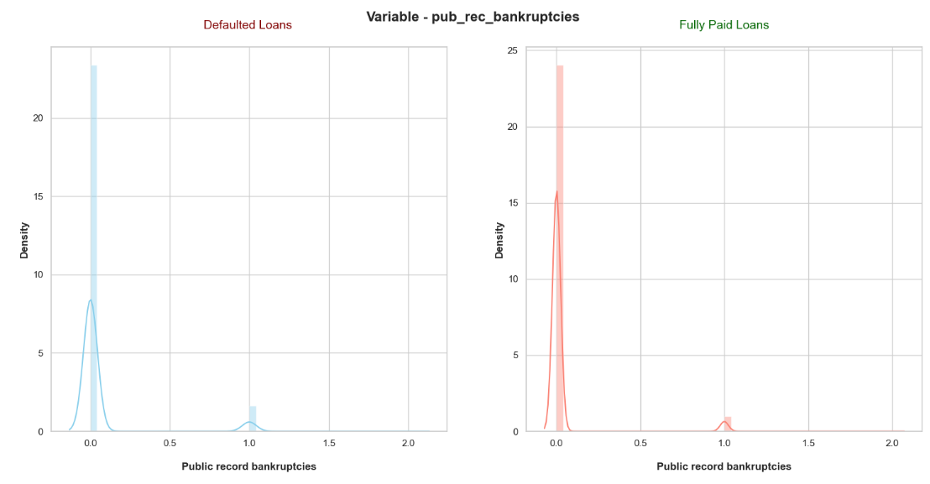
Numeric Variables

Slide 8
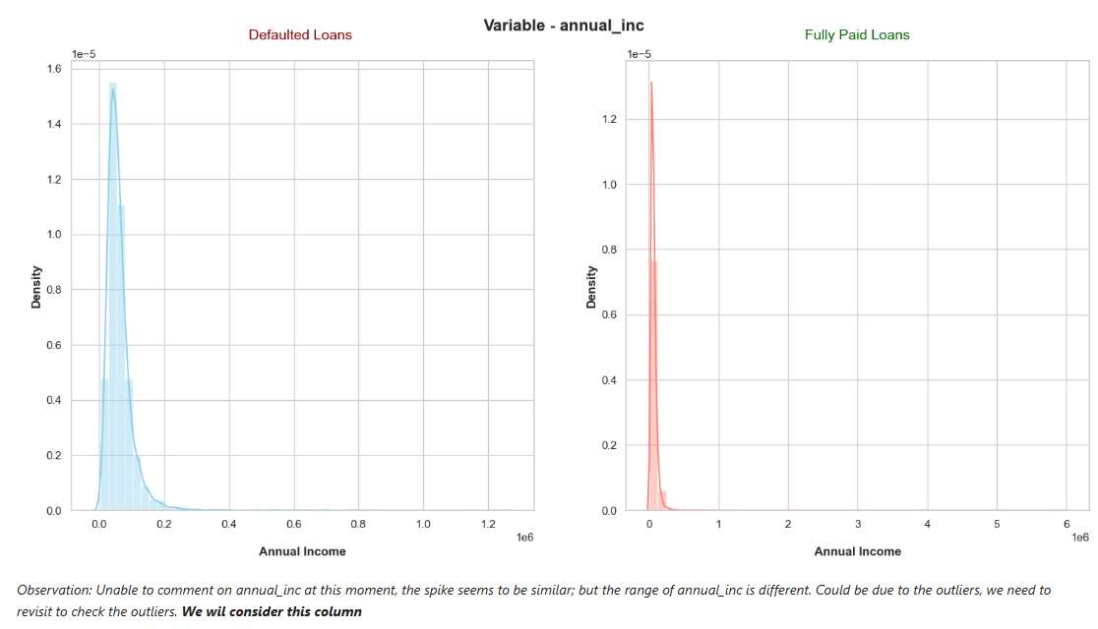
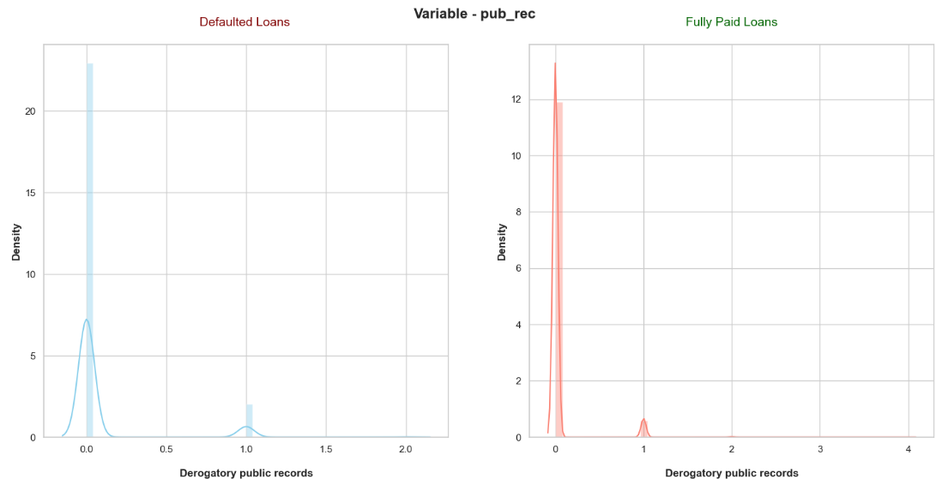
Numeric Variables

Slide 9
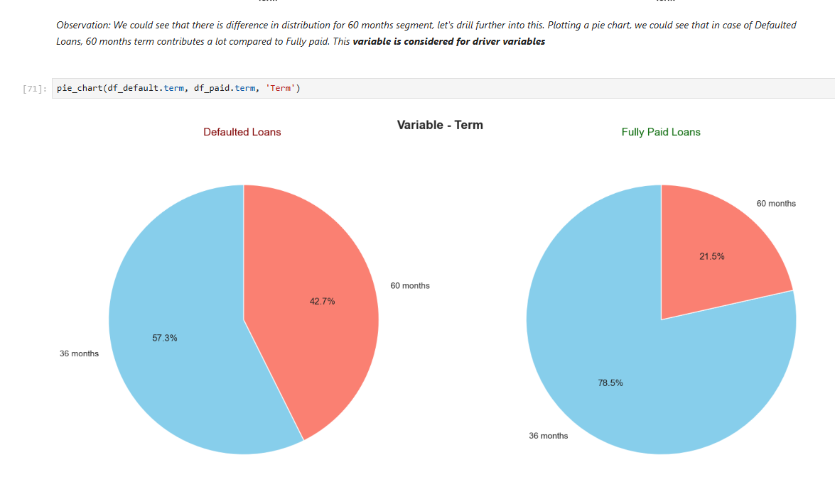
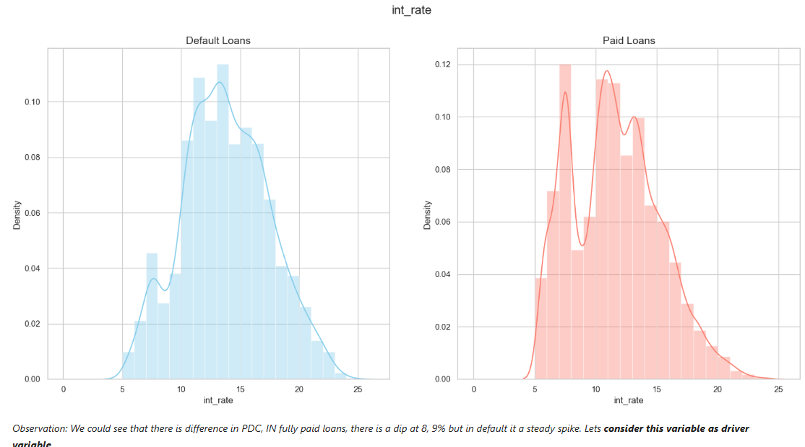
Ordered categorical Driver variables

Slide 10
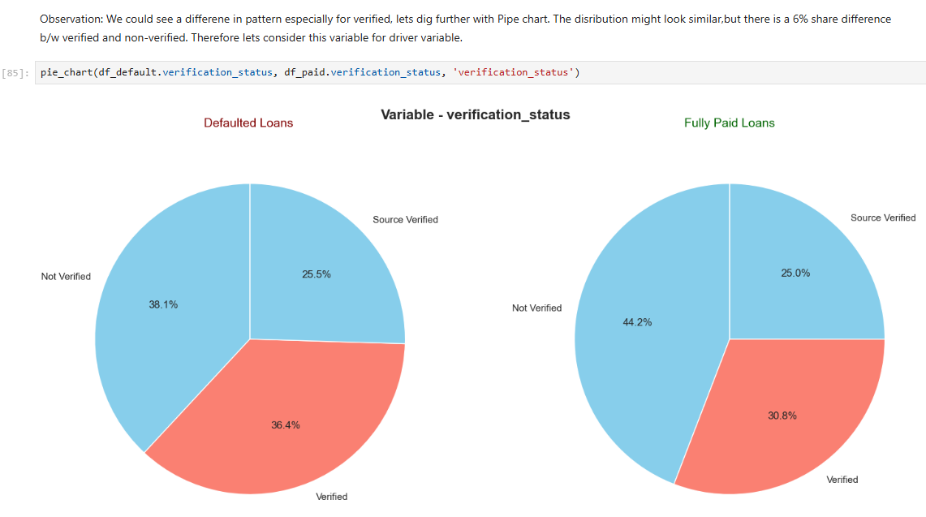
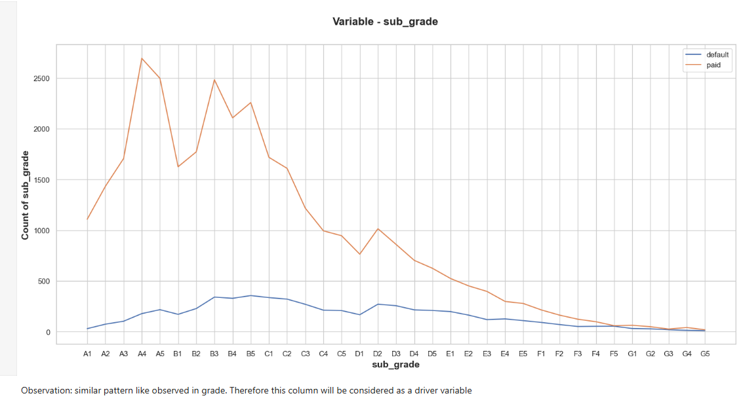
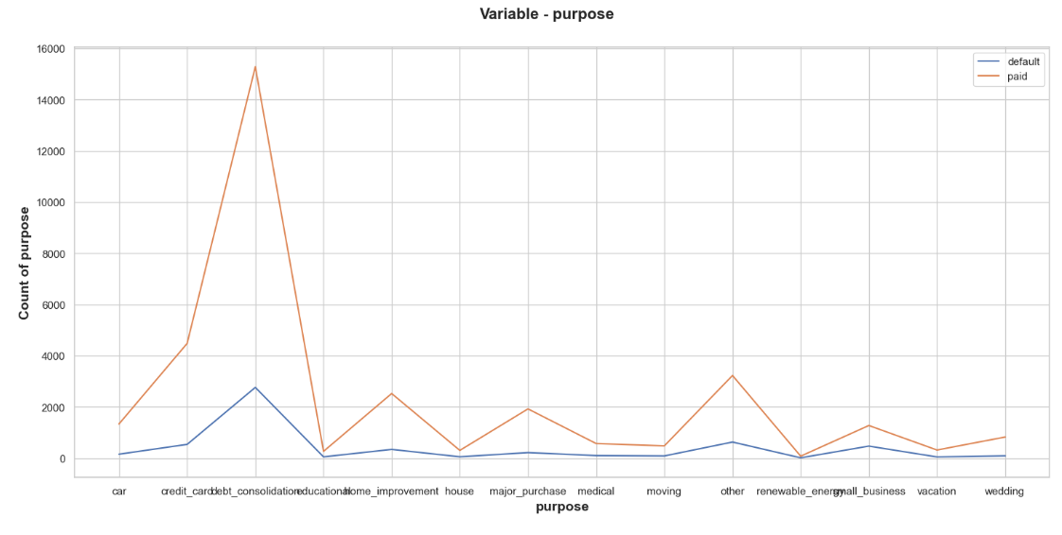
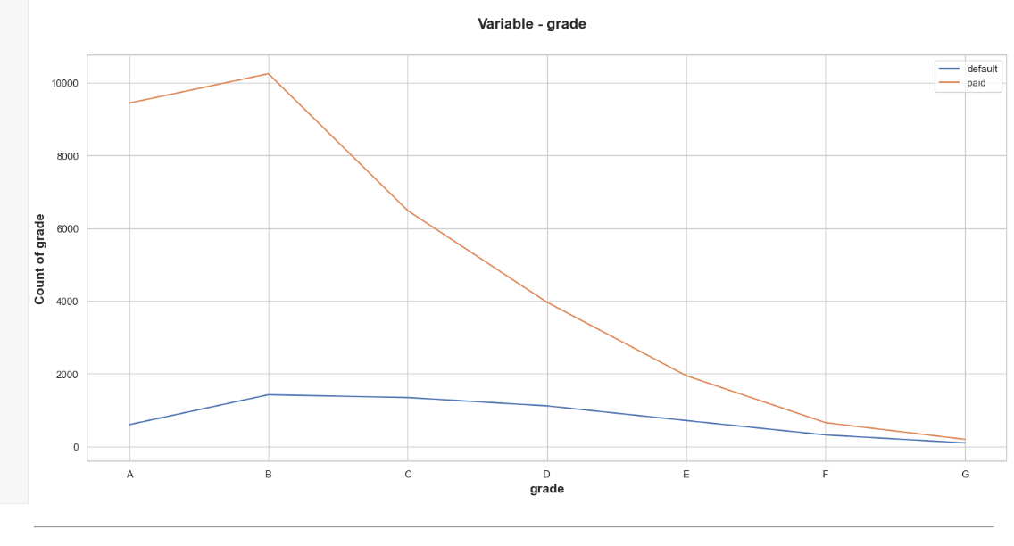
Ordered categorical Driver variables

Slide 11
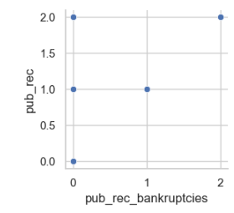
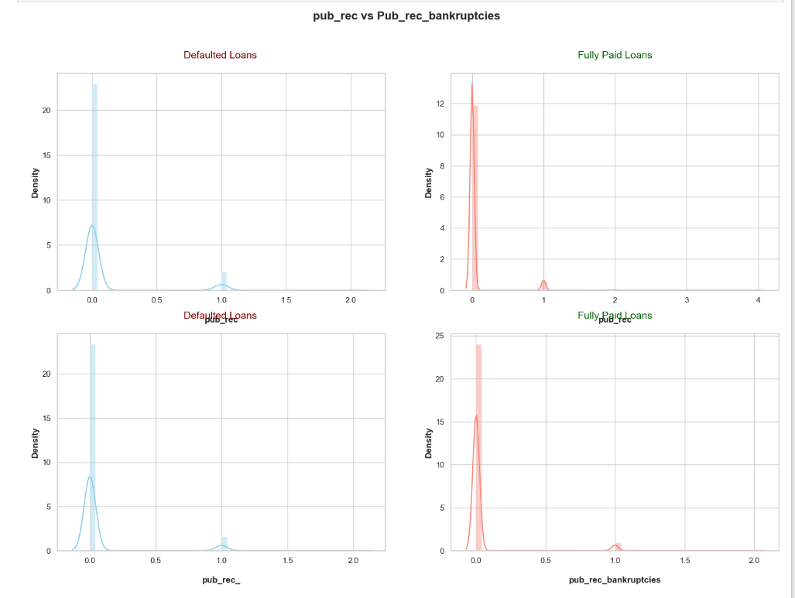
Bivariate – Numeric correlation
Pub_rec vs Pub_rec_bankruptcies, has linear progression relationship with each other, we shall ignore Pub_rec_bankruptcies from driver variables

Slide 12
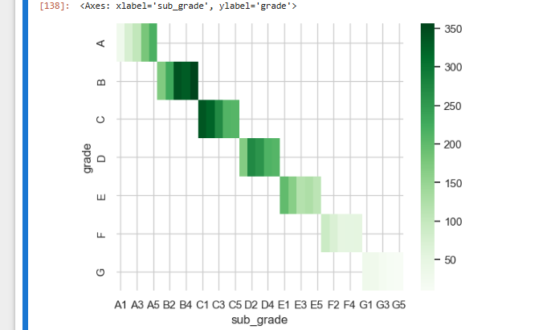
Bivariate - categorical
Grade, sub_grade – grade can be dropped
Output is logical, because sub_grade is component of grade

Slide 13
Inferences/Relationships from other Bivariate analysis
Relationships:
Pub_rec and pub_rec_bankruptices are related to each other, one can be dropped
Similarly, Grade – Sub_grade is a component of Grade; grade can be dropped
Few Inferences:
int_rate vs term:Loans of 36 months with interest 10-14% seems to be risky
grade vs term: Loans of 36 months with sub_Grade B3,B5 seems to be high risky
verification_status vs term: Loans of 36 months not verified is risky
purpose vs term: Debt Consolidation seems to be risky - highest for 36 months and next for 60 months

Slide 14
Recommendations & Conclusions
We have identified 8 variables that drive the target variable (loan_status)
Also, inferential relationships can be identified, which can be used in machine learning model later
Variable | Variable type
term | Ordered Categorical
int_rate | Ordered Categorical
sub_grade | Unordered Categorical
annual_inc | Numerical
verification_status | Unordered Categorical
purpose | Unordered Categorical
pub_rec | Numerical
revol_util | Numerical

Slide 15

Thank you

