Slide 1
CGB1201 – JAVA PROGRAMMING
Department of Artificial Intelligence and Data Science
Academic Year: 2024 – 2025 (Odd Semester)
Register Number :2303811724321099
Name :A.Sathiyaseelan
Year :II year
Semester :III
Section :B
Date :25.11.2024

Slide 2
Title of the Project
ATTENDANCE MANAGEMENT SYSTEM

Slide 3
Problem Identification
In educational institutions, maintaining student attendance records is critical to tracking performance and ensuring compliance with attendance policies. However, the traditional manual methods or outdated systems often:
Lack scalability for handling a large number of students.
Fail to notify students and advisors promptly about low attendance.
Do not provide a user-friendly interface for viewing or modifying attendance.
This results in inefficiencies, delays, and potential academic risks due to unnoticed low attendance patterns.

Slide 4
Objective
To design and implement an Attendance Monitoring and Notification System that:
1. Enables advisors to manage attendance records efficiently.
2. Allows students to view their attendance details securely.
3. Sends notifications for low attendance based on a predefined threshold.
4. Provides an interactive, user-friendly interface using Java Swing and AWT.

Slide 5
Proposed Architecture
User Interface Layer
Business Logic
Layer
Data Management Layer:

Slide 6
Java Programming - Concepts Used
1. Swing and AWT: For creating the graphical user interface (GUI).
2. Classes and Objects: For defining students and their attributes.
3. ArrayList: For dynamic storage and retrieval of student details.
4. Event Handling: For managing button clicks and user interactions.
5. Control Structures: For processing logic like conditional checks and loops.
6. OptionPane: For dialog-based user input and notifications.

Slide 7
List of Modules
1. Student Module
2. Advisor Module
3. Add Students Module
4. Modify Attendance Module
5. Send Notifications Module
6. View Attendance Module
7. Exit Module

Slide 8
Module Description
1. Student Module:
Allows students to securely view their attendance details by entering their Student ID.
2. Advisor Module:
Grants advisors access to view all student records.
Allows for the modification of attendance records.
3. Add Students Module:
Enables advisors to add new students along with their details (ID, name, attendance).
Displays a success message after storing data.
4. Modify Attendance Module:
Allows advisors to update the attendance percentage of a specific student.

Slide 9
Module Description (Cont..)
5. Send Notifications Module:
Checks for students below a specified attendance threshold.
Notifies advisors about the low attendance records.
If no students fall below the threshold, it displays a message: "No students are below the threshold."
6. View Attendance Module:
Displays all attendance records for advisors.
7. Exit Module:
Closes the application gracefully.

Slide 10
Source Code
import javax.swing.*;
import java.awt.*;
import java.util.ArrayList;
class Student {
String id;
String name;
double attendance;
Student(String id, String name, double attendance) {
this.id = id;
this.name = name;
this.attendance = attendance;
}
}
public class AttendanceMonitoringSystemSwing {
private JFrame frame;

Slide 11
Source Code
private JTextArea outputArea;
private ArrayList<Student> students;
private static final double THRESHOLD = 75.0; // Predefined attendance threshold
public AttendanceMonitoringSystemSwing() {
students = new ArrayList<>();
setupUI();
}
private void setupUI() {
frame = new JFrame("Attendance Monitoring System");
frame.setDefaultCloseOperation(JFrame.EXIT_ON_CLOSE);
frame.setSize(600, 400);
JPanel panel = new JPanel();
panel.setLayout(new BorderLayout());

Slide 12
Source Code
outputArea = new JTextArea();
outputArea.setEditable(false);
JScrollPane scrollPane = new JScrollPane(outputArea);
JPanel buttonPanel = new JPanel();
buttonPanel.setLayout(new GridLayout(2, 3));
JButton studentViewButton = new JButton("Student View");
studentViewButton.addActionListener(e -> studentView());
JButton advisorViewButton = new JButton("Advisor View");
advisorViewButton.addActionListener(e -> advisorView());
JButton addStudentButton = new JButton("Add Student (Advisor)");
addStudentButton.addActionListener(e -> addNewStudents());
JButton modifyAttendanceButton = new JButton("Modify Attendance (Advisor)");
modifyAttendanceButton.addActionListener(e -> modifyAttendance());
JButton sendNotificationButton = new JButton("Send Notification");

Slide 13
Source Code
sendNotificationButton.addActionListener(e -> sendNotifications());
JButton exitButton = new JButton("Exit");
exitButton.addActionListener(e -> System.exit(0));
buttonPanel.add(studentViewButton);
buttonPanel.add(advisorViewButton);
buttonPanel.add(addStudentButton);
buttonPanel.add(modifyAttendanceButton);
buttonPanel.add(sendNotificationButton);
buttonPanel.add(exitButton);
panel.add(scrollPane, BorderLayout.CENTER);
panel.add(buttonPanel, BorderLayout.SOUTH);
frame.add(panel);
frame.setVisible(true);
}

Slide 14
Source Code
private void studentView() {
String studentId = JOptionPane.showInputDialog(frame, "Enter your Student ID:");
for (Student student : students) {
if (student.id.equals(studentId)) {
outputArea.append("Student ID: " + student.id + "\n");
outputArea.append("Name: " + student.name + "\n");
outputArea.append("Attendance: " + student.attendance + "%\n");
return;
}
}
JOptionPane.showMessageDialog(frame, "Student ID not found!");
}
private void advisorView() {
outputArea.setText("All Student Attendance Records:\n");
for (Student student : students) {

Slide 15
Source Code
outputArea.append("ID: " + student.id + ", Name: " + student.name + ", Attendance: " + student.attendance + "%\n");
}
}
private void addNewStudents() {
String countStr = JOptionPane.showInputDialog(frame, "Enter the number of students to add:");
try {
int count = Integer.parseInt(countStr);
for (int i = 0; i < count; i++) {
String id = JOptionPane.showInputDialog(frame, "Enter Student ID:");
String name = JOptionPane.showInputDialog(frame, "Enter Student Name:");
double attendance = Double.parseDouble(JOptionPane.showInputDialog(frame, "Enter Attendance Percentage:"));
students.add(new Student(id, name, attendance));
}
JOptionPane.showMessageDialog(frame, "Student details stored successfully.");
} catch (Exception ex) {

Slide 16
Source Code
outputArea.append("Invalid input. Please try again.\n");
}
}
private void modifyAttendance() {
String studentId = JOptionPane.showInputDialog(frame, "Enter Student ID to modify:");
for (Student student : students) {
if (student.id.equals(studentId)) {
double newAttendance = Double.parseDouble(JOptionPane.showInputDialog(frame, "Enter new Attendance Percentage:"));
student.attendance = newAttendance;
JOptionPane.showMessageDialog(frame, "Attendance updated successfully.");
return;
}
}
JOptionPane.showMessageDialog(frame, "Student ID not found!");

Slide 17
Source Code
}
private void sendNotifications() {
boolean found = false;
outputArea.append("Sending notifications for students below " + THRESHOLD + "% attendance:\n");
for (Student student : students) {
if (student.attendance < THRESHOLD) {
outputArea.append("Notification sent to Student ID: " + student.id + " (Name: " + student.name + ") - Attendance: " + student.attendance + "%\n");
found = true;
}
}
if (found) {
JOptionPane.showMessageDialog(frame, "Notifications successfully sent to students and advisors!");
} else {

Slide 18
Source Code
outputArea.append("No students are below the threshold.\n");
JOptionPane.showMessageDialog(frame, "All students have attendance above the threshold.");
}
}
public static void main(String[] args) {
SwingUtilities.invokeLater(AttendanceMonitoringSystemSwing::new);
}
}

Slide 19
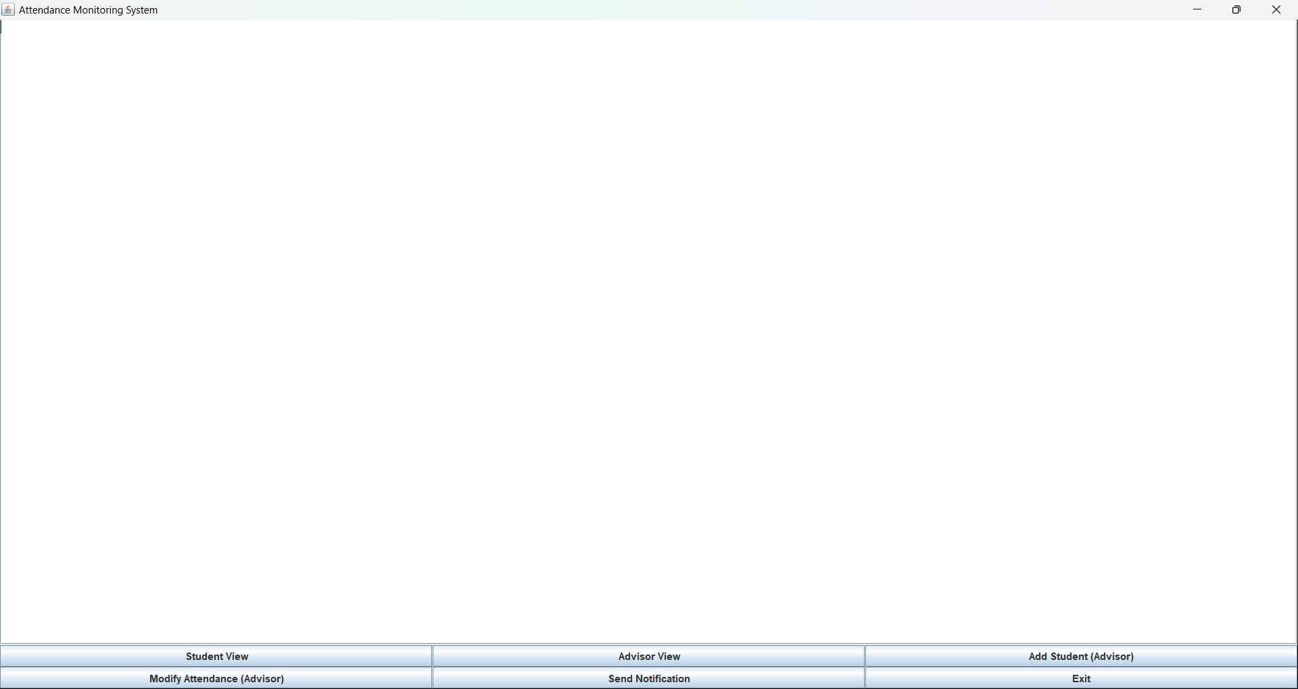
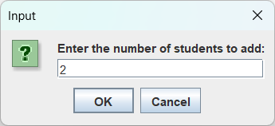
Results

Slide 20
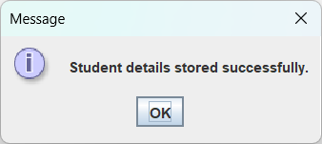
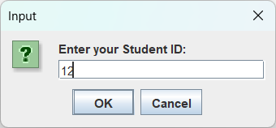
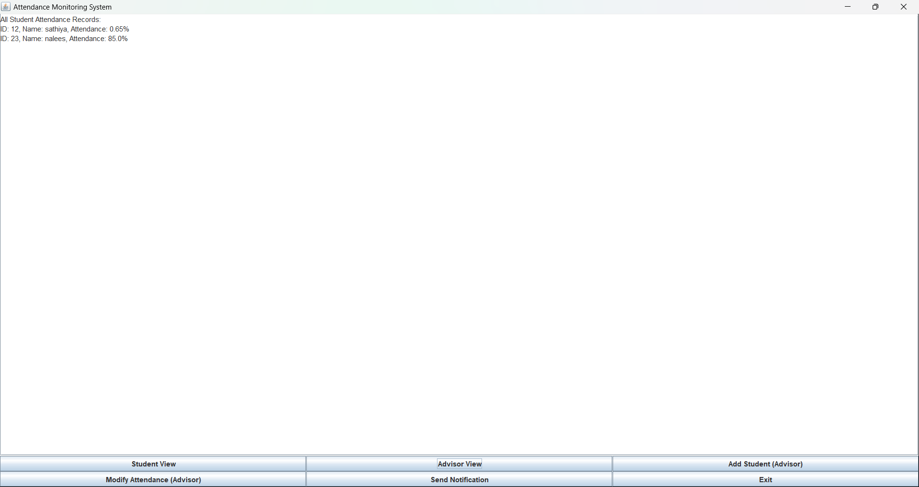
Results

Slide 21
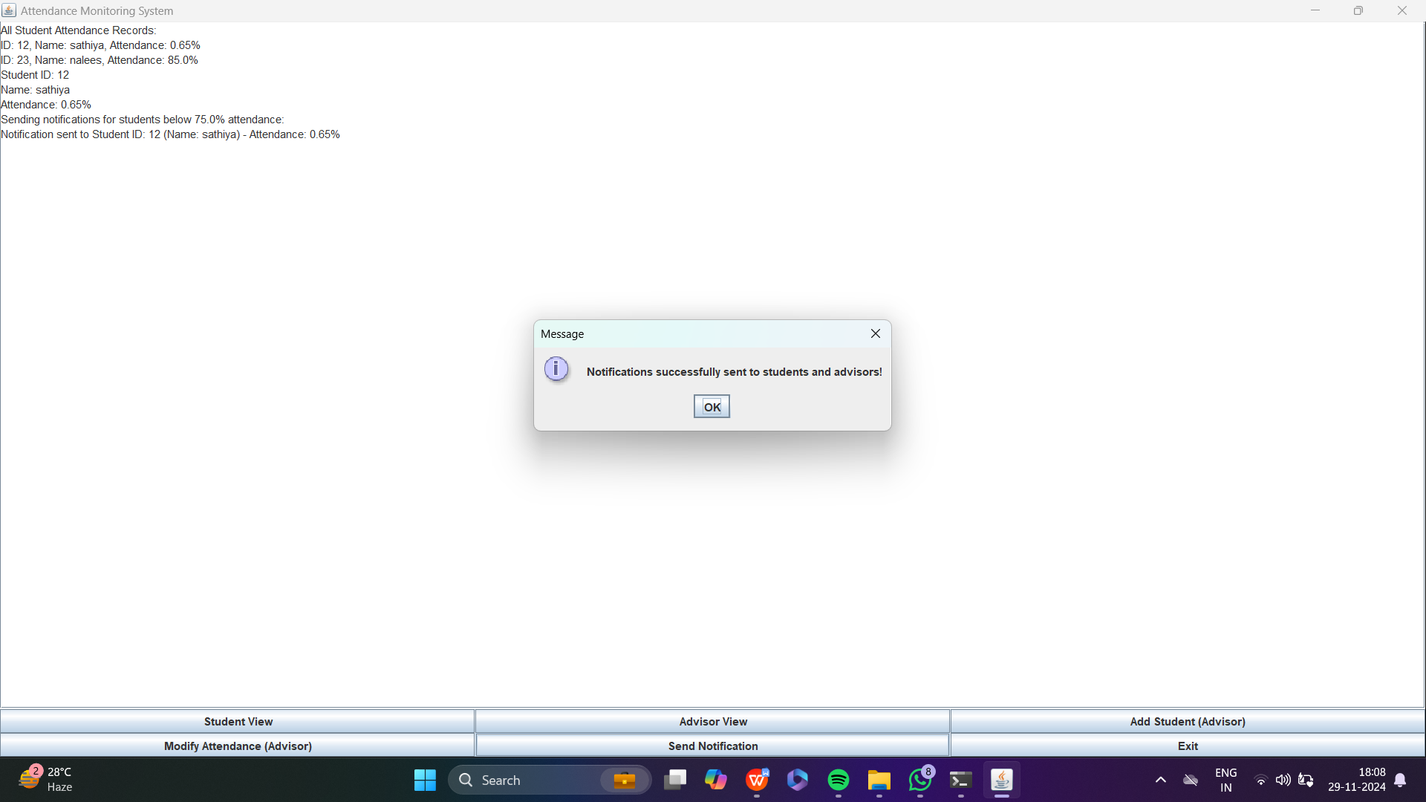
Results

Slide 22
Conclusion
The Attendance Monitoring and Notification System is a robust solution for educational institutions to manage and monitor student attendance. By integrating Java Swing and AWT with OOP principles, the project achieves a balance between functionality and usability. The system ensures:
1. Accurate and secure record management.
2. Timely notifications to improve attendance and academic performance.
3. Scalability to handle institutions of varying sizes.

Slide 23
Thank You
Any queries???

